Slide 1

SNS COLLEGE OF TECHNOLOGY
Kurumbapalayam (Po), Coimbatore – 641 107
An Autonomous Institution
Accredited by NBA – AICTE and Accredited by NAAC – UGC with ‘A’ Grade Approved by AICTE, New Delhi & Affiliated to Anna University, Chennai
DEPARTMENT OF COMPUTER SCIENCE AND ENGINEERING COURSE NAME : 23CSB201 - OBJECT ORIENTED PROGRAMMING
I YEAR / II SEMESTER
Unit I - INTRODUCTION TO OOP
Topic :Object Oriented Programming Concepts Mrs.D.NIRMALA – AP/CSE

Slide 2
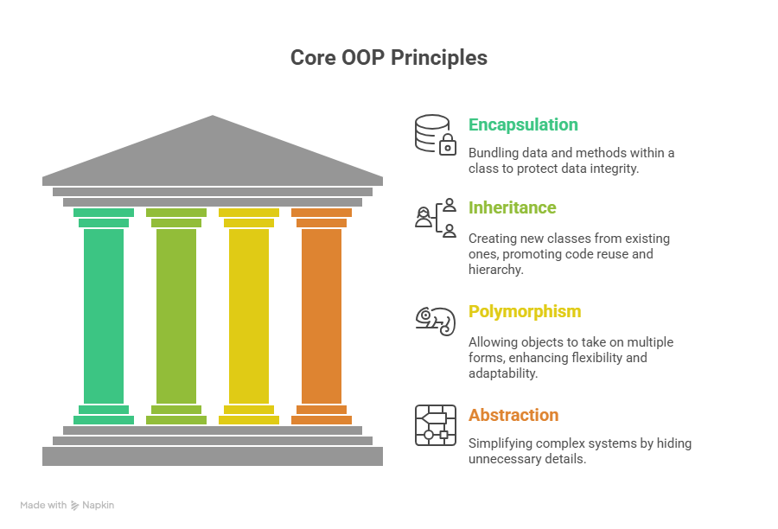
Object Oriented Programming Concepts

Slide 3
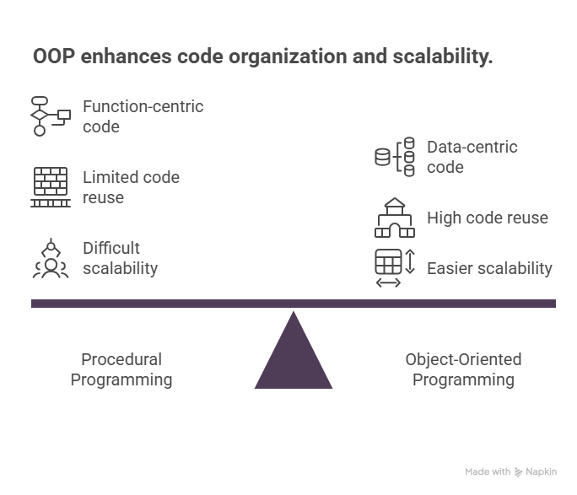
Introduction to OOP
Object Oriented Programming (OOP) is a programming paradigm based on objects
Objects represent real-world entities
Focuses on data rather than procedures
Improves code reusability and maintainability
3.1.26 UNIT-1 /INTRODUCTION TO OOP/ 23CSB201 OBJECT ORIENTED PROGRAMMING/MS.D.NIRMALA/CSE /SNSCT 3/13

Slide 4
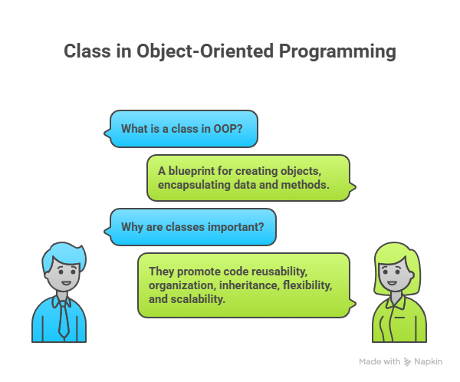
Class
A class is a blueprint or template for creating objects
Defines properties (data members) and methods
Memory is allocated only when object is created
Example: class Student
3.1.26 UNIT-1 /INTRODUCTION TO OOP/ 23CSB201 OBJECT ORIENTED PROGRAMMING/MS.D.NIRMALA/CSE /SNSCT 4/13

Slide 5
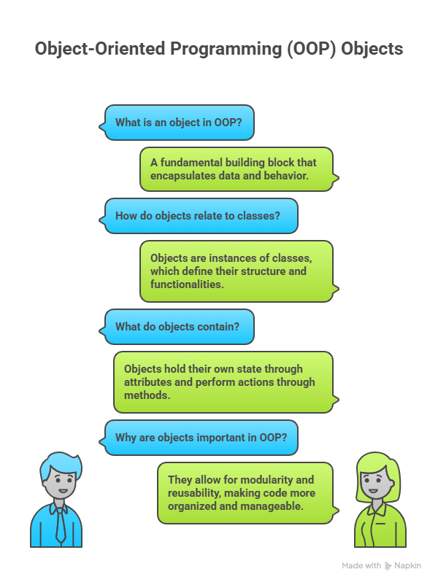
Object
An object is an instance of a class
Represents real-world entities
Each object has its own state and behavior
Example: Student s1 = new Student();
3.1.26 UNIT-1 /INTRODUCTION TO OOP/ 23CSB201 OBJECT ORIENTED PROGRAMMING/MS.D.NIRMALA/CSE /SNSCT 5/13

Slide 6
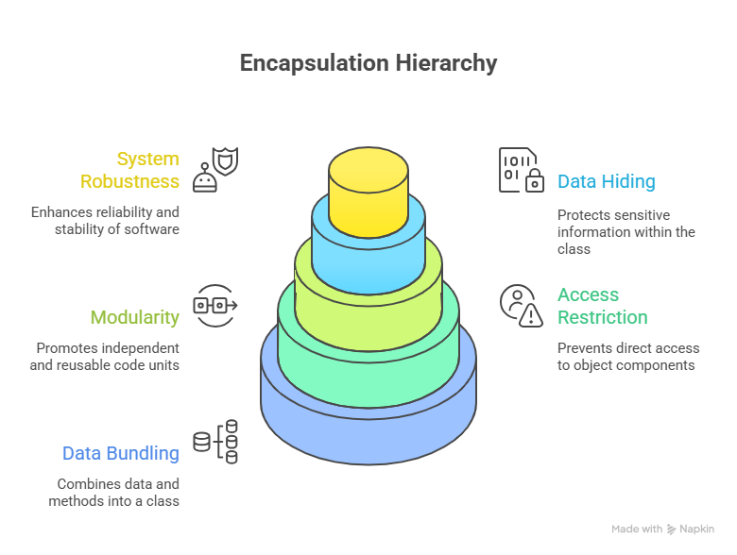
Encapsulation
Wrapping data and methods into a single unit (class)
Achieved using access modifiers
Protects data from unauthorized access
Enhances data security
3.1.26 UNIT-1 /INTRODUCTION TO OOP/ 23CSB201 OBJECT ORIENTED PROGRAMMING/MS.D.NIRMALA/CSE /SNSCT 6/13

Slide 7
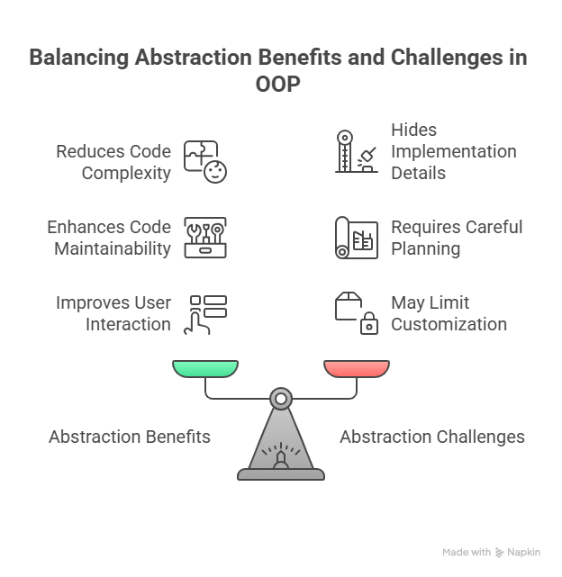
Abstraction
Hiding internal implementation and showing only essential features
Achieved using abstract classes and interfaces
Reduces complexity
Improves code readability
3.1.26 UNIT-1 /INTRODUCTION TO OOP/ 23CSB201 OBJECT ORIENTED PROGRAMMING/MS.D.NIRMALA/CSE /SNSCT 7/13

Slide 8
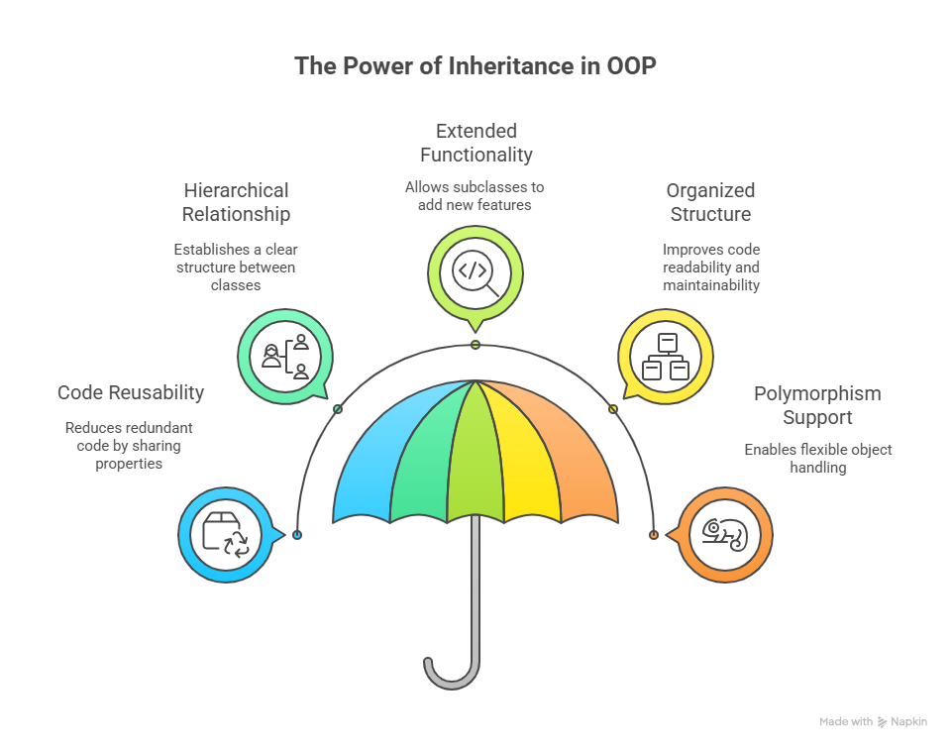
Inheritance
Mechanism where one class acquires properties of another
Achieved using 'extends' keyword
Promotes code reusability
Represents IS-A relationship
3.1.26 UNIT-1 /INTRODUCTION TO OOP/ 23CSB201 OBJECT ORIENTED PROGRAMMING/MS.D.NIRMALA/CSE /SNSCT 8/13

Slide 9
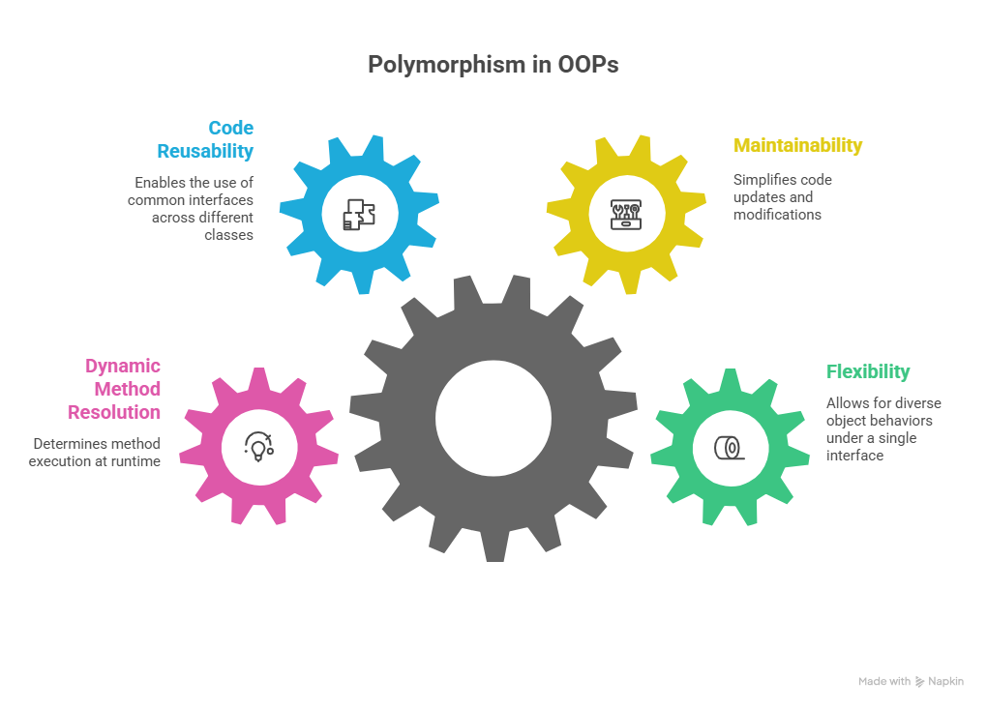
Polymorphism
Ability of a method to take multiple forms
Compile-time polymorphism: Method Overloading
Run-time polymorphism: Method Overriding
Improves flexibility and scalability
3.1.26 UNIT-1 /INTRODUCTION TO OOP/ 23CSB201 OBJECT ORIENTED PROGRAMMING/MS.D.NIRMALA/CSE /SNSCT 9/13

Slide 10
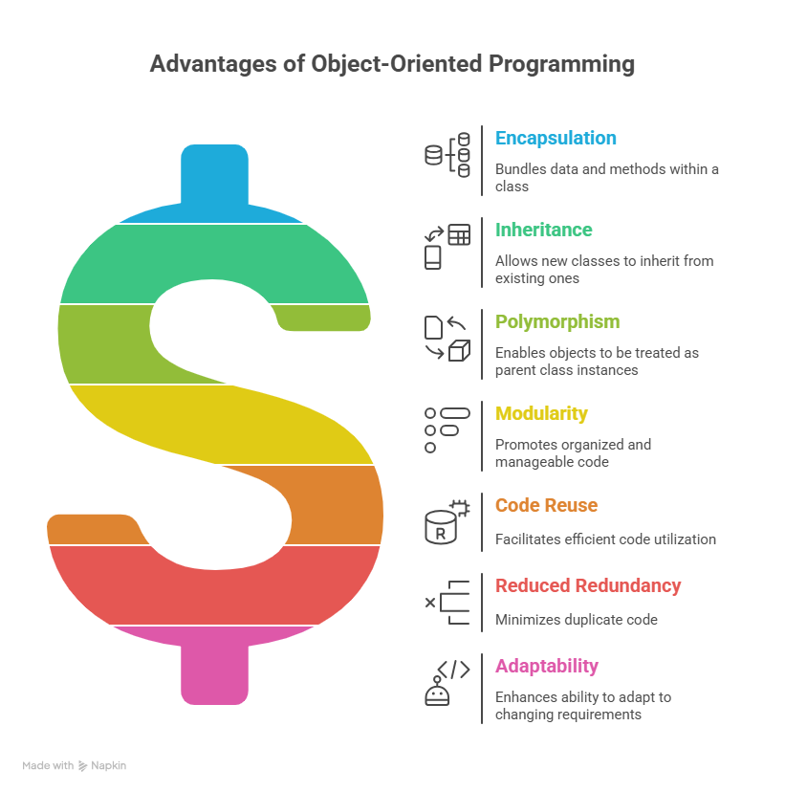
Advantages of OOP
3.1.26 UNIT-1 /INTRODUCTION TO OOP/ 23CSB201 OBJECT ORIENTED PROGRAMMING/MS.D.NIRMALA/CSE /SNSCT 10/13

Slide 11
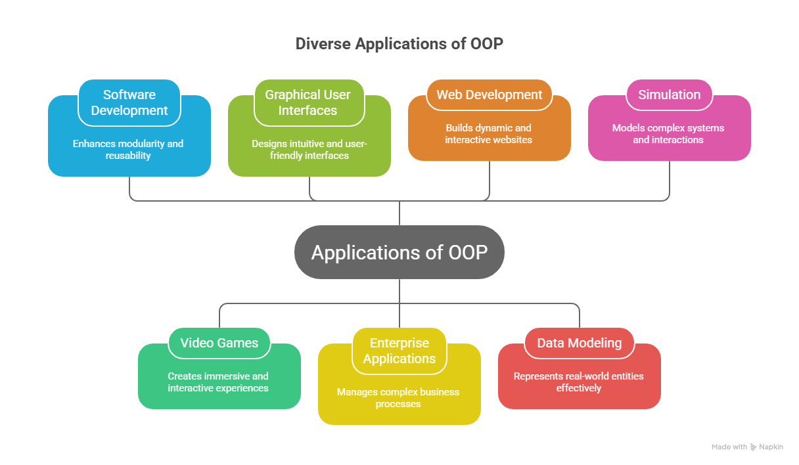
Applications of OOP
3.1.26 UNIT-1 /INTRODUCTION TO OOP/ 23CSB201 OBJECT ORIENTED PROGRAMMING/MS.D.NIRMALA/CSE /SNSCT 11/13

Slide 12
Object Oriented Programming – Questions to Solve
Design a Student Management System using OOP concepts.
Identify suitable classes and objects
Explain how encapsulation and abstraction are applied
A banking application requires secure handling of customer data.
Which OOP concept ensures data hiding?
How will you implement it in Java?
Explain how inheritance reduces code redundancy with a real-world example.
Differentiate method overloading and method overriding with suitable program logic.
3.1.26 UNIT-1 /INTRODUCTION TO OOP/ 23CSB201 OBJECT ORIENTED PROGRAMMING/MS.D.NIRMALA/CSE /SNSCT 12/13

Slide 13


