Slide 1

SNS COLLEGE OF TECHNOLOGY
Kurumbapalayam (Po), Coimbatore – 641 107
An Autonomous Institution
Accredited by NBA – AICTE and Accredited by NAAC – UGC with ‘A’ Grade Approved by AICTE, New Delhi & Affiliated to Anna University, Chennai
DEPARTMENT OF COMPUTER SCIENCE AND ENGINEERING COURSE NAME : 23CSB201 - OBJECT ORIENTED PROGRAMMING
I YEAR / II SEMESTER
Unit I - INTRODUCTION TO OOP
Topic : Java Architecture
Mrs.D.NIRMALA – AP/CSE

Slide 2
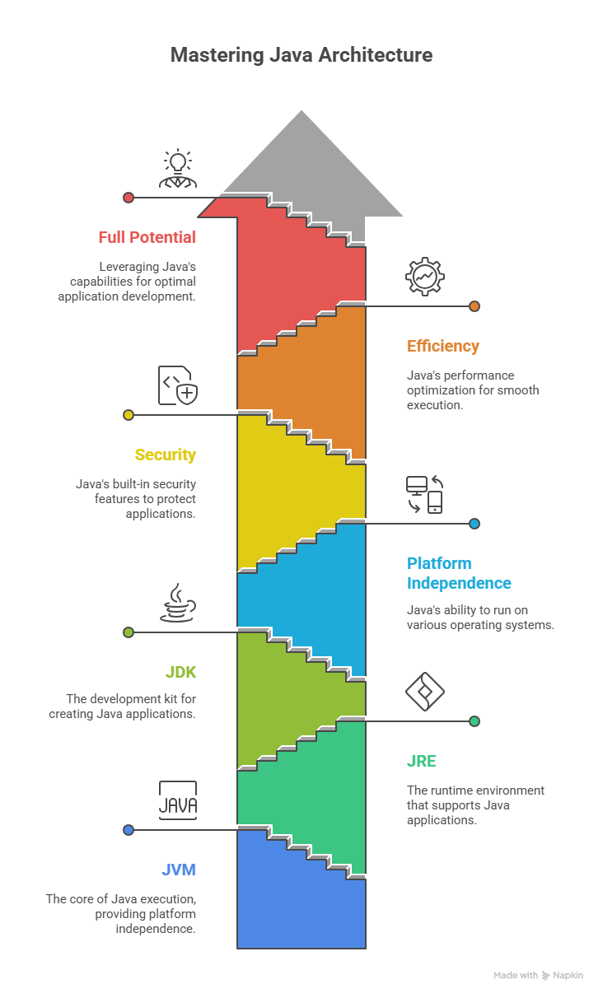
Introduction
• Java Architecture defines how Java programs run
• Based on JVM concept
• Ensures platform independence
3.1.26 UNIT-1 / Java Architecture / 23CSB201 OBJECT ORIENTED PROGRAMMING/MS.D.NIRMALA/CSE /SNSCT 2/15

Slide 3
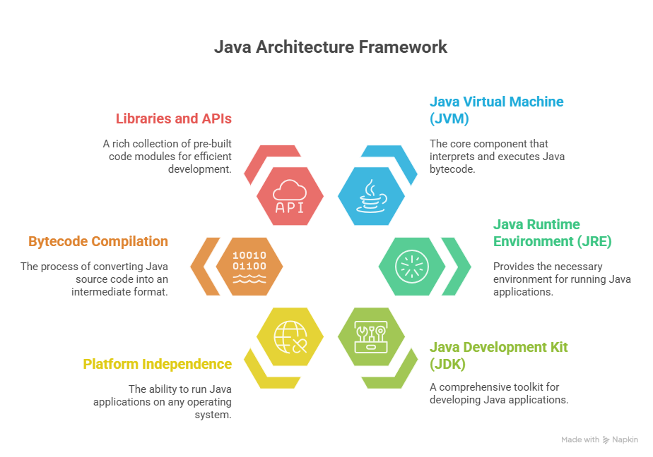
Java Architecture Overview
• Java Source Code (.java)
• Java Compiler (javac)
• Bytecode (.class)
• Java Virtual Machine (JVM)
• Operating System & Hardware
3.1.26 UNIT-1 / Java Architecture / 23CSB201 OBJECT ORIENTED PROGRAMMING/MS.D.NIRMALA/CSE /SNSCT 3/15

Slide 4
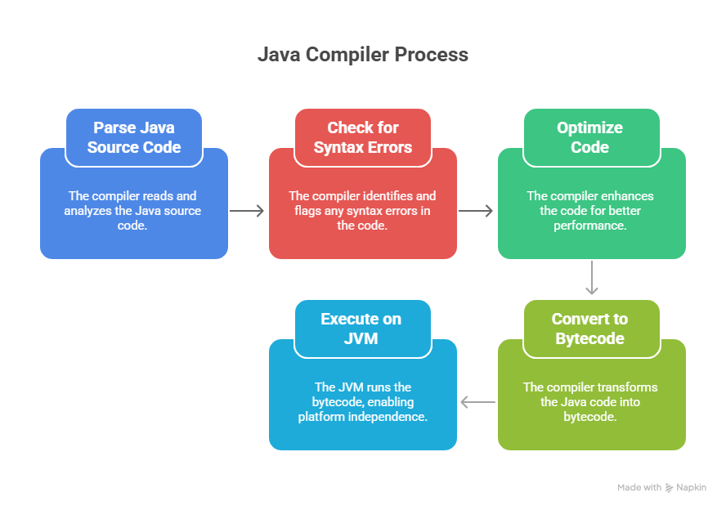
Java Compiler
• Converts source code into bytecode
• Bytecode is platform-independent
• Stored in .class files
3.1.26 UNIT-1 / Java Architecture / 23CSB201 OBJECT ORIENTED PROGRAMMING/MS.D.NIRMALA/CSE /SNSCT 4/15

Slide 5
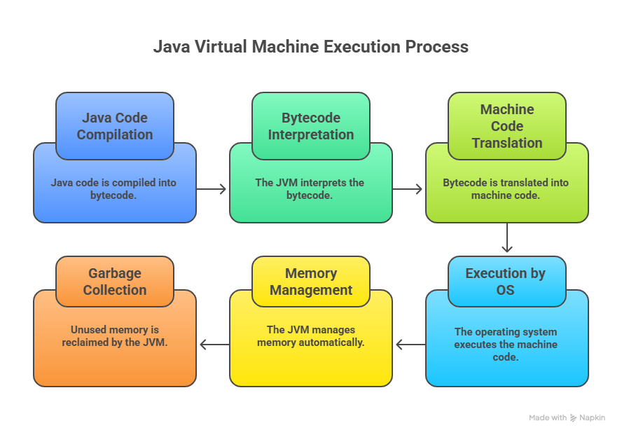
Java Virtual Machine (JVM)
• Executes Java bytecode
• Platform dependent
• Provides runtime environment
3.1.26 UNIT-1 / Java Architecture / 23CSB201 OBJECT ORIENTED PROGRAMMING/MS.D.NIRMALA/CSE /SNSCT 5/15

Slide 6
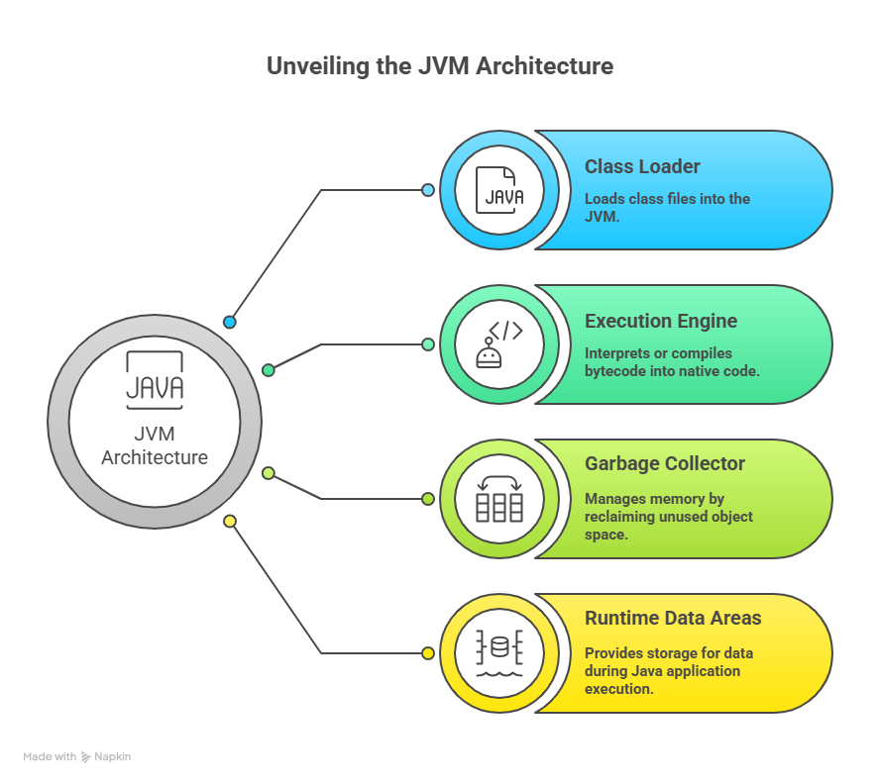
JVM Architecture
• Class Loader Subsystem
• Runtime Data Areas
• Execution Engine
• Native Method Interface
3.1.26 UNIT-1 / Java Architecture / 23CSB201 OBJECT ORIENTED PROGRAMMING/MS.D.NIRMALA/CSE /SNSCT 6/15

Slide 7
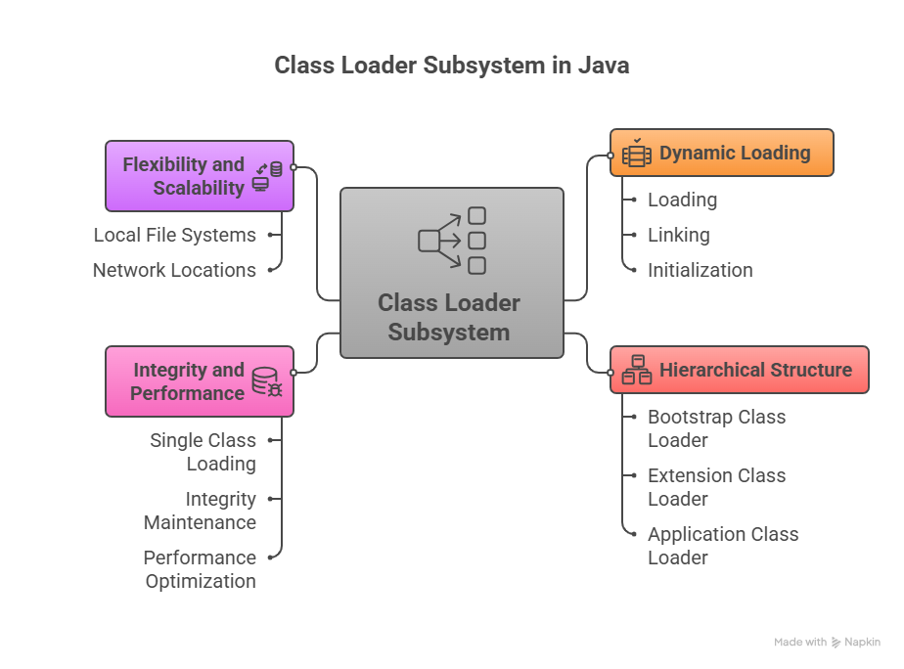
Class Loader Subsystem
• Loads class files into memory
• Loading, Linking, Initialization
• Bootstrap, Extension, Application loaders
3.1.26 UNIT-1 / Java Architecture / 23CSB201 OBJECT ORIENTED PROGRAMMING/MS.D.NIRMALA/CSE /SNSCT 7/15

Slide 8
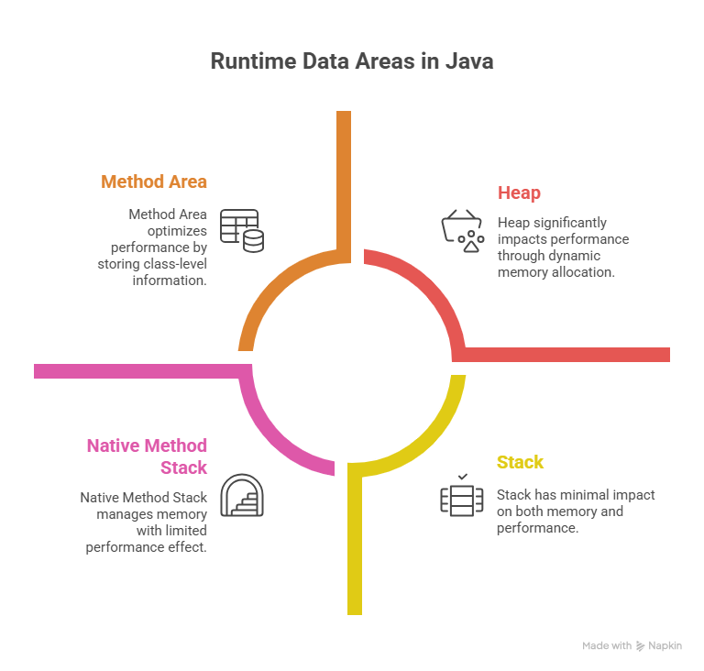
Runtime Data Areas
• Method Area
• Heap
• Stack
• PC Register
• Native Method Stack
3.1.26 UNIT-1 / Java Architecture / 23CSB201 OBJECT ORIENTED PROGRAMMING/MS.D.NIRMALA/CSE /SNSCT 8/15

Slide 9
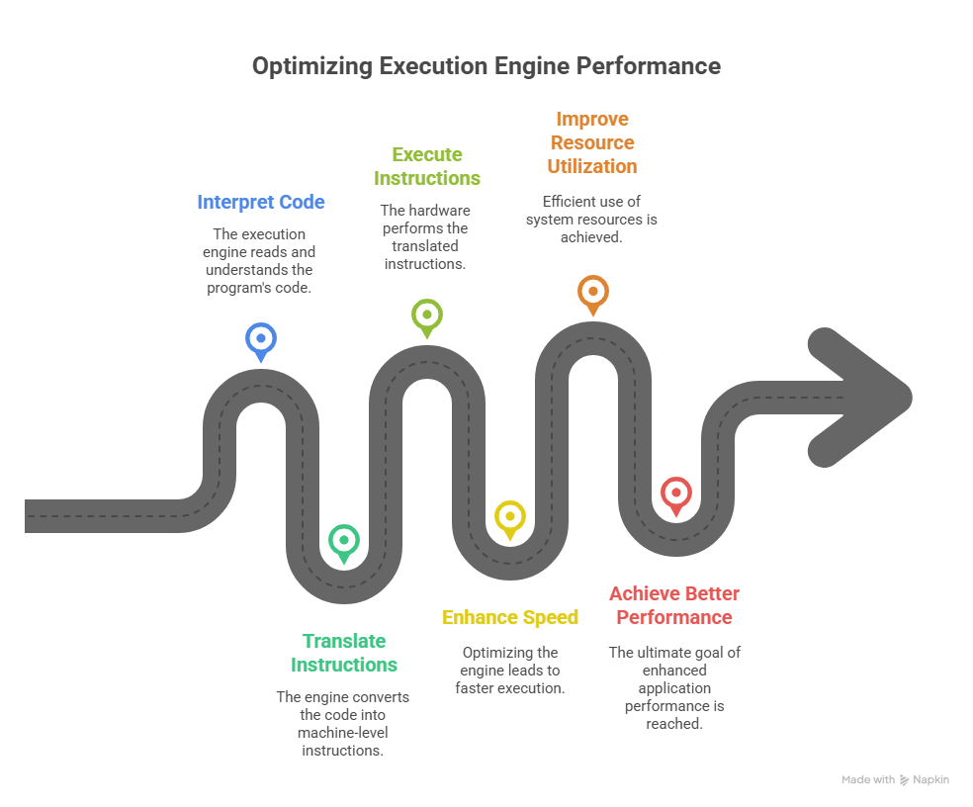
Execution Engine
• Interpreter
• JIT Compiler
• Garbage Collector
3.1.26 UNIT-1 / Java Architecture / 23CSB201 OBJECT ORIENTED PROGRAMMING/MS.D.NIRMALA/CSE /SNSCT 9/15

Slide 10
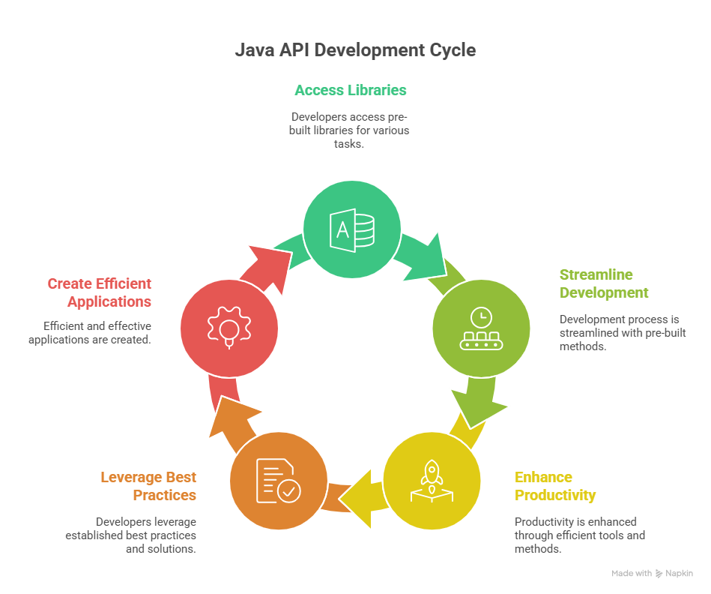
Java API
• Collection of pre-defined classes
• Supports GUI, networking, I/O
• Makes development faster
3.1.26 UNIT-1 / Java Architecture / 23CSB201 OBJECT ORIENTED PROGRAMMING/MS.D.NIRMALA/CSE /SNSCT 10/15

Slide 11
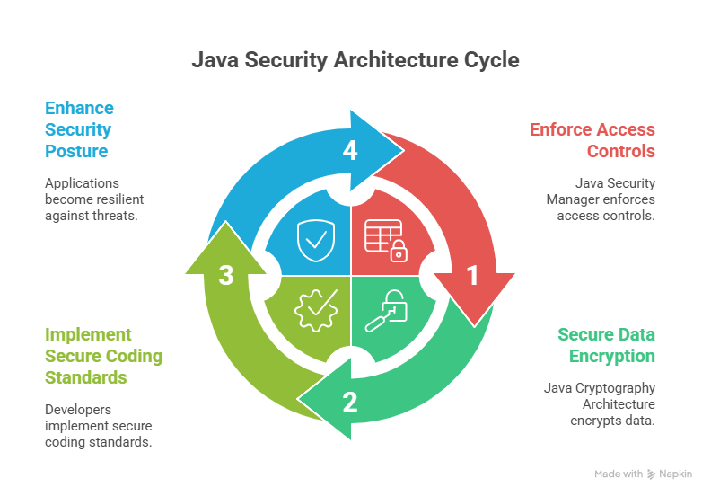
Security in Java Architecture
• Bytecode verifier
• Class loader security
• Security manager
3.1.26 UNIT-1 / Java Architecture / 23CSB201 OBJECT ORIENTED PROGRAMMING/MS.D.NIRMALA/CSE /SNSCT 11/15

Slide 12
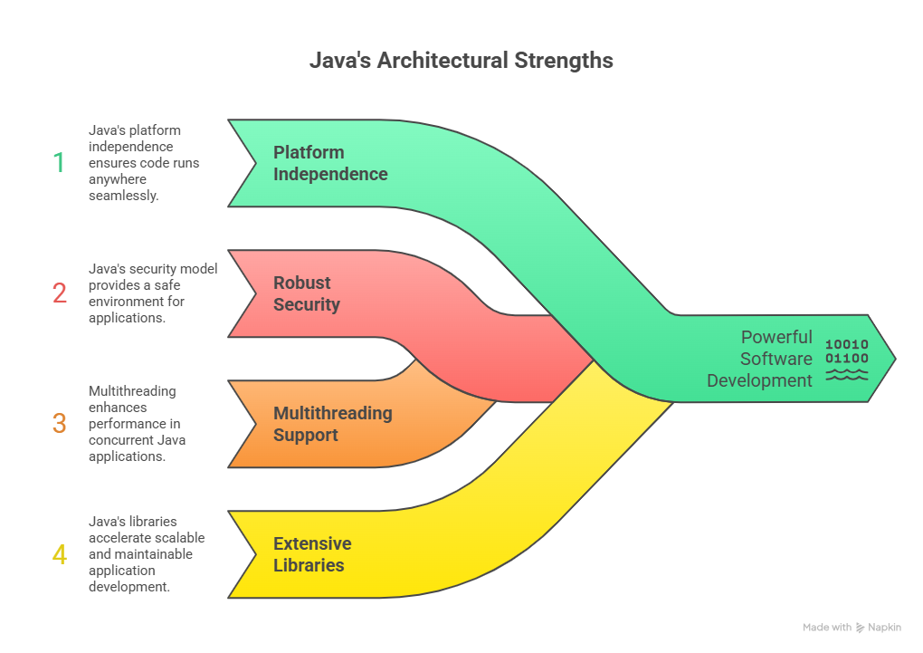
Advantages of Java Architecture
• Platform independent
• Secure and robust
• High performance
• Scalable
3.1.26 UNIT-1 / Java Architecture / 23CSB201 OBJECT ORIENTED PROGRAMMING/MS.D.NIRMALA/CSE /SNSCT 12/15

Slide 13
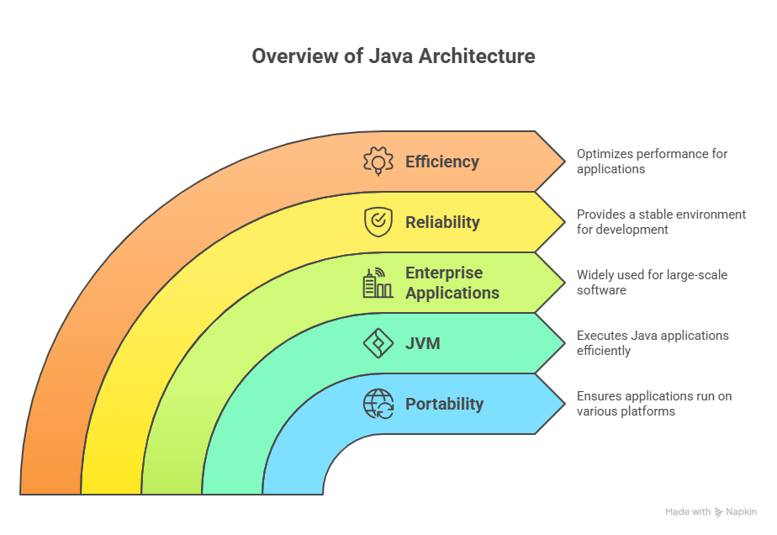
Conclusion
• Java Architecture ensures portability
• JVM is the core component
• Widely used in enterprise applications
3.1.26 UNIT-1 / Java Architecture / 23CSB201 OBJECT ORIENTED PROGRAMMING/MS.D.NIRMALA/CSE /SNSCT 13/15

Slide 14
Object Oriented Programming in Java – Questions to Solve
A financial application developed in Java 6 suffers from verbose code and poor readability.
Which Java evolution features can improve code clarity and maintainability?
A company wants to modernize its legacy Java application to support functional programming concepts.
How does Java 8 address this requirement?
A real-time analytics system processes large collections of data.
Which Java features help in improving performance and data processing efficiency?
A distributed system requires better handling of null values to avoid runtime errors.
How did Java evolution address this problem?
3.1.26 UNIT-1 / Java Architecture / 23CSB201 OBJECT ORIENTED PROGRAMMING/MS.D.NIRMALA/CSE /SNSCT 14/15

Slide 15


