Slide 1


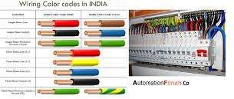
SNS COLLEGE OF TECHNOLOGY
An Autonomous Institution Coimbatore-35
Department of Artifical intelligence and Data science
23EET101-Basic Electrical and Electronics Engg.
I B.E AIDS / I SEMESTER
UNIT III :WIRING,
GROUNDING AND SAFETY
Topic 3 : Types of wiring
Wiring: General Rules , Materials and Accessories\23EET103\ECED\Ms.RANJANI K \ AP\IOT\SNSCT

Slide 2
Let’s Recall !!ti
What is a wiring system?
Why do houses/offices need different wiring methods?
Factors affecting selection of wiring
Good vs Poor wiring method
Wiring: General Rules , Materials and Accessories\23EET103\ECED\Ms.RANJANI K \ AP\IOT\SNSCT

Slide 3
TOPICS FOR DISCUSSIONTION
Classification of Wiring Systems
Types of Wiring
Cleat Wiring
Wooden Casing & Capping Wiring
CTS / TRS / Lead Sheathed Wiring
Conduit Wiring (Surface / Concealed)
Advantages & Limitations
Wiring: General Rules , Materials and Accessories\23EET103\ECED\Ms.RANJANI K \ AP\IOT\SNSCT

Slide 4
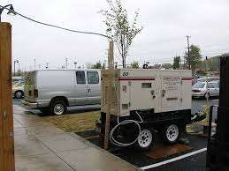
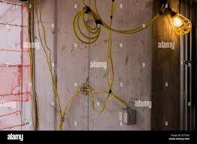
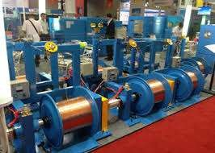
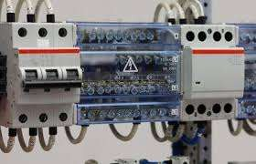
Let's explore !!
Definition:
Wiring system refers to the layout and method used to distribute electrical power safely within a building.
Classification:
Temporary Wiring
Permanent Wiring
Wiring: General Rules , Materials and Accessories\23EET103\ECED\Ms.RANJANI K \ AP\IOT\SNSCT

Slide 5
TYPES OF WIRING
The type of wiring to be selected for a particular place of use is based on several factors such as durability , mechanical protection , appearance , environmental condition etc. The various type of wiring in practice are as follows:
Cleat wiring
Wooden casing and capping wiring.
Batten wiring
Conduit wiring.
Lead sheathed wiring.
Wiring: General Rules , Materials and Accessories\23EET103\ECED\Ms.RANJANI K \ AP\IOT\SNSCT

Slide 6
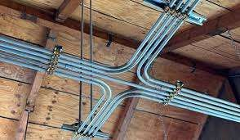
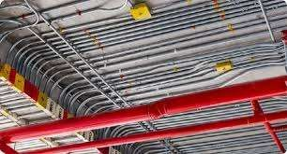
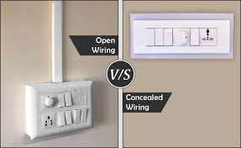
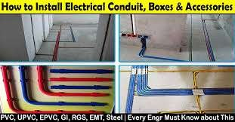
TYPES OF WIRING
There are additional types of conduit wiring according to Pipes installation (Where steel and PVC pipes are used for wiring connection and installation).
Surface or open Conduit type
Recessed or concealed or underground type Conduit
Wiring: General Rules , Materials and Accessories\23EET103\ECED\Ms.RANJANI K \ AP\IOT\SNSCT

Slide 7
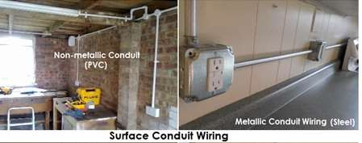
SURFACE OR OPEN CONDUIT TYPE
If conduits installed on roof
or wall, It is
known as wiring. in
surface conduit
this wiring method, they make holes on the surface of wall on equal distances and conduit is installed then with the help of rowel plugs
Wiring: General Rules , Materials and Accessories\23EET103\ECED\Ms.RANJANI K \ AP\IOT\SNSCT
7/16

Slide 8
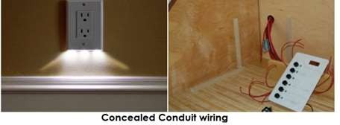
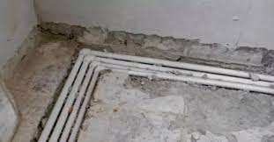
CONCEALED CONDUIT TYPE
If the conduits is hidden inside the wall slots with the help of plastering, it is called concealed conduit wiring. In other words, the electrical wiring system inside wall, roof or floor with the help of plastic or metallic piping is called concealed conduit wiring.
Obviously, It is the
most popular, beautiful, stronger and common
electrical wiring system nowadays.
Wiring: General Rules , Materials and Accessories\23EET103\ECED\Ms.RANJANI K \ AP\IOT\SNSCT

Slide 9

CONCEALED CONDUIT TYPE
Following conduits are used in the conduit wiring systems
Metallic Conduit
Non-metallic conduit
Wiring: General Rules , Materials and Accessories\23EET103\ECED\Ms.RANJANI K \ AP\IOT\SNSCT

Slide 10
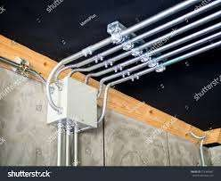
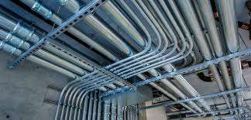
METALIC CONDUIT WIRING
Metallic conduits are made of steel which are very strong but costly as well.
There are two types of metallic conduits.
Class A Conduit: Low gauge conduit (Thin layer steel sheet conduit)
Class B Conduit: High gauge conduit (Thick sheet of steel conduit)
Wiring: General Rules , Materials and Accessories\23EET103\ECED\Ms.RANJANI K \ AP\IOT\SNSCT

Slide 11
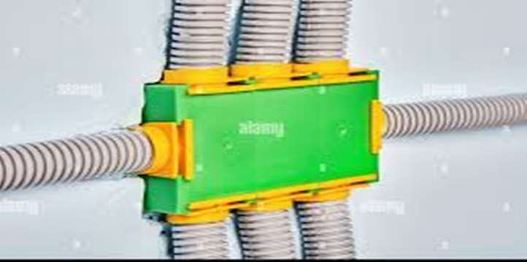
NON - METALIC CONDUIT WIRING
A solid PVC conduit is used as non-metallic conduit now a days, which is flexible and easy to bend.
Wiring: General Rules , Materials and Accessories\23EET103\ECED\Ms.RANJANI K \ AP\IOT\SNSCT

Slide 12
ADVANTAGES
It is the safest wiring system (Concealed conduit wring)
Appearance is very beautiful (in case of concealed conduit wiring)
No risk of mechanical wear & tear and fire in case of metallic pipes.
Customization can be easily done according to the future needs.
Repairing and maintenance is easy.There is no risk of damage the cables insulation.It is safe from corrosion (in case of PVC conduit) and risk of fire.
It can be used even in humidity , chemical effect and smoky areas.
No risk of electric shock (In case of proper earthing and grounding of metallic pipes).It is reliable and popular wiring system.Sustainable and long-lasting wiring system.
Wiring: General Rules , Materials and Accessories\23EET103\ECED\Ms.RANJANI K \ AP\IOT\SNSCT

Slide 13
DISADVANTAGES
It is expensive wiring system (Due to PVC and Metallic pipes, Additional earthing for metallic pipes Tee(s) and elbows etc.
Very hard to find the defects in the wiring.
Installation is not easy and simple.
Risk of Electric shock (In case of metallic pipes without proper earthing system)
Very complicated to manage additional connection in the future.
Wiring: General Rules , Materials and Accessories\23EET103\ECED\Ms.RANJANI K \ AP\IOT\SNSCT

Slide 14
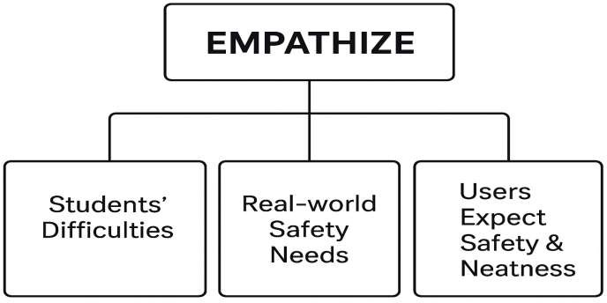
Types of Wiring
DT-Empathize
Wiring: General Rules , Materials and Accessories\23EET103\ECED\Ms.RANJANI K \ AP\IOT\SNSCT

Slide 15
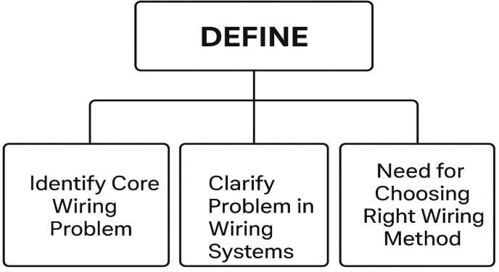
Types of Wiring
DT-Define
Wiring: General Rules , Materials and Accessories\23EET103\ECED\Ms.RANJANI K \ AP\IOT\SNSCT

Slide 16
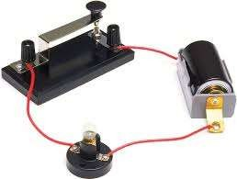
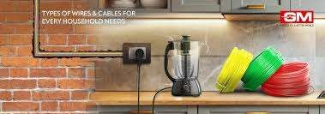
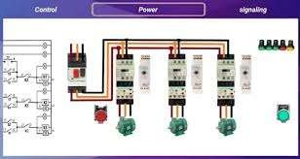
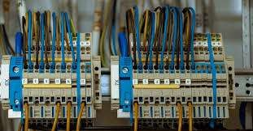
Application of DC Components in Real world
Workshops
Homes
Offices
Commercial buildings
Service Building
Workshops
Wiring: General Rules , Materials and Accessories\23EET103\ECED\Ms.RANJANI K \ AP\IOT\SNSCT

Slide 17
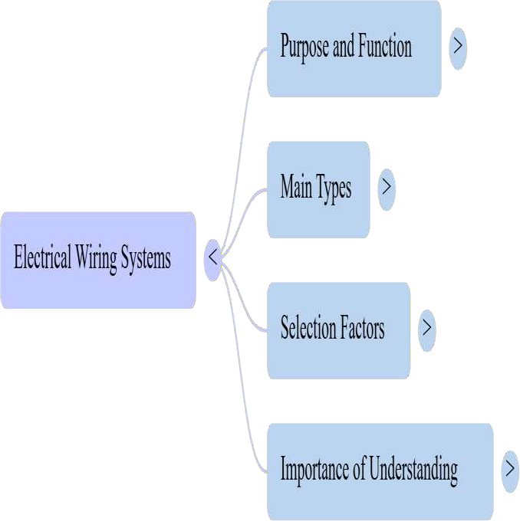

Let’s summarize
Wiring: General Rules , Materials and Accessories\23EET103\ECED\Ms.RANJANI K \ AP\IOT\SNSCT

Slide 18
References
https://www.electricaltechnology.org/2015/09/types-of-wiring-systems-electrical-
wiring-methods.html ELECTRICAL TECHNOLOGY
“System of Electrical Wiring” — Electrical4U: https://www.electrical4u.com/system- of-wiring/ Electrical4U
“Types of Electrical Wiring – Everything You Need to Know” — dfliq.net Blog:
https://www.dfliq.net/blog/types-of-electrical-wiring/ dfliq.net
“Types of Electrical Wiring: BYJU’S” — BYJU’S: https://byjus.com/physics/types-
of-wiring/ BYJU'S
“Understanding the Various Types of Electrical House Wiring Systems” — Zimmerman Electrician Blog: https://www.zimmermanelectrician.com/blog/understanding-the-various-types-of- electrical-house-wiring-systems
Wiring: General Rules , Materials and Accessories\23EET103\ECED\Ms.RANJANI K \ AP\IOT\SNSCT
18/16

Slide 19
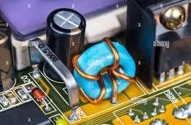

Wiring: General Rules , Materials and Accessories\23EET103\ECED\Ms.RANJANI K \ AP\IOT\SNSCT
19/16

