Slide 1
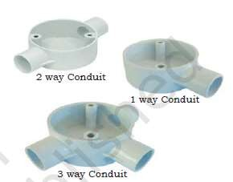
SNS COLLEGE OF TECHNOLOGY
An Autonomous Institution
Accredited by NBA – AICTE and Accredited by NAAC – UGC with ‘A++’ Grade
Approved by AICTE, New Delhi & Affiliated to Anna University, Chennai
DEPARTMENT OF ARITIFICIAL INTELLIGENCE AND DATA SCIENCE
23EET103-Electric Circuits and Electron Devices
UNIT 3 WIRING, GROUNDING AND SAFETY
4. Conduit Wiring
Wiring: General Rules , Materials and Accessories\23EET103\ECED\Ms.RANJANI K \ AP\IOT\SNSCT

Slide 2
Electrical conduits are used to protect and provide the route of electrical wiring in an electrical system. Electrical conduits are made of metal, plastic, or fibre and can be rigid or flexible. Conduits must be installed by electricians as per standard regulations.
For workshops and public buildings, conduit wiring is the best and most desirable system of wiring.
It provides protection and safety against fire.
Wiring: General Rules , Materials and Accessories\23EET103\ECED\Ms.RANJANI K \ AP\IOT\SNSCT

Slide 3
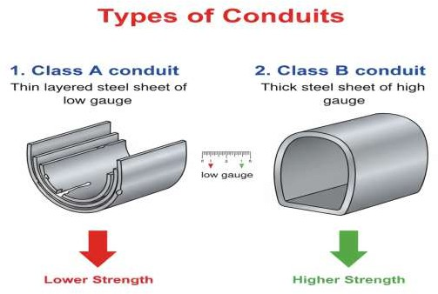
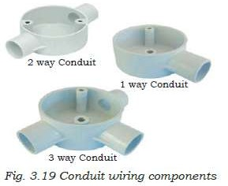
Types of Conduits
Class A conduit: Thin layered steel sheet of low gauge
Class B conduit: Thick steel sheet of high gauge
Wiring: General Rules , Materials and Accessories\23EET103\ECED\Ms.RANJANI K \ AP\IOT\SNSCT

Slide 4
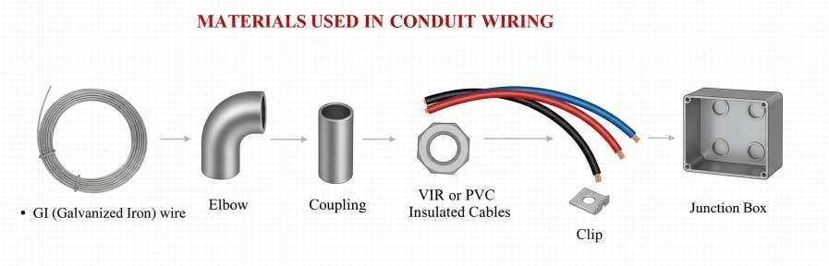
Materials used in Conduit Wiring
GI (Galvanised Iron) wire
Elbow
Coupling
VIR (Vulcanized Indian Rubber) or PVC (Poly Vinyl Chloride) insulated cables
Lock nut
Clip
Junction Box
Wiring: General Rules , Materials and Accessories\23EET103\ECED\Ms.RANJANI K \ AP\IOT\SNSCT

Slide 5
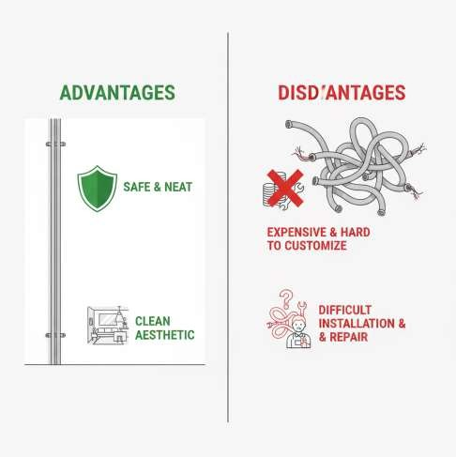
Advantages of conduit wiring
Safe
Better appearance
No risk of fire
No risk of damage of cable insulation
Safe from humidity, smoke, steam, etc.
No risk of shock
Long lasting
Disadvantages of conduit wiring
Expensive
Installation is not easy
Not easily customisable for future use
Hard to detect faults
Wiring: General Rules , Materials and Accessories\23EET103\ECED\Ms.RANJANI K \ AP\IOT\SNSCT

Slide 6
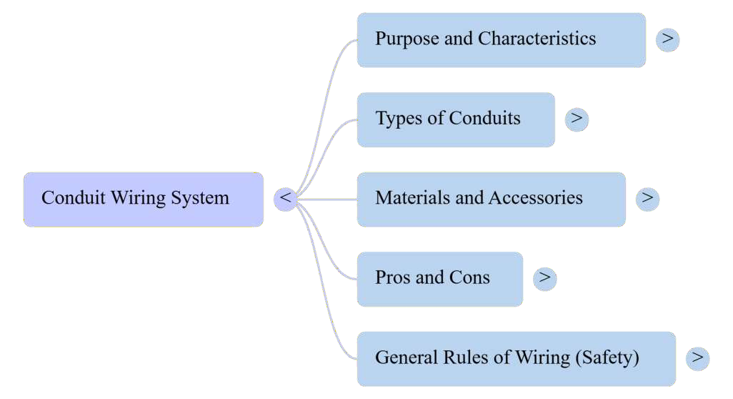
Wiring: General Rules , Materials and Accessories\23EET103\ECED\Ms.RANJANI K \ AP\IOT\SNSCT

Slide 7
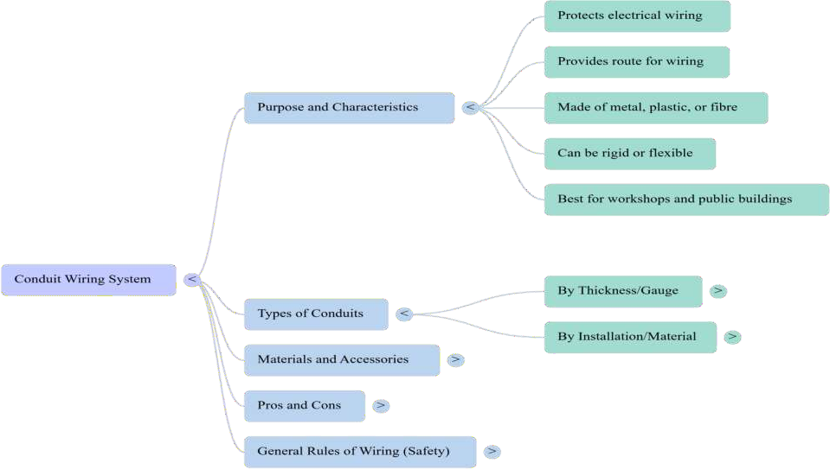
Wiring: General Rules , Materials and Accessories\23EET103\ECED\Ms.RANJANI K \ AP\IOT\SNSCT

Slide 8
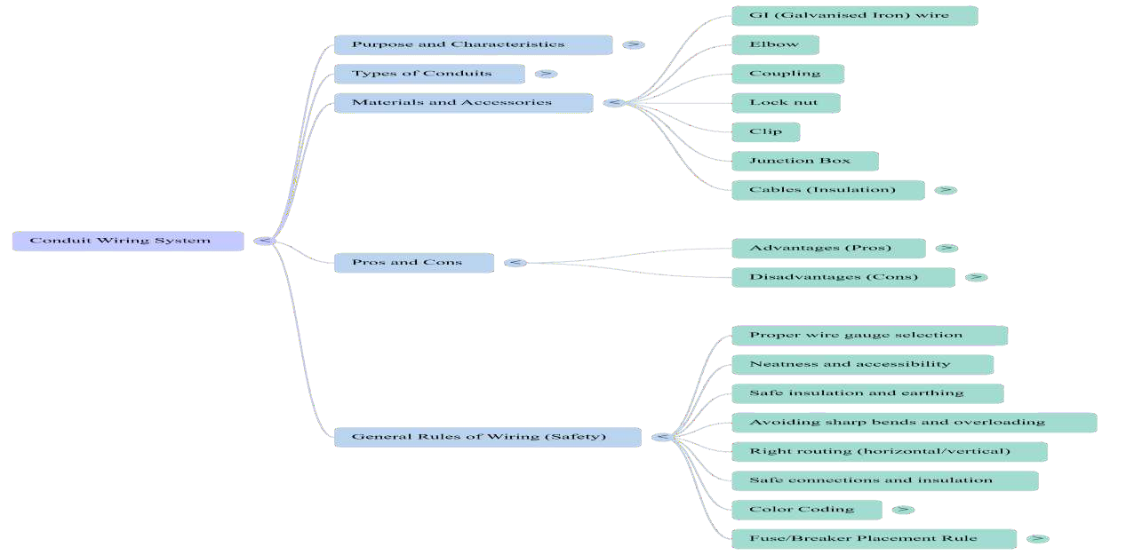
Wiring: General Rules , Materials and Accessories\23EET103\ECED\Ms.RANJANI K \ AP\IOT\SNSCT

Slide 9
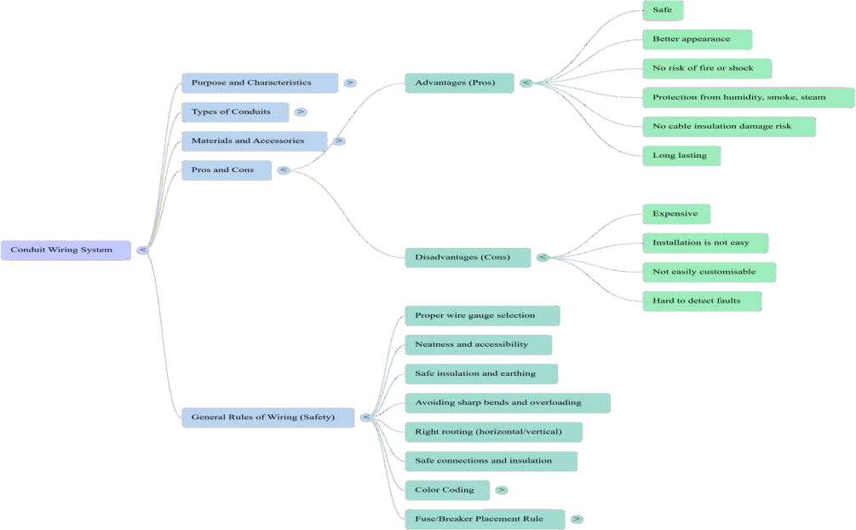

Slide 10
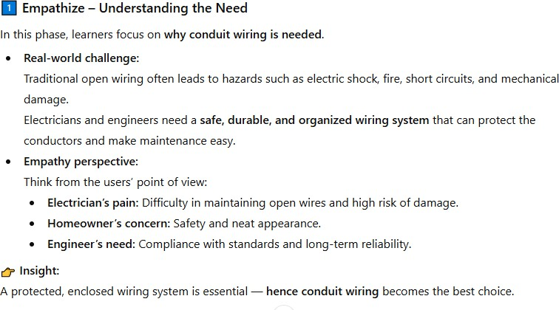
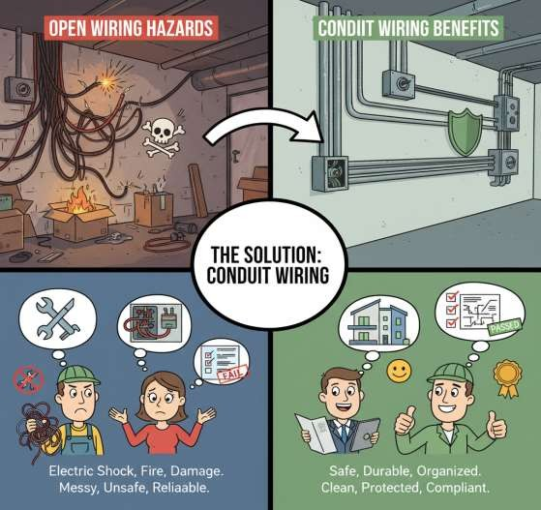
General Rules of Wiring
Wiring: General Rules , Materials and Accessories\23EET103\ECED\Ms.RANJANI K \ AP\IOT\SNSCT

Slide 11
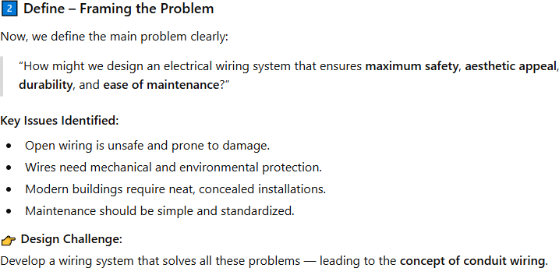
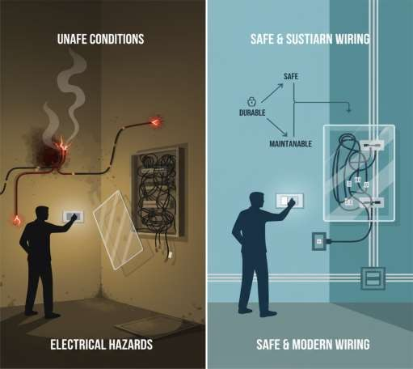
General Rules of Wiring
Wiring: General Rules , Materials and Accessories\23EET103\ECED\Ms.RANJANI K \ AP\IOT\SNSCT

Slide 12
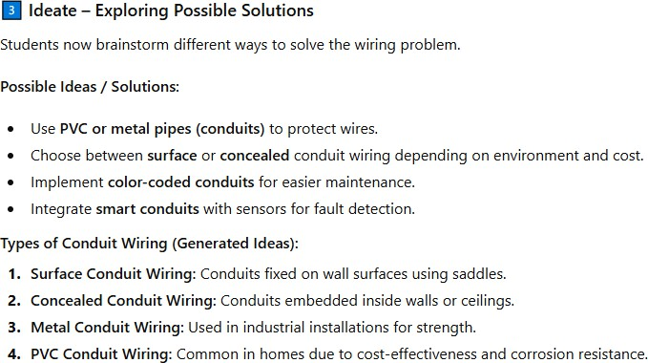
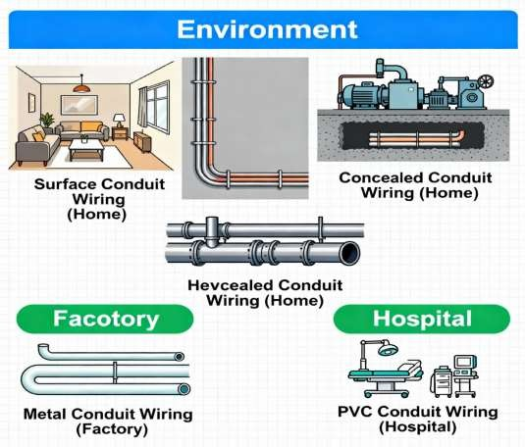
General Rules of Wiring
Wiring: General Rules , Materials and Accessories\23EET103\ECED\Ms.RANJANI K \ AP\IOT\SNSCT

Slide 13
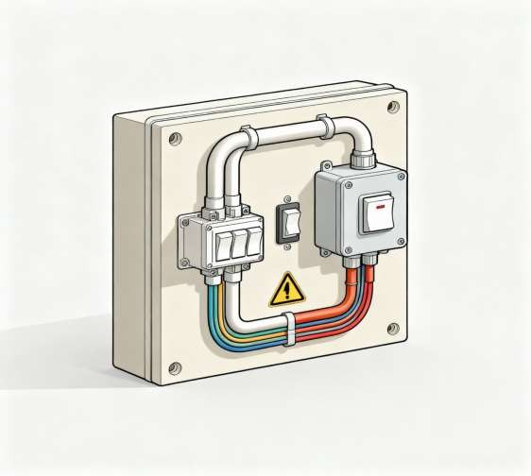
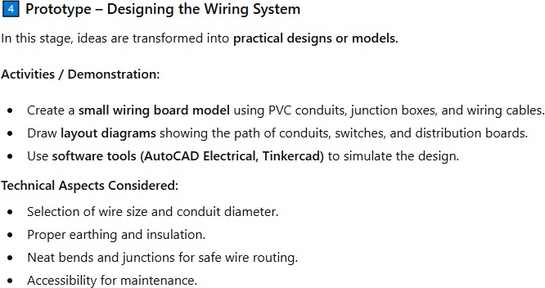
General Rules of Wiring
Wiring: General Rules , Materials and Accessories\23EET103\ECED\Ms.RANJANI K \ AP\IOT\SNSCT

Slide 14
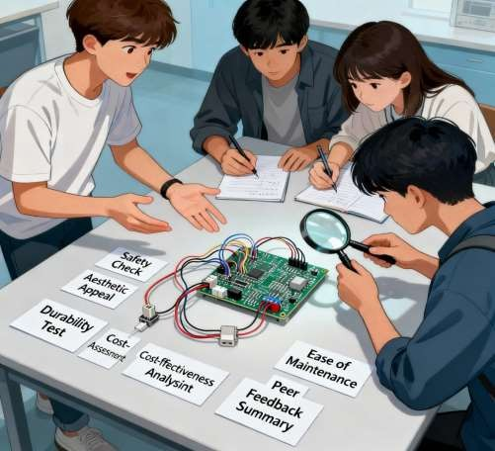
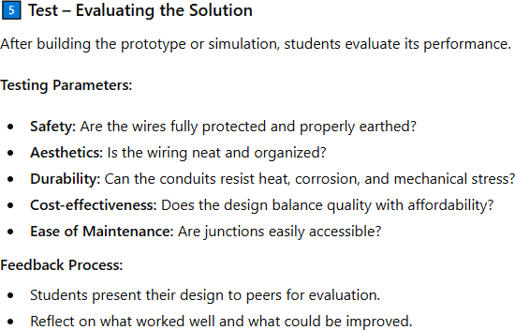
General Rules of Wiring
Wiring: General Rules , Materials and Accessories\23EET103\ECED\Ms.RANJANI K \ AP\IOT\SNSCT

Slide 15
Activity: Wiring Materials and Accessories
Prototype – Designing the Wiring System
Goal: Apply knowledge through small-scale
models or simulations.
Activities:
Mini Project / Lab Model:
Students create a prototype using PVC conduits,
junction boxes, elbows, and wiring cables on a
plywood board.
CAD or Simulation:
Alternatively, students use software (like AutoCAD
Electrical or Tinkercad) to design conduit layouts.
Labeling Exercise:
Identify switches, sockets, distribution boards,
bends, and conduits.
Learning Output:
Students demonstrate how conduit wiring provides
mechanical protection and neatness.
Ideate – Generating Solutions
Goal: Explore different conduit wiring options.
Activities:
Group brainstorming:
Students discuss and list different types of conduit wiring:
  Surface conduit wiring
  Concealed conduit wiring
  PVC conduit wiring
  Metal conduit wiring
Think-Pair-Share:
Each group suggests where each type would be most
effective (home, factory, lab, hospital, etc.).
Sketching Task:
Groups draw layout diagrams showing conduit wiring
paths for a classroom or lab setup.
Encourage creative ideas — color-coded conduits, modular junction boxes, flexible bends, etc.
Wiring: General Rules , Materials and Accessories\23EET103\ECED\Ms.RANJANI K \ AP\IOT\SNSCT

Slide 16
DT Activity
Ideate (Generate Possible Solutions)
Activity:
Brainstorm as many ideas as possible to address the
defined problem.
Encourage creativity — e.g., modular wiring boards,
coded wiring maps, transparent junction boxes, or color-
coded route labels.
Rules:
No idea is too wild initially — quantity first, then quality.
Relate each idea to wiring rules like:
  Proper wire gauge selection
  Neatness and accessibility
  Safe insulation and earthing
  Avoiding sharp bends and overloading
    Deliverable:
Sketches or concept notes showing improved wiring layouts following general wiring rules.
Prototype (Build and Demonstrate)
Activity:
Use materials (cardboard, wires, switches, LED lamps,
labels) to build a mini wiring model (e.g., a small
room, control board, or lab setup).
Apply all wiring rules:
  Proper color coding (Red–Live, Black–Neutral, Green–
Earth)
  Right routing (horizontal/vertical)
  Accessibility and aesthetics
  Safe connections and insulation
Deliverable:
A physical or digital prototype demonstrating safe,
rule-based wiring design.
Wiring: General Rules , Materials and Accessories\23EET103\ECED\Ms.RANJANI K \ AP\IOT\SNSCT

Slide 17
DT Activity
Test – Evaluation and Reflection
Goal: Evaluate their conduit design’s performance.
Activities:
Peer Review:
Groups present their models; classmates evaluate on
parameters:
  Safety
  Aesthetics
  Ease of installation
  Cost-effectiveness
Reflection Questions:
  What worked well in your design?
  What challenges did you face?
  How could the system be improved?
Outcome:
Students understand the practical aspects and real-
world constraints of conduit wiring design
Wiring: General Rules , Materials and Accessories\23EET103\ECED\Ms.RANJANI K \ AP\IOT\SNSCT

Slide 18
Puzzles
According to the general rules of
wiring, where should a fuse or circuit breaker never be placed?
A.Near the point of entry for the supply cables.
B.On the live conductor of each sub-circuit.
C.On a distribution fuse board.
D.In the neutral or earth wire.
In the Design Thinking process applied to wiring, which phase
focuses on translating user
observations into a clear problem statement?
A.Prototype
B.Define
C.Empathize
D.Ideate
Wiring: General Rules , Materials and Accessories\23EET103\ECED\Ms.RANJANI K \ AP\IOT\SNSCT

Slide 19
Puzzles
According to the provided material, what is
the correct color-coding scheme for wiring in a single-phase installation?
What is the standard installation height for a switchboard from the floor level?
Green for phase, Black for neutral, Red for earth
Red for phase, Green for neutral, Black for earth
Black for phase, Red for neutral, Green for earth
Red for phase, Black for neutral, Green for earth
A.2.75 metres
B.1.30 metres
C.2.5 metres
D.1.25 metres
Wiring: General Rules , Materials and Accessories\23EET103\ECED\Ms.RANJANI K \ AP\IOT\SNSCT

Slide 20

Wiring: General Rules , Materials and Accessories\23EET103\ECED\Ms.RANJANI K \ AP\IOT\SNSCT

Slide 21
Reference
Reference Research Papers
Youtube links
https://www.youtube.com/shorts/lDV He3TgMnw
https://www.youtube.com/shorts/i7K4 3.
umx6myw
https://youtu.be/N3ccRS9DWW8?si=
Y-Xc18jkashJbitc
https://youtu.be/bkD6VRTtwCc?si= a3o1zVtq_oo3D8Yp
1.
“Electrical Wiring Components and Accessories” (PDF) – Explores wiring materials (conductors, insulators) and accessories for building installations. NCERT“
Top Electrical Wiring Components you should know” – Blog overview of wiring accessories, switches, sockets, circuit protection etc. goldmedalindia.com“
Electical materials and accessories (Ch-2 PPTX)” – Presentation discussing conductor/insulator materials, conduit types, accessories. www.slideshare.net“
10 basics to know about wire-harness design” – Focus on the design side (wire
routing, selection, environment) which is helpful for ideation/prototyping.
Cadonix
“Future of Commercial Building Wiring: Key Trends and Innovations” – Valuable for the “ideate” phase (what’s possible / future-trends). systemsolutionswa.com
“Industrial and Allied Electrical Systems” (PDF) – More advanced, covers wiring material + accessory selection in bigger installations. Malla Reddy Engineering CollegeCase study:
“Wire and cable routings and harness designing systems with AI – a review” –
Thinking about wiring systems from a design/optimization viewpoint.
2.
4.
5.
6.
7.
Wiring: General Rules , Materials and Accessories\23EET103\ECED\Ms.RANJANI K \ AP\IOT\SNSCT
21/11

