Slide 1


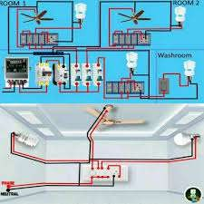
SNS COLLEGE OF TECHNOLOGY
An Autonomous Institution Coimbatore-35
Department of Arificial Intelligence and Data Science
23EET103-Electric Circuits and Electron Devices.
I B.E AIDS / II SEMESTER
UNIT III :WIRING,
GROUNDING AND SAFETY
Topic 4 : Wiring layout of Residential building
Wiring: General Rules , Materials and Accessories\23EET103\ECED\Ms.RANJANI K \ AP\IOT\SNSCT

Slide 2
Let’s Recall !!ti
What are the essential components in a home electrical system?
Why do we need a proper wiring layout for safety and convenience?
What happens if wiring layout is poorly planned?
How many circuits does a typical house need (lighting, power, appliances)?
Wiring: General Rules , Materials and Accessories\23EET103\ECED\Ms.RANJANI K \ AP\IOT\SNSCT
2/19

Slide 3
TOPICS FOR DISCUSSIONTION
Introduction to Residential Wiring Layout
Components involved in house wiring
Standard circuit layout for residential buildings
Distribution Board (DB) layout
Room-wise wiring arrangement
Conduit routing in residential spaces
Safety considerations in house wiring
Advantages of proper wiring layout
Wiring: General Rules , Materials and Accessories\23EET103\ECED\Ms.RANJANI K \ AP\IOT\SNSCT

Slide 4
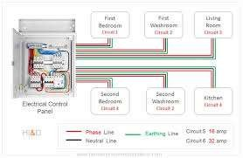
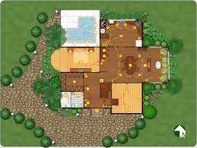
Let's explore !!
Definition:
Wiring layout of a residential building refers to the systematic arrangement of electrical wiring, circuits, switches, and distribution boards to ensure safe and efficient power delivery throughout the house.
Purpose:
To provide uninterrupted power supply to all rooms
To ensure safety from fire & electric shock
To maintain aesthetic appearance
To allow future expansion or maintenance
Wiring: General Rules , Materials and Accessories\23EET103\ECED\Ms.RANJANI K \ AP\IOT\SNSCT

Slide 5
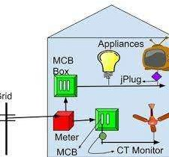
RESIDENTIAL WIRING
Residential electrical wiring systems start with the utility's power lines and equipment that provide power to the home, known collectively as the service entrance.
The power is run through an electric meter, which records how much energy is used in the home and is the basis for the monthly electric bill.
Wiring: General Rules , Materials and Accessories\23EET103\ECED\Ms.RANJANI K \ AP\IOT\SNSCT

Slide 6
Wiring layout of Residential Building
Typical residential building has:
Lighting Circuits → 5–10 points per circuit
Fan Circuits → 1 fan per switchboard
5A Socket Circuits (general-purpose outlet)
16A Power Circuits (heavy loads)
Dedicated Circuits for:
A/C
Refrigerator
Geyser
Washing machine
Microwave oven
Wiring: General Rules , Materials and Accessories\23EET103\ECED\Ms.RANJANI K \ AP\IOT\SNSCT

Slide 7
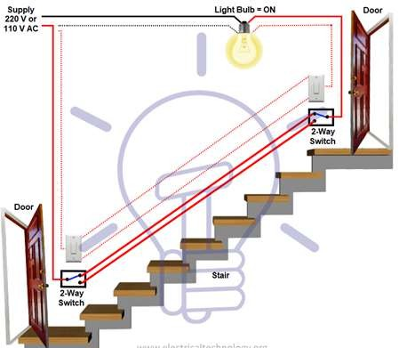
LAYOUT OF HOUSEHOLD WIRING
Staircase Wiring Circuit Diagram Connection
Here we can control a bulb from two different places by using two 2-way switches.
Wiring: General Rules , Materials and Accessories\23EET103\ECED\Ms.RANJANI K \ AP\IOT\SNSCT

Slide 8
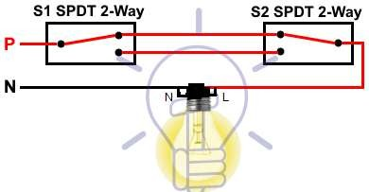
LAYOUT OF HOUSEHOLD WIRING
Staircase Wiring Circuit Diagram Connection
Here we can control a bulb from two different places by using two 2-way switches.
Wiring: General Rules , Materials and Accessories\23EET103\ECED\Ms.RANJANI K \ AP\IOT\SNSCT

Slide 9
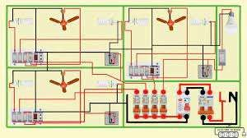
LAYOUT OF HOUSEHOLD WIRING
Living Room
MODEL 1
2–3 light points
2 fan points
2 switchboards
16A AC point
TV point
Bedroom
Light + fan
5A sockets
AC wiring
Charging sockets near bedside
Kitchen
Mixer + grinder points
Refrigerator outlet (16A)
Chimney point
Oven / microwave point
Bathroom
Geyser point (20A/32A)
Exhaust fan point
Wiring: General Rules , Materials and Accessories\23EET103\ECED\Ms.RANJANI K \ AP\IOT\SNSCT

Slide 10
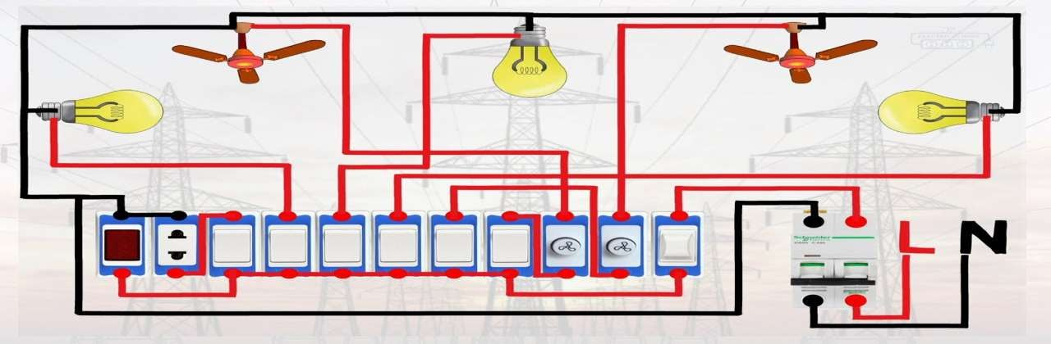
LAYOUT OF HOUSEHOLD WIRING
MODEL 2
Wiring: General Rules , Materials and Accessories\23EET103\ECED\Ms.RANJANI K \ AP\IOT\SNSCT
10/19

Slide 11
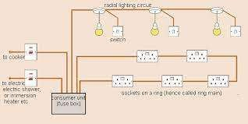
LAYOUT OF HOUSEHOLD WIRING
MODEL 3
Conduit routes:
Horizontal conduit runs above switchboard level
Vertical runs only at switchboard and fixture points
Ceiling conduits for fan and light points
Separate conduits for power and lighting circuits to reduce interference
Concealed Wiring – Most Preferred
Aesthetic
Safe from environmental damage
Wiring: General Rules , Materials and Accessories\23EET103\ECED\Ms.RANJANI K \ AP\IOT\SNSCT
11/19

Slide 12
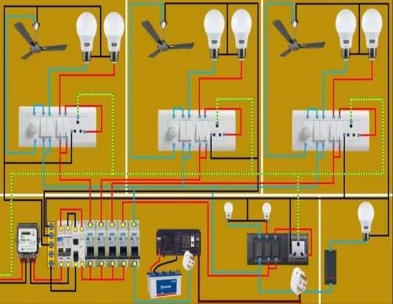
LAYOUT OF HOUSEHOLD WIRING
MODEL 4
Typical layout includes:
EB line → Meter → Main Switch
→ DB
DB → Separate circuits (lighting, fans, sockets…)
Conduits → Switchboards → Loads
Wiring: General Rules , Materials and Accessories\23EET103\ECED\Ms.RANJANI K \ AP\IOT\SNSCT
12/19

Slide 13
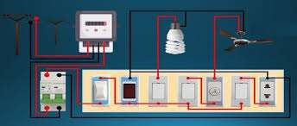
LAYOUT OF HOUSEHOLD WIRING
MODEL 5
Distribution Board (DB) Layout
A DB typically includes:
Main MCB (40–63A) – Isolates the entire supply
RCCB / ELCB – Protects from earth faults
MCB Circuits
6A: Lighting
10A: Fans
16A: Power sockets
20A/32A: AC/Geyser
Neutral link, Earth busbar, indicators
Purpose:
To distribute electrical power safely and separately to
each circuit.
Wiring: General Rules , Materials and Accessories\23EET103\ECED\Ms.RANJANI K \ AP\IOT\SNSCT
13/19

Slide 14
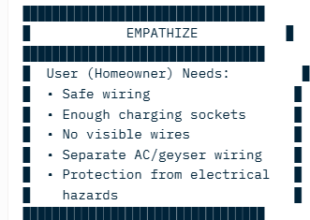
Types of Wiring
DT-Empathize
Wiring: General Rules , Materials and Accessories\23EET103\ECED\Ms.RANJANI K \ AP\IOT\SNSCT

Slide 15
Types of Wiring
DT-Define
█████████████████████████████████
DEFINE █
█████████████████████████████████
⬛ | Problem Statement: █
⬛ | “How might we design a █
⬛ | residential wiring layout █
⬛ | that ensures safety, █
⬛ | convenience and long-term █
⬛ | reliability while █
⬛ | maintaining a clean █
⬛ | appearance?” █
█████████████████████████████████
Wiring: General Rules , Materials and Accessories\23EET103\ECED\Ms.RANJANI K \ AP\IOT\SNSCT

Slide 16


Application of DC Components in Real world
Workshops
Residential homes
Apartments
Villas and bungalows
Hostels
Guest houses
Farmhouses
Wiring: General Rules , Materials and Accessories\23EET103\ECED\Ms.RANJANI K \ AP\IOT\SNSCT

Slide 17
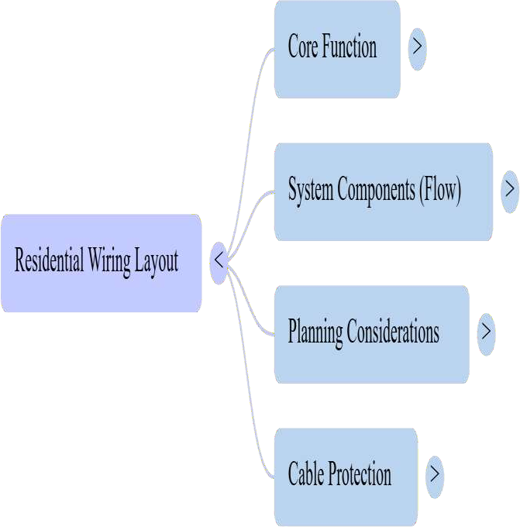

Let’s summarize
Wiring: General Rules , Materials and Accessories\23EET103\ECED\Ms.RANJANI K \ AP\IOT\SNSCT

Slide 18
References
Electrical4U – “System of Electrical Wiring” article:
https://www.electrical4u.com/system-of-wiring/ electrical4u.com+1
Bureau of Indian Standards – IS 732:2019 Code of Practice for Electrical Wiring Installations: https://standardsbis.bsbedge.com/search_redirect.aspx?id=14239 standardsbis.bsbedge.com+1
Legrand – Wiring Accessories catalogue (PDF): https://assets.legrand.com/pim/DOCUMENT/wiring-accessories-2020-040- 046.pdf assets.legrand.com+1
Schneider Electric – Electrical Installation Guide: https://www.se.com/ww/en/work/products/product-launch/electrical- installation-guide/
Wiring: General Rules , Materials and Accessories\23EET103\ECED\Ms.RANJANI K \ AP\IOT\SNSCT

Slide 19


Wiring: General Rules , Materials and Accessories\23EET103\ECED\Ms.RANJANI K \ AP\IOT\SNSCT

