Slide 1


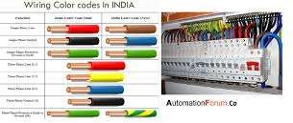
SNS COLLEGE OF TECHNOLOGY
An Autonomous Institution Coimbatore-35
Department of Artificial Intelligence and Data Science
23EET101- Electric circuits and Electronics Device.
I B.E AIDS / IISEMESTER
UNIT III :WIRING,
GROUNDING AND SAFETY
Topic 5 : Safety: Causes of accidents, Accident
prevention
Wiring: General Rules , Materials and Accessories\23EET103\ECED\Ms.RANJANI K \ AP\IOT\SNSCT

Slide 2
Let’s Recall !!
Why do accidents happen even with safety rules?
Can all accidents be prevented?
What happens if safety symbols are ignored?
Who is responsible for ensuring safety—individual or organization?
Wiring: General Rules , Materials and Accessories\23EET103\ECED\Ms.RANJANI K \ AP\IOT\SNSCT

Slide 3
TOPICS FOR DISCUSSIONTION
What is an accident?
Causes of accidents
Types of workplace hazards
Prevention strategies
Safety rules & precautions
Real-world industry practices (ABB, Bosch, L&T)
Wiring: General Rules , Materials and Accessories\23EET103\ECED\Ms.RANJANI K \ AP\IOT\SNSCT

Slide 4
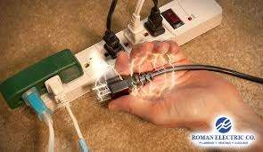
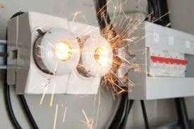
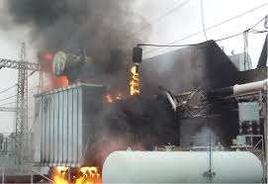
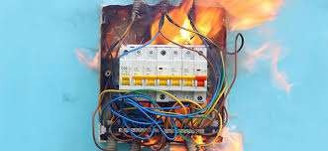
Let's explore !!
An accident is an unexpected and
unintentional event that causes:
Injury
Damage to equipment
Loss of life
Production downtime
Most accidents are preventable with
proper safety measures.
Major causes:
Human error (carelessness, lack of
attention)
Poor housekeeping (clutter, wet floors)
Faulty tools/equipment Ignoring safety rules Lack of training
Using equipment beyond limits Mechanical failures
Electrical faults (leakage, overloading)
Wiring: General Rules , Materials and Accessories\23EET103\ECED\Ms.RANJANI K \ AP\IOT\SNSCT

Slide 5
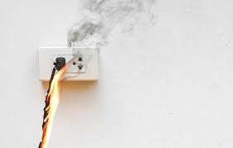
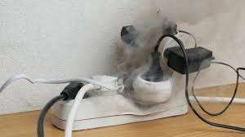
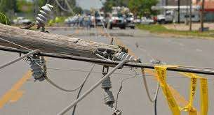
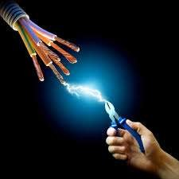
CAUSES OF ELECTRICAL ACCIDENTS
Top 5 Causes of Electrical Accidents
Cords and Plugs.
Misuse of Electrical Appliances.
Faulty Wiring System.
Wet Areas/GFCI.
Ignoring Safety Precautions.
Wiring: General Rules , Materials and Accessories\23EET103\ECED\Ms.RANJANI K \ AP\IOT\SNSCT

Slide 6
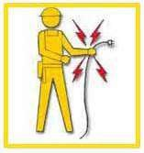
CAUSES OF ELECTRICAL ACCIDENTS
BE SAFE
Burns
Electrocution
Shock
Arc flash/arc blast
Fire
Explosions
Wiring: General Rules , Materials and Accessories\23EET103\ECED\Ms.RANJANI K \ AP\IOT\SNSCT

Slide 7
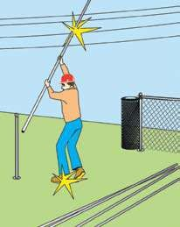
CAUSES OF ELECTRICAL ACCIDENTS
Contact with overhead power lines:
Overhead power
and lines
buried carry
extremely high voltage
Risks
  Electrocution (main risk)
  Burns and falls
Wiring: General Rules , Materials and Accessories\23EET103\ECED\Ms.RANJANI K \ AP\IOT\SNSCT

Slide 8
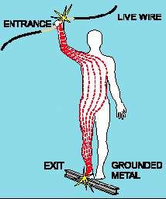
CAUSES OF ELECTRICAL ACCIDENTS
Contact with energized sources:
Live parts
  The major hazards
    Electrical shock and burns
Electrical occurs when
shock
the
body becomes part of
the electric circuit
Wiring: General Rules , Materials and Accessories\23EET103\ECED\Ms.RANJANI K \ AP\IOT\SNSCT
8/20

Slide 9
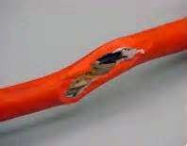
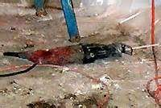
CAUSES OF ELECTRICAL ACCIDENTS
Damaged Or Bare Wires:
Fault current may travel through a body, causing electrical burns or death, if
  Power supply is not grounded
  Path has been broken
  There are live parts or bare wires
Extreme conditions and rough treatment can change electrical equipment from safe to hazardous
Wiring: General Rules , Materials and Accessories\23EET103\ECED\Ms.RANJANI K \ AP\IOT\SNSCT
9/20

Slide 10
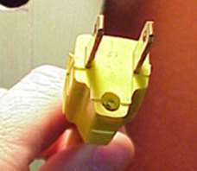
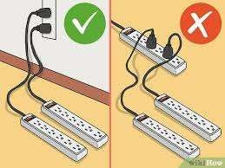
ELECTRICAL SAFETY
Never carry a tool by the cord.
Never yank the cord to disconnect it.
Keep cords away from heat, oil, and sharp edges.
Disconnect when not in use and when changing accessories such as blades and bits.
Wiring: General Rules , Materials and Accessories\23EET103\ECED\Ms.RANJANI K \ AP\IOT\SNSCT

Slide 11
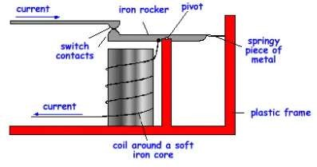
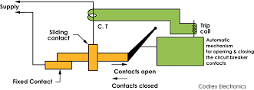
CIRCUIT BRAKERS
An electrical circuit breaker is a switching device which can be operated manually and automatically for controlling and protecting an electrical power system.
As the modern power system deals with huge currents, special attention should be given during designing of a circuit breaker to ensure it is able to safely interrupt the arc produced during the closing of a circuit breaker. This was the basic definition of circuit breaker.
Wiring: General Rules , Materials and Accessories\23EET103\ECED\Ms.RANJANI K \ AP\IOT\SNSCT

Slide 12
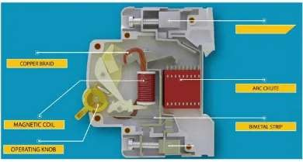
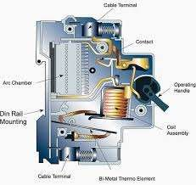
CIRCUIT BRAKERS- MCB
A Miniature Circuit Breaker (MCB) is an automatically operated electrical switch used to protect low voltage electrical circuits from damage caused by excess current from an overload or short circuit.
MCBs are typically rated up to a current up to 125 A,
and can be thermal or thermal- magnetic in operation.
Wiring: General Rules , Materials and Accessories\23EET103\ECED\Ms.RANJANI K \ AP\IOT\SNSCT
12/20

Slide 13
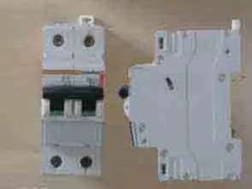
MCB VS FUSES
The MCB
has many advantages
compared to a fuse:
It automatically switches off the electrical circuit during the abnormal conditions of the network (both overload and fault conditions). The MCB is much more reliable in the detection of such conditions, is it is more sensitive to change in current.
The handling of an MCB is more electrically safe than a fuse.
Wiring: General Rules , Materials and Accessories\23EET103\ECED\Ms.RANJANI K \ AP\IOT\SNSCT

Slide 14
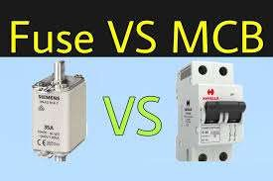
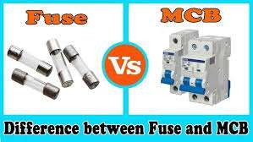
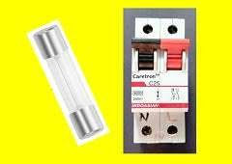
MCB VS FUSES
As the switch operating knob comes at its off position during tripping, the faulty zone of the electrical circuit can easily be identified. But in case of a fuse, the fuse wire should be checked by opening fuse grip or cutout from fuse base, for confirming the blow of fuse wire. Thus is it much detect if an MCB has been operated compared to a fuse.
Quick restoration of supply can not be possible in case of fuse, as fuses have to be rewirable or replaced for restoring the supply. But in the case of an MCB, quick restoration is possible by (literally) flipping a switch.
MCBs can be controlled remotely, whereas fuses can not
Wiring: General Rules , Materials and Accessories\23EET103\ECED\Ms.RANJANI K \ AP\IOT\SNSCT

Slide 15
Types of Wiring
DT-Empathize
User Type | Feelings / Emotions | Challenges / Pain Points | Observed Behaviors | User Needs
Students / Learners | Fear of shock, confusion, anxiety in labs | Exposed wires, lack of clear instructions, improper tools | Touching equipment without checking, rushing experiments | Clear guidance, safe lab setup, awareness training
Electricians / Technicians | Stress, safety concerns, job pressure | Faulty wiring, old equipment, no PPE, overloaded circuits | Working with live circuits, skipping PPE due to hurry | Proper tools, PPE, safe work procedures, regular training
Industrial Workers | Fear of arc flash, injury, downtime stress | Poor maintenance, moisture areas, high load machines | Plugging devices without checking conditions | Safety devices (ELCB, MCCB), insulated tools, proper grounding
Household Users | Carelessness, lack of awareness | Wet hands use, overloading sockets, damaged appliances | Using extension cords unsafely, ignoring sparks/trips | Safe wiring, child-proof sockets, awareness of safe usage
Maintenance Staff | Frustration, time pressure | No clear labeling, hidden faults, outdated wiring | Quick fixes, temporary wiring setups | Preventive maintenance schedule, proper documentation
Wiring: General Rules , Materials and Accessories\23EET103\ECED\Ms.RANJANI K \ AP\IOT\SNSCT

Slide 16
Types of Wiring
DT-Define
Category | Problem Identified | Root Cause | Impact | Defined Need / Requirement
Human Error | Unsafe handling of electrical equipment | Lack of awareness, no training, carelessness | Electric shock, burns, accidents | Mandatory safety training, clear instructions, awareness programs
Faulty Wiring | Exposed wires, loose connections, old cables | Poor installation, aging infrastructure, no inspections | Fire hazards, short circuits | Standardized wiring, periodic inspection, replacement of old cables
Overloading | Too many devices in one socket | Limited circuits, misuse of extensions | Tripping, overheating, fire | Load balancing, MCB/ELCB installation, proper circuit design
Poor Grounding/Earthing | Shock during equipment use | Improper or no earthing connection | Leakage current, fatal shocks | Proper grounding system, regular testing of earth resistance
Environmental Conditions | Wet floors, moisture, rain exposure | No waterproofing, poor insulation | Electric shock risk increases | IP-rated enclosures, insulation, dry environment maintenance
Lack of Safety Devices | Accidents continue despite warnings | Absence of MCB, RCCB, fuses, alarms | Equipment damage, personal injury | Install modern protection devices (RCCB/ELCB/MCB)
Poor Maintenance | Equipment failure, sparks, noise | No routine checks, outdated tools | Breakdowns, high accident probability | Preventive maintenance schedule, documented checks
Wiring: General Rules , Materials and Accessories\23EET103\ECED\Ms.RANJANI K \ AP\IOT\SNSCT

Slide 17
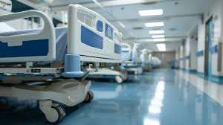
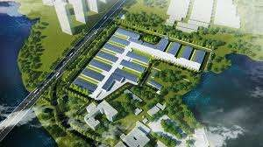


Applications in Real world
Homes / Residential Buildings
Industrial Plants / Factories
Construction Sites
Hospitals / Healthcare
Educational Institutions / Laboratories
Commercial Buildings / Offices
Agriculture / Farms
Transportation (Railways, Airports,
Metro)
Commercial Kitchens / Restaurants
Smart Homes / IoT Systems
Wiring: General Rules , Materials and Accessories\23EET103\ECED\Ms.RANJANI K \ AP\IOT\SNSCT

Slide 18

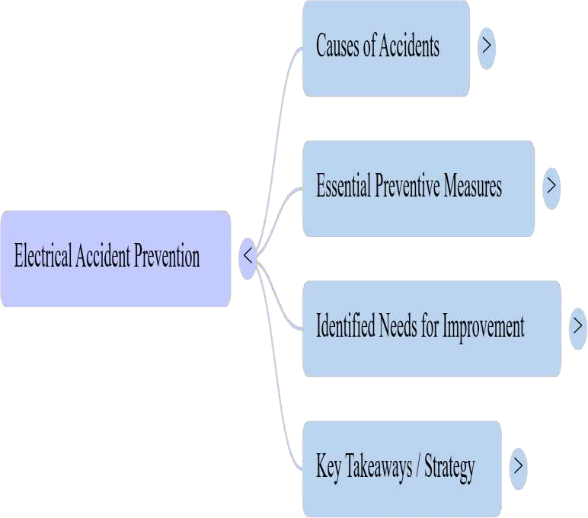
Let’s summarize
Wiring: General Rules , Materials and Accessories\23EET103\ECED\Ms.RANJANI K \ AP\IOT\SNSCT

Slide 19
References
Central Electricity Authority (CEA) – Electrical Safety Booklet
https://cea.nic.in/wp-content/uploads/safetylineman/2024/12/Electric_Safety_Booklet.pdf
TPC Training – Causes of Electrical Accidents
https://www.tpctraining.com/blogs/news/3-causes-of-electrical-accidents
SafeWorld HSE – Common Causes of Electrical Accidents
https://www.safeworldhse.com/2021/06/common-causes-of-electrical-accidents.html
SafeWork SA – Electrical Safety & Prevention
https://www.safework.sa.gov.au/resources/online-activities/introduction-to-safety-tutorial/introduction-
to-safety/safety-tutorial-electricity
STAMI – Electrical Accidents and Injury Prevention
https://stami.no/en/advisory-work/electrical-accidents-and-injuries
NPC India – Measures Against Electrical Accidents
https://www.npcindia.gov.in/NPC/Uploads/webinar/Template-ELECTRICAL-SAFETY.pdf
OSHA (USA) – Electrical Safety Guidelines
htts://www.osha.gov/electrical
Wiring: General Rules , Materials and Accessories\23EET103\ECED\Ms.RANJANI K \ AP\IOT\SNSCT
19/20

Slide 20
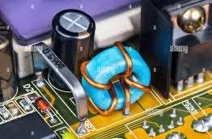

Wiring: General Rules , Materials and Accessories\23EET103\ECED\Ms.RANJANI K \ AP\IOT\SNSCT
20/20

