Slide 1

SNS COLLEGE OF TECHNOLOGY
Kurumbapalayam (Po), Coimbatore – 641 107
An Autonomous Institution
Accredited by NBA – AICTE and Accredited by NAAC – UGC with ‘A’ Grade Approved by AICTE, New Delhi & Affiliated to Anna University, Chennai
DEPARTMENT OF COMPUTER SCIENCE AND ENGINEERING COURSE NAME : 23CSB201 - OBJECT ORIENTED PROGRAMMING
I YEAR / II SEMESTER
Unit I - INTRODUCTION TO OOP
Topic : Data Types
Mrs.D.NIRMALA – AP/CSE

Slide 2
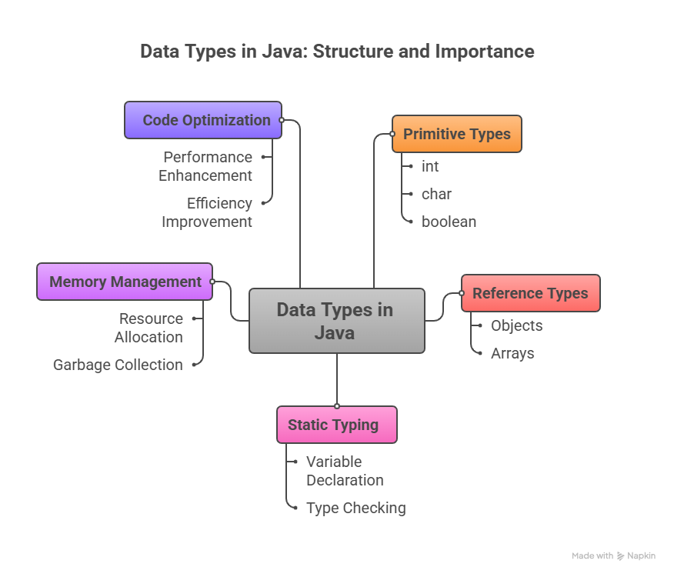
What is a Data Type?
Specifies the type of data a variable can hold
Helps in memory allocation and error checking
3.1.26 UNIT-1 / Data Types/ 23CSB201 OBJECT ORIENTED PROGRAMMING/MS.D.NIRMALA/CSE /SNSCT 2/15

Slide 3
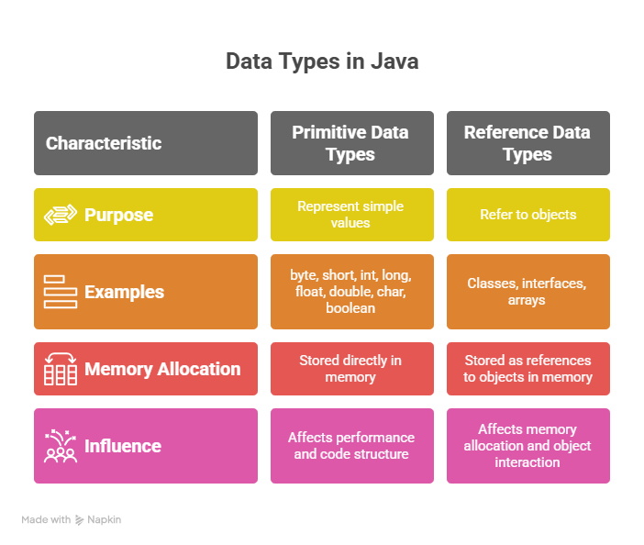
Classification of Data Types
Primitive Data Types
Non-Primitive (Reference) Data Types
3.1.26 UNIT-1 / Data Types/ 23CSB201 OBJECT ORIENTED PROGRAMMING/MS.D.NIRMALA/CSE /SNSCT 3/15

Slide 4
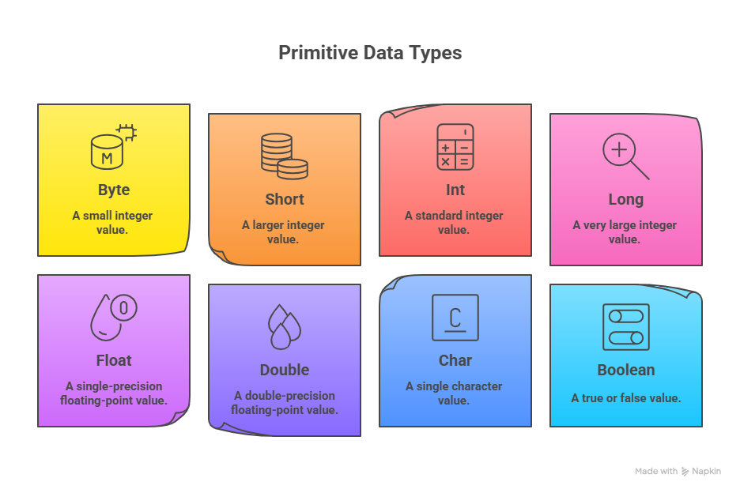
Primitive Data Types
byte, short, int, long
float, double
char
boolean
3.1.26 UNIT-1 / Data Types/ 23CSB201 OBJECT ORIENTED PROGRAMMING/MS.D.NIRMALA/CSE /SNSCT 4/15

Slide 5
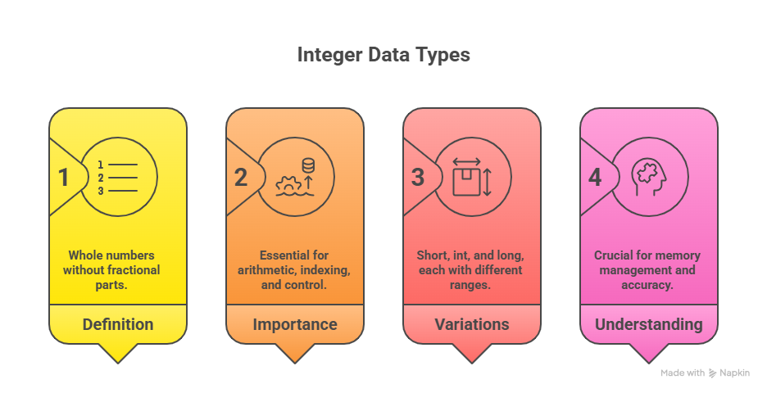
Integer Data Types
byte – 1 byte
short – 2 bytes
int – 4 bytes
long – 8 bytes
3.1.26 UNIT-1 / Data Types/ 23CSB201 OBJECT ORIENTED PROGRAMMING/MS.D.NIRMALA/CSE /SNSCT 5/15

Slide 6
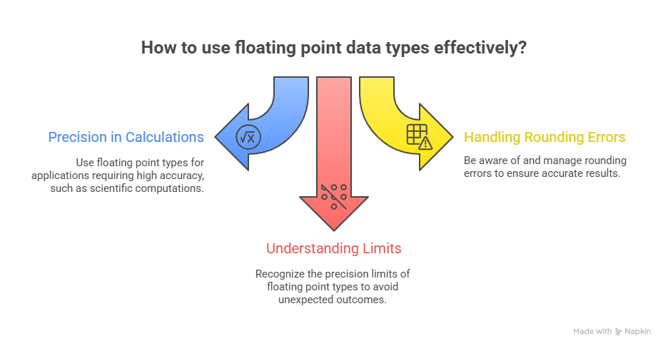
Floating Point Data Types
float – 4 bytes
Used for decimal values
double – 8 bytes (default)
3.1.26 UNIT-1 / Data Types/ 23CSB201 OBJECT ORIENTED PROGRAMMING/MS.D.NIRMALA/CSE /SNSCT 6/15

Slide 7
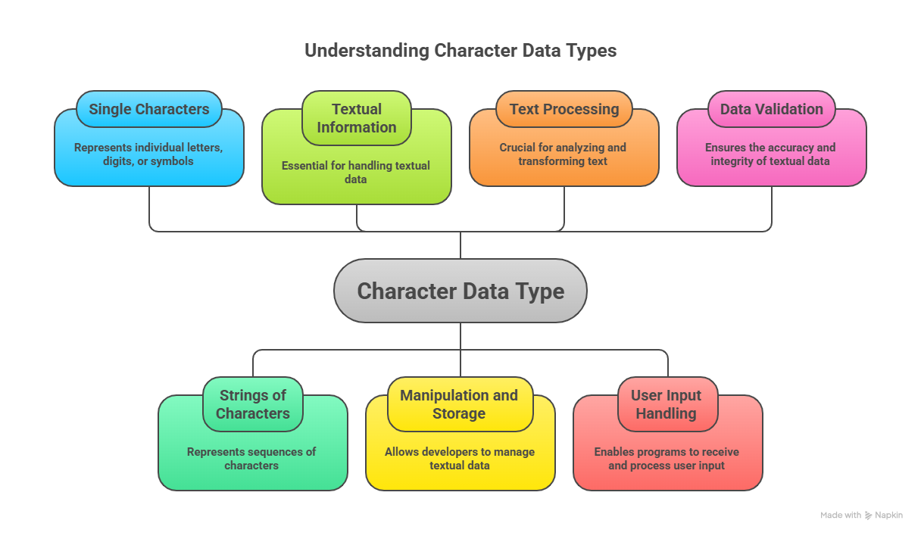
Character Data Type
char – 2 bytes
Stores a single Unicode character
3.1.26 UNIT-1 / Data Types/ 23CSB201 OBJECT ORIENTED PROGRAMMING/MS.D.NIRMALA/CSE /SNSCT 7/15

Slide 8
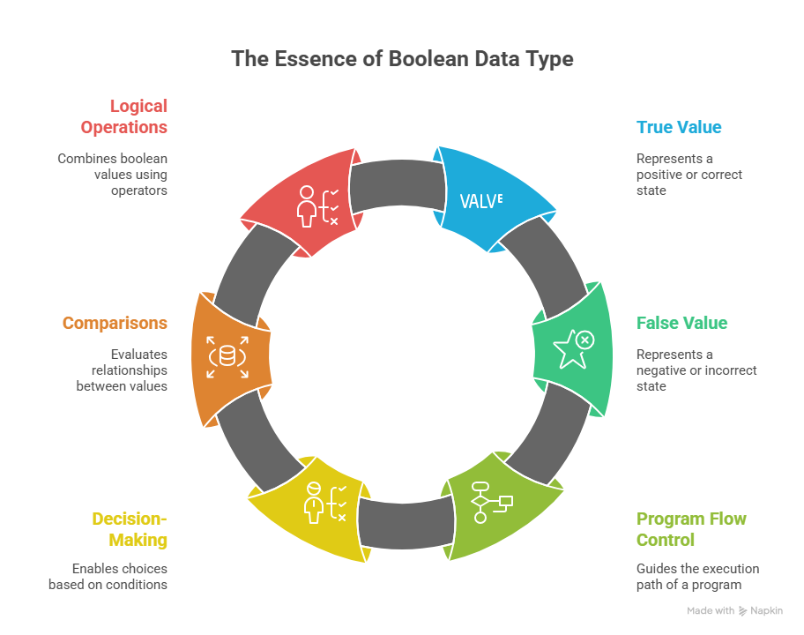
Boolean Data Type
boolean – 1 bit
Stores true or false
3.1.26 UNIT-1 / Data Types/ 23CSB201 OBJECT ORIENTED PROGRAMMING/MS.D.NIRMALA/CSE /SNSCT 8/15

Slide 9
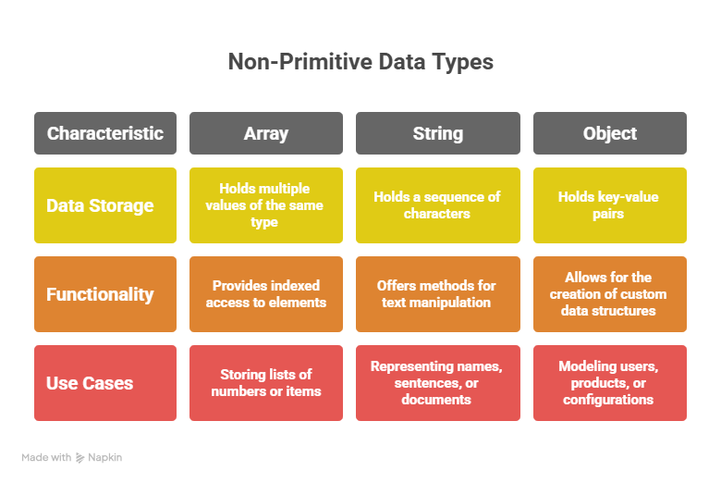
Non-Primitive Data Types
String
Array
Class
Interface
3.1.26 UNIT-1 / Data Types/ 23CSB201 OBJECT ORIENTED PROGRAMMING/MS.D.NIRMALA/CSE /SNSCT 9/15

Slide 10
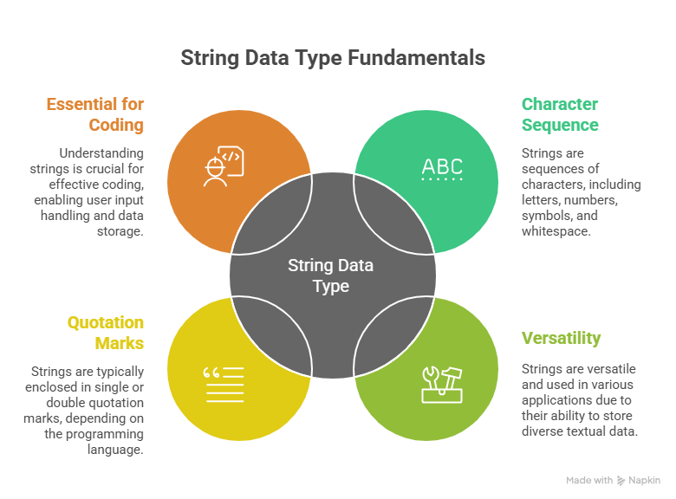
String Data Type
Sequence of characters
Immutable
Example: String s = "Java";
3.1.26 UNIT-1 / Data Types/ 23CSB201 OBJECT ORIENTED PROGRAMMING/MS.D.NIRMALA/CSE /SNSCT 10/15

Slide 11
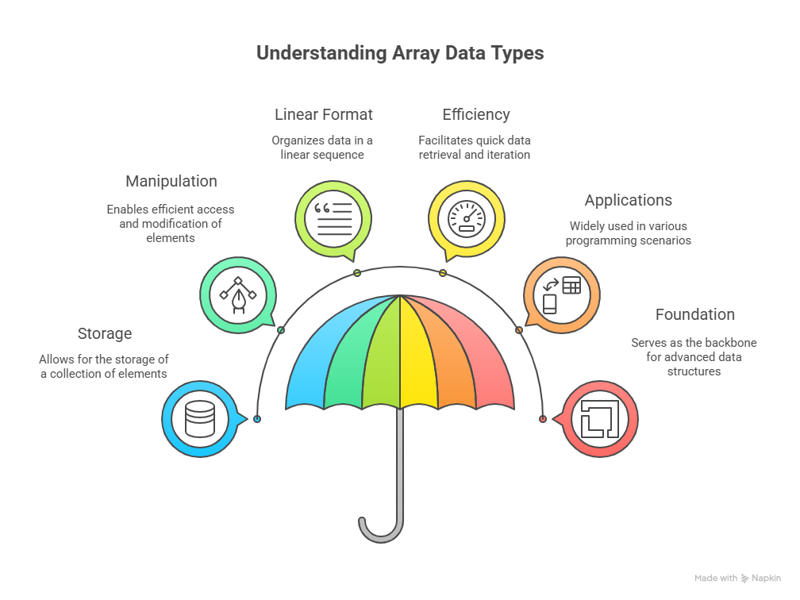
Array Data Type
Stores multiple values of same type
Fixed size
Example: int[] a = {1,2,3};
3.1.26 UNIT-1 / Data Types/ 23CSB201 OBJECT ORIENTED PROGRAMMING/MS.D.NIRMALA/CSE /SNSCT 11/15

Slide 12
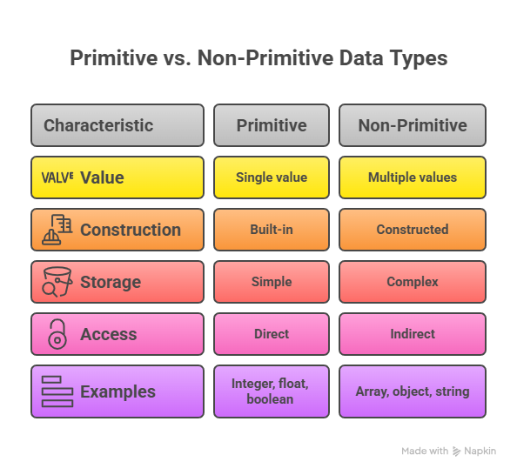
Difference: Primitive vs Non-Primitive
Primitive: stores value directly
Non-Primitive: stores reference
3.1.26 UNIT-1 / Data Types/ 23CSB201 OBJECT ORIENTED PROGRAMMING/MS.D.NIRMALA/CSE /SNSCT 12/15

Slide 13
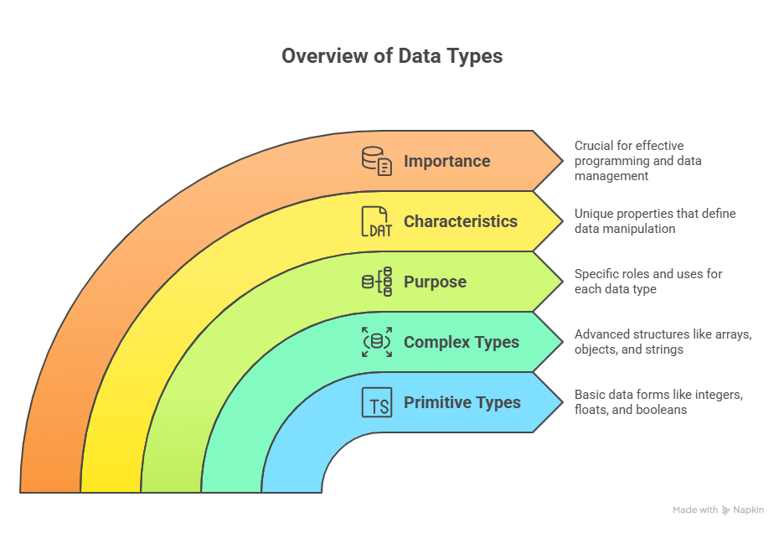
Summary
Java supports different data types
Choice depends on data and memory needs
3.1.26 UNIT-1 / Data Types/ 23CSB201 OBJECT ORIENTED PROGRAMMING/MS.D.NIRMALA/CSE /SNSCT 13/15

Slide 14
Object Oriented Programming in Java – Questions to Solve
A banking application must protect customer data while allowing controlled access.
Which OOP concept should be used and how is it implemented in Java?
A university management system has different types of users such as Student, Faculty, and Admin sharing common attributes.
Which OOP principle is suitable for this design? Explain.
A graphics application needs to draw different shapes like Circle, Rectangle, and Triangle using a common interface.
Which OOP concept enables this and how?
A vehicle rental system supports multiple vehicle types (Car, Bike, Truck) with different rental calculations.
Which OOP concept allows different implementations for the same method?
A payment system must support Credit Card, Debit Card, and UPI without modifying existing code.
Which OOP principle ensures flexibility and scalability?
3.1.26 UNIT-1 / Data Types/ 23CSB201 OBJECT ORIENTED PROGRAMMING/MS.D.NIRMALA/CSE /SNSCT 14/15

Slide 15


