Slide 1

SNS COLLEGE OF TECHNOLOGY
An Autonomous Institution Coimbatore-35
Department of Artificial Engineering and Data Science
23EET103 Electric Circuits and Electron Devices
I B.E-AIDS/ II SEMESTER
UNIT IV : ELECTRONIC DEVICES AND APPLICATIONS
Topic : -PN Junction Diode – Construction & VI Characteristics

Slide 2
Let’s Recall!!
Diodes are the simplest semiconductor allowing current to flow in one direction only.
devices
They are formed by joining P-type and N-type semiconductor materials.
PN junctions act as rectifiers, switches, detectors, and clippers.

Slide 3
Topics for discussion
What is a PN junction and how is it formed?
What happens when P and N regions are joined?
How does biasing (forward/reverse) affect diode behavior?
What is a VI characteristic curve?
What are the practical applications of the PN junction diode?
2026-03-24

Slide 4
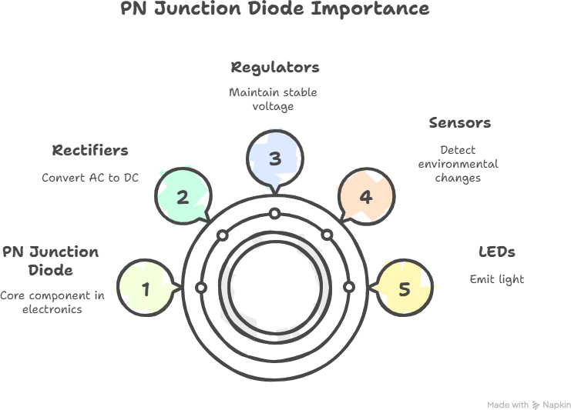
Why Study PN Junction Diode?DT-Empathize
PN junction diodes are the building blocks of electronics.
Understanding their behavior is essential for analyzing rectifiers, regulators, sensors, photodiodes, LEDs, logic circuits, and many other devices.

Slide 5
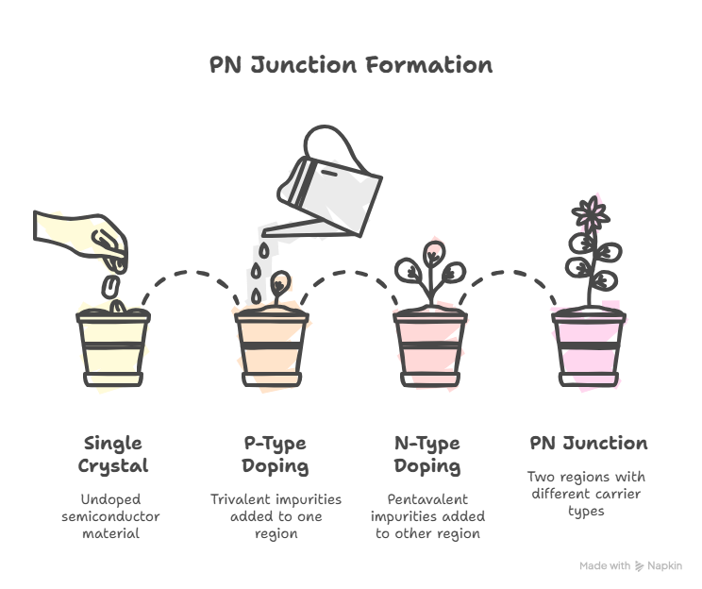
Construction of PN Junction Diode
DT-DEFINE
A PN junction is created by doping a single crystal of semiconductor in two different regions:
P-Type Region
Doped with trivalent impurities (Boron,
Gallium)
Contains holes → majority carriers N-Type Region
Doped with pentavalent impurities
(Phosphorus, Arsenic)
Contains electrons → majority carriers

Slide 6
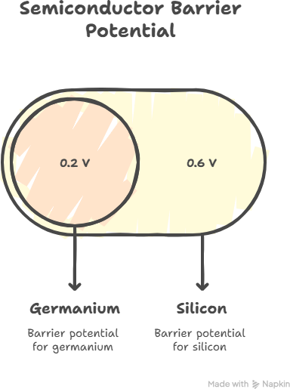
Formation of Depletion Region
DT-DEFINE
When P and N regions are joined: Electrons from N diffuse to P Holes from P diffuse to N
Immobile ions are left behind
A depletion layer is formed
An internal electric field (barrier potential) is created
Barrier Potential Values
Silicon ≈ 0.6 V
Germanium ≈ 0.2 V
6/11

Slide 7
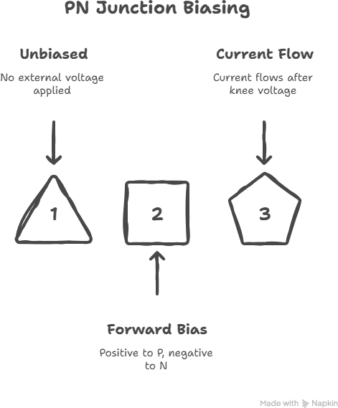
Ideate: Biasing a PN Junction
DT-IDEATE

Slide 8
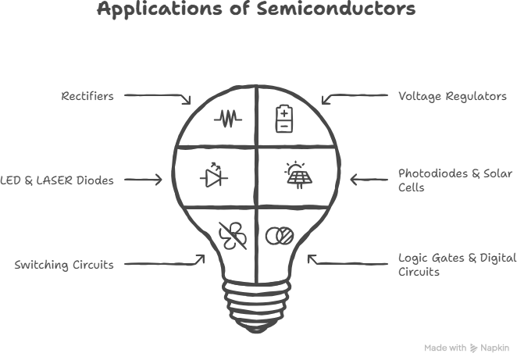
Practical Applications
DT-IDEATE

Slide 9
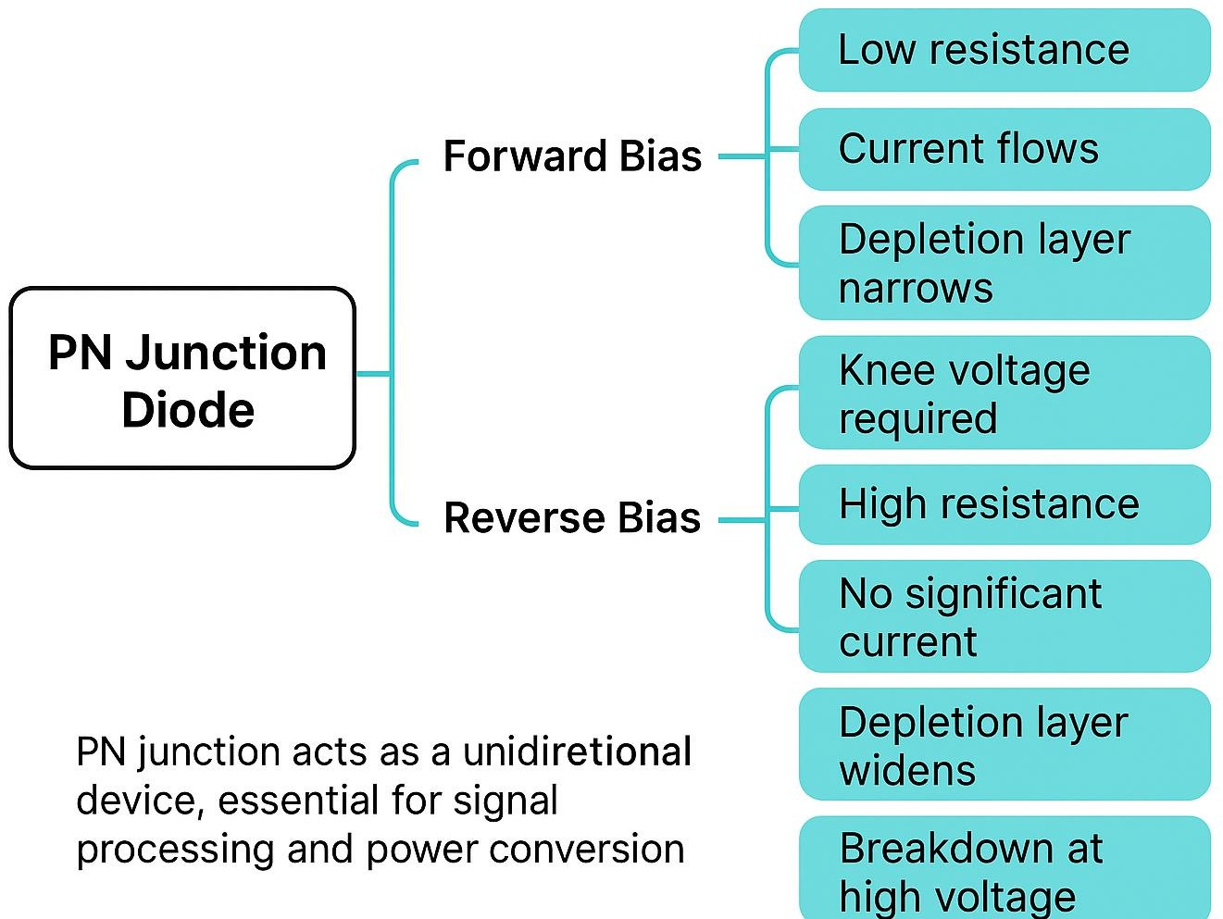
Summary

Slide 10
References
https://www.electronics-tutorials.ws/diode/?utm_source=chatgpt.com
https://www.electrical4u.com/p-n-junction-diode/?utm_source=chatgpt.com
https://www.tutorialspoint.com/basic_electronics/basic_electronics_diodes.ht m?utm_source=chatgpt.com/
https://testbook.com/physics/pn-junction-diode?utm_source=chatgpt.com

Slide 11
Thank You

