Slide 1

SNS COLLEGE OF TECHNOLOGY An Autonomous Institution Coimbatore-35
23EET103 Electric Circuits and Electron Devices
I B.E-AIDS/ II SEMESTER
UNIT IV : ELECTRONIC DEVICES AND APPLICATIONS
Topic : Zener Diode – Working & V-I Characteristics

Slide 2
Let’s Recall!!
Diodes conduct current in one direction.
But when operated in reverse bias, a special diode called the Zener diode can conduct safely in the breakdown region without damage.
Zener diodes are designed to maintain a constant voltage, making them essential for voltage regulation.

Slide 3
Topics for discussion
What makes the Zener diode different from a PN diode?
How does Zener breakdown occur?
What is avalanche breakdown?
How does a Zener diode regulate voltage?
V–I characteristics: forward & reverse regions

Slide 4
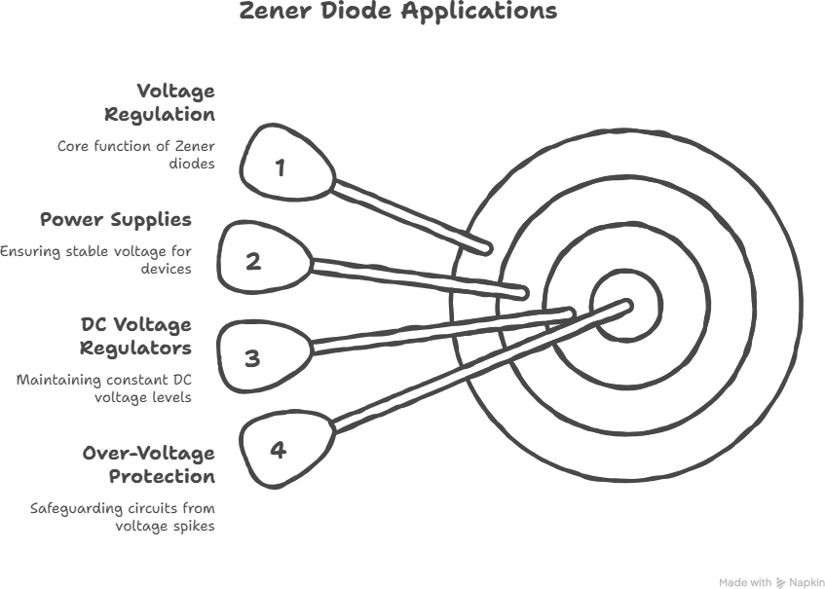
Why Study Zener Diode?DT-Empathize
Zener diodes are the heart of voltage regulation circuits, stabilizing output voltage in:
Power supplies
DC voltage regulators
Over-voltage protection circuits
Reference voltage generators

Slide 5
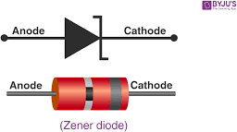
Construction of Zener Diode
DT-DEFINE
A Zener diode is similar to a PN junction diode but heavily doped on both sides.
Features
Narrow depletion layer
Low, precise breakdown voltage (3.3V, 5.1V, 6.8V, etc.)
Sharp and controlled reverse breakdown Symbol:
Same as diode but with a bent line on
cathode

Slide 6
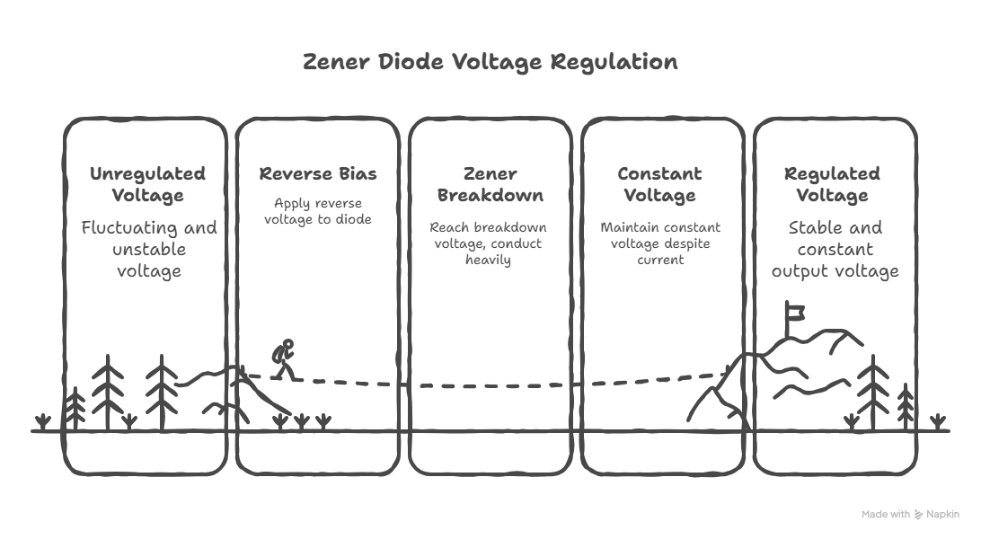
Working Principle
DT-DEFINE
A Zener diode operates in two conditions:
1. Forward Bias Operation
Acts like a normal diode
Conducts after the forward knee voltage
2.Reverse Bias Operation (Important)
When reverse biased:
Reverse current flows very small (µA region)
At a particular voltage → Zener
Breakdown Voltage (Vₓ or Vz)

Slide 7
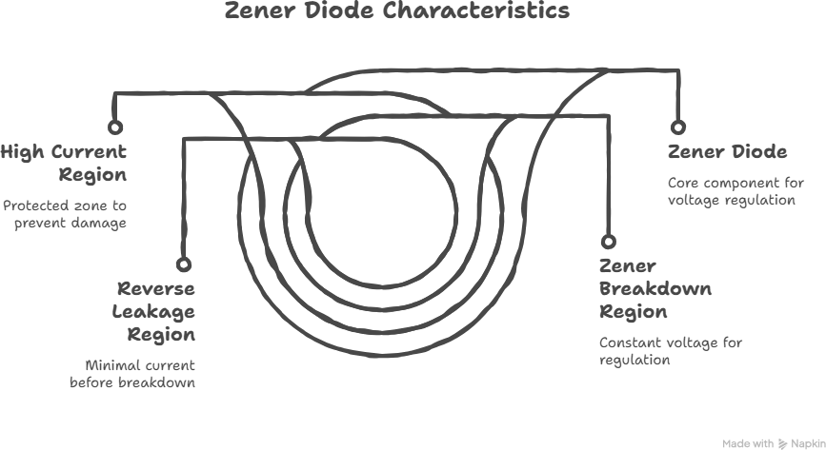
Ideate: V–I Characteristics of Zener Diode
DT-IDEATE

Slide 8
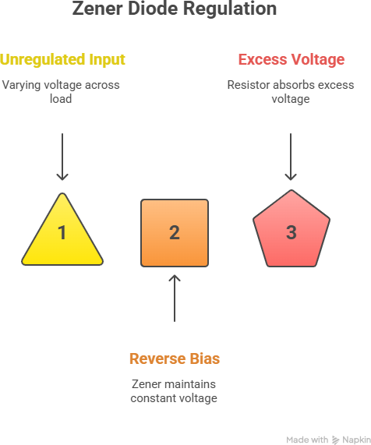
Ideate: Zener Diode as Voltage Regulator
DT-IDEATE
When connected in reverse bias across a
load:
Input voltage varies → Zener maintains
constant output voltage = Vz
Excess voltage appears across series
resistor
Output remains stable → regulated DC

Slide 9
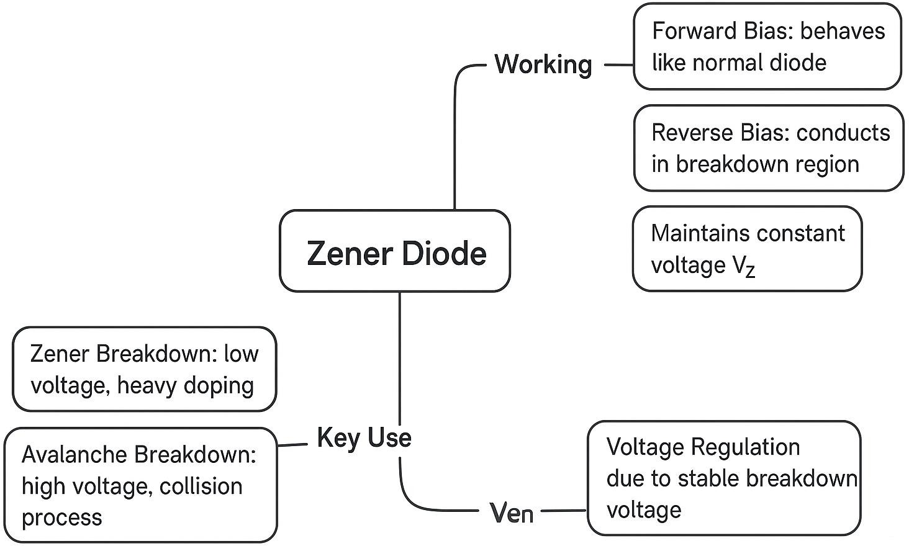
Summary

Slide 10
References
https://www.electronics-tutorials.ws/diode/diode_7.html
https://www.allaboutcircuits.com/textbook/semiconductors/chpt- 3/zener-diodes/
https://www.tutorialspoint.com/zener-diodes

Slide 11
Thank You

