Slide 1

SNS COLLEGE OF TECHNOLOGY
An Autonomous Institution Coimbatore-35
Department of Electronics and Communication Engineering
23EET103 Electric Circuits and Electron Devices
I B.E-AIDS/ II SEMESTER
UNIT IV : ELECTRONIC DEVICES AND APPLICATIONS
Topic : - Working principle and characteristics of BJT

Slide 2
Let’s Recall!!
Semiconductor basics – n-type and p-type materials and charge carriers (electrons and holes).
PN junction diode – depletion region, forward bias and reverse bias operation.
Current flow in semiconductors – movement of electrons and holes under applied voltage.

Slide 3
Topics for discussion
Introduction to BJT
Construction and Structure of BJT (Emitter, Base, Collector)
Types of BJT – NPN and PNP
Working Principle of BJT
Modes/Regions of Operation (Cutoff, Active, Saturation)
Input Characteristics of BJT
Output Characteristics of BJT
Basic Applications of BJT (Amplification and Switching)

Slide 4
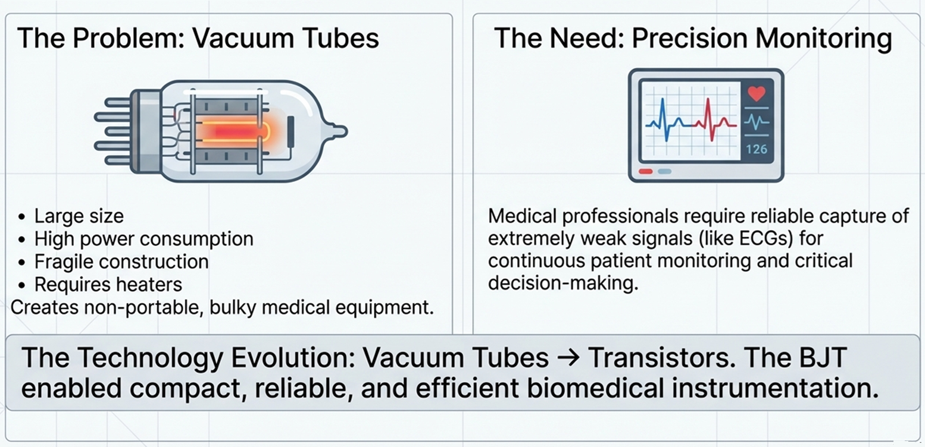
Why to Study BJT?DT-Empathize

Slide 5
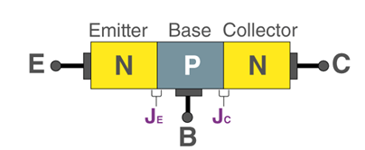
What is BJT
DT-DEFINE
Bipolar Junction Transistor (BJT) is a three-terminal semiconductor device.
It consists of two p–n junctions formed by three semiconductor regions.
The three terminals are Emitter, Base, and Collector.
BJT is a current-controlled device, where base current controls collector current.
A small input signal applied at the base produces a larger amplified signal at the collector.
Terminal | Symbol | Role
Emitter | E | Emits majority charge carriers; heavily doped
Base | B | Controls current; very thin and lightly doped
Collector | C | Collects carriers from emitter; moderately doped

Slide 6
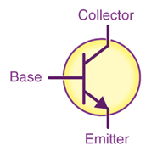
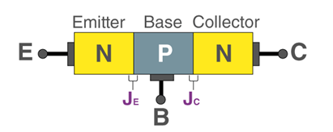
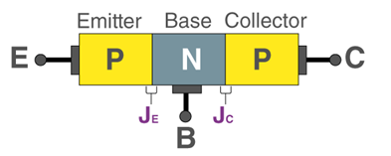
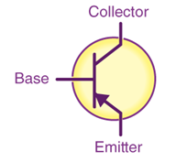
Types of BJT
NPN Transistor
Structure: N-type → P-type → N-type
Majority carriers: Electrons
Current direction: Collector → Emitter (conventional)
Turn ON condition: Positive base current required
PNP Transistor
Structure: P-type → N-type → P-type
Majority carriers: Holes
Current direction: Emitter → Collector (conventional)
Turn ON condition: Negative base current (current flows out of base)

Slide 7
Working of BJT
Step 1: Emitter-Base junction is forward biased → electrons from the emitter flood into the thin base region.
Step 2: Base is very thin → most electrons (~98%) do not recombine with holes; they diffuse through to the collector.
Step 3: Collector-Base junction is reverse biased → it sweeps electrons across, creating the collector current (I_{C}).
Step 4: A small base current (I_{B}) controls a large collector current (I_{C}), achieving current amplification (β = I_{C} / I_{B}).

Slide 8

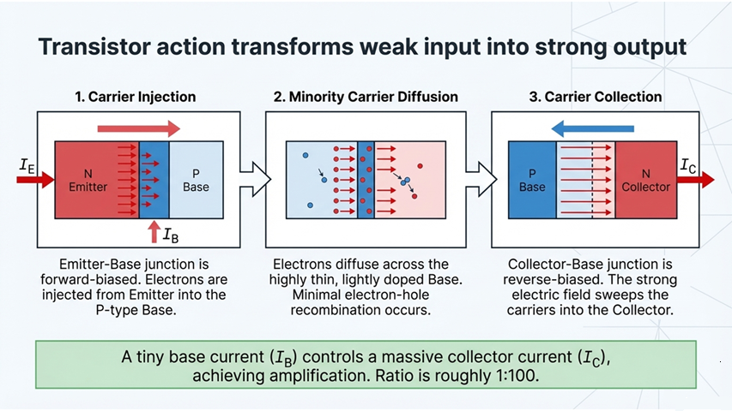

Slide 9
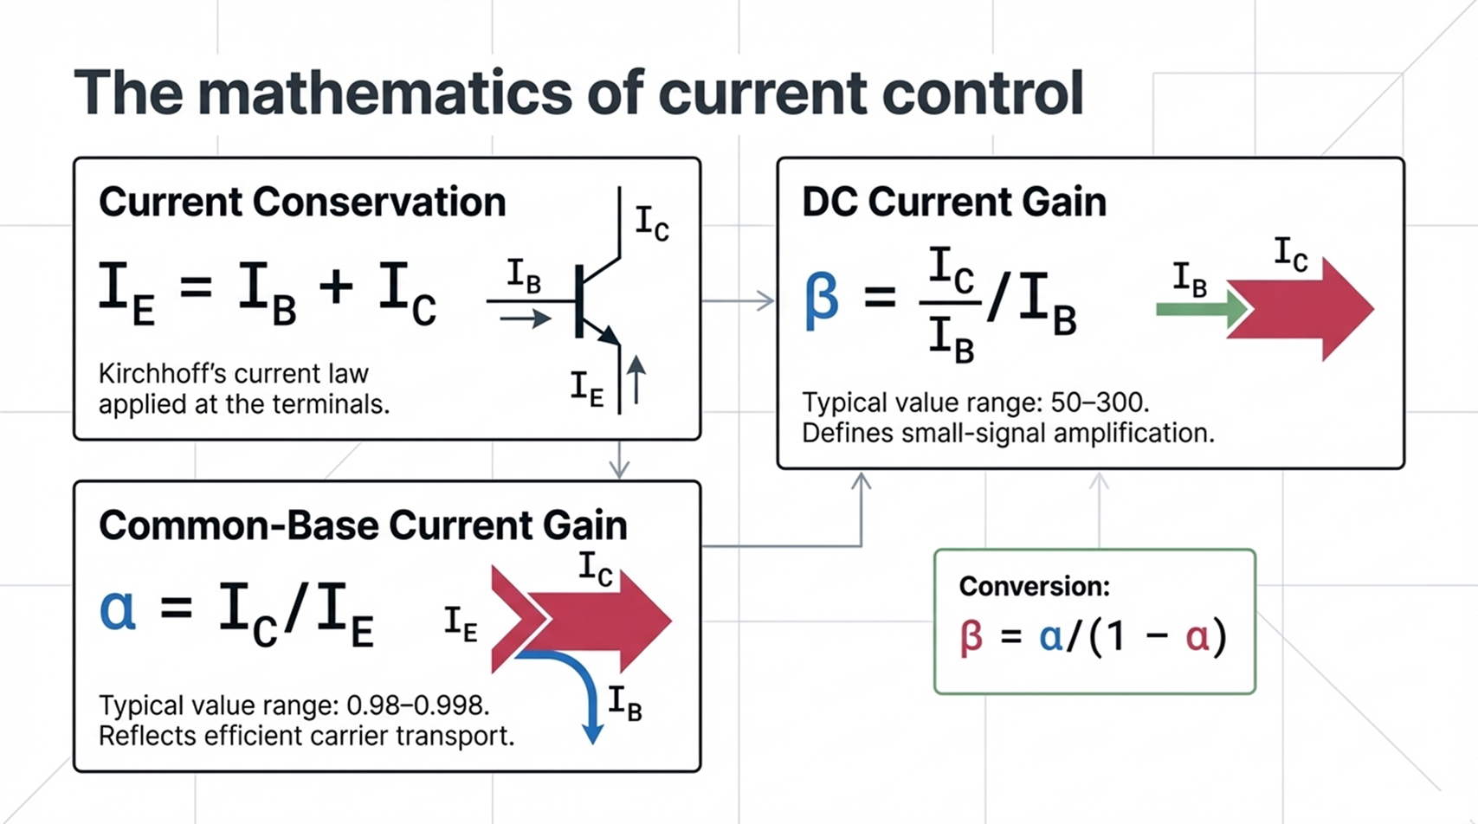
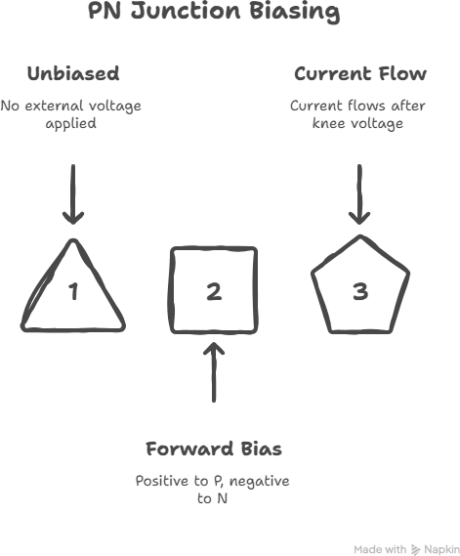
Ideate: Biasing a PN Junction
DT-IDEATE

Slide 10
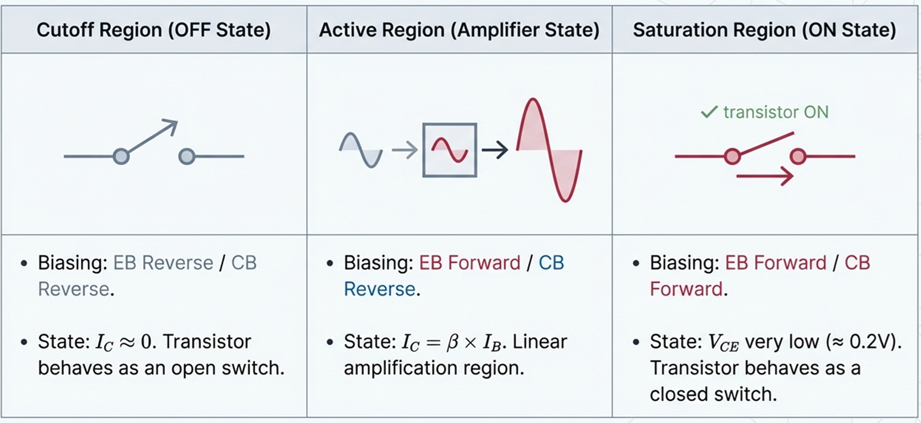
Regions of Operation

Slide 11
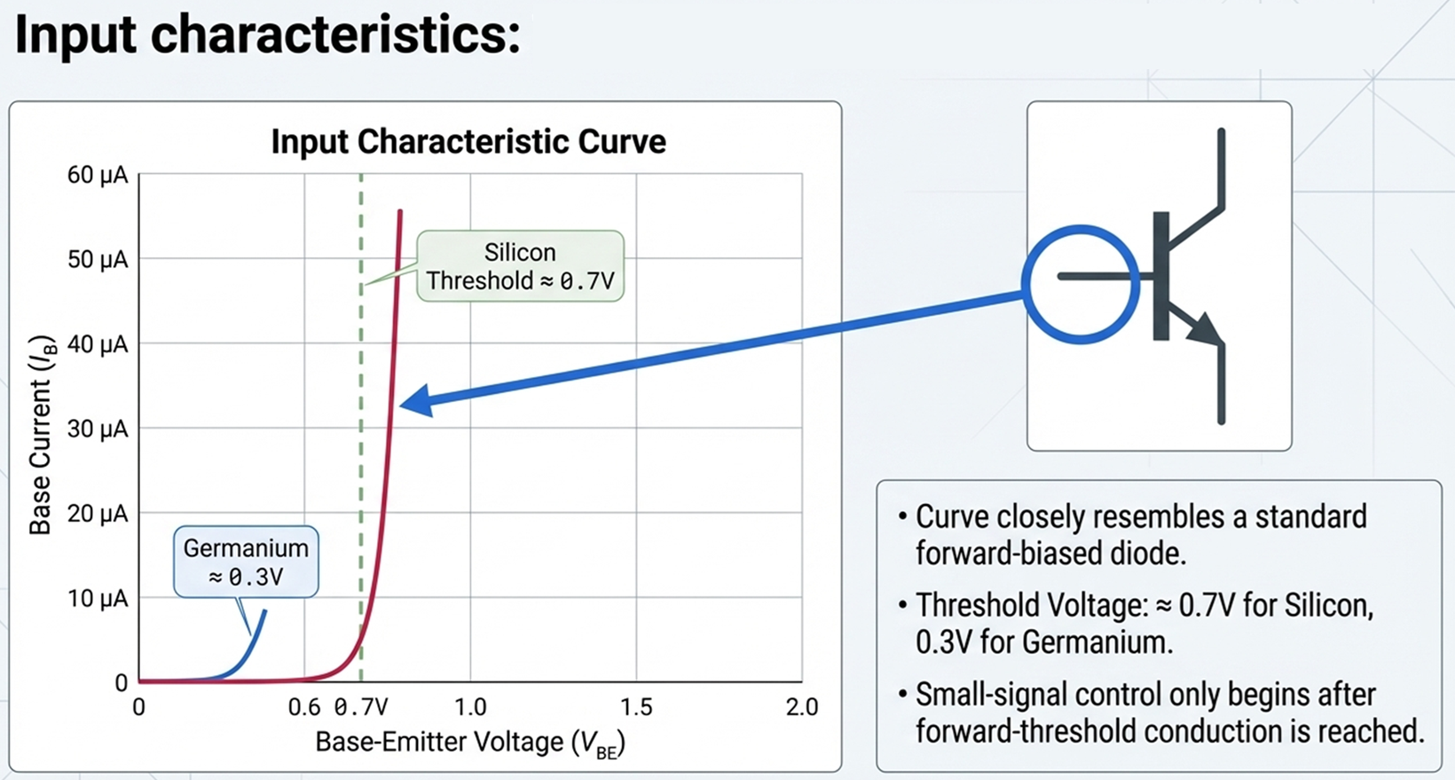

Slide 12
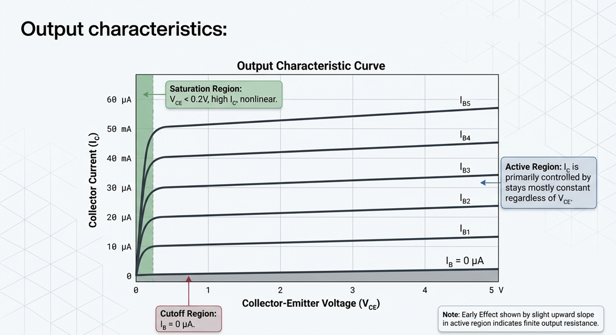

Slide 13
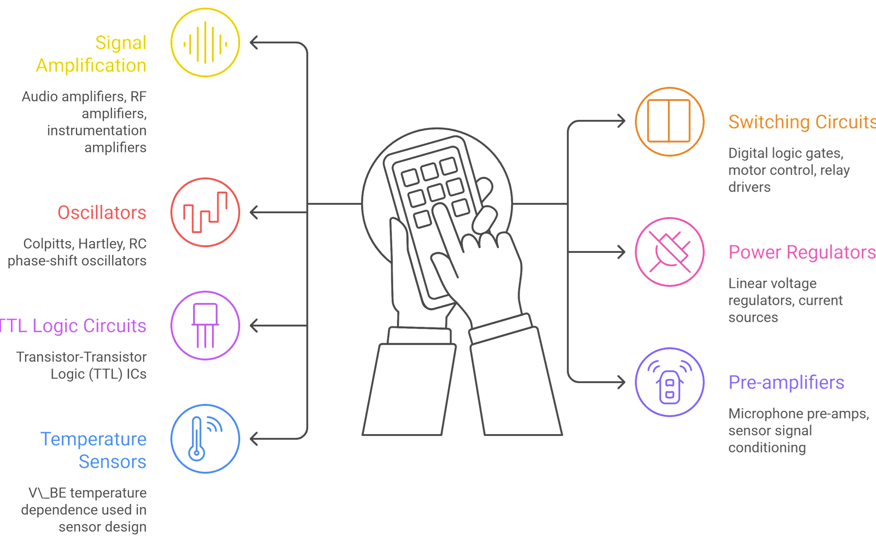
Applications of BJT
DT-IDEATE

Slide 14
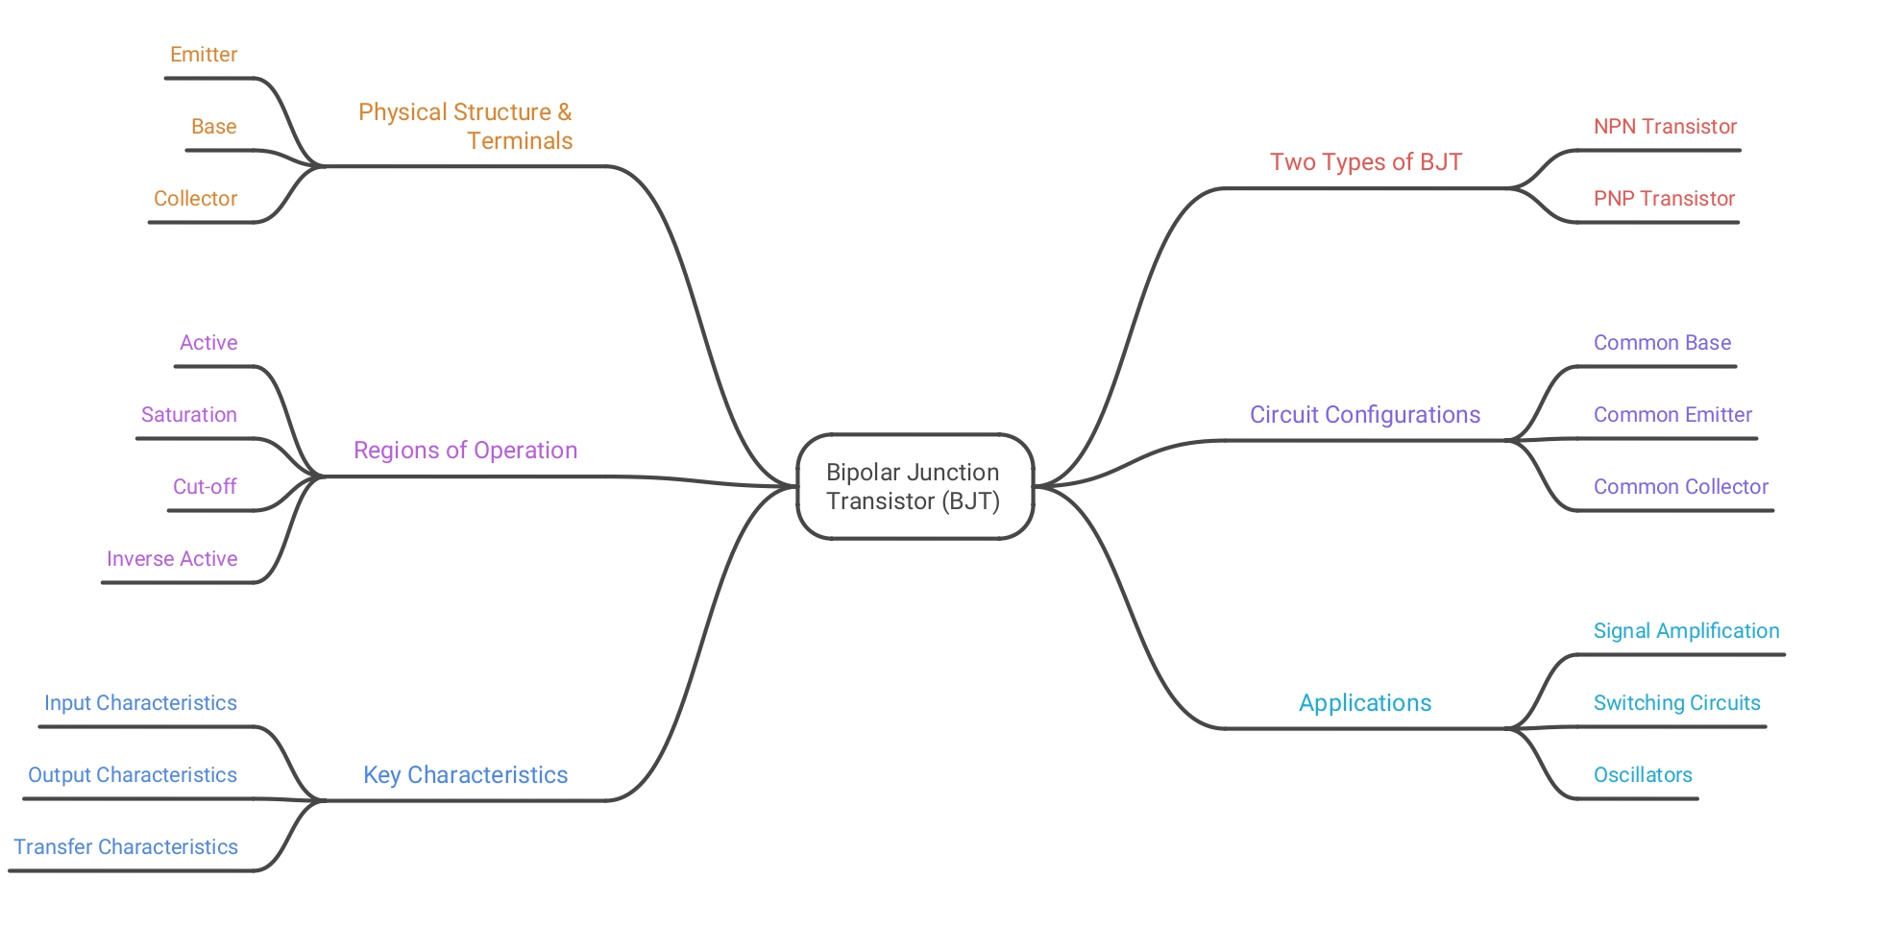
Summary
Let’s Summarize

Slide 15
References
All About Circuits – BJT Basics https://www.allaboutcircuits.com/textbook/semiconductors/chpt-4/bipolar-junction-transistors/
Electronics Tutorials – Bipolar Transistor https://www.electronics-tutorials.ws/transistor/tran_1.html
NPTEL Electronics Engineering Courses https://nptel.ac.in/courses/108
Khan Academy – Bipolar Junction Transistor https://www.khanacademy.org/science/electrical-engineering/ee-semiconductors/ee-bjt

Slide 16
Thank You

