Slide 1

SNS COLLEGE OF TECHNOLOGY
An Autonomous Institution Coimbatore-35
Department of Electronics and Communication Engineering
23EET103 Electric Circuits and Electron Devices
I B.E-AD-A/ II SEMESTER
UNIT IV : ELECTRONIC DEVICES AND APPLICATIONS
Topic : - Working principle and characteristics of JFET

Slide 2
Let’s Recall!!
Semiconductor basics – n-type and p-type materials and charge carriers (electrons and holes).
PN junction diode – depletion region, forward bias and reverse bias operation.
Current flow in semiconductors – movement of electrons and holes under applied voltage.

Slide 3
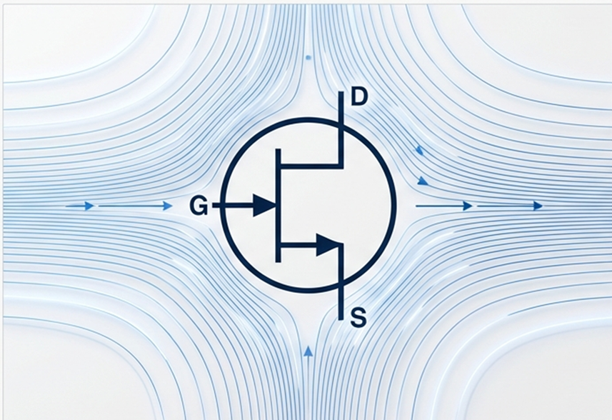
Topics for discussion
Introduction to JFET (Junction Field Effect Transistor)
Construction and Structure of JFET
Types of JFET – N-Channel and P-Channel
Working Principle of JFET
Pinch-Off Voltage and Channel Control
Regions of Operation (Ohmic, Saturation, Cutoff)
Drain Characteristics of JFET
Transfer Characteristics of JFET
Advantages of JFET (High Input Impedance, Low Noise)
Applications of JFET (Amplifiers, Switches, Buffer Circuits)

Slide 4
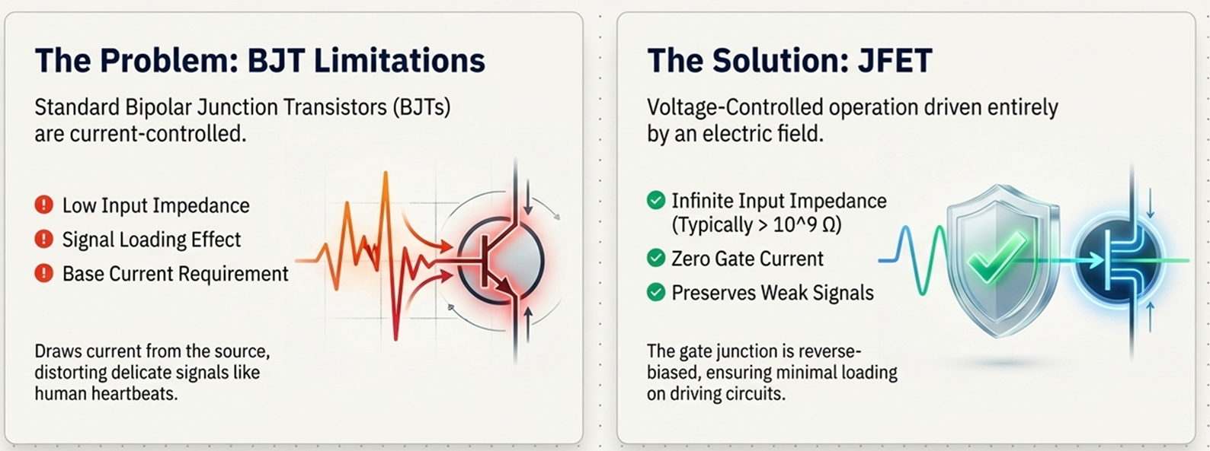
Why to Study JFET?DT-Empathize

Slide 5
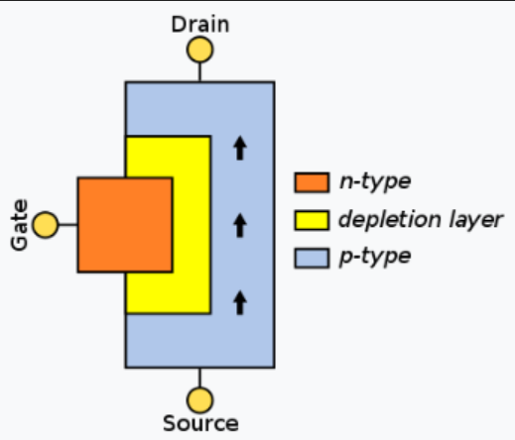
What is JFET
DT-DEFINE
JFET is a three-terminal semiconductor device consisting of Gate, Source, and Drain.
It is a voltage-controlled device, where the gate voltage controls the current flow in the channel.
JFET is a unipolar device, meaning current conduction occurs due to only one type of charge carrier (electrons or holes).
It controls current through a semiconductor channel using an electric field.
The gate is reverse biased, resulting in very high input impedance and nearly zero gate current.
Terminal | Symbol | Role
Gate | G | Controls current flow via electric field
Source | S | Entry point of charge carriers
Drain | D | Exit point of charge carriers

Slide 6
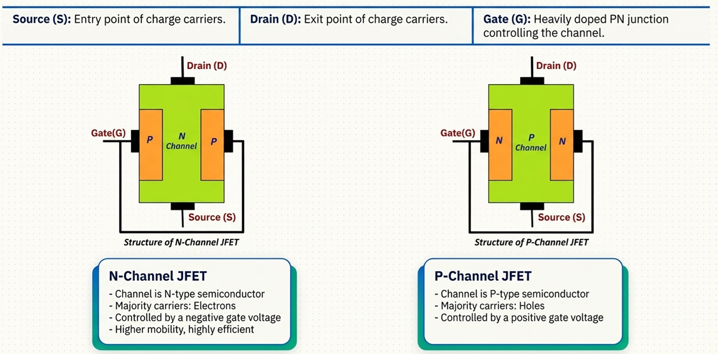
Types of JFET

Slide 7
Working of JFET
Step 1 — No Bias (V_{GS} = 0)
When V_{GS} = 0 and a small V_{DS} is applied, maximum drain current (I_{DSS}) flows from Drain to Source. The depletion region is very small, allowing full channel conduction.
Step 2 — Negative Gate Voltage Applied (V_{GS} < 0)
A negative voltage at the Gate reverse-biases the PN junction, causing the depletion region to widen. This "squeezes" the channel, increasing its resistance and reducing drain current (I_{D}).
Step 3 — Pinch-Off (V_{GS} = V_{P})
When V_{GS} reaches the Pinch-Off Voltage (V_{P}), the depletion regions meet at the center of the channel — the channel is completely blocked and I_{D} → 0. This is the Cut-off region.

Slide 8
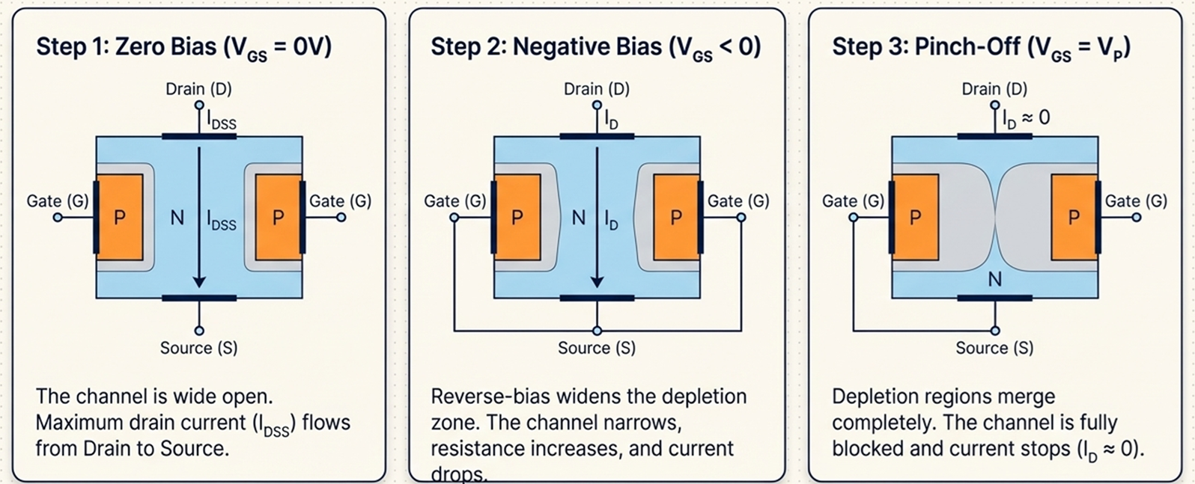
Working of JFET

Slide 9
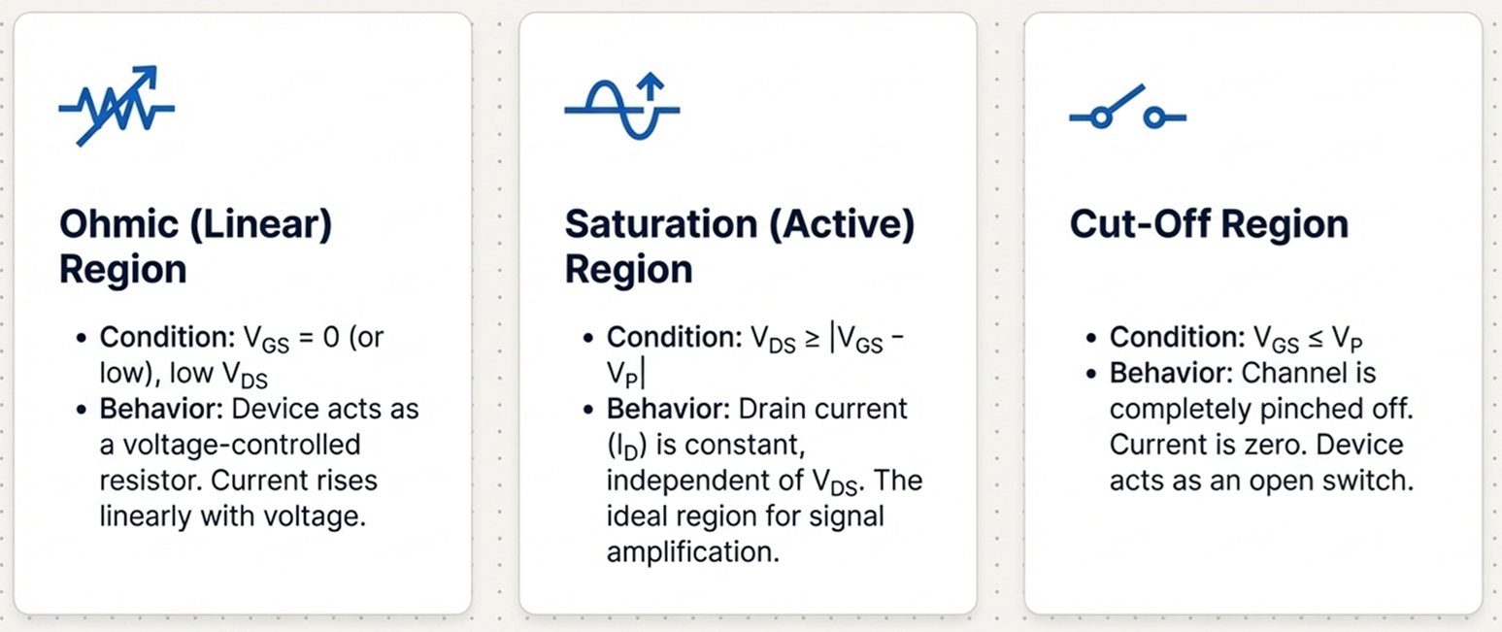
Regions of Operation

Slide 10

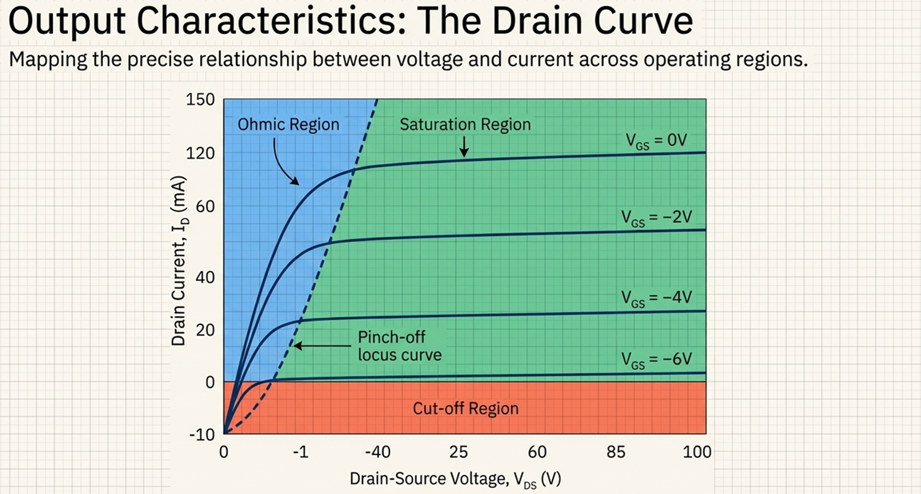

Slide 11
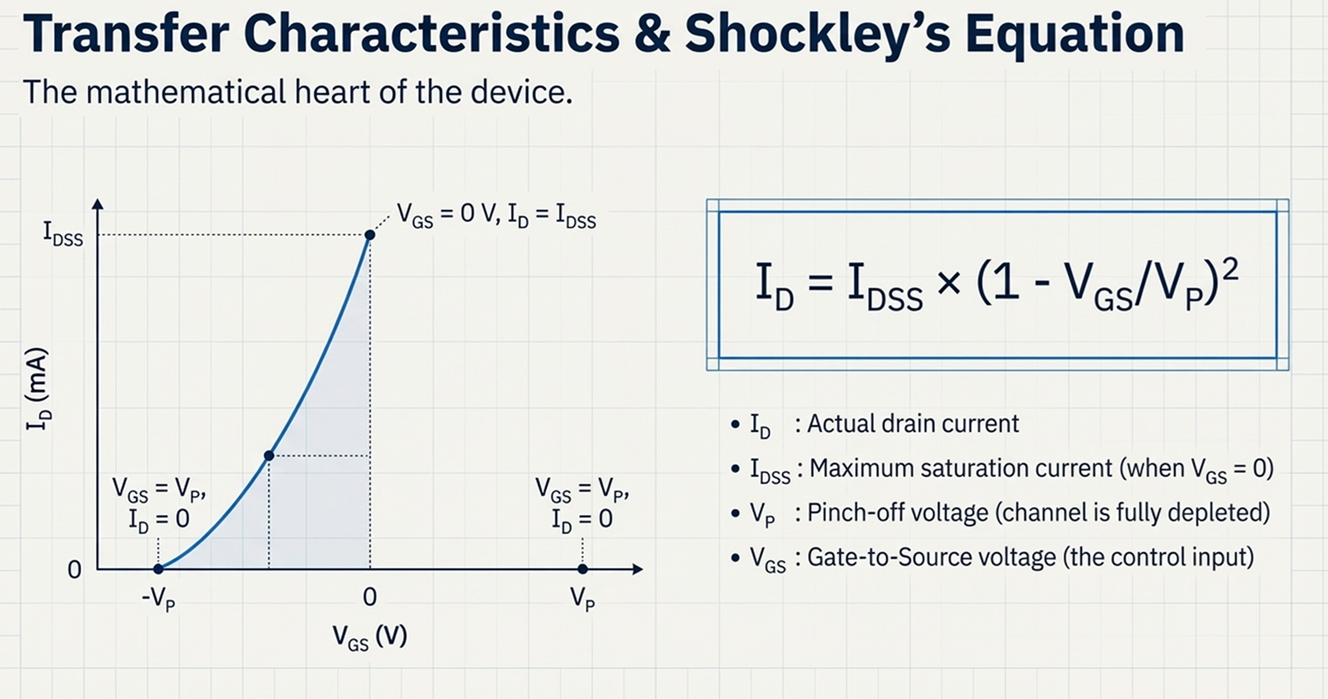

Slide 12
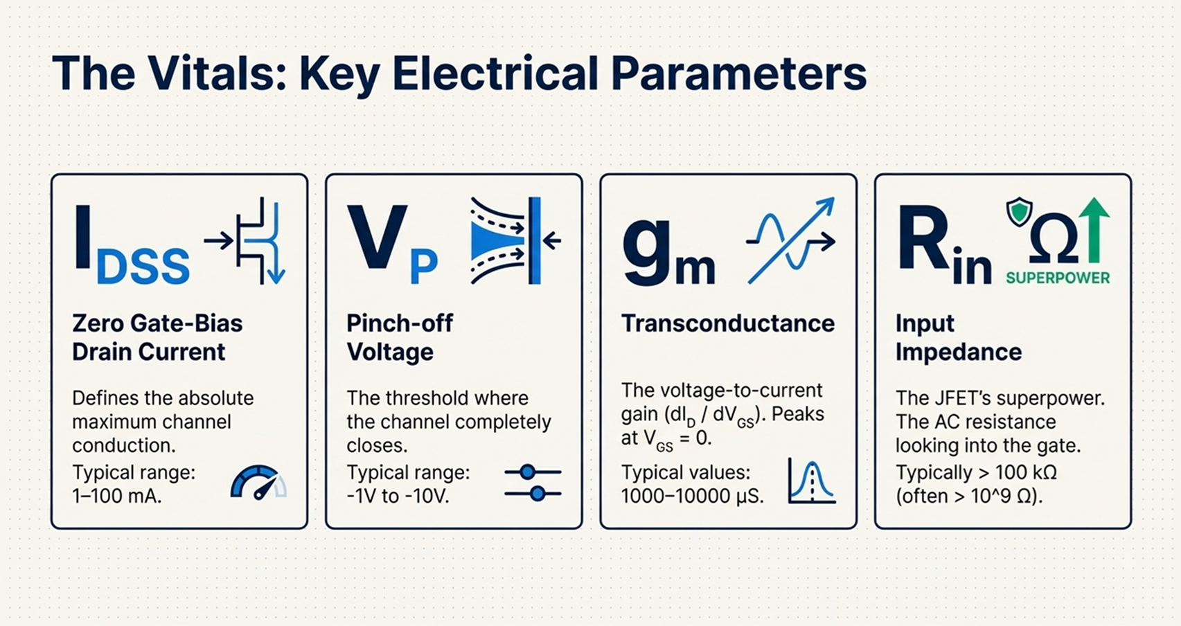

Slide 13
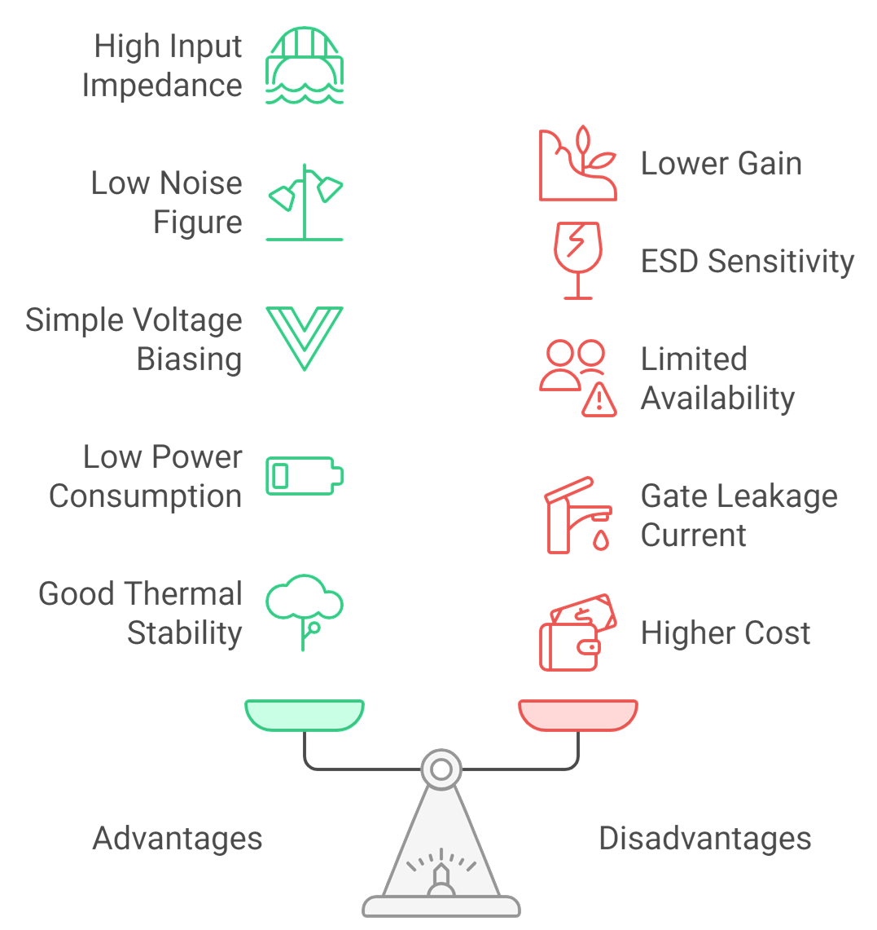
Trade Off’s

Slide 14
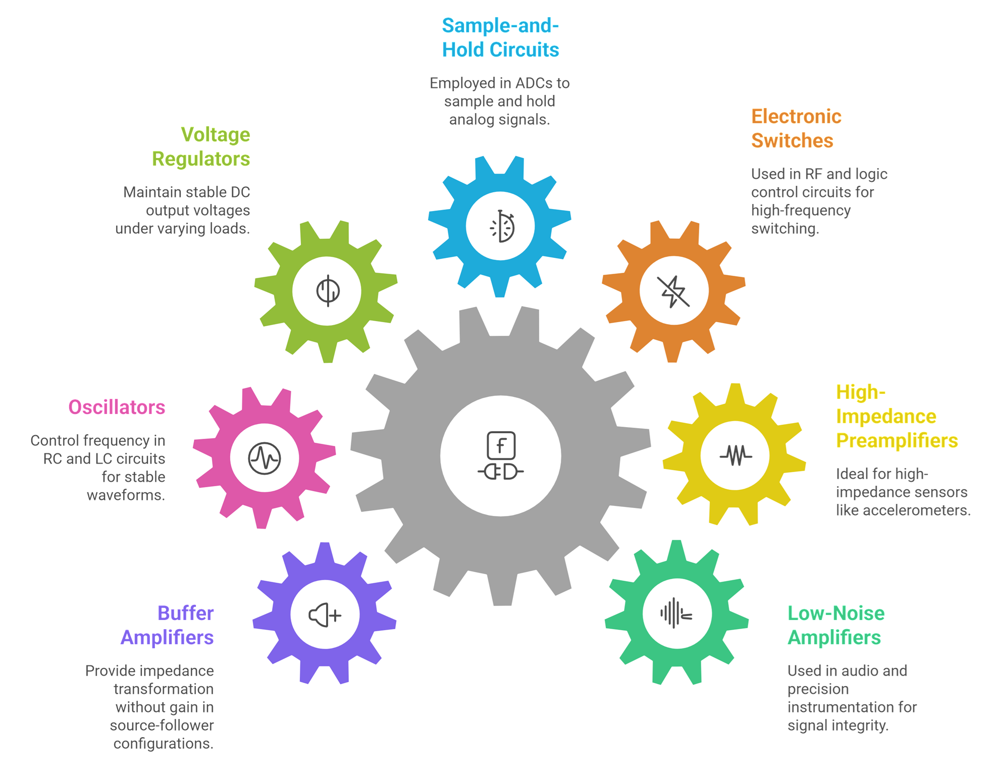
Applications of JFET
DT-IDEATE

Slide 15
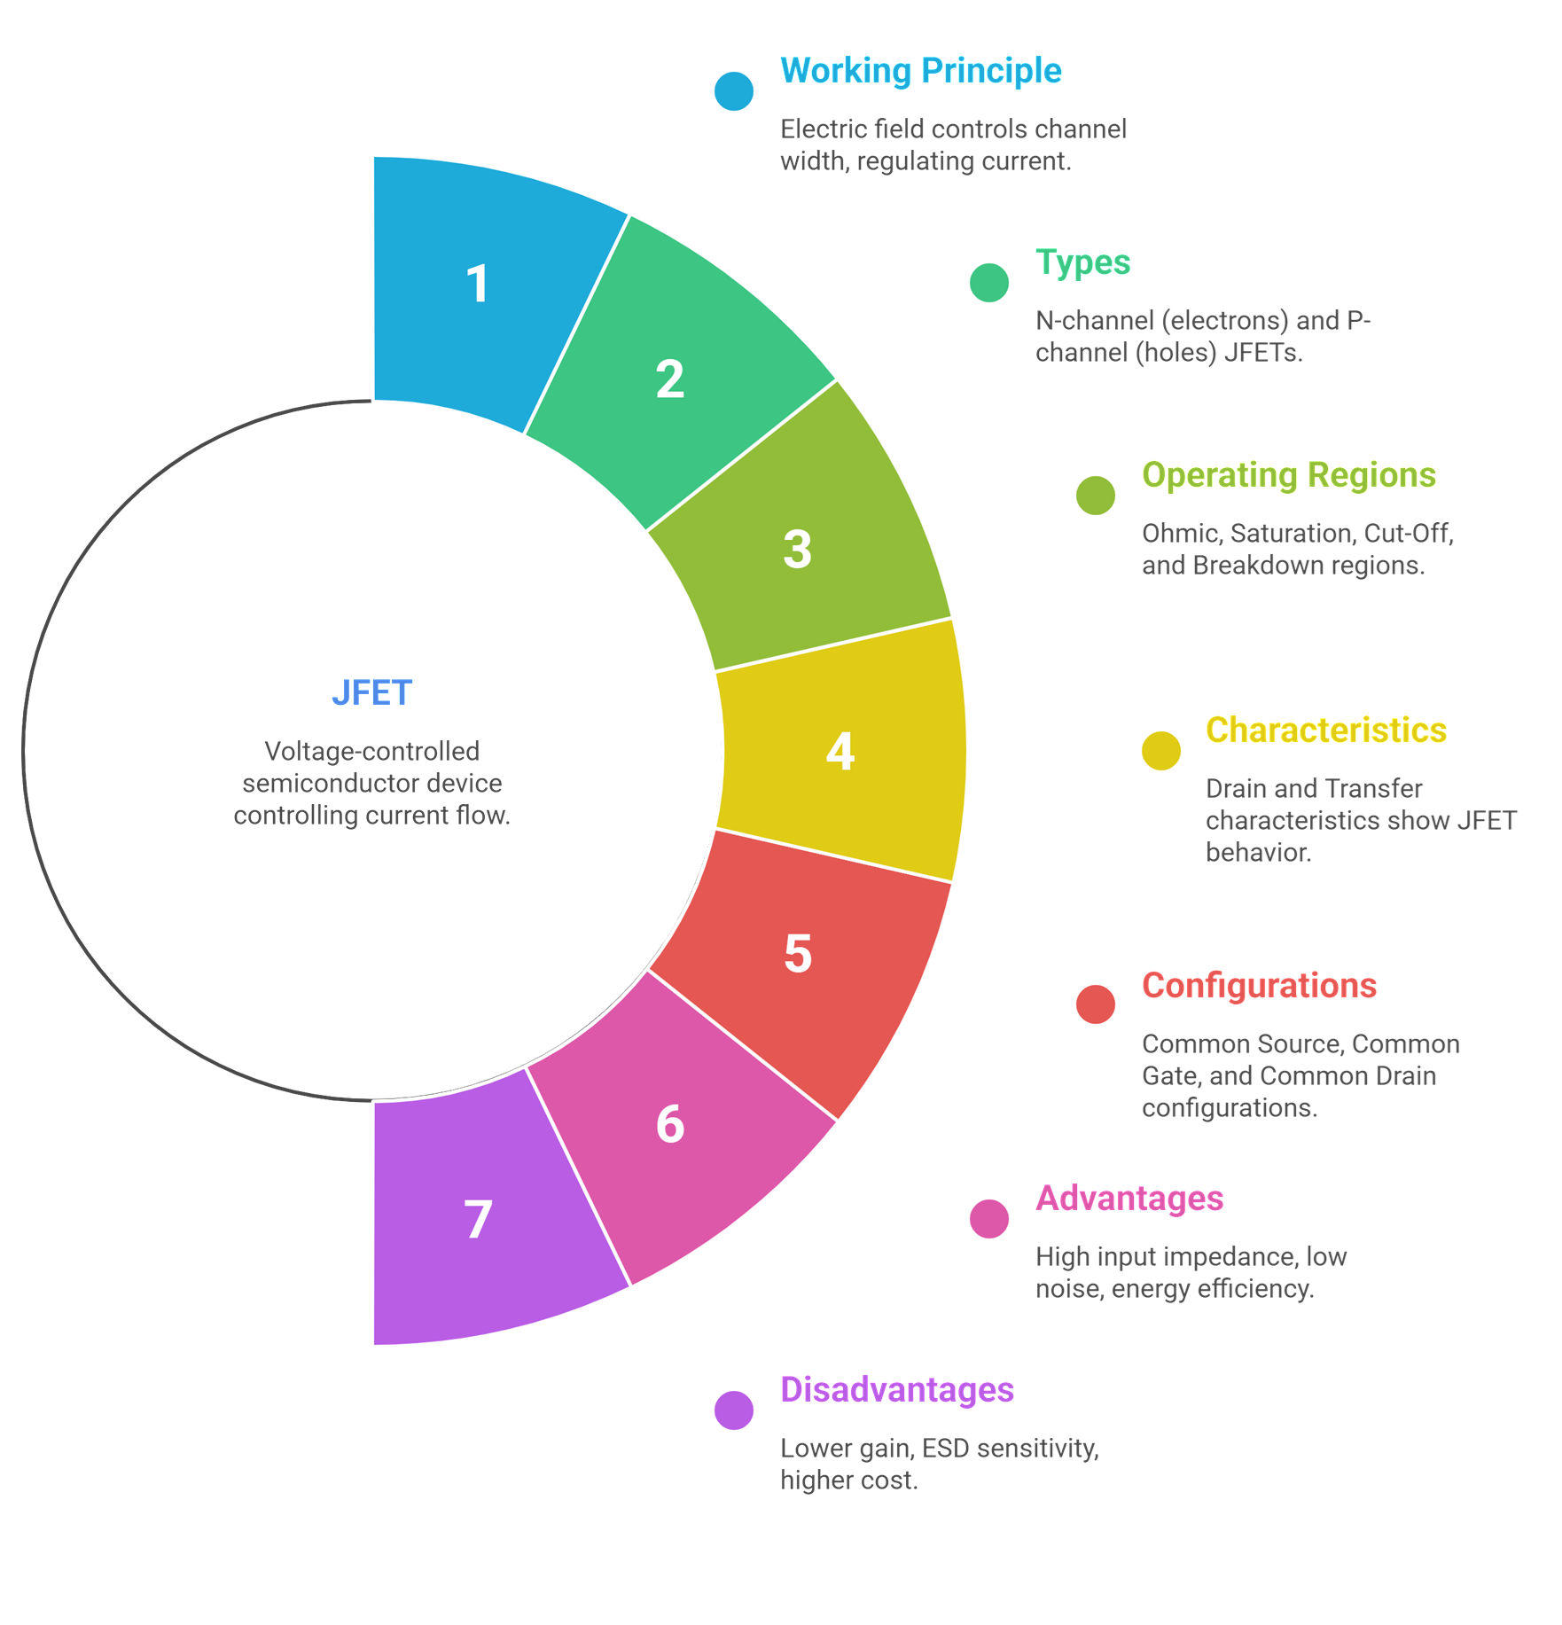
Summary
Let’s Summarize

Slide 16
References
https://www.electronics-tutorials.ws/transistor/tran_5.html
https://www.allaboutcircuits.com/textbook/semiconductors/chpt-5/junction-field-effect-transistors-jfet/
https://www.tutorialspoint.com/electronic_devices/electronic_devices_jfet.htm
https://www.elprocus.com/jfet-junction-field-effect-transistor/
https://www.electronicshub.org/jfet-junction-field-effect-transistor/
https://www.geeksforgeeks.org/junction-field-effect-transistor-jfet/

Slide 17
Thank You

