Slide 1

SNS COLLEGE OF TECHNOLOGY
An Autonomous Institution Coimbatore-35
Department of Electronics and Communication Engineering
23EET103 Electric Circuits and Electron Devices
I B.E-AIDS/ II SEMESTER
UNIT IV : ELECTRONIC DEVICES AND APPLICATIONS
Topic : - Working principle and characteristics of MOSFET

Slide 2
Let’s Recall!!
Semiconductor basics – n-type and p-type materials and charge carriers (electrons and holes).
PN junction diode – depletion region, forward bias and reverse bias operation.
FET fundamentals – Basic idea of voltage-controlled devices and channel conduction.

Slide 3
Topics for discussion
Introduction to MOSFET (Metal Oxide Semiconductor Field Effect Transistor)
Construction and Structure of MOSFET
Types of MOSFET – Enhancement Mode and Depletion Mode
N-Channel and P-Channel MOSFET
Working Principle of MOSFET
Operating Regions (Cut-off, Linear/Ohmic, Saturation)
Drain Characteristics of MOSFET
Transfer Characteristics of MOSFET
Advantages of MOSFET (High input impedance, fast switching)
Applications of MOSFET (Amplifiers, Switching circuits, Power electronics)

Slide 4
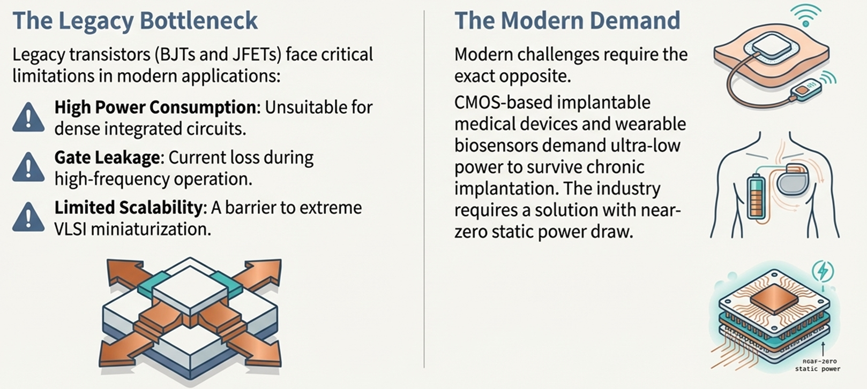
Why to Study MOSFET?DT-Empathize

Slide 5
What is MOSFET
DT-DEFINE
MOSFET (Metal Oxide Semiconductor Field Effect Transistor) is an electronic device used for switching and amplifying signals in circuits.
It is a voltage-controlled device, where the gate voltage controls the current flow between terminals.
MOSFET is widely used in digital and analog electronic circuits.
A MOSFET generally has four terminals.
Terminal | Symbol | Function
Gate | G | Controls channel formation via electric field through oxide
Source | S | Origin of majority carriers — defines reference potential
Drain | D | Destination of majority carriers — collects current
Body/Bulk | B | Semiconductor body — often connected to Source

Slide 6
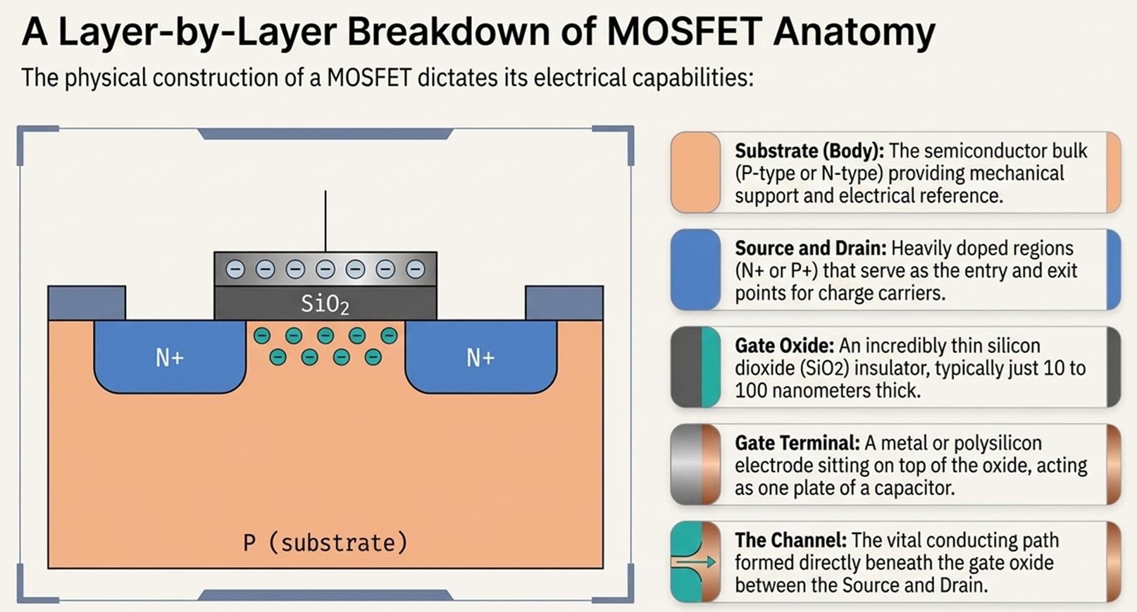


Slide 7
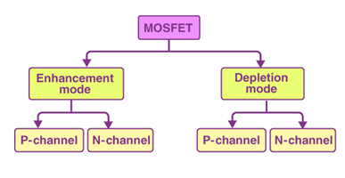
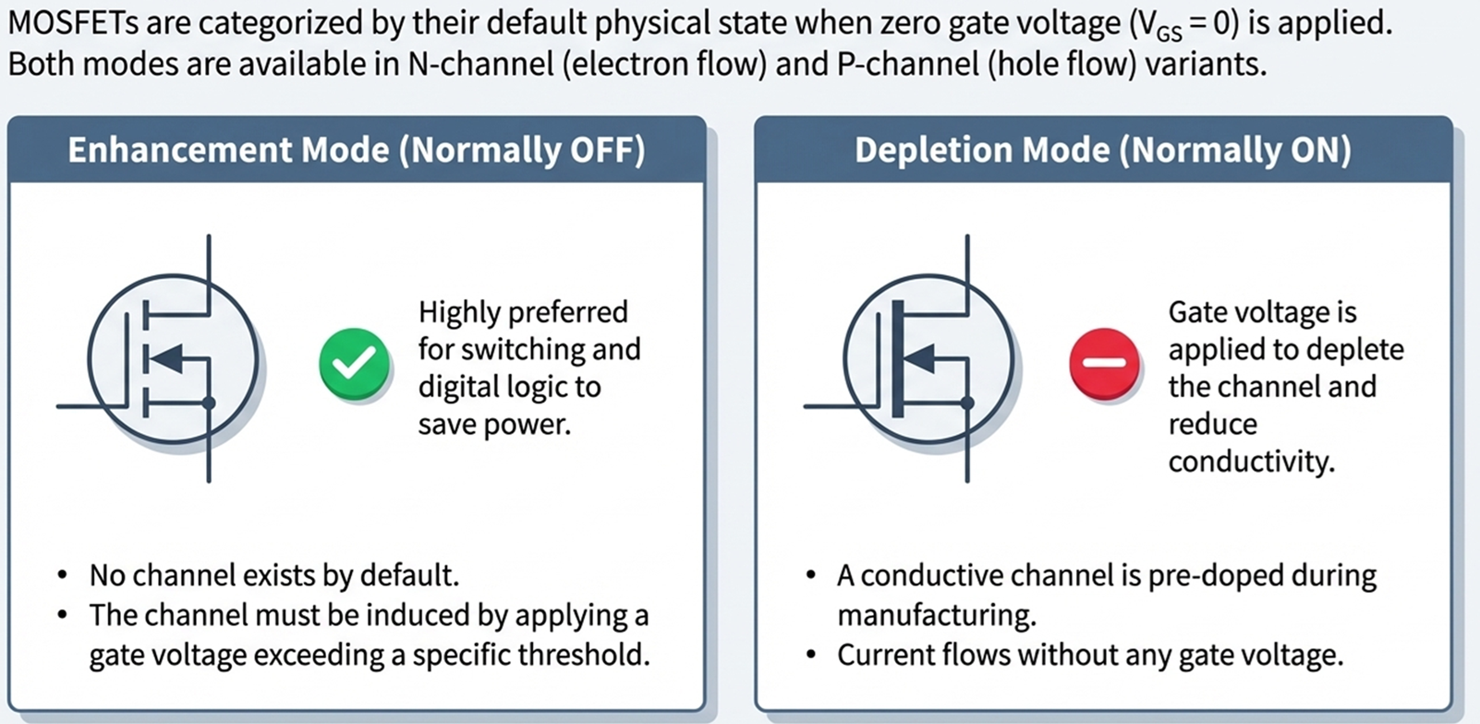
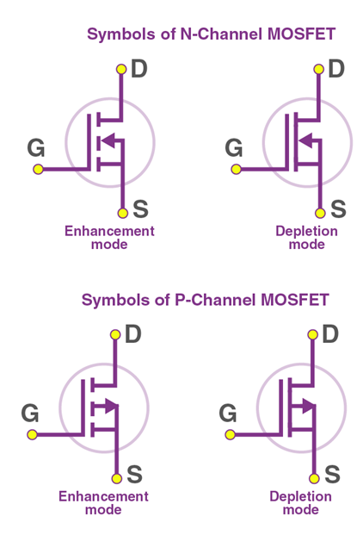
Types of MOSFET

Slide 8
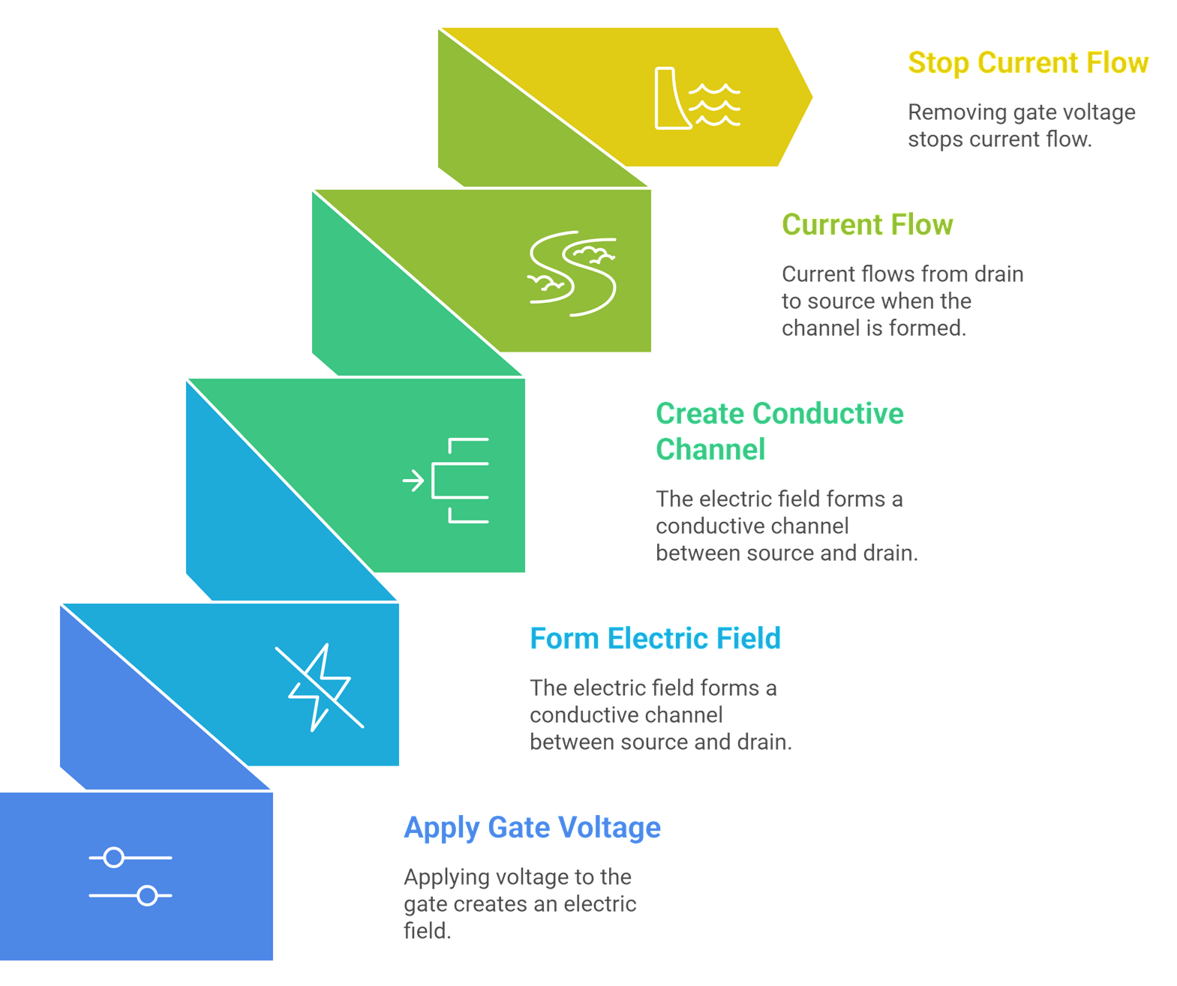
Working of MOSFET

Slide 9
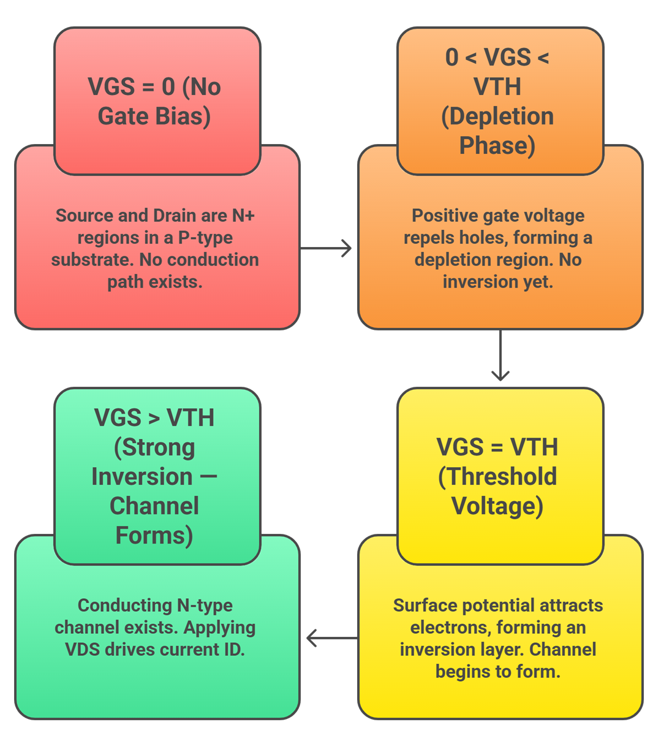
Working of Enhancement Mode MOSFET (N-Channel)

Slide 10
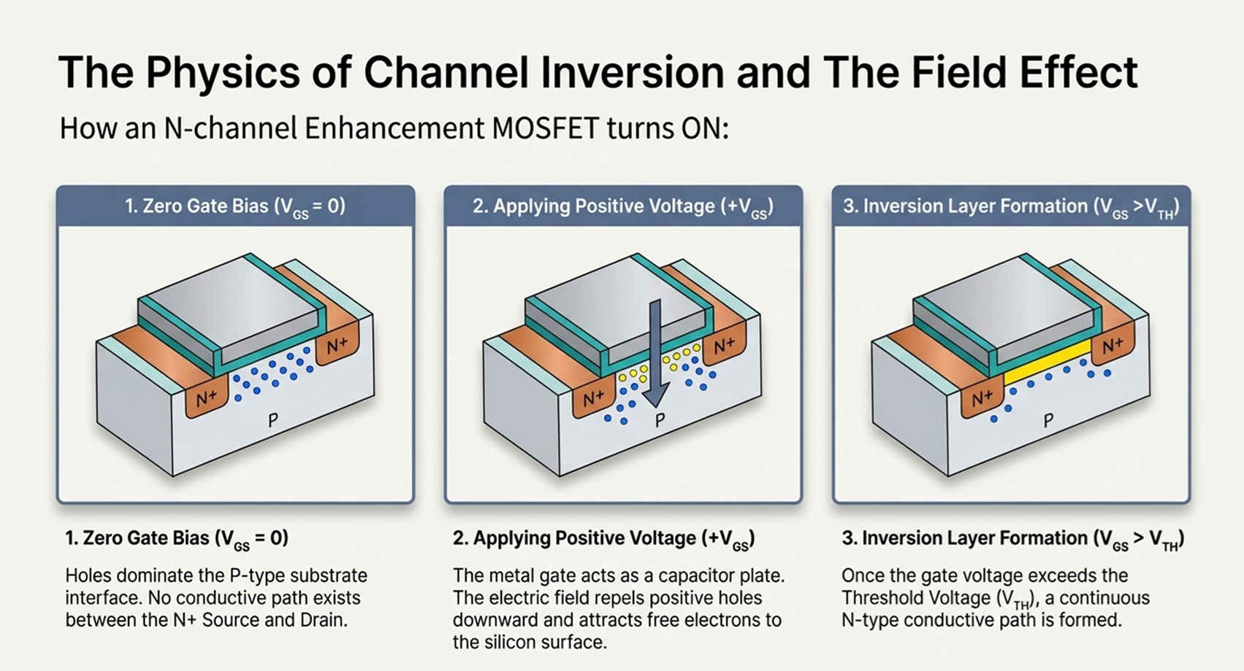

Slide 11
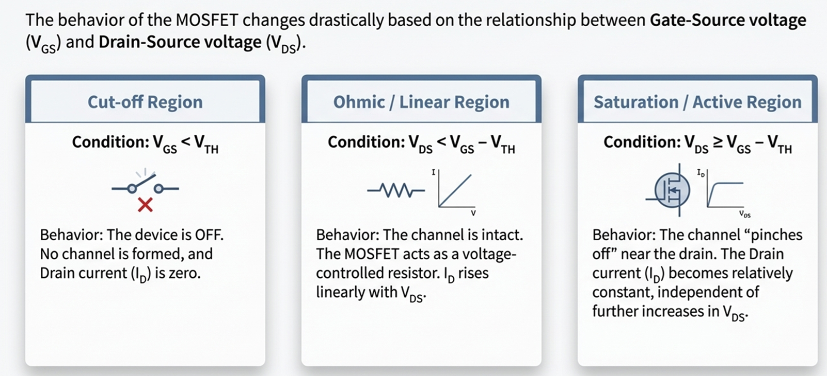
Regions of Operation

Slide 12
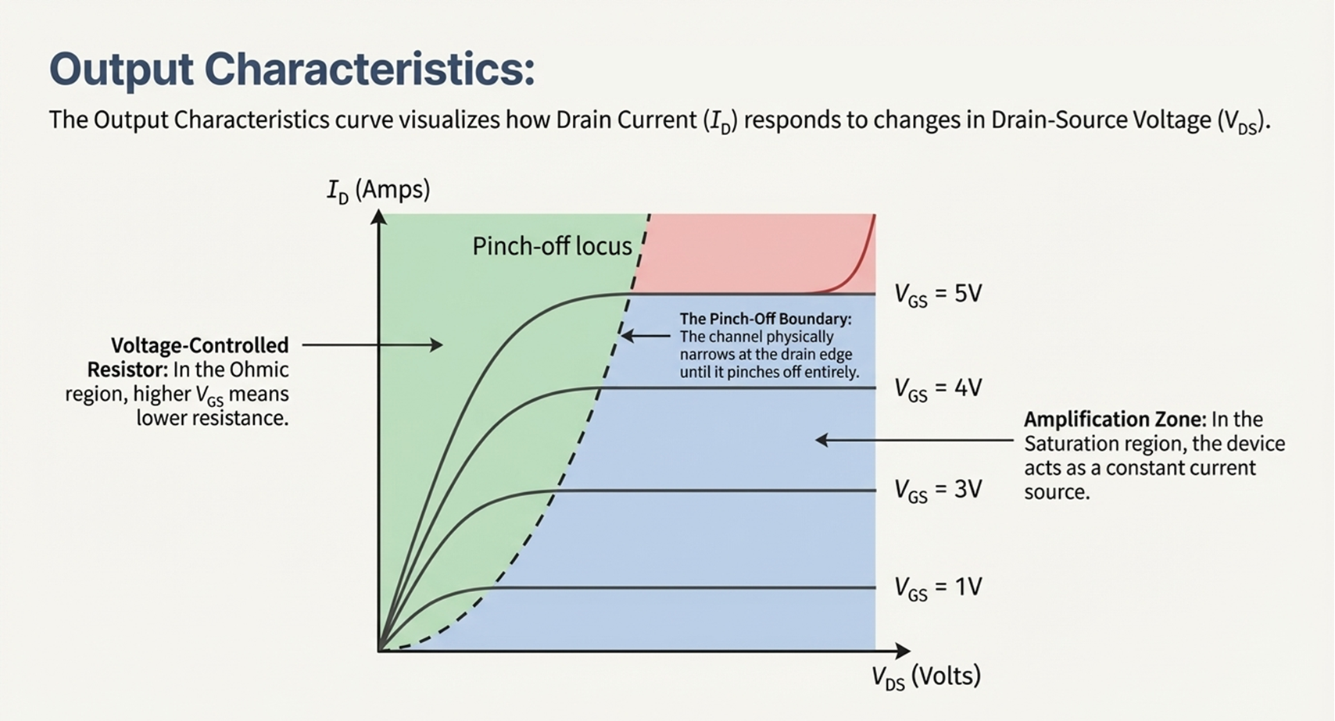

Slide 13
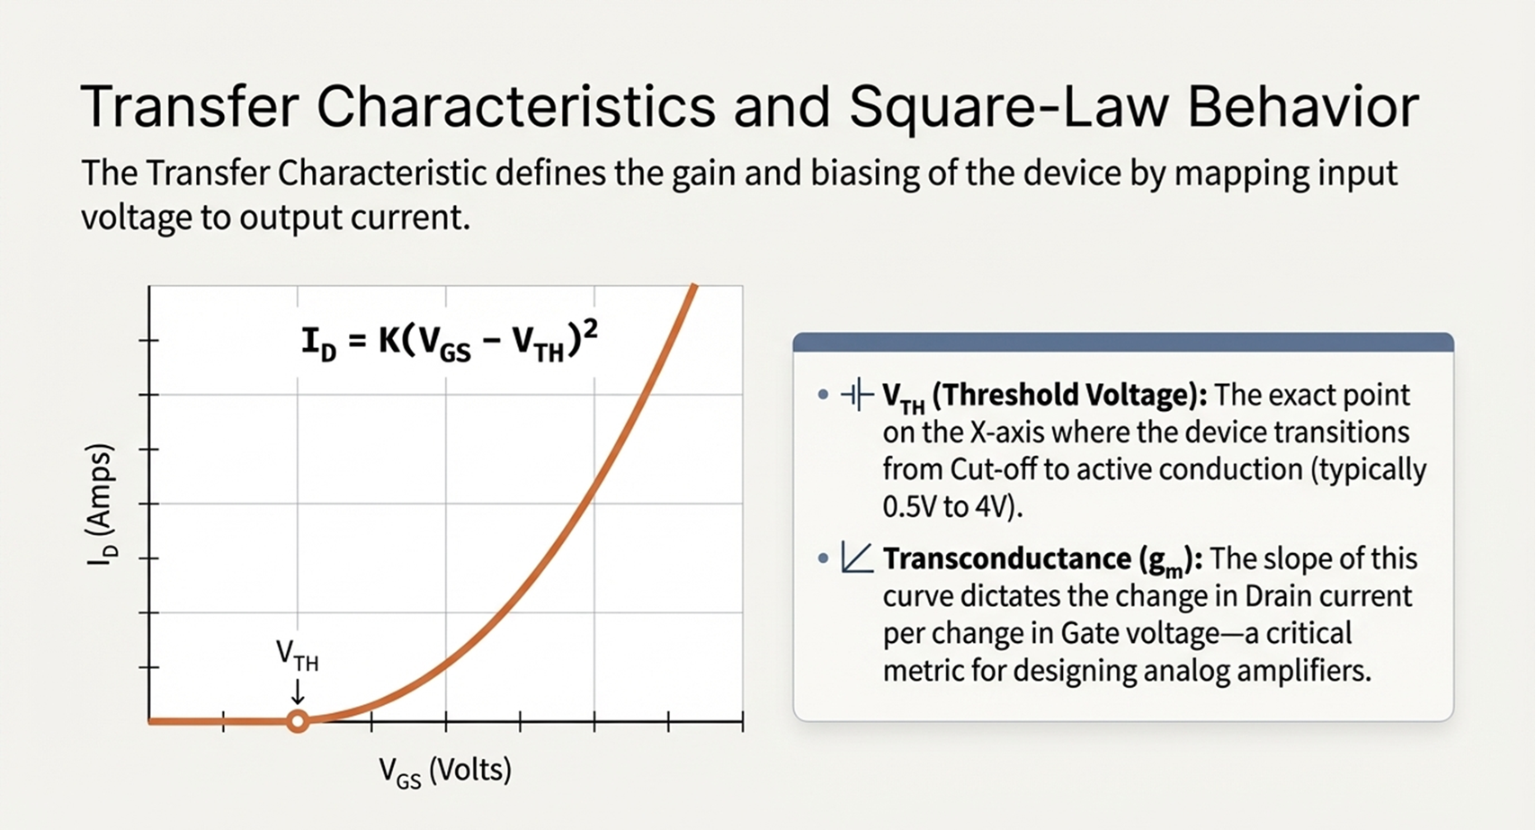

Slide 14
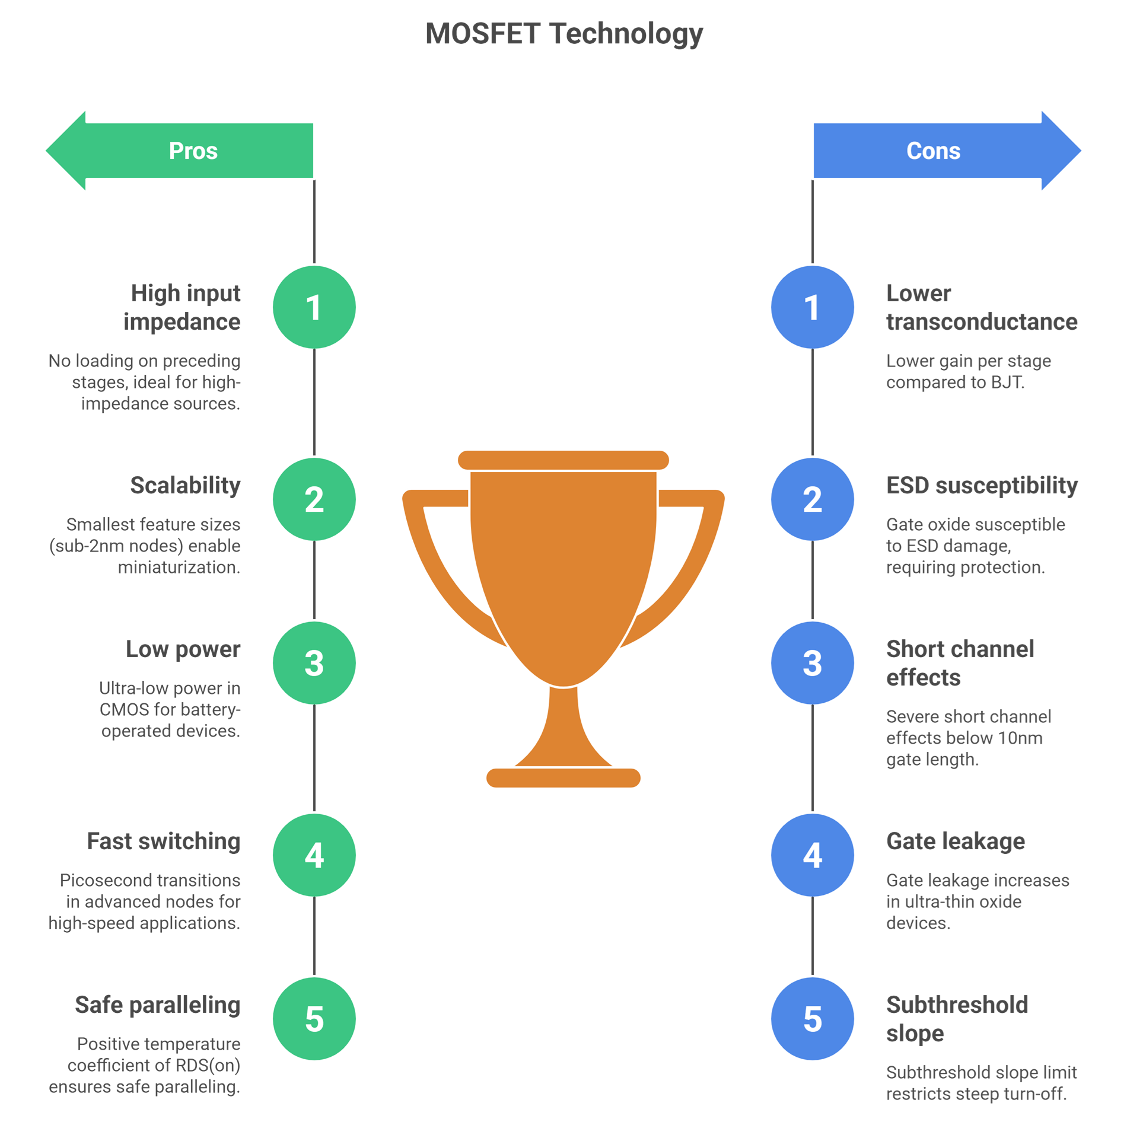

Slide 15
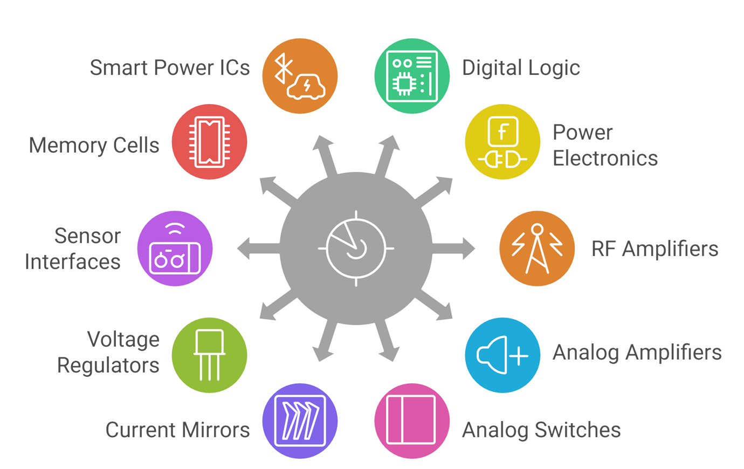
Applications of MOSFET
DT-IDEATE

Slide 16
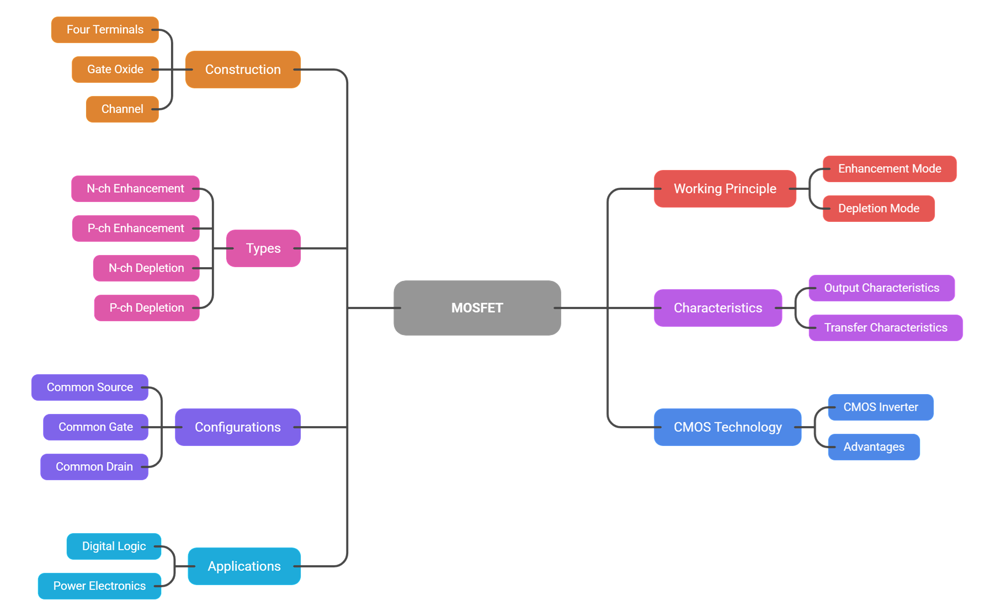
Summary
Let’s Summarize

Slide 17
References
https://www.electronics-tutorials.ws/transistor/tran_7.html
https://www.electrical4u.com/mosfet-working-principle-of-p-channel-n-channel-mosfet/
https://www.geeksforgeeks.org/electronics-engineering/mosfet/
https://www.tutorialspoint.com/basic_electronics/basic_electronics_mosfet.htm

Slide 18
Thank You

