Slide 1
SNS College of Technology (An Autonomous Institutions)
Department of Computer Science and Engineering
23CSB201-Object Oriented Programming
Topic: Abstract Class
Mrs.G.Devi
Assistant Professor

Slide 2
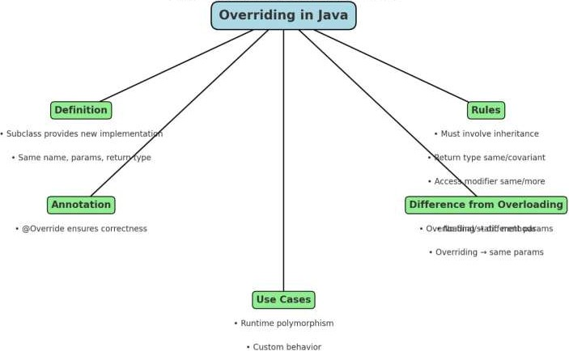
Recall
10/24/2025
2/18

Slide 3
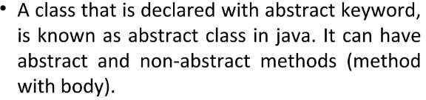
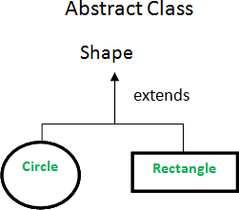
Abstract class

Slide 4
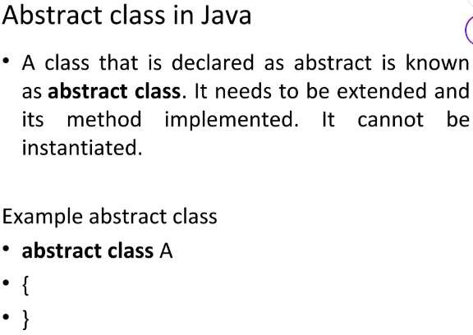
Abstract class

Slide 5
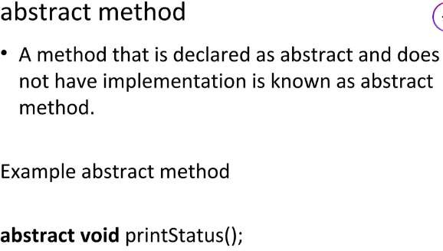
Abstract Method

Slide 6
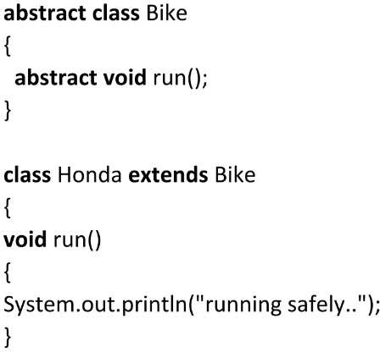
Example

Slide 7
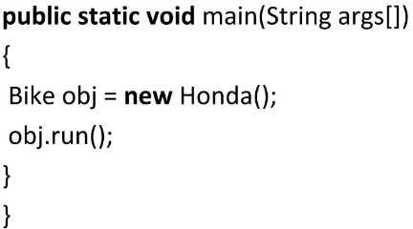
Example

Slide 8
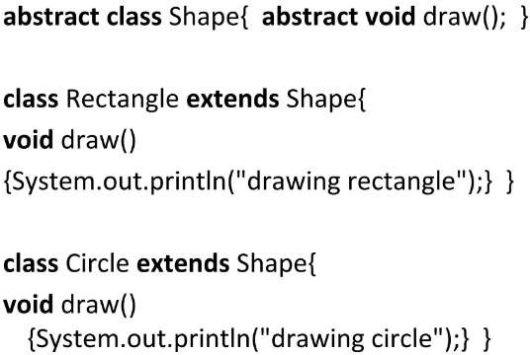
Example

Slide 9
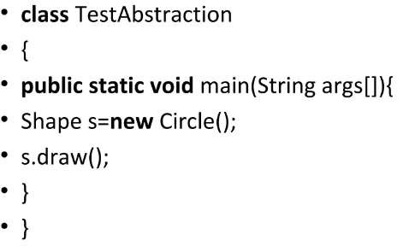
Example

Slide 10
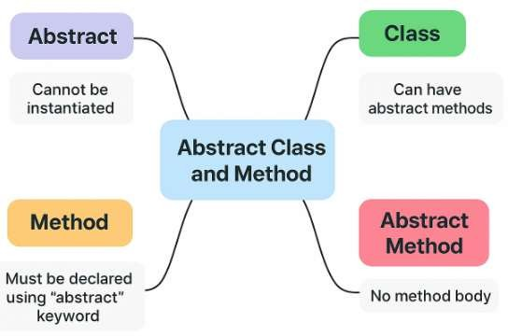
Mind Map

Slide 11
PUZZLE
Design an abstract class Shape with one abstract method area() and one non-abstract method displayArea() that prints "Area of
<Shape>: " before calling area().
Derive classes Circle, Square, and Triangle, implement area()
accordingly, and analyze:
Which class controls the output sequence?
Why abstract class is better than interface in this scenario?

Slide 12
Reference
Herbert Schildt, “Java: The Complete Reference”, 11th Edition, McGraw Hill
Education, New Delhi, 2019
Cay S. Horstmann, “Core Java Fundamentals”, Volume 1, 11th Edition, Prentice Hall, 2018

