Slide 1
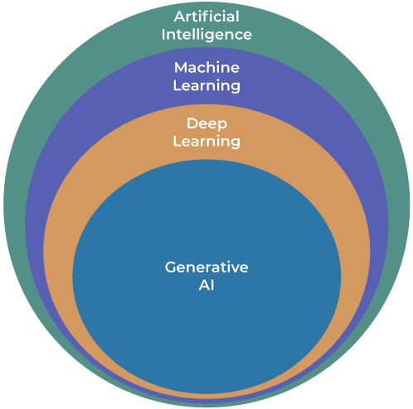
SNS COLLEGE OF TECHNOLOGY An Autonomous Institution
Coimbatore-35
Basics of Generative AI
UNIT I
INTRODUCTION TO GENERATIVE AI

Slide 2
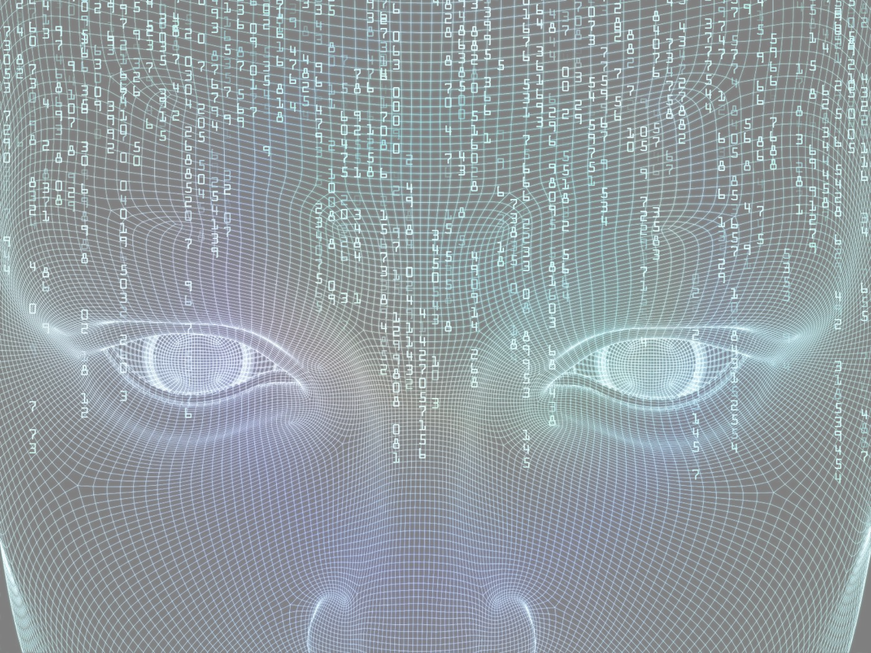



What do you think Artificial Intelligence is?

Slide 3

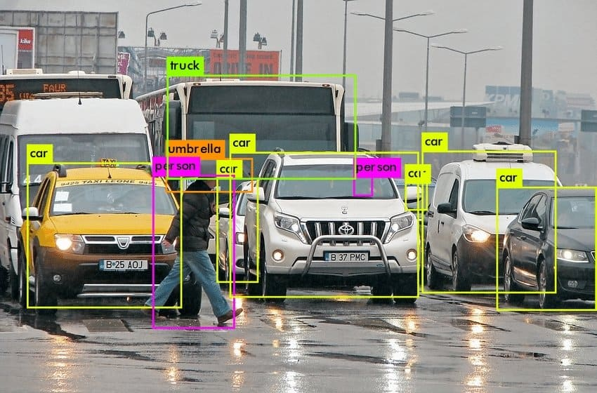
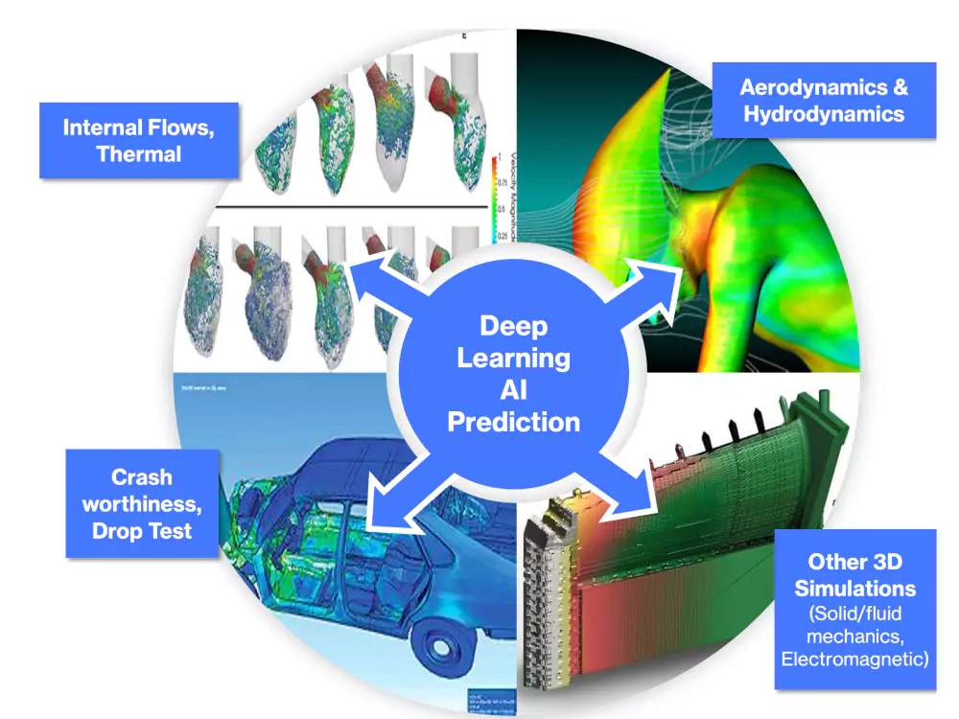
What is Artificial Intelligence?
Artificial Intelligence (AI) refers to systems designed to mimic human cognitive abilities such as learning, reasoning, perception, and decision-making. These systems process data, identify patterns, and make informed choices without explicit programming for every scenario.
Recommendation Systems
Image Recognition
Identifying objects, faces, and patterns in visual data with high accuracy
Personalized content suggestions based on user behavior and preferences
Predictive Analytics
Forecasting future outcomes using historical data and statistical models

Slide 4
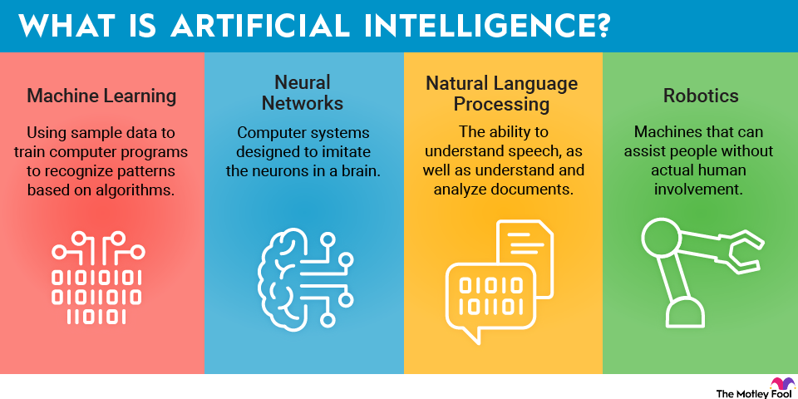

Slide 5




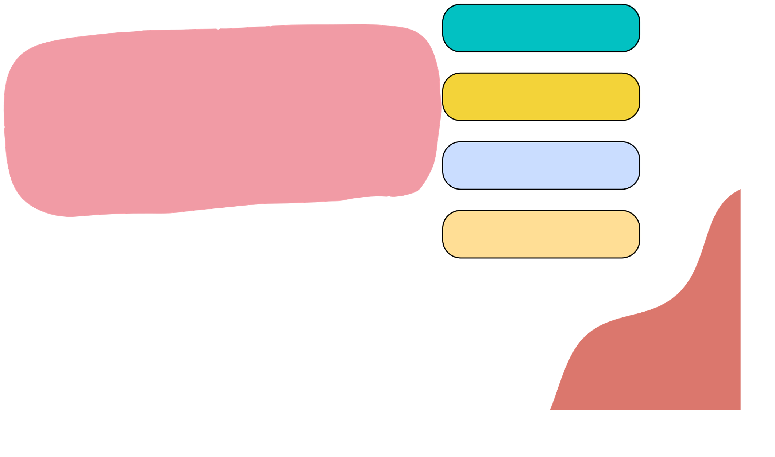






EXAMPLES
AI can be used for various situations, but these are some examples of AI in our daily life.
Virtual Assistance
Recommendation systems
Autonomous
vehicles
Navigation apps
Chatbots
Facial recognition
E-commerce
Text editors

Slide 6



How does Machine Learning Relate to AI?
Although the terms artificial intelligence (AI) and machine learning are frequently used interchangeably, (machine learning is a subset of the larger category of AI. )
Artificial intelligence signifies computers' general ability to mimic human thought while carrying out tasks in real-world environments
Machine learning implies to the technologies and algorithms that allow systems to recognize patterns, make decisions, and improve themselves through experience and data.

Slide 7

WHAT PROBLEMS CAN AI SOLVE?
Cybersecurity Healthcare Research Transportation
→ detecting spam
→medical records
→idea generation, finding data
→ self driving cars

Slide 8
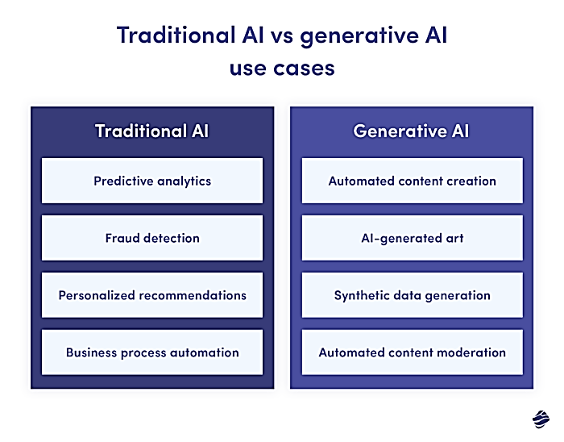
From Traditional AI to Generative AI
Traditional AI
Analyzes existing data to predict outcomes or classify information into predefined categories.
Classification tasks
Pattern recognition
Decision prediction

Slide 9
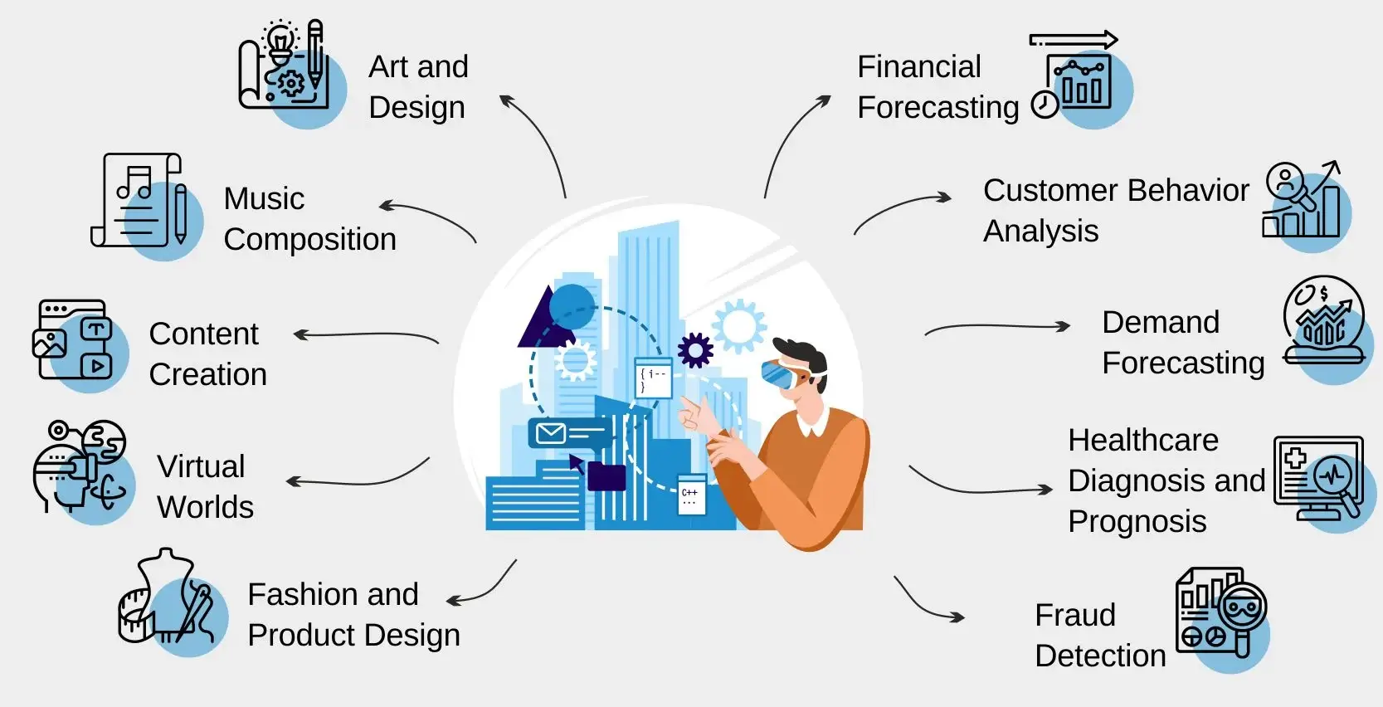
From Traditional AI to Generative AI
Generative AI
Creates entirely new content by learning patterns from training data and generating novel outputs.
Text generation
Image synthesis
Design creation
Code generation

Slide 10

What is Generative AI?
1
2
3
Pattern Learning
Novel Generation
Statistical Approach
Generative AI analyzes thousands of examples to understand underlying data patterns and probability distributions
Creates entirely new data instances that resemble human-created content but are completely original
Works with probability distributions rather than fixed rules, enabling flexible and creative outputs

Slide 11

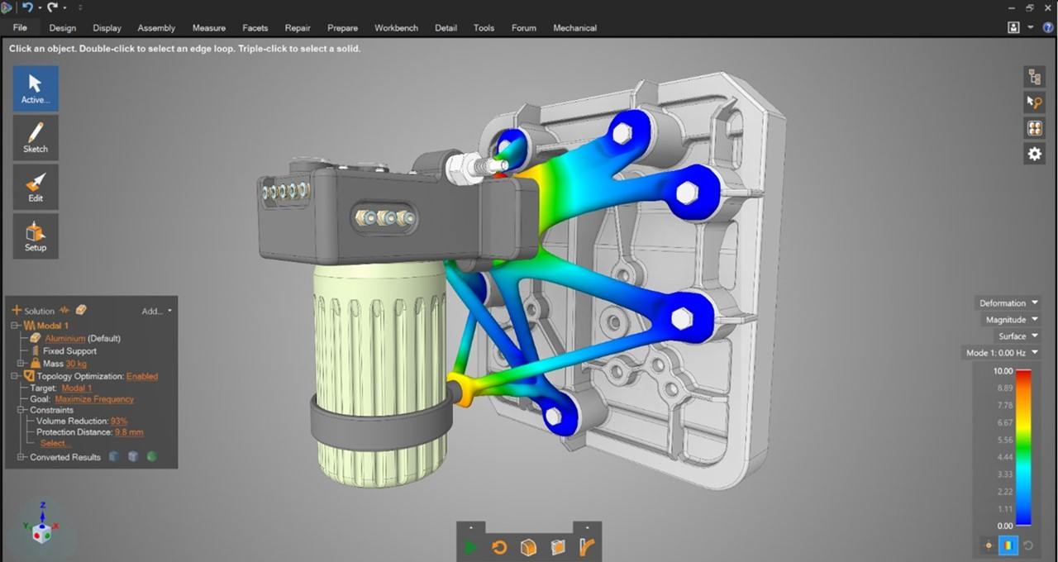
What is Generative AI?
Engineering Example: Feed the model thousands of mechanical component designs → Generate a new optimized design with improved stress distribution and reduced material usage

Slide 12
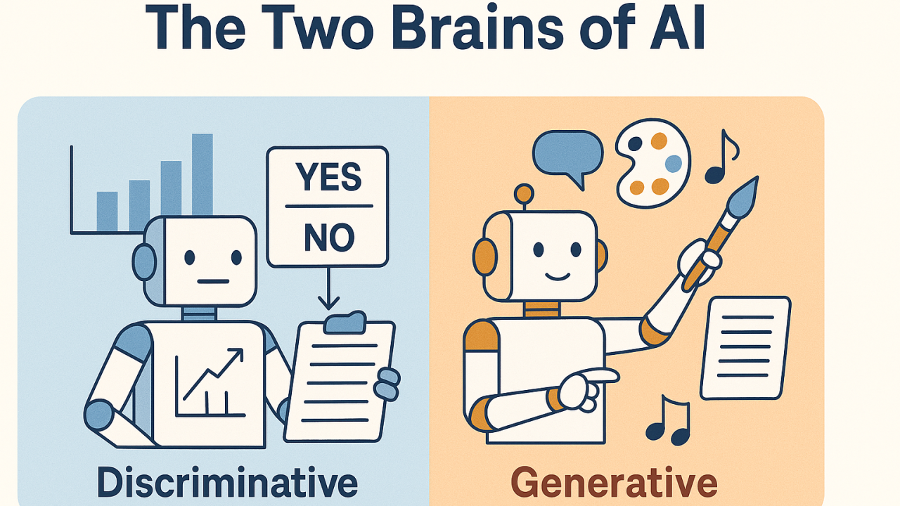
Generative AI vs Discriminative AI
Discriminative AI
Predicts labels and classifies existing data into categories
Classification tasks
Anomaly detection
Quality control
Question it answers: "Is this component defective?"
Generative AI
Generates entirely new data and creates original content
Content creation
Design synthesis
Innovation support
Question it answers: "Can you create a better design?"

Slide 13
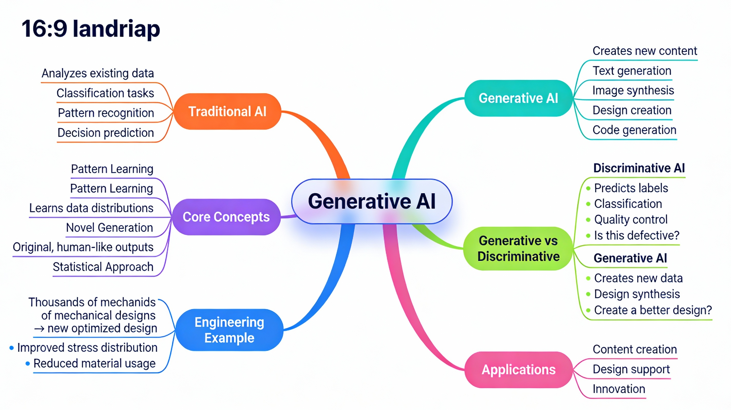
Let’s Recap!

Slide 14


