Slide 1

SNS COLLEGE OF TECHNOLOGY
AN AUTONOMOUS INSTITUTION
COIMBATORE - 35
Department of Computer Science and Engineering
23CSB201 - OBJECT ORIENTED PROGRAMMING
I Year / II Semester
Unit – 2: CONTROL STATEMENTS AND CONSTRUCTORS
Topic – COPY CONSTRUCTOR
Ms. S. Sangeetha, AP-CSD
09/01/2026 23CSB201 – Object Oriented Programming | Unit 2 - Copy Constructor | Ms. S. Sangeetha SNSCT 1/10

Slide 2


Object Cloning
Empathy
To create an independent duplicate (a "clone") of an existing object, ensuring that changes to the copy do not affect the original object.

Slide 3
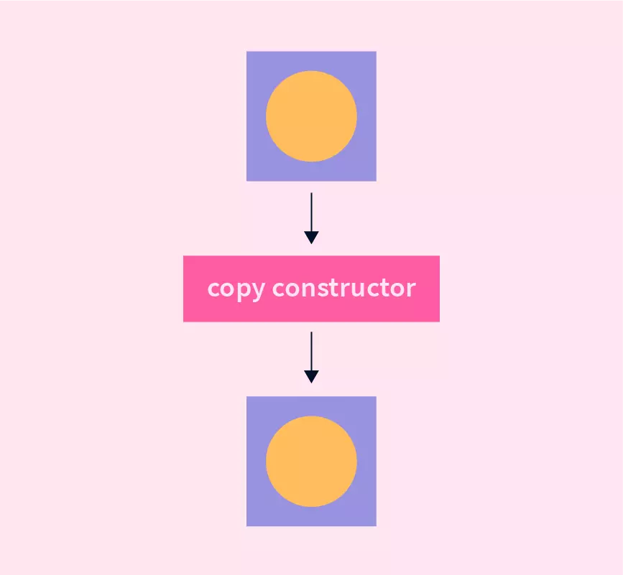

Object Cloning
Ideate #1
Ideate #2

Slide 4
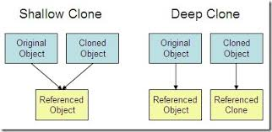
Cloning Types
Ideate

Slide 5
Copy Constructor
Define
A copy constructor in a Java class is a constructor that creates an object using another object of the same Java class.
when we want to copy a complex object that has several fields, or when we want to make a deep copy of an existing object.
To duplicate objects without sharing references (deep copy).
To pass objects by value rather than by reference.
Working with mutable classes and want to avoid unintended side effects.

Slide 6
Copy Constructor (Shallow)
Prototype #1
public class Person { // class variables
private String name;
private int age;
// defining parameterised constructor
public Person(String name, int age){
this.name = name;
this.age = age;
}
// creating display function
public void display(){
System.out.println("Name : "+this.name);
System.out.println("Age : "+this.age);
}
public static void main(String[] args){
// create a new object of class Person
Person p = new Person("Mohan", 15);
// display original person details System.out.println("Displaying the original object"); p.display();
// defining a new object
Person p1;
// copying p to p1
p1 = p; // performs a shallow copy
// Display copied person details System.out.println("Displaying the copied object"); p1.display();
}
}
Output:
Displaying the original object
Name : Mohan
Age : 15
Displaying the copied object
Name : Mohan
Age : 15

Slide 7
Copy Constructor (Deep)
Prototype #2
public class Student {
private String name;
private int age;
// defining parameterised constructor
public Student(String name, int age){
this.name = name;
this.age = age;
}
// defining copy constructor
public Student(Student s){
this.name = s.name;
this.age = s.age;
}
// creating display function
public void display(){
System.out.println("Name : "+this.name);
System.out.println("Age : "+this.age);
}
public static void main(String[] args){
// create a new object of class Student
Student s = new Student("Mohan", 15);
// Display original student details System.out.println("Displaying the original object");
s.display();
// Display copied student details
System.out.println("Displaying the copied object");
Student copiedStudent = new Student(s);
copiedStudent.display();
}
}
Output:
Displaying the original object
Name : Mohan
Age : 15
Displaying the copied object
Name : Mohan
Age : 15

Slide 8
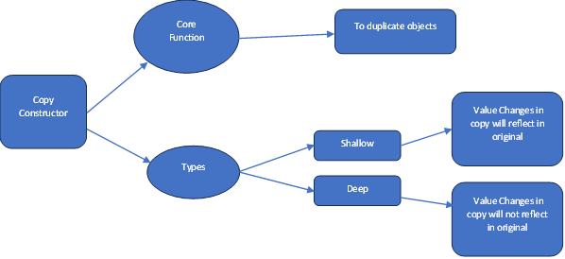
Mind-map

Slide 9
Puzzles
What happens when you use the assignment operator (=) to assign one object to another (obj2 = obj1;) in Java?
a) A copy constructor is implicitly called.
b) A new, separate object is created with copied values.
c) Both object references point to the same memory location (they become aliases).
d) The original object (obj1) is destroyed.
2. When is a copy constructor typically used in Java?
a) To destroy an object and free up memory.
b) To initialize a new object with the data from an existing object.
c) To call the superclass's constructor automatically.
d) When an object is passed to a method by reference
Answer: c
Answer: b

Slide 10

References
https://www.w3schools.com/java/java_constructors.asp
https://www.geeksforgeeks.org/java/constructors-in-java/
https://www.tutorialspoint.com/java/java_constructors.htm

Slide 11


