Slide 1

SNS COLLEGE OF TECHNOLOGY
AN AUTONOMOUS INSTITUTION
COIMBATORE - 35
Department of Computer Science and Engineering
23CSB201 - OBJECT ORIENTED PROGRAMMING
I Year / II Semester
Unit 2 - CONTROL STATEMENTS AND CONSTRUCTORS
Topic – CONSTRUCTORS
Ms. S. Sangeetha, AP-CSD
09/01/2026 23CSB201 – Object Oriented Programming | Unit 2 – Default Constructor | Ms. S. Sangeetha SNSCT 01/10

Slide 2

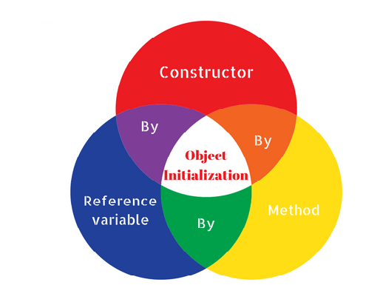
Object Initialization
Empathy

Slide 3
Constructor
Define
A constructor in Java is a special member that is called when an object is created.
It initializes the new object’s state.
It is used to set default or user-defined values for the object's attributes
Properties:
A constructor has the same name as the class.
It does not have a return type, not even void.
It can accept parameters to initialize object properties.

Slide 4
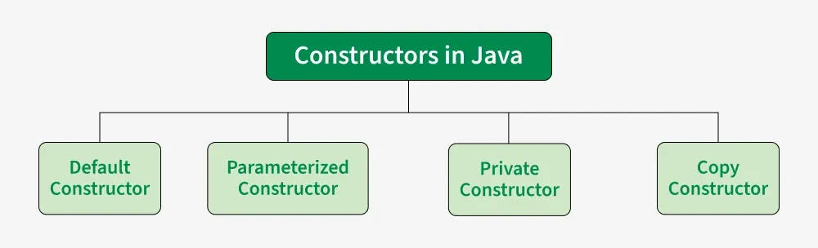
Types of Constructor

Slide 5
Default Constructor
A Java default constructor is a no-argument constructor that the Java compiler automatically provides for a class only if the programmer does not explicitly define any other constructor.
Its primary purpose is to enable object creation and ensure that instance variables are assigned their default values (e.g., 0 for int, null for objects, false for boolean).
Syntax:
class ClassName {
ClassName()
{
---------
---------
}
}

Slide 6
Default Constructor
Prototype #1
public class Car {
String model;
int year;
public static void main(String[] args) {
Car car = new Car();
System.out.println("Model: " + car.model + ", Year: " + car.year);
}
}
Output:
Model: null, Year: 0

Slide 7
Default Constructor
Prototype #2
public class Car {
String model;
int year;
// Default Constructor
public Car() {
model = "Basic";
year = 2000;
}
public static void main(String[] args) {
Car car = new Car();
System.out.println("Model: " + car.model + ", Year: " + car.year);
}
}
Output:
Model: Basic, Year: 2000

Slide 8
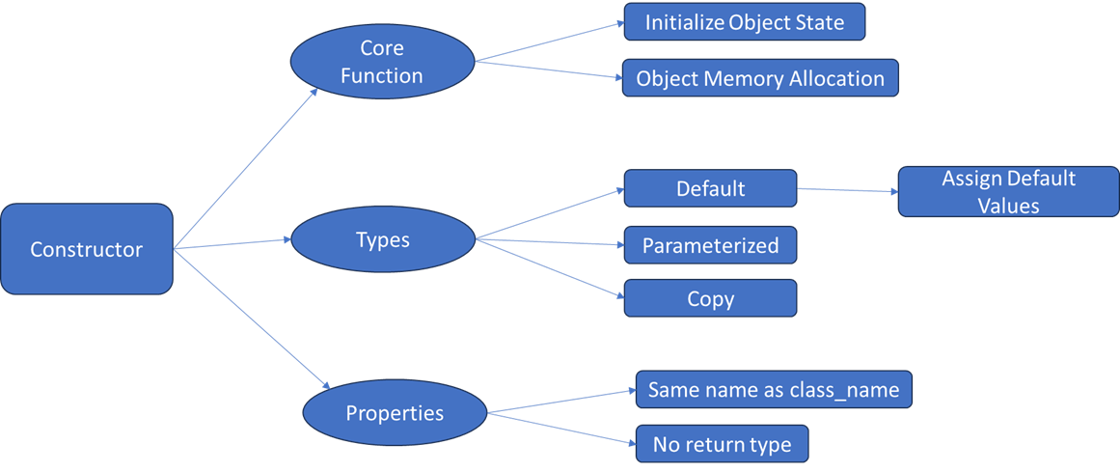
Mindmap

Slide 9
Puzzles
1. What is false about constructor?
a) Constructors cannot be synchronized in Java b) Java does not provide default copy constructor c) Constructor can have a return type d) “this” and “super” can be used in a constructor
2. What happens if you do not define a constructor in a Java class?
a) The program will not compile.
b) The compiler provides a default constructor.
c) The class cannot be instantiated.
d) The constructor from another class will be used.
Answer: c
Answer: b

Slide 10

References
https://www.w3schools.com/java/java_constructors.asp
https://www.geeksforgeeks.org/java/constructors-in-java/
https://www.tutorialspoint.com/java/java_constructors.htm

Slide 11


