Slide 1
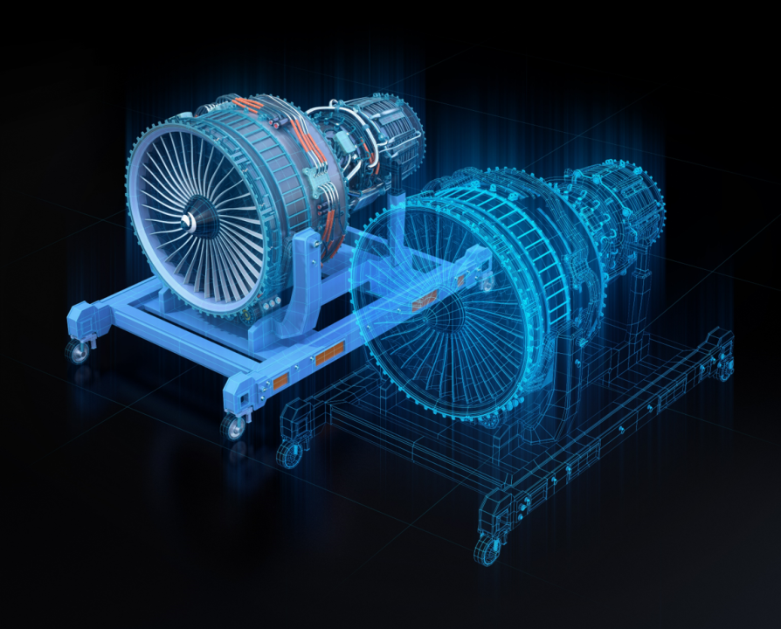
SNS COLLEGE OF TECHNOLOGY
An Autonomous Institution
Coimbatore-35
Digital Twins in Mechanical Systems
UNIT I
INTRODUCTION TO GENERATIVE

Slide 2
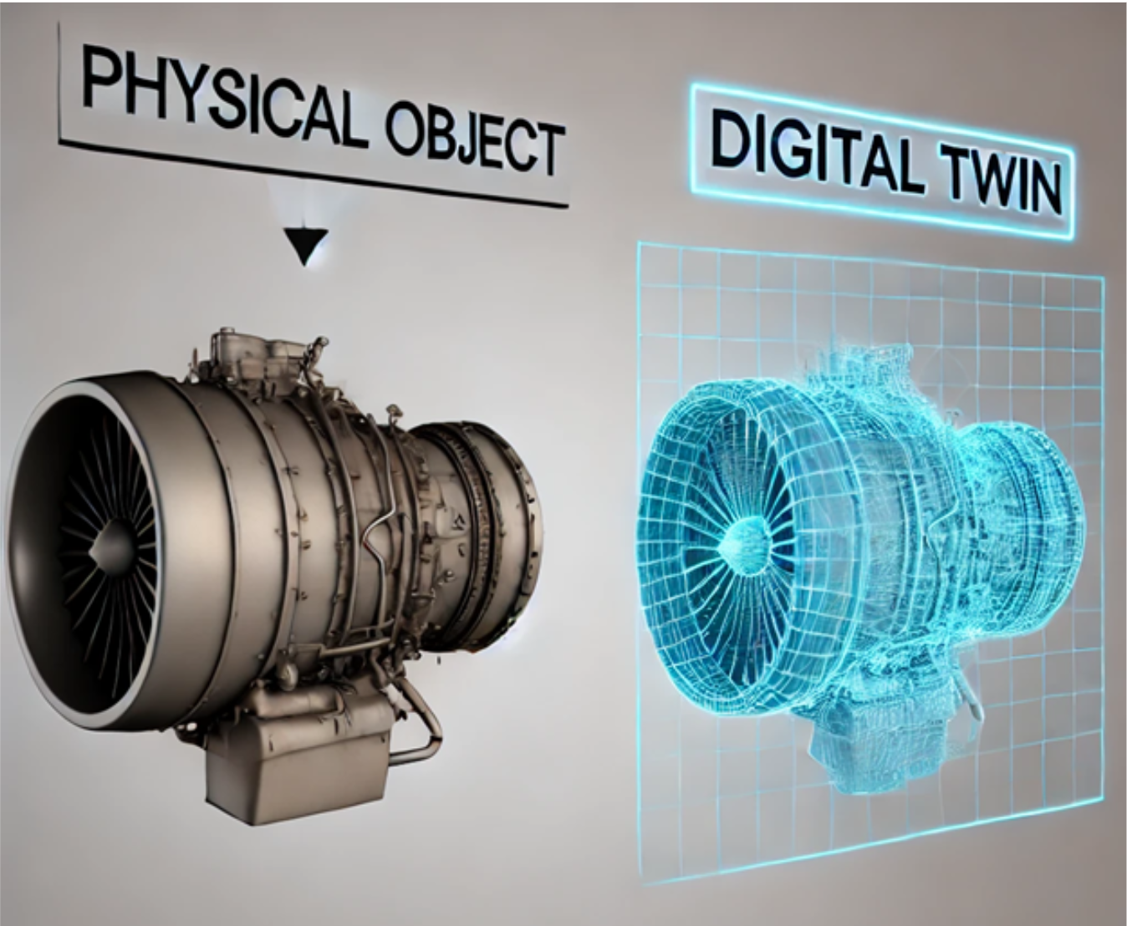
Digital Twin: Core Concept
A digital twin is a virtual replica of a physical mechanical system that evolves in real-time. It's not just a static 3D model—it's a living, breathing digital counterpart that mirrors actual operational behavior, geometry, and performance characteristics.
Real-Time Synchronization
Behavioral Accuracy
Continuously updated with sensor data from the physical system
Represents dynamic performance, thermal states, and mechanical responses
Physical Fidelity
Captures precise geometry, material properties, and operational constraints
Examples in mechanical engineering: CNC machining centers, automotive engines, industrial robotic arms, turbomachinery

Slide 3

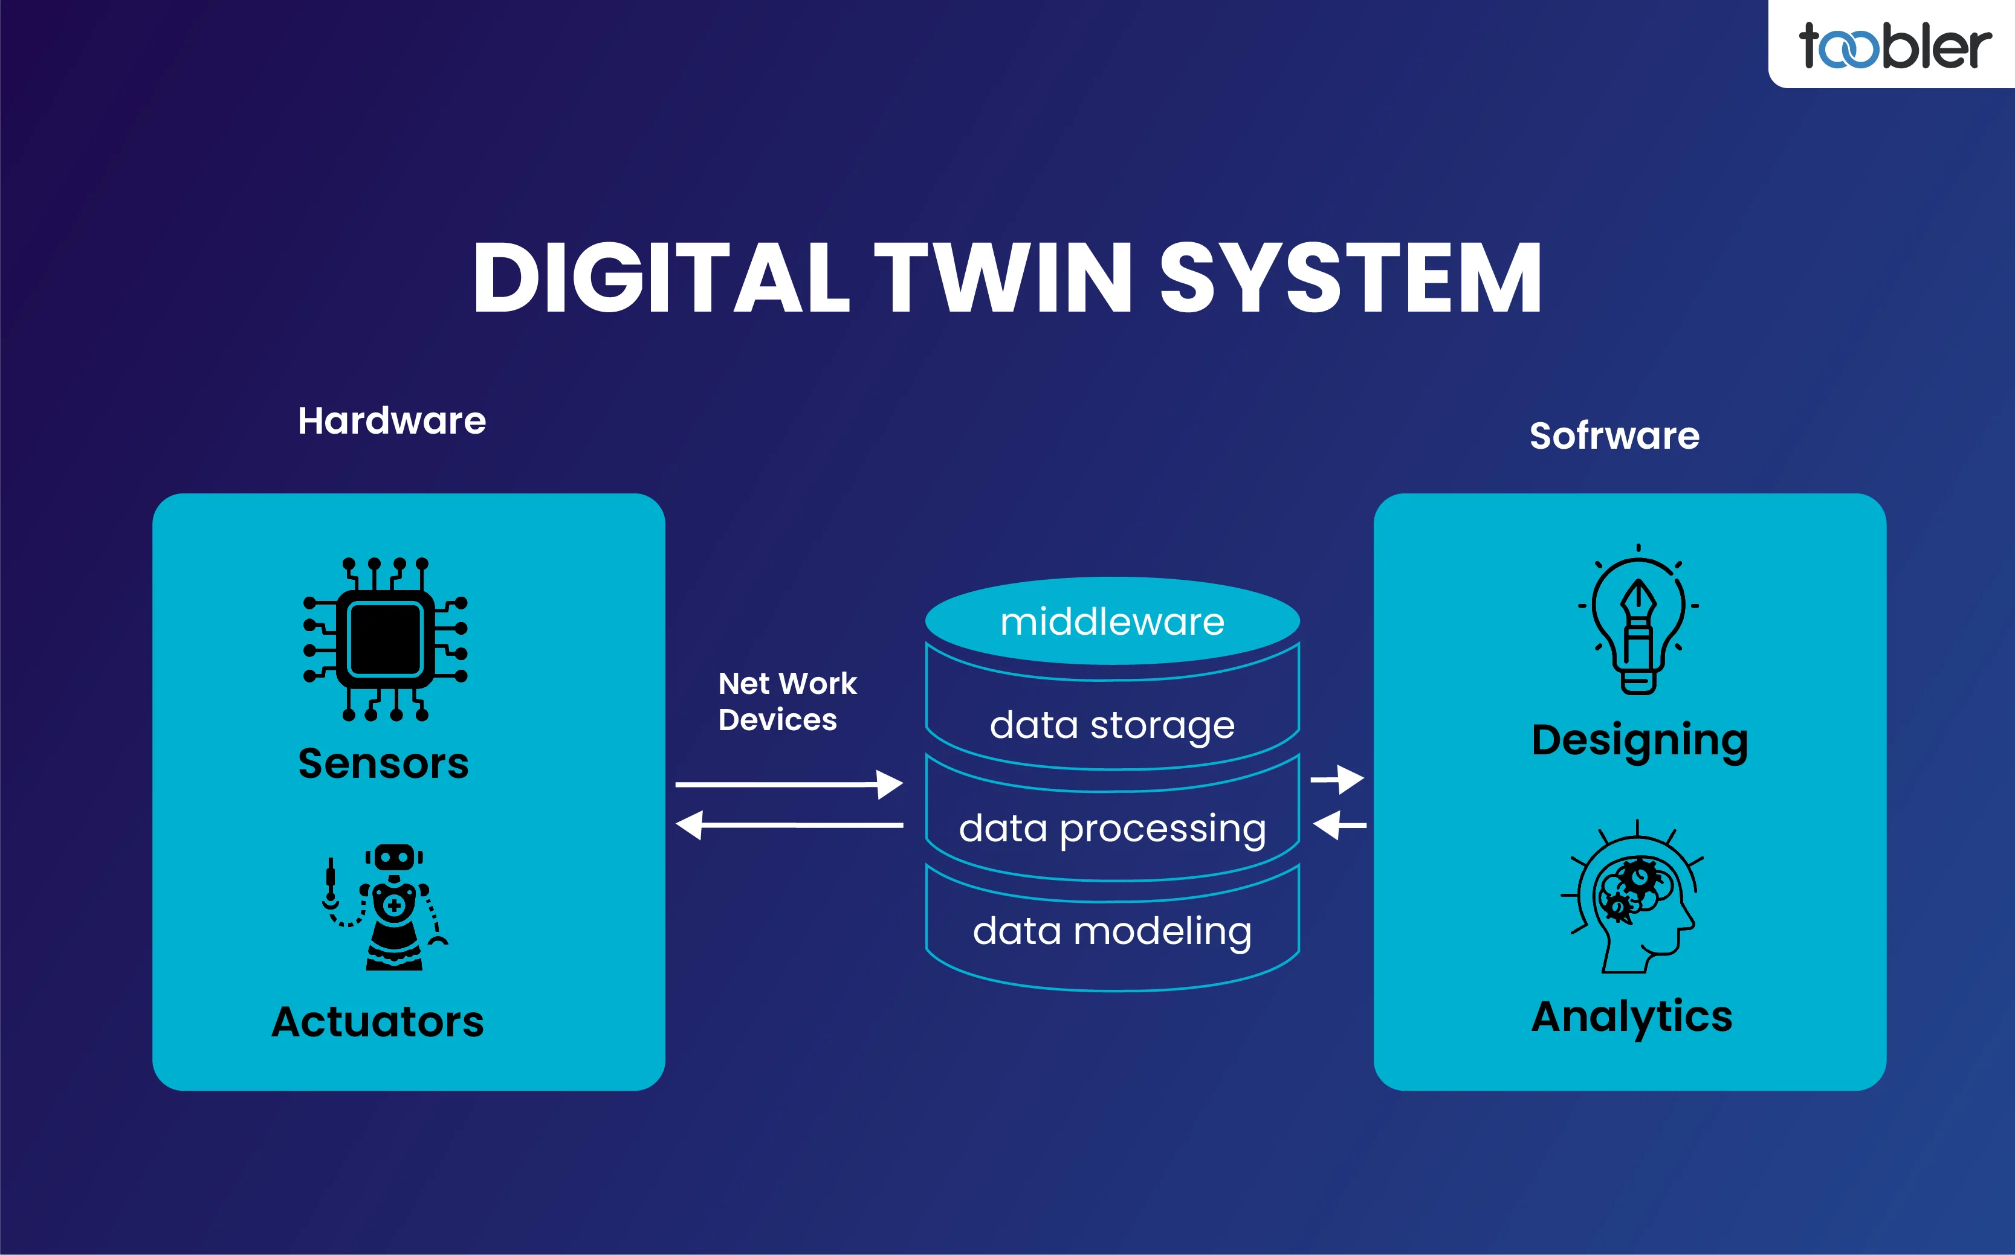



Components of a Digital Twin
A digital twin system integrates physical hardware, data collection, computational modeling, and intelligent feedback loops to create a seamless physical-digital ecosystem.
Physical System
The actual mechanical equipment—machine tool, engine,
or robotic mechanism operating in the real world
Sensors & Data Acquisition
IoT sensors capture temperature, vibration, pressure, position,
and performance metrics in real-time
Computational Model
Physics-based simulations and mathematical models replicate
system behavior digitally
Feedback & Control Loop
Bidirectional data flow enables predictive insights and adaptive
control strategies

Slide 4
Traditional Digital Twins: Limitations
Conventional digital twin approaches rely heavily on first-principles physics modeling, which presents significant engineering challenges in real-world industrial applications.
Computational Burden
Modeling Complexity
High-fidelity physics simulations require significant computing resources and lengthy calculation times
Developing accurate models demands extensive domain expertise and experimental validation
Limited Adaptability
Uncertainty Handling
Static models struggle to adapt to changing operational conditions or component wear
Poor performance with noisy data, manufacturing variations, and unpredictable operating environments

Slide 5



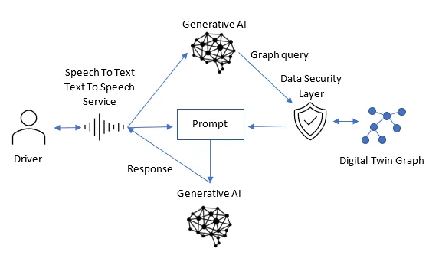


Why Generative AI in Digital Twins?
KEY TRANSFORMATION
Generative AI fundamentally transforms digital twins from static simulation tools into intelligent, adaptive systems capable of learning from operational reality and generating insights beyond traditional physics-based approaches.
Pattern Learning
State Generation
Discovers complex relationships in operational
data that physics models might miss
Predicts missing sensor readings and future system
states with high accuracy
Nonlinear Mastery
Excels at modeling complex, nonlinear behaviors in multi-physics mechanical systems
Paradigm Shift: From purely physics-driven static twins to data-driven intelligent twins that continuously learn and improve

Slide 6
Architecture of an AI-Driven Digital Twin
An AI-enhanced digital twin creates a closed-loop intelligent system where physical operations, machine learning, and virtual simulation work together seamlessly.
Physical System
1
Operating machinery generating real-world data
2
Sensor Stream
Continuous data flow from IoT sensors
AI Model
3
Generative models process and learn patterns
4
Digital Simulation
Virtual twin mirrors and predicts behavior
Optimization Feedback
5
Insights drive operational improvements

Slide 7
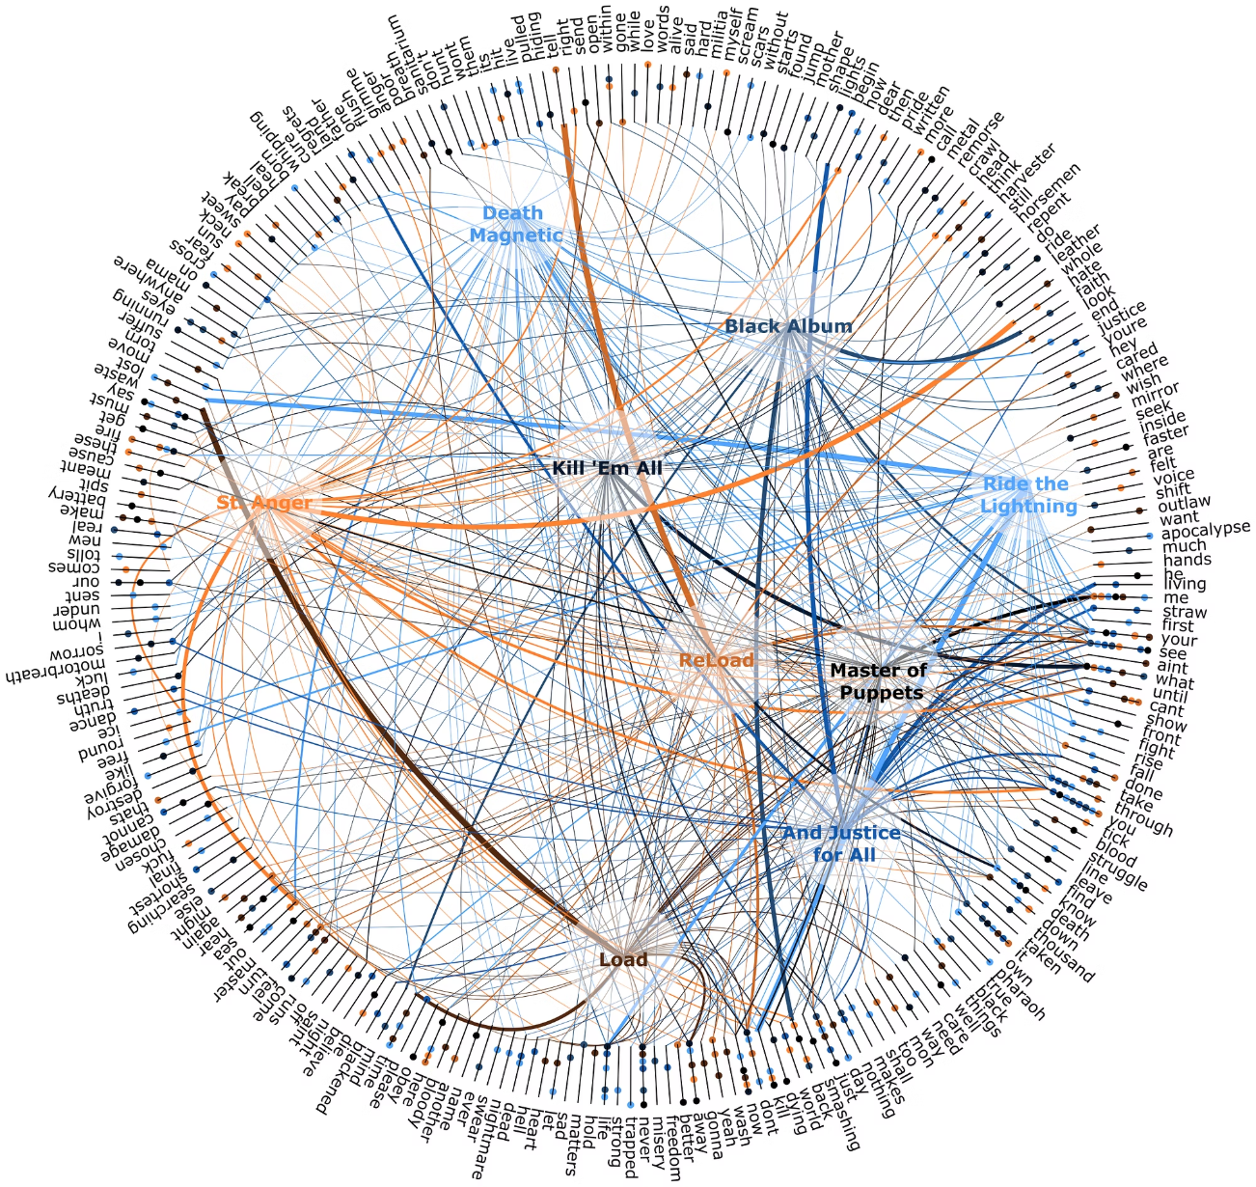
Role of Generative AI Models
Generative AI models serve three critical functions in digital twins, enabling capabilities impossible with traditional approaches.
1
Synthetic Data Generation
Creates realistic sensor data for rare or hazardous operating conditions
2
Failure Simulation
Generates what-if scenarios for component failures without physical testing
3
Behavior Prediction
Forecasts future system states based on current and historical patterns
Autoencoders
Compress sensor data, detect anomalies, and reconstruct missing measurements
GANs
Generate synthetic operational scenarios and augment training datasets
Diffusion Models
Produce high-fidelity predictions with uncertainty quantification

Slide 8
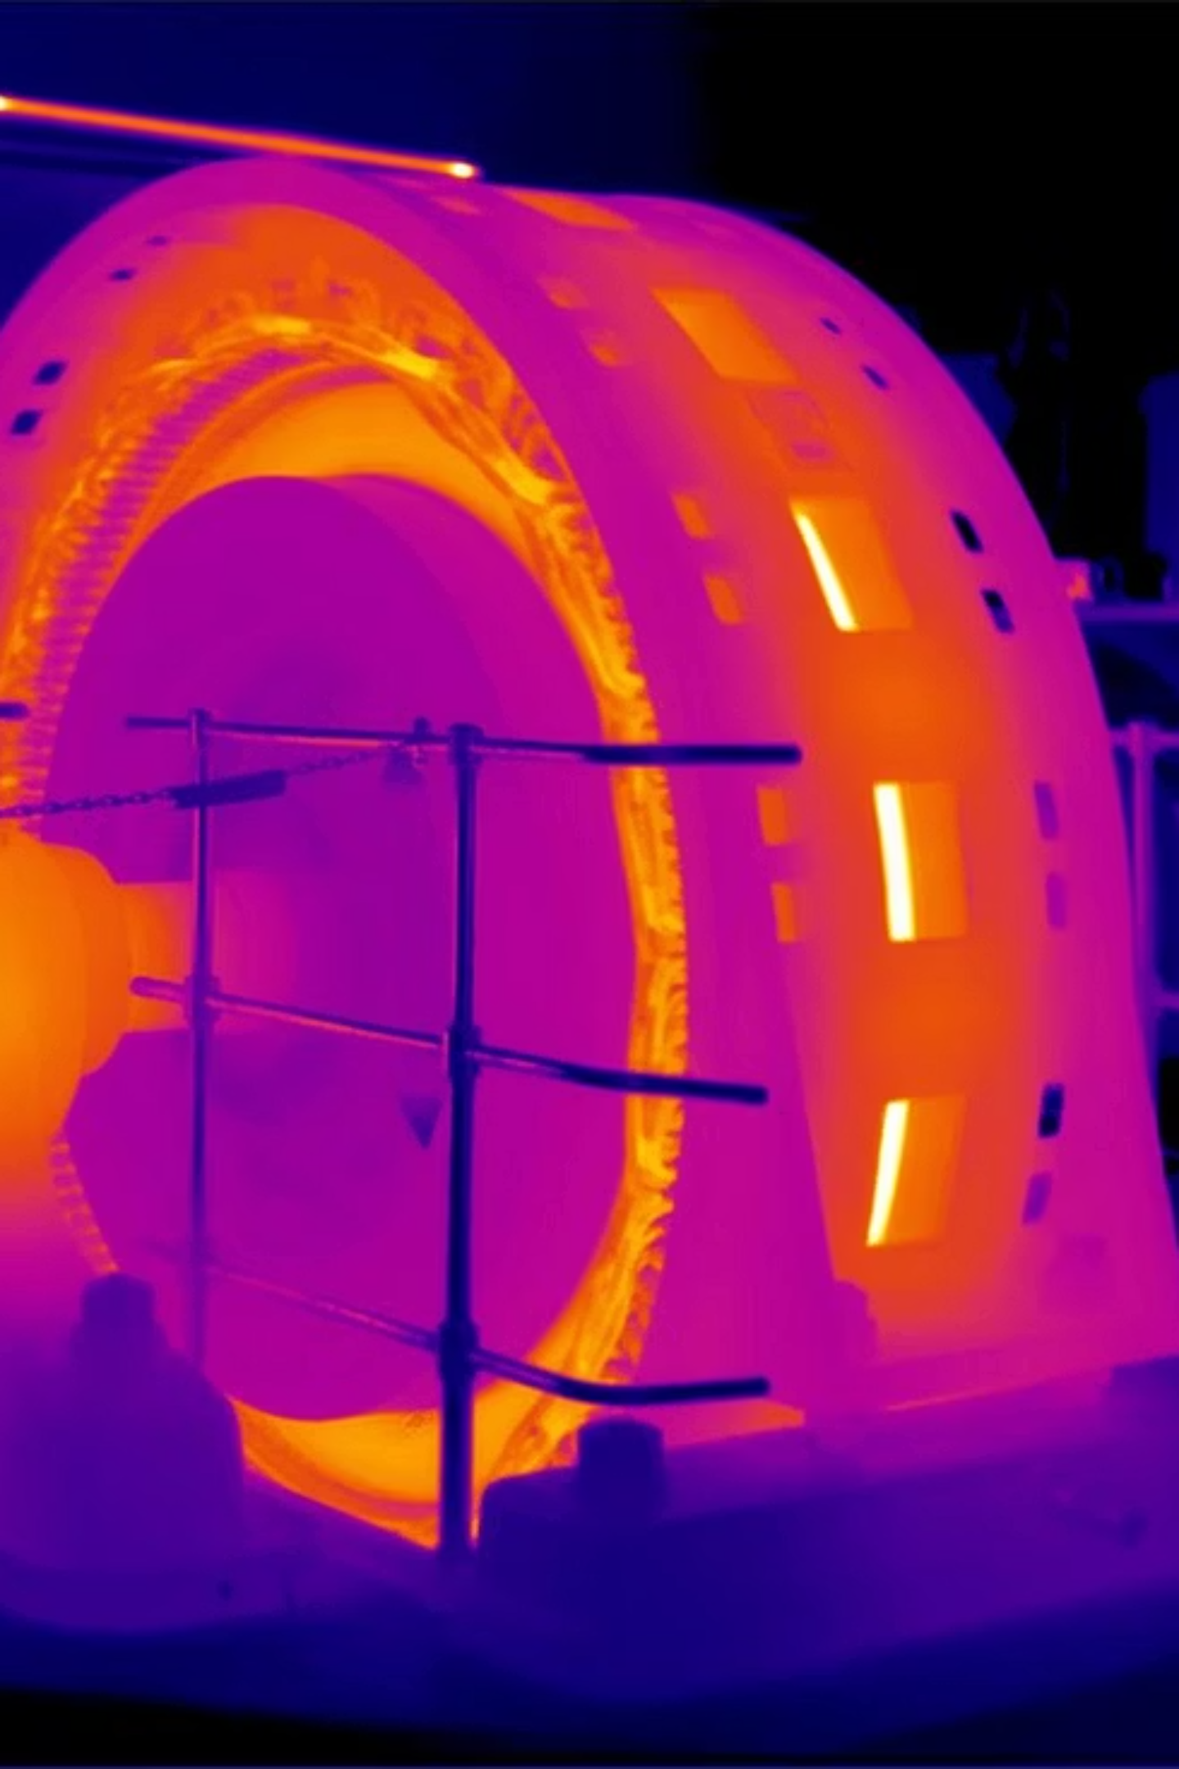



Digital Twins in Mechanical Systems
Generative AI-powered digital twins are revolutionizing monitoring and control across critical mechanical engineering applications.
Machine Tool Monitoring
Real-time tracking of cutting forces, tool wear, and dimensional accuracy in CNC operations
Thermal Behavior
Predictive modeling of thermal expansion, heat distribution, and cooling system performance
Structural Health
Continuous assessment of stress, fatigue, and structural integrity in mechanical assemblies
Spindle Vibration Twin
Predicts bearing wear and imbalance issues before catastrophic failure
Bearing Wear Twin
Monitors lubrication, temperature, and acoustic signatures for early degradation detection

Slide 9
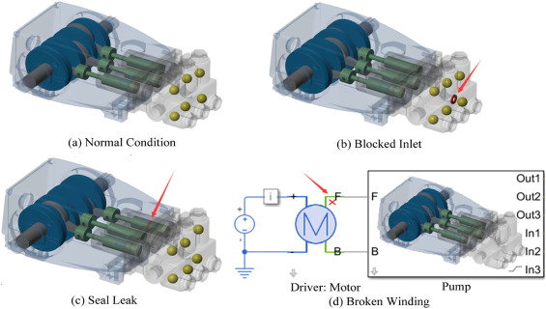

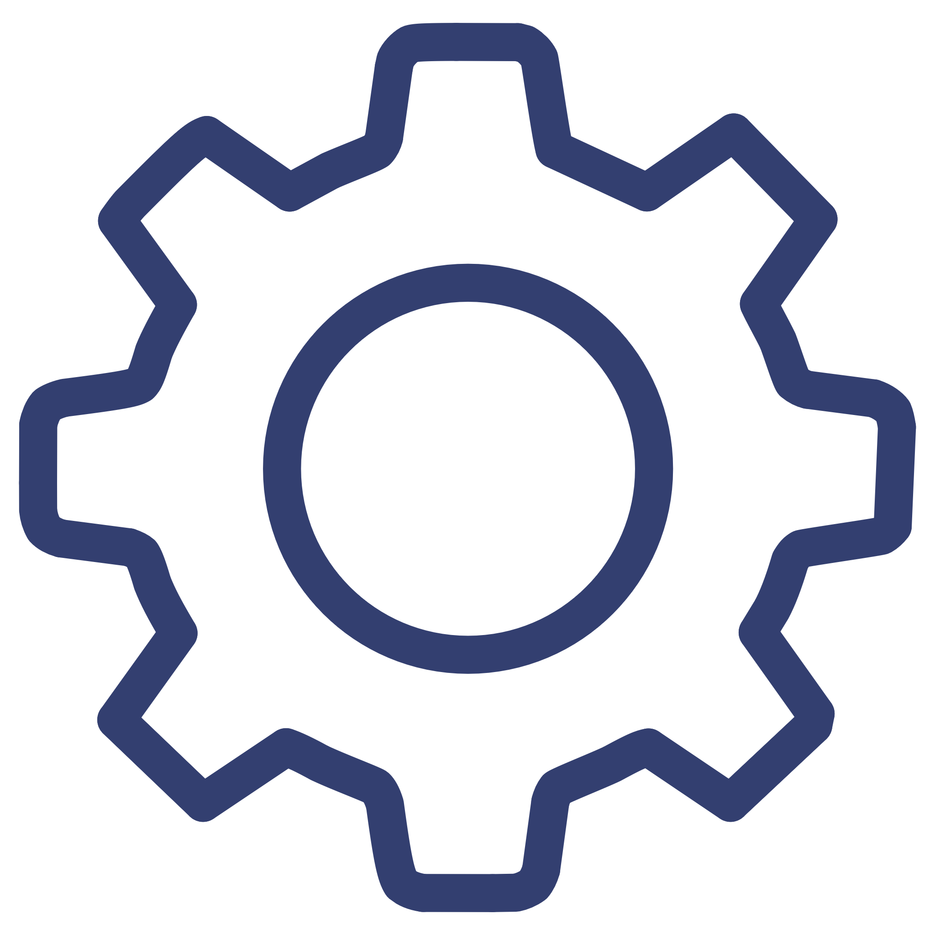

Digital Twin for Predictive Maintenance
Predictive maintenance powered by AI-driven digital twins transforms maintenance strategy from reactive repairs to proactive optimization, dramatically reducing costs and downtime.
1
Failure Prediction
Identify impending failures days or weeks before breakdown occurs
2
Downtime Reduction
Eliminate unplanned shutdowns through scheduled interventions
3
Schedule Optimization
Bearings
Perform maintenance only when needed, not on arbitrary time intervals
Vibration and temperature analysis
Gears
Wear pattern and load monitoring
Cutting Tools
Edge condition and performance tracking

Slide 10
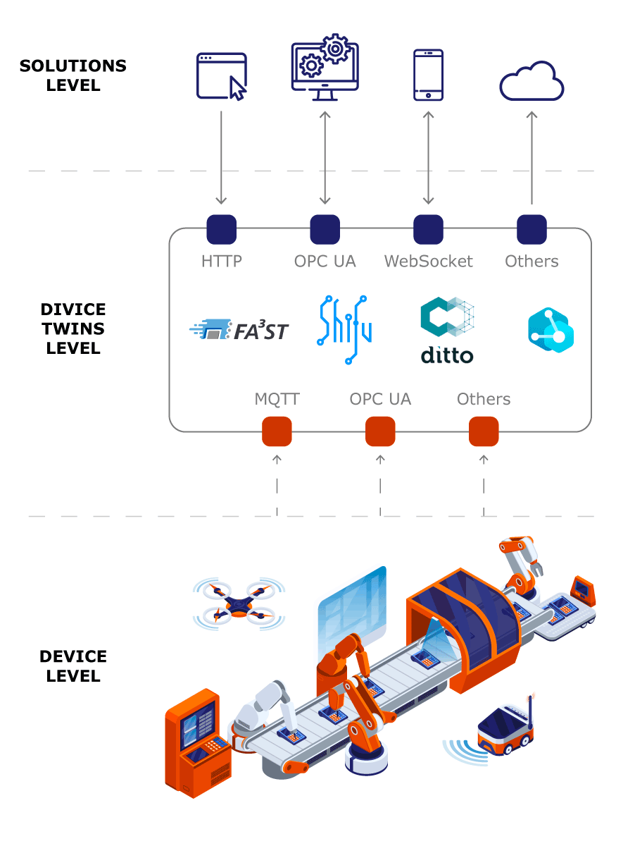
Digital Twin for Design & Optimization
AI-driven digital twins accelerate the design process by enabling virtual testing and optimization before physical prototyping, reducing development time and costs substantially.
Initial Design
Create preliminary design with specified parameters and constraints
Digital Twin Simulation
Test multiple design variations virtually under diverse operating conditions
AI-Driven Optimization
Generative models explore design space and suggest optimal configurations
Refined Design
Finalized design with improved reliability, efficiency, and performance
Example Application: Engine parameter optimization
Example Application: Gearbox optimization
Combustion chamber geometry
Tooth profile modifications
Valve timing configurations
Material selection strategies
Cooling system layouts
Lubrication system design

Slide 11
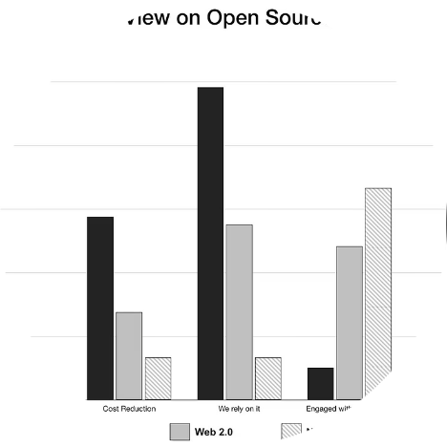
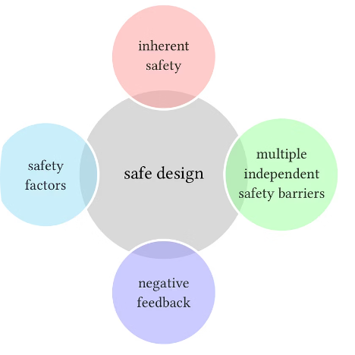
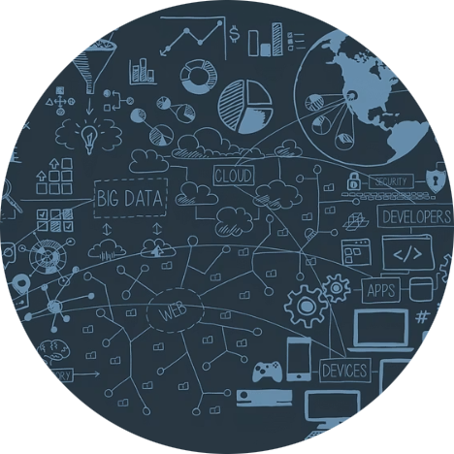
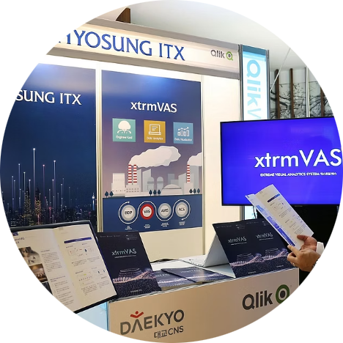
Engineering Benefits & Takeaways
Generative AI-powered digital twins represent a fundamental advancement in mechanical engineering practice, delivering measurable value across the entire product lifecycle.
Cost & Time Reduction
Reliability & Safety
Faster Decisions
Smart Manufacturing
Reduce prototyping costs by 40-60% and accelerate time-to-market through virtual validation
Improve system reliability and prevent catastrophic failures through continuous monitoring
Enable data-driven engineering decisions with real-time insights and predictive analytics
Foundation for Industry 4.0, enabling autonomous systems and adaptive production

Slide 12
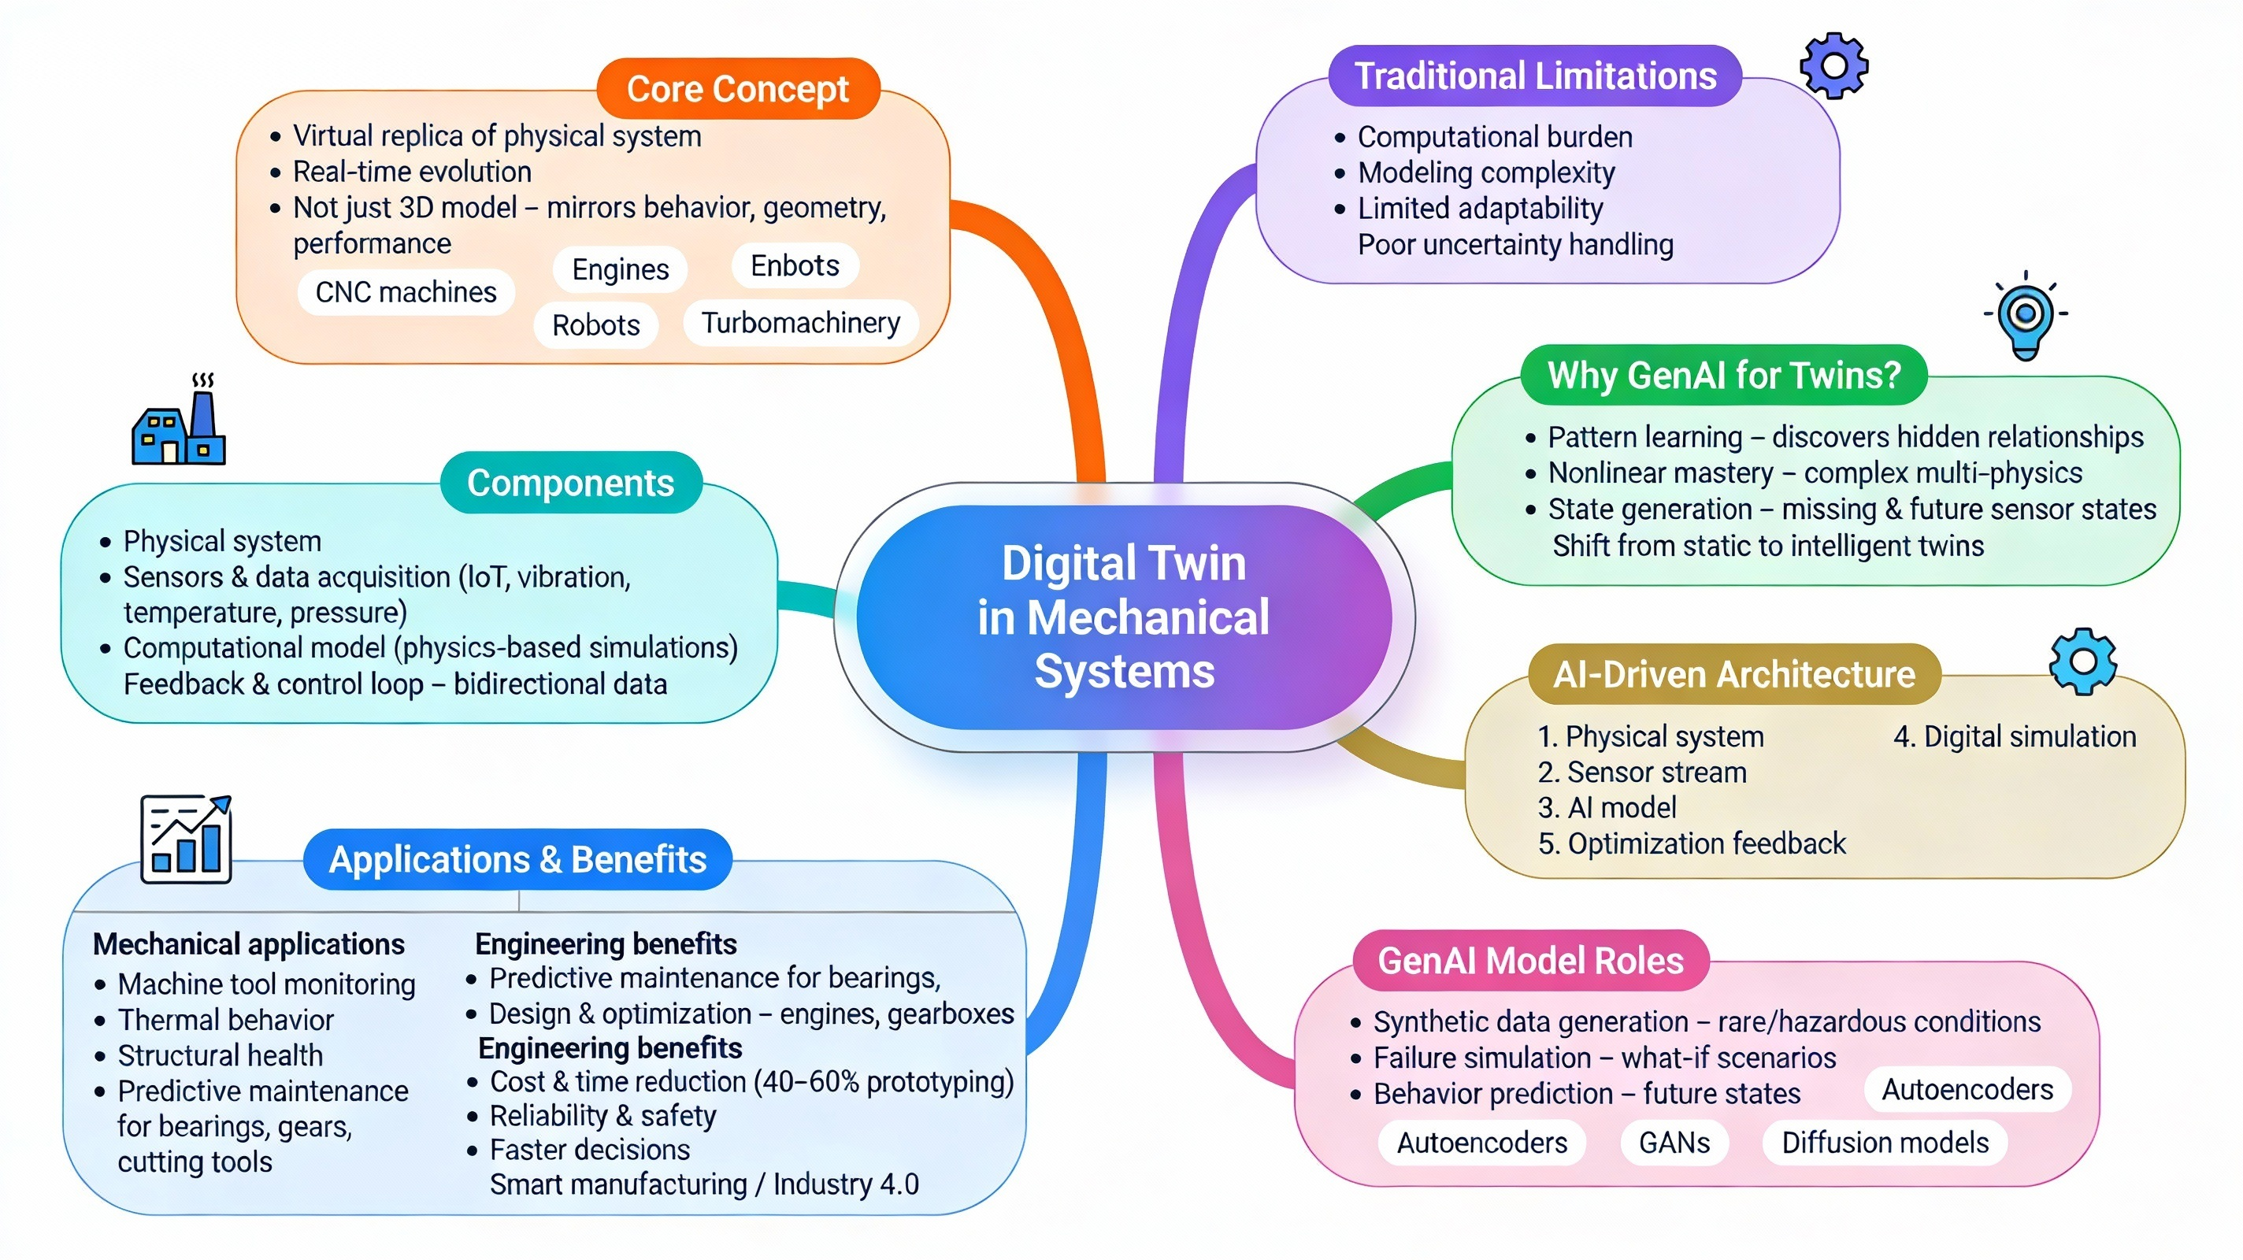
Let’s Recap!

Slide 13


