Slide 1
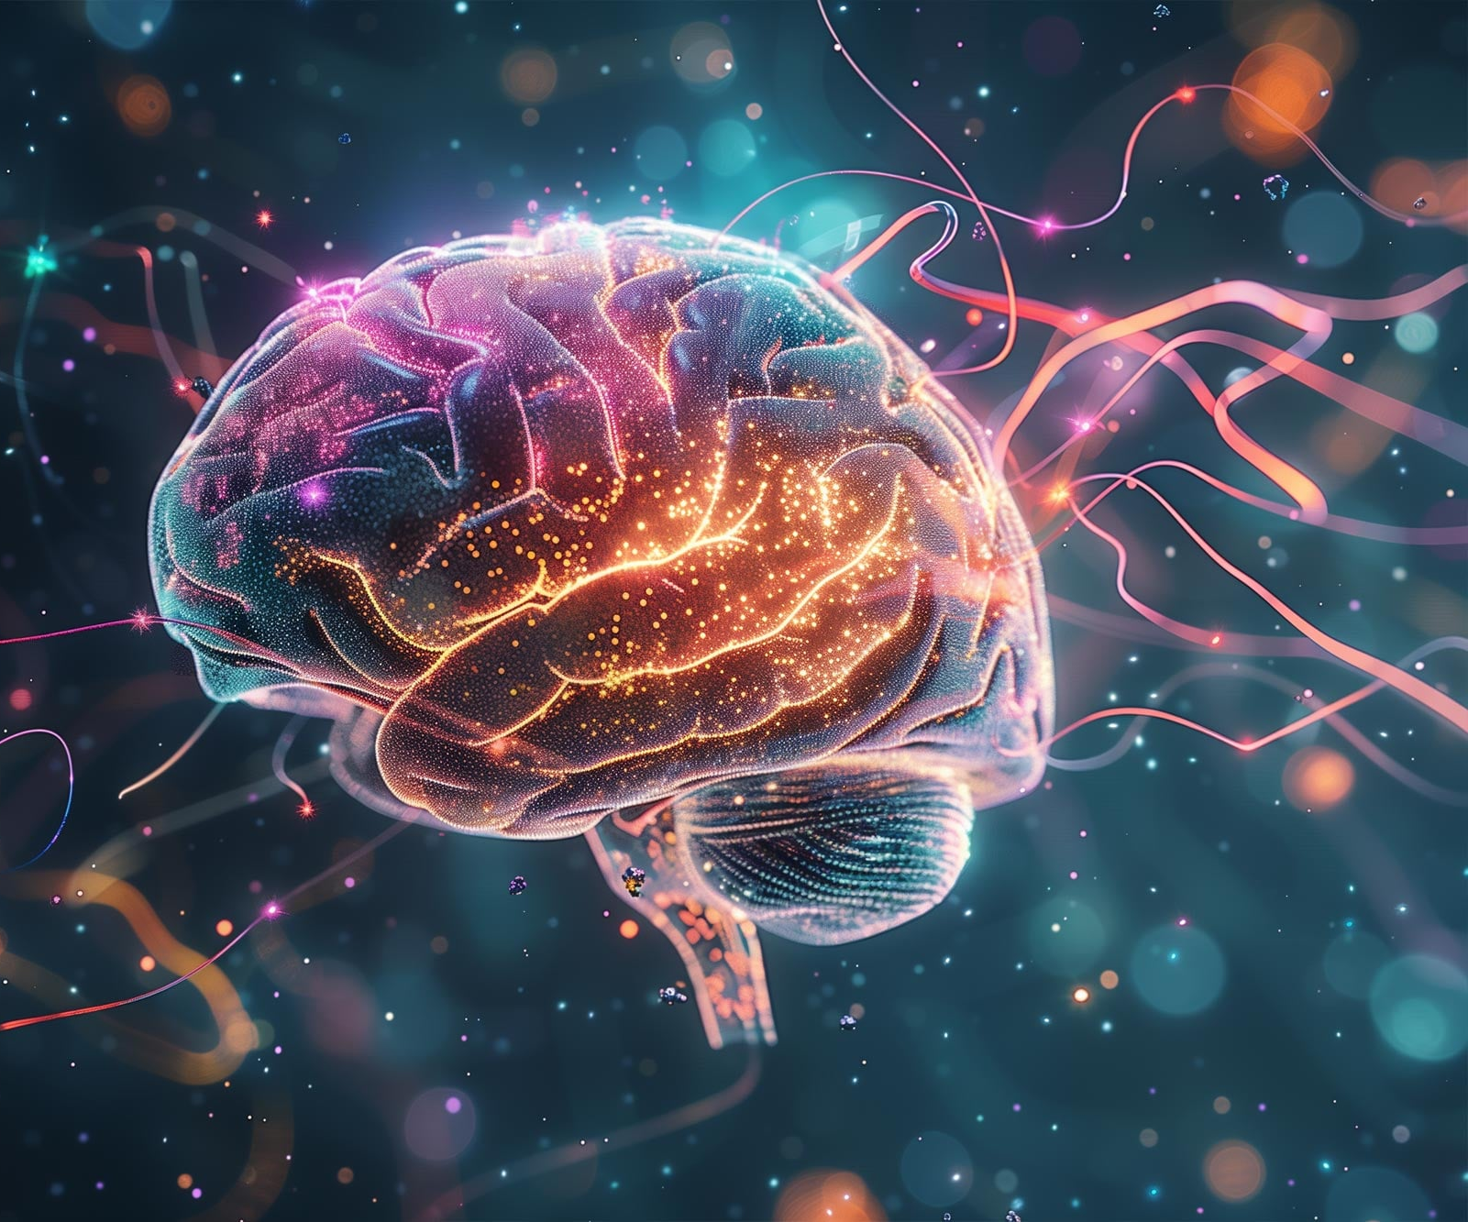
SNS COLLEGE OF TECHNOLOGY An Autonomous Institution
Coimbatore-35
Unit I – Introduction to Generative AI
Evolution of Generative AI
LECTURE 2

Slide 2




Why Study the Evolution of AI?
Understand Origins
Reveals why generative AI emerged and what problems it solves
Learn Limitations
Shows constraints of earlier approaches and their shortcomings
Connect Technology
Links technological growth with real engineering needs and solutions

Slide 3

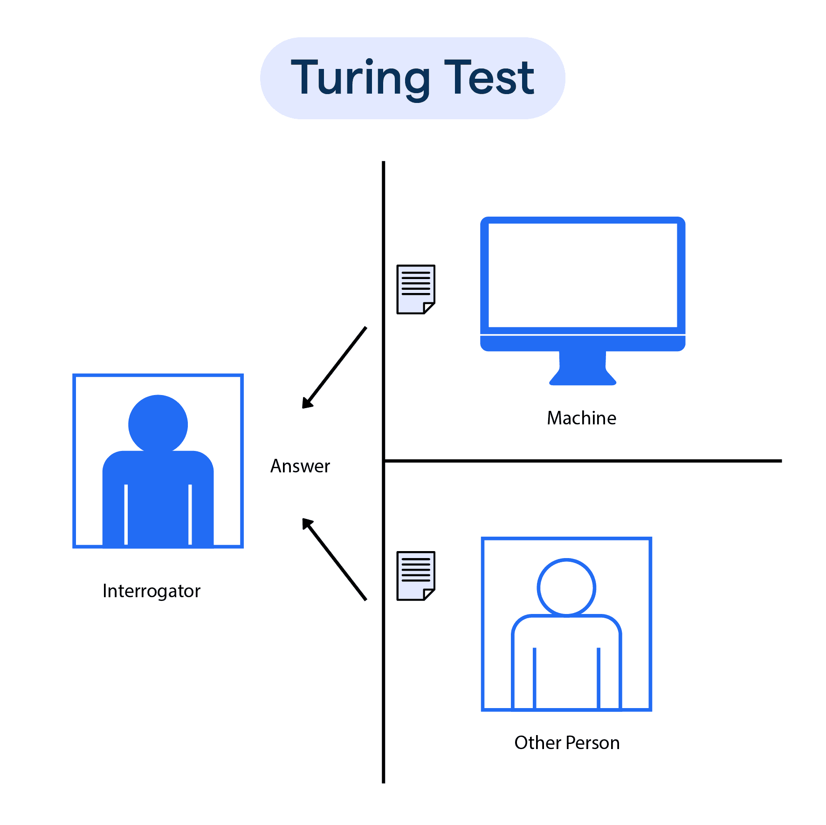
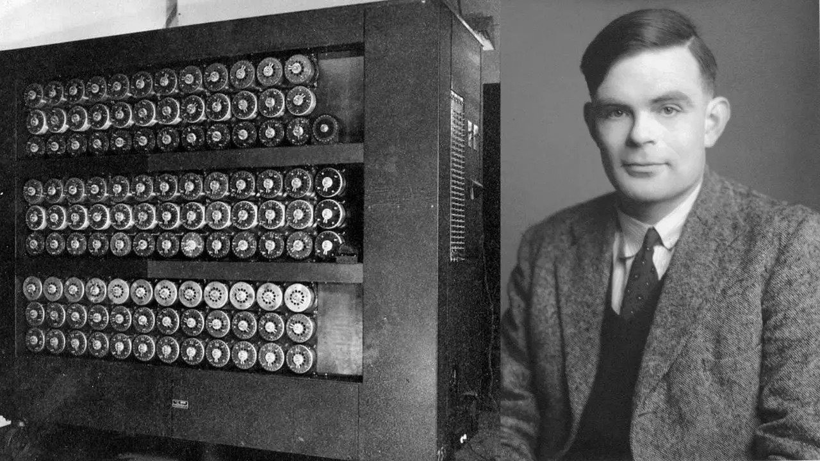
The Turing Test

Slide 4

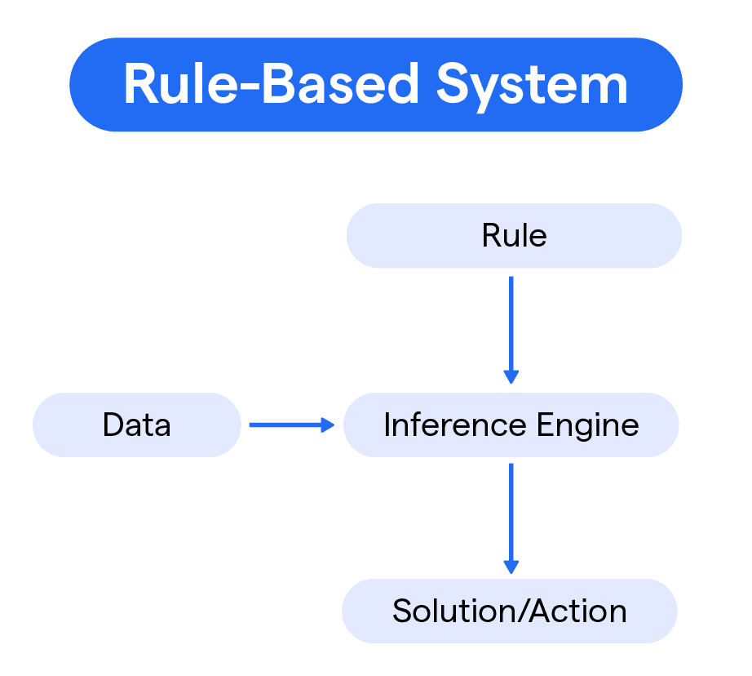
Phase 1: Rule-Based & Symbolic AI
1950S–1990’s
Key Characteristics
Hard-Coded Rules
Logic-Based Decisions
Systems relied on manually programmed logic trees and decision paths
Expert systems used symbolic reasoning to mimic human decision-making
No Learning Capability
Systems couldn't improve from experience or adapt to new situations
Critical Limitations
Not scalable: Every new scenario required manual rule creation
Example: If-then rule flow in early expert systems
No adaptability: Couldn't handle unexpected inputs or evolving conditions

Slide 5

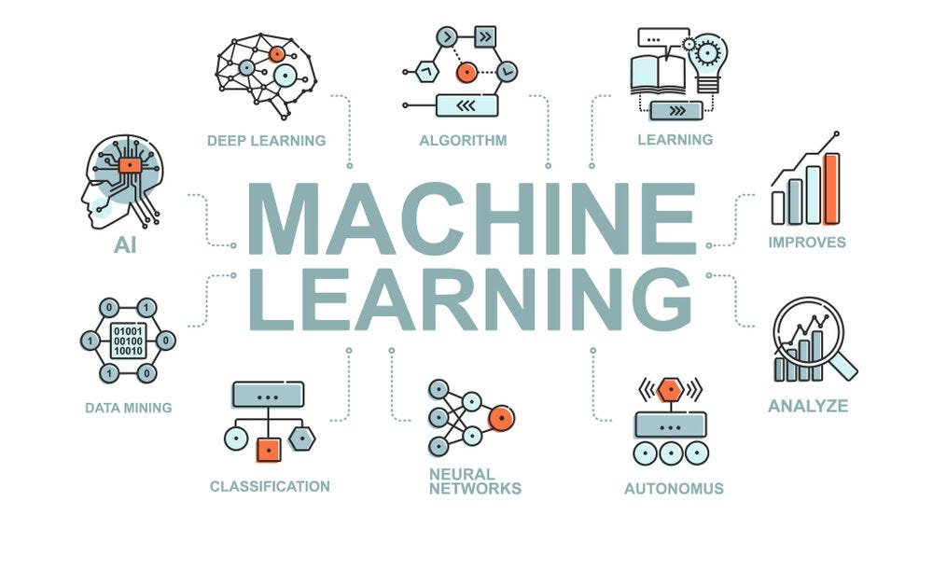




1990S–2010’s
Phase 2: Machine Learning Era
Data-Driven Models
Systems learned patterns from historical data rather than explicit rules
Statistical Learning
Applied probability and statistics to make predictions and classifications
Feature Engineering
Required manual selection and crafting of relevant input features
Engineering Applications
Tool Wear Prediction
Quality Classification
ML models analyzed sensor data to predict when cutting tools needed replacement, reducing downtime and improving manufacturing efficiency
Automated defect detection systems classified product quality based on measurements and visual inspection data

Slide 6

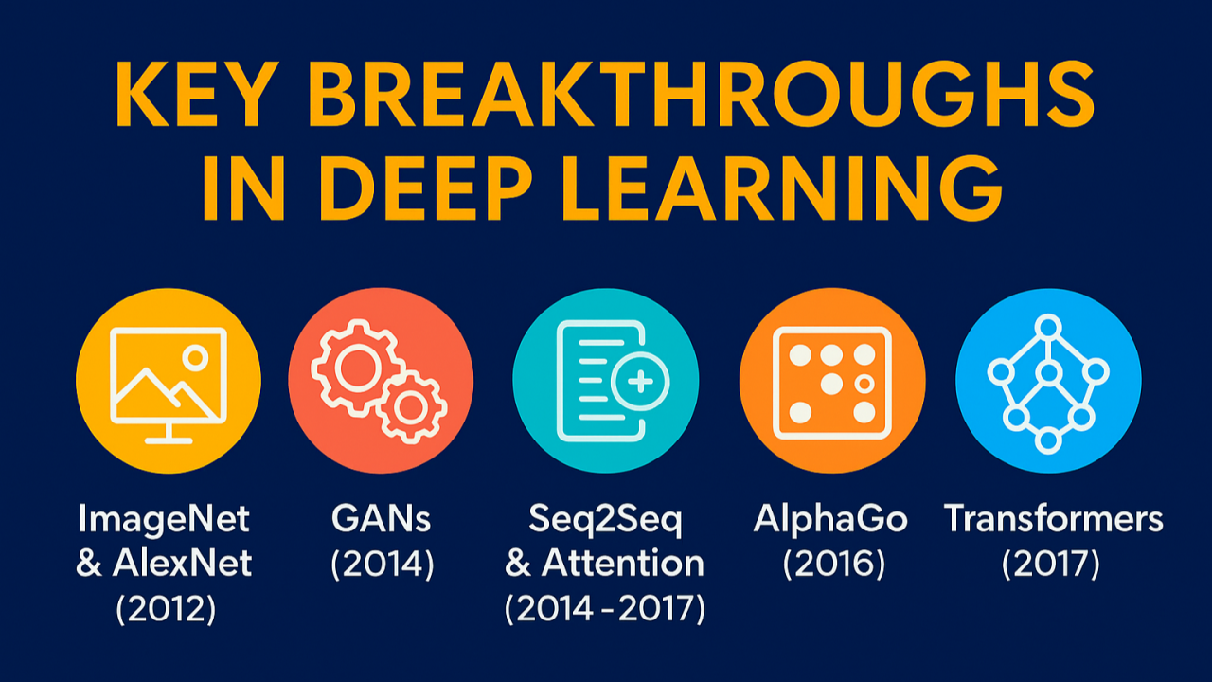
2010–2018
Phase 3: Deep Learning Breakthrough
Core Innovations
01
Multi-Layer Networks
Neural networks with dozens or hundreds of layers processed complex patterns
02
Automatic Features
Networks learned optimal feature representations without manual engineering
03
Vision & Speech
Enabled breakthrough applications in image recognition and natural language
Key Enablers
GPU Computing
Parallel processing hardware accelerated training by 100x or more
Big Data
Massive labeled datasets provided fuel for training deep networks

Slide 7


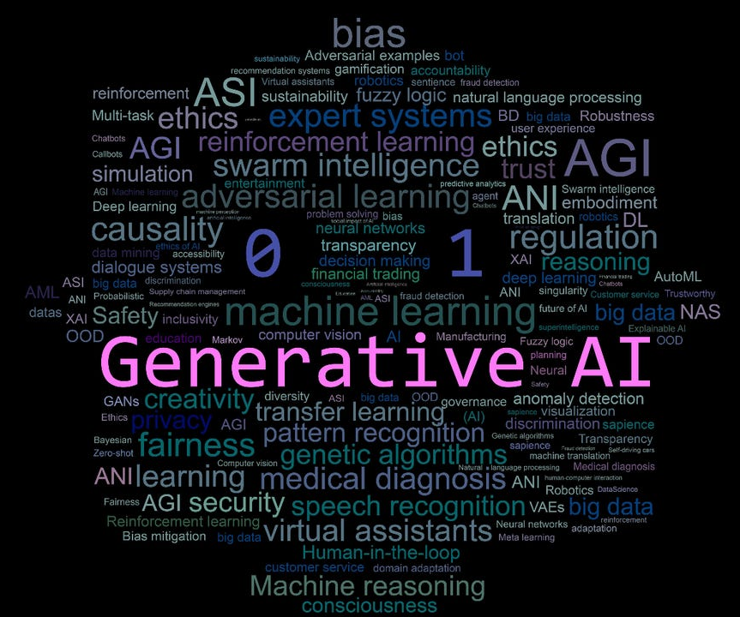
Phase 4: Rise of Generative AI
CURRENT ERA
2018–PRESENT
Defining Characteristics
Creates New Data
Generates novel outputs rather than just classifying existing data
Multi-Modal Output
Produces text, images, 3D designs, code, and more
Learns Distributions
Models underlying patterns to synthesize realistic new examples

Slide 8
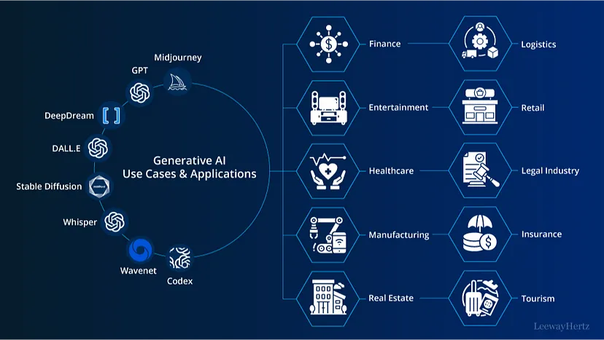


Phase 4: Rise of Generative AI
CURRENT ERA
2018–PRESENT
Engineering Examples
AI Design Generation
Systems create optimized CAD models and component designs based on specifications
Synthetic Data
Generate realistic simulation datasets for training and testing without physical prototypes

Slide 9
Key Technological Drivers of GenAI
Four foundational pillars enable the generative AI revolution, each building on decades of research and engineering innovation.
Large Datasets
GPU/TPU Computing
Billions of examples scraped from the internet, books, and specialized domains
Specialized hardware for massively parallel matrix operations
Training times reduced from months to days
Text corpora with trillions of tokens
Real-time inference capabilities
Image databases with billions of labeled photos
Distributed computing clusters
Engineering CAD repositories
Transformer Architecture
Cloud Infrastructure
Attention mechanisms that revolutionized sequence modeling
Scalable computing resources and model deployment platforms
Processes entire sequences in parallel
On-demand GPU clusters
Captures long-range dependencies
API-based model access
Foundation for GPT, BERT, and more
Distributed training frameworks

Slide 10
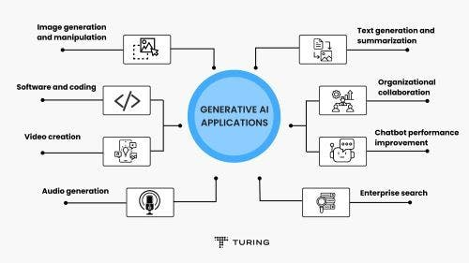
Key Application Domains of Generative AI
Text & Language
Images & Video
Code Generation
Design & Simulation
Content generation, translation, summarization, and conversational AI assistants
Photo synthesis, style transfer, video generation, and visual content creation
Automated programming, code completion, bug detection, and software synthesis
CAD modeling, generative design, physics simulation, and digital twin creation

Slide 11
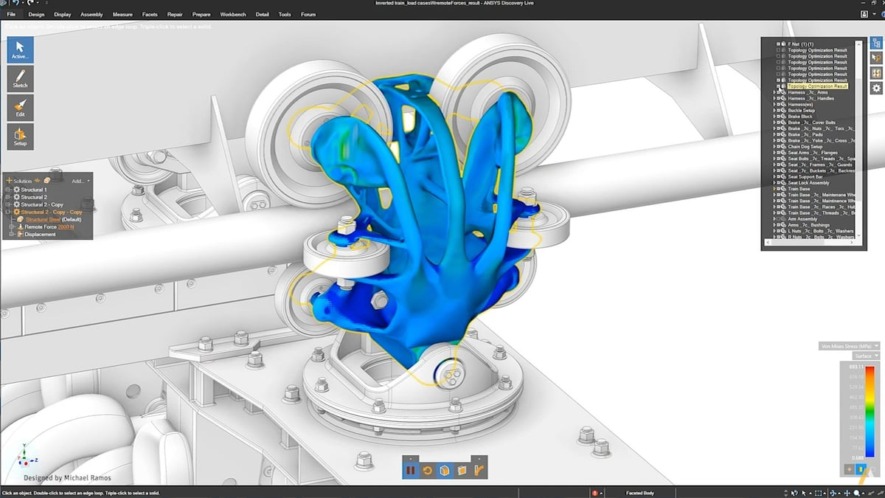

Generative AI in Engineering Applications
CAD Design Suggestions
1
AI analyzes design constraints and generates optimized component geometries, reducing design iteration time by 60-70%
Synthetic Simulation Data
2
Generate thousands of realistic test scenarios for FEA, CFD, and system validation without physical prototyping
Process Optimization
3
AI models learn from production data to suggest parameter adjustments that improve efficiency and reduce waste
Spotlight: Mechanical Design Optimization
Predictive Maintenance
AI-assisted topology optimization generates lightweight structures that meet strength requirements while minimizing material use. Engineers input constraints, and GenAI explores thousands of design variants in minutes.
4
Generate failure scenarios and maintenance schedules by learning patterns from sensor data and equipment history

Slide 12

Evolution of GenAI: A Timeline of Significant Milestones
Turing Test (Imitation Game)
I, Robot (Isaac Asimov)
3 Robot Principles
1950
Checkers
Play Program (Samuel)
1955
Artificial Intelligence
MIT introduces NLP-based Chatbot ELIZA
(Joseph Weizenbaum)
1965
Autonomous Vehicle
Test Project
(Stanford AI Lab)
1974
MIT AI Lab
founded
1959
1943
ANN
(McCulloch-
Pitts)
1951
Chess Play
Program
(Claude Shannon)
1956
Dartmouth Summer Research Project on AI
(McCarthy-Minsky-Rochester-Shannon)
1961
General Motors Automated Assembly Line
1969
Shaky Mobile Robot (Stanford Research Lab)
1980
LISP – Expert System (Edward Feigenbaum)
Machine Learning
1987–1993 : AI Winter
(LISP Market Collapse )
Virtual Voice Assistant (Microsoft Cortana, Apple Siri)
2011
IBM Jeopardy Machine
beats Quiz Champion
Google Autonomous Vehicle Test Drive
2009
DARPA Grand Challenge on Autonomous Vehicle
2005
SONY AIBO (Dog like Fast Running Robot)
1999
ALVINN - Neural Network Autonomous Vehicle (CMU)
1989
2010
QUILL Automatic Report Writer
2008
Google Speech-to-Search iPhone App
2000
Robot with Emotional Intelligence (MIT AI Lab)
1997
IBM DeepBlue Chess Engine beats Garry Kasparov
Natural Language Processing
Reinforcement Learning
Amazon ALEXA
Facebook DeepFace
(NearHuman Accuracy 97.5%)
2014
Reinforcement Learning
Deepmind Alphafold
(Protein Structure Prediction)
2020–21
AI Agents
2025
Deepmind AlphaGo (SuperHuman GamePlay)
UBER starts Self-driving Car Service at Arizona
2016
2012
Google Brain + Stanford (75% Accuracy in Youtube CAT Identification)
2015
TensorFlow Open-sourced (Google)
OpenAI $1 Billion Fund (Elon Mask)
2017
Transformer Models – LLM
Google BERT, Generative AI
2022
ChatGPT by OpenAI
Deep Learning
Large Language Models (LLM)

Slide 13
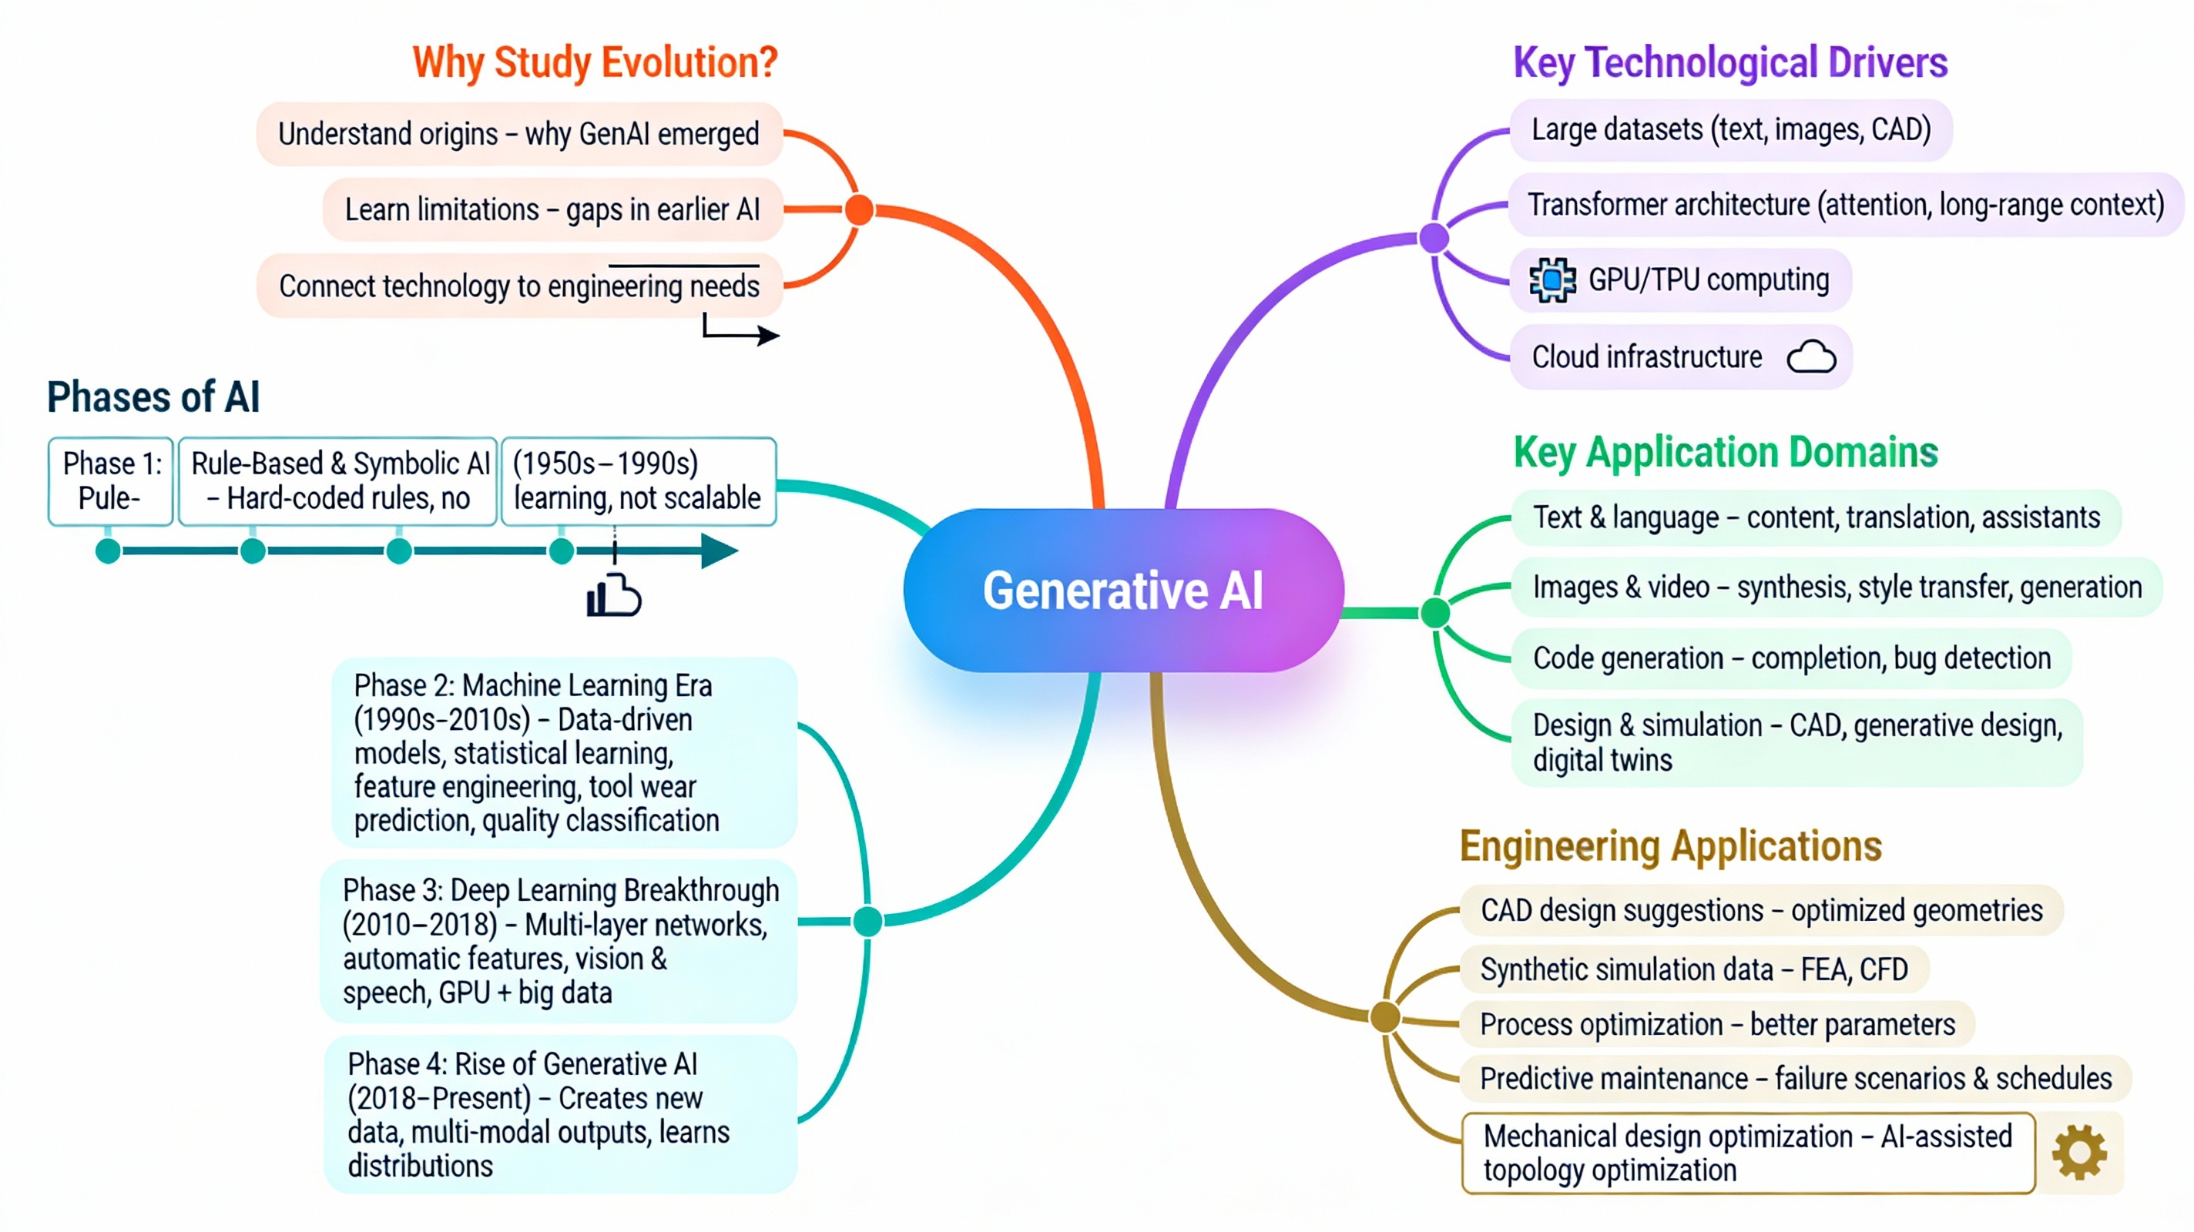
Let’s Recall!

Slide 14


