Slide 1
SNS College of Technology
(An Autonomous Institutions)
Department of Computer Science and Engineering
23CSB201-Object Oriented Programming
Topic: Final Methods & Class
Mrs.G.Devi
Assistant Professor

Slide 2
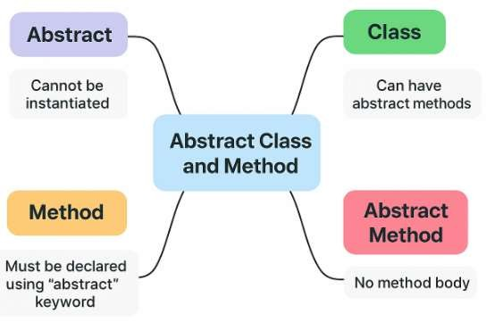
Recall

Slide 3
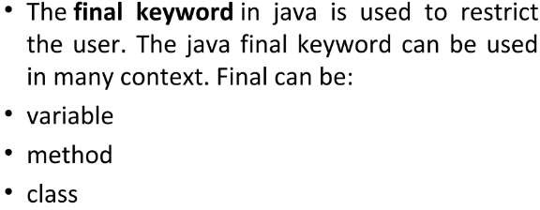

Final methods and classes

Slide 4
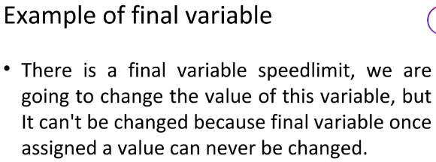
Example

Slide 5
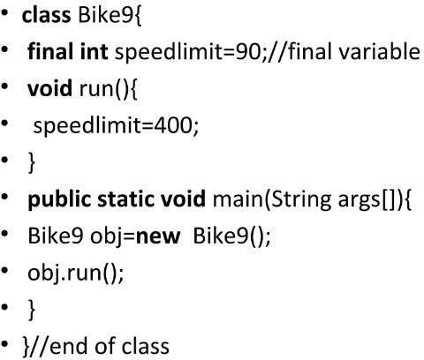
Example

Slide 6
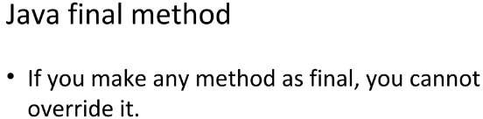
Example

Slide 7
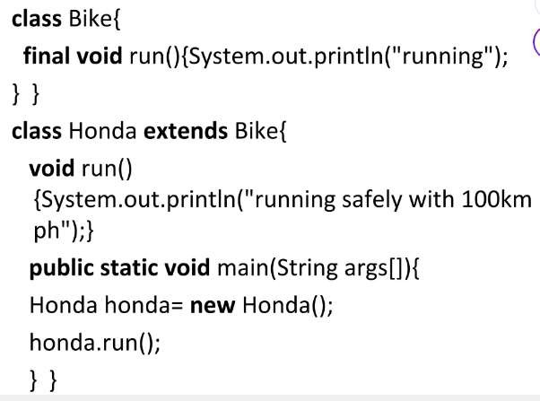
Example

Slide 8
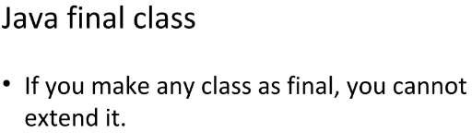
Example

Slide 9
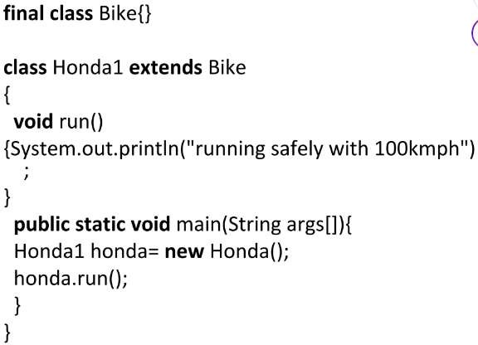
Example

Slide 10
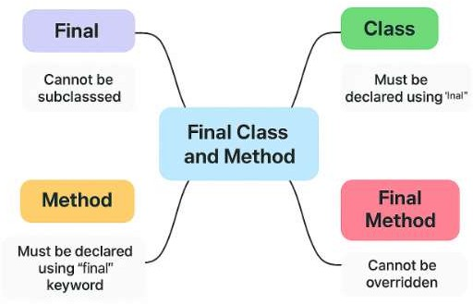
Mind Map

Slide 11
Reference
Herbert Schildt, “Java: The Complete Reference”, 11th Edition, McGraw Hill
Education, New Delhi, 2019
Cay S. Horstmann, “Core Java Fundamentals”, Volume 1, 11th Edition, Prentice Hall, 2018

