Slide 1
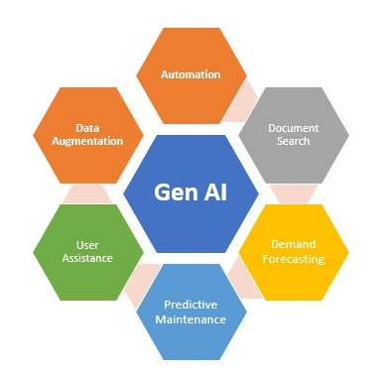
SNS COLLEGE OF TECHNOLOGY
An Autonomous Institution
Coimbatore-35
OPPORTUNITIES & CHALLENGES
UNIT I
INTRODUCTION TO GENERATIVE

Slide 2

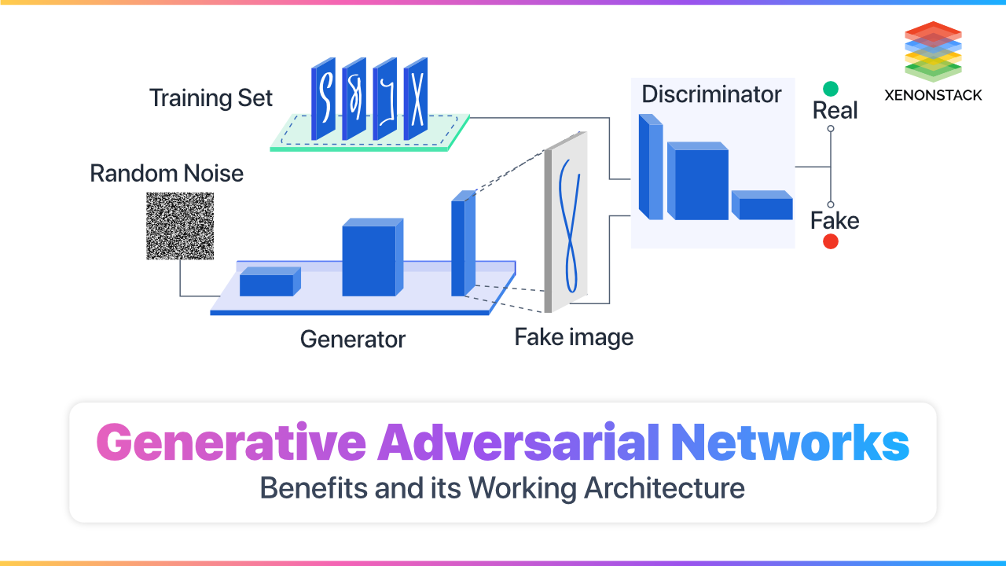




MODEL ARCHITECTURE
Generative Adversarial Networks (GANs)
GANs employ a competitive game between two neural networks that push each other toward excellence, resulting in remarkably realistic generated content.
Generator
Creates synthetic data attempting to fool the discriminator
Discriminator
Distinguishes between real and generated data
Feedback Loop
Both networks improve through competition
Engineering Use Cases: Generate synthetic defect images for training quality control systems • Create realistic surface texture variations for material testing • Produce design alternatives for component optimization

Slide 3
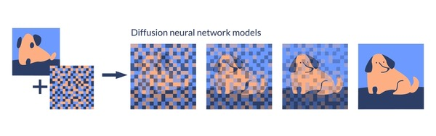
MODEL ARCHITECTURE
Diffusion Models: Step-by-Step Generation
How It Works
Diffusion models learn to progressively remove noise from random data, creating high-quality outputs through a controlled, iterative refinement process.
01
Start with Noise
Begin with random noise data
02
Iterative Denoising
Gradually remove noise step-by-step
03
Final Output
Generate highly realistic result
Engineering Applications
High-fidelity image synthesis for visualization
Design variation generation with controlled parameters
Stable and predictable output quality
Complex geometry creation for 3D modeling

Slide 4
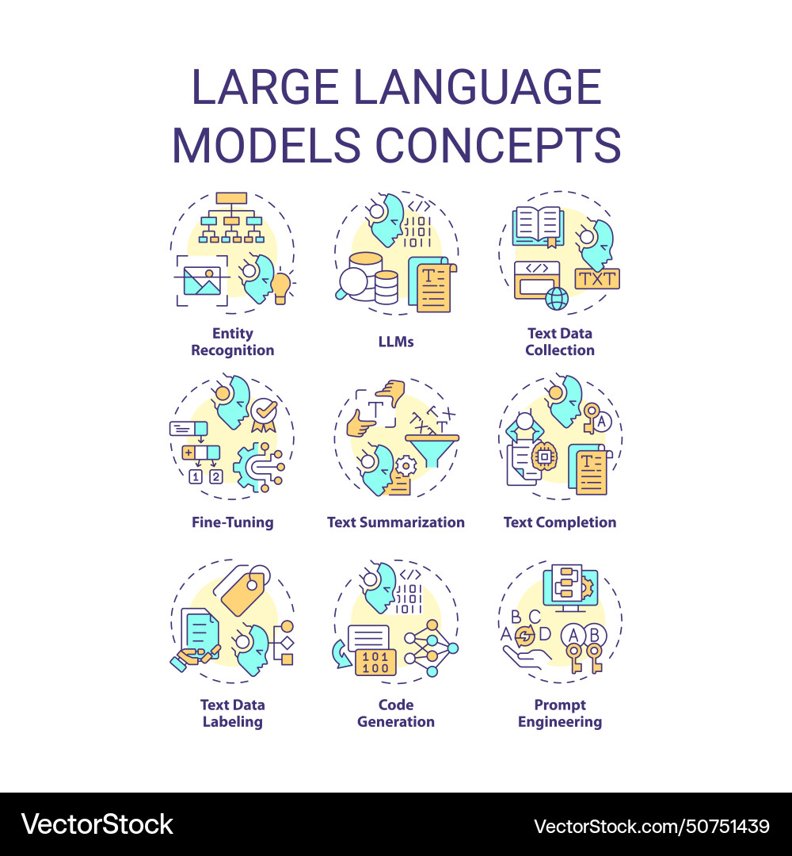
MODEL ARCHITECTURE
Large Language Models (LLMs)
LLMs are trained on vast amounts of text data, enabling them to understand context, follow instructions, and generate human-quality language across diverse applications.
Technical Documentation
Automated report drafting, specifications, and documentation generation
Code Generation
Writing, debugging, and optimizing code in multiple programming languages
Design Documentation
Creating detailed design descriptions, assembly instructions, and technical manuals

Slide 5
MODEL ARCHITECTURE
Large Language Models (LLMs)
175B
45TB
50+
Parameters
Training Data
Languages
Modern LLMs contain billions of trainable parameters
Trained on massive text datasets from diverse sources
Support for multiple natural and programming languages

Slide 6



AI can Write
Within a week that would include word processors like Word/Docs & tools like Grammarly
Grammarly: Grammarly is a popular writing assistant tool that uses AI to check for grammar, punctuation, and spelling errors
Google Docs: While not specifically a writing assistant tool, Google Docs uses AI to help users write more effectively.
"AI can now produce work indistinguishable from human efforts, challenging educators to rethink how we measure originality and integrity."
Microsoft Word: Microsoft Word also uses AI to help users improve their writing.
– Bowen & Watson, Teaching with AI.

Slide 7
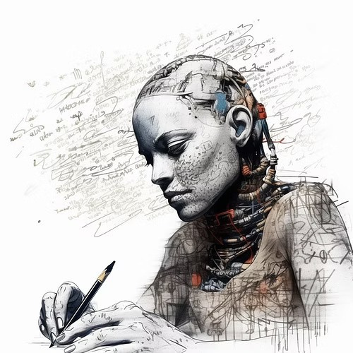
New Rhetorics: “AI Literacy”
As writers, we must consider the ways AI writing technologies are changing the way we write and how we conceive of writing itself.
As professionals, we must consider how the emergence of AI writing tools opens up new careers and job opportunities.
As educators, we must consider the possibilities of AI writing to empower ourselves and our students. By integrating AI writing tools, we can teach students to think critically about the information generated by AI, develop their creativity by using AI as a collaborative tool, and improve their digital literacy skills

Slide 8
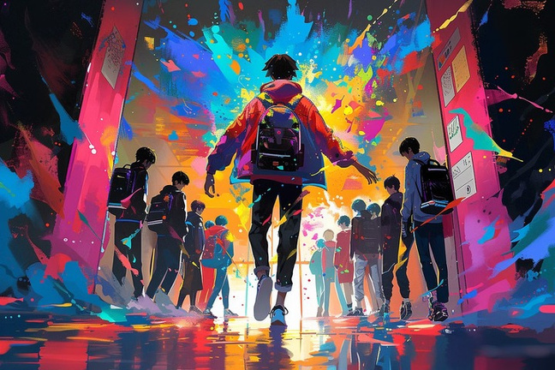
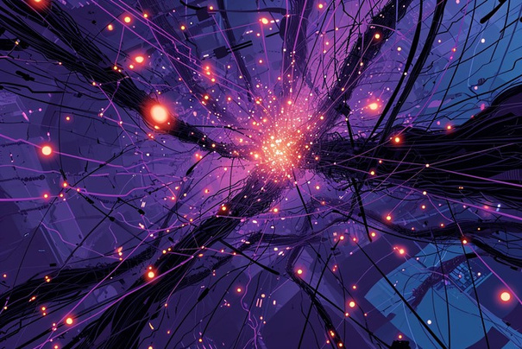
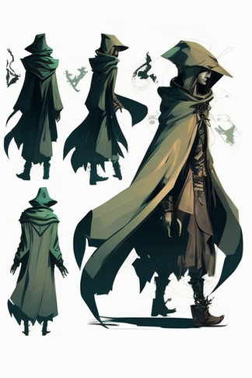



But it can do much more...
Generate Artworks
You can create characters, scenes & settings, models, graphics, and even worlds using AI!

Slide 9

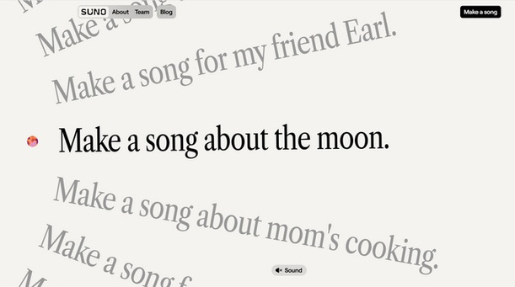


But it can do much more...
Generate Video
Generate Audio/Music
https://suno.com/about
https://openai.com/sora

Slide 10
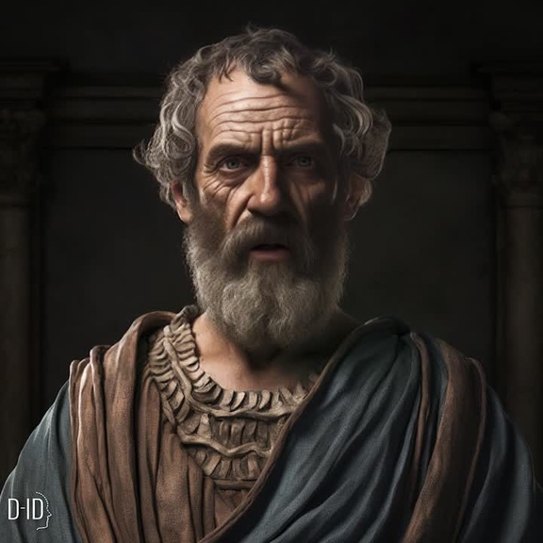
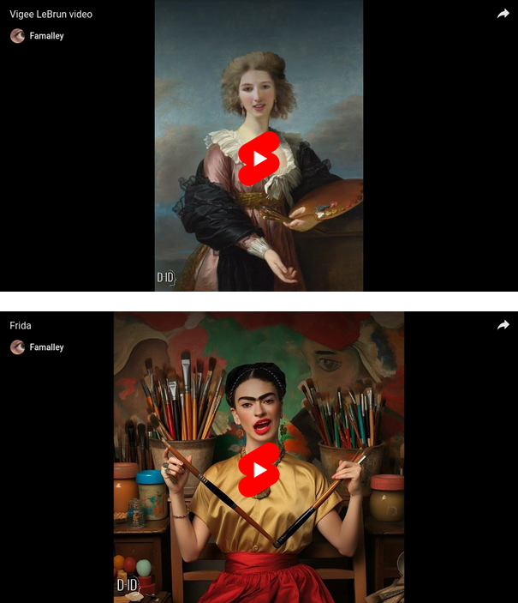

But it can do much more...
Create AI Agents

Slide 11
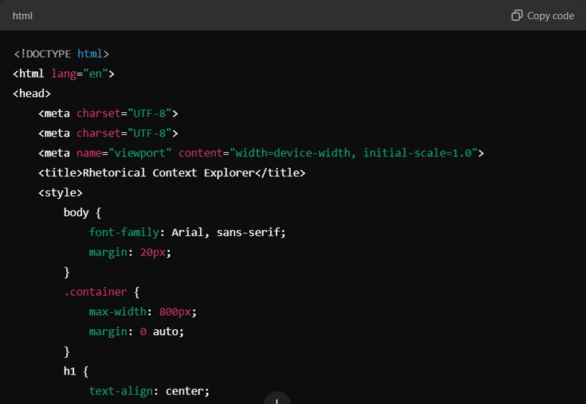
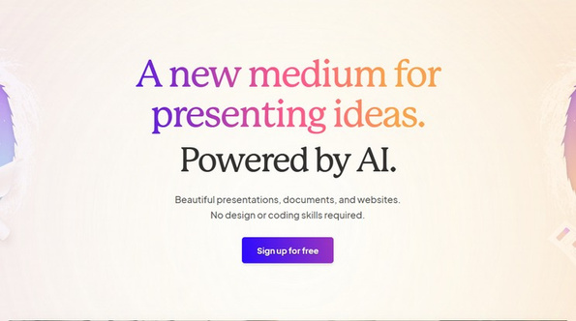

But it can do much more...
Design Websites & Interactive Presentations
Code
Automating repetitive coding tasks. Generating boilerplate code.
Assisting in debugging and finding solutions.
Helping beginners by explaining code.
https://gamma.app

Slide 12
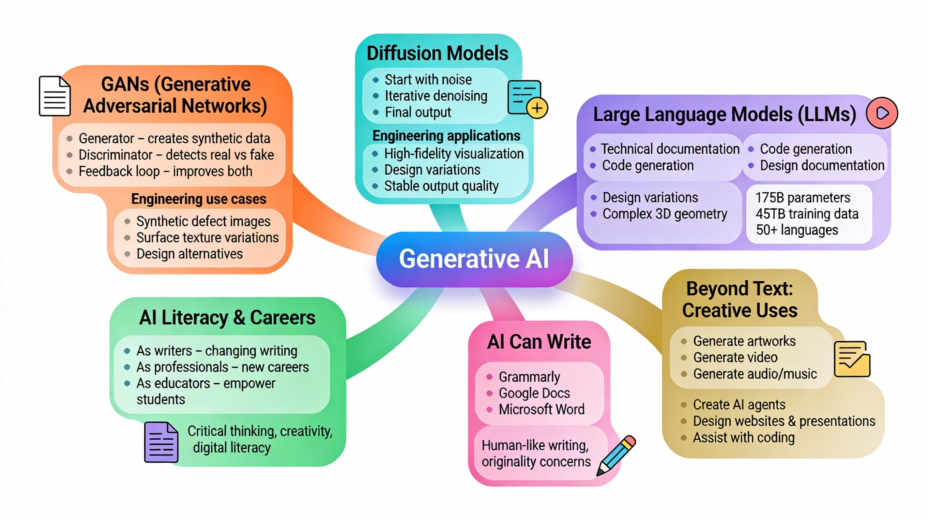
Let’s Recall!

Slide 13


