Slide 1
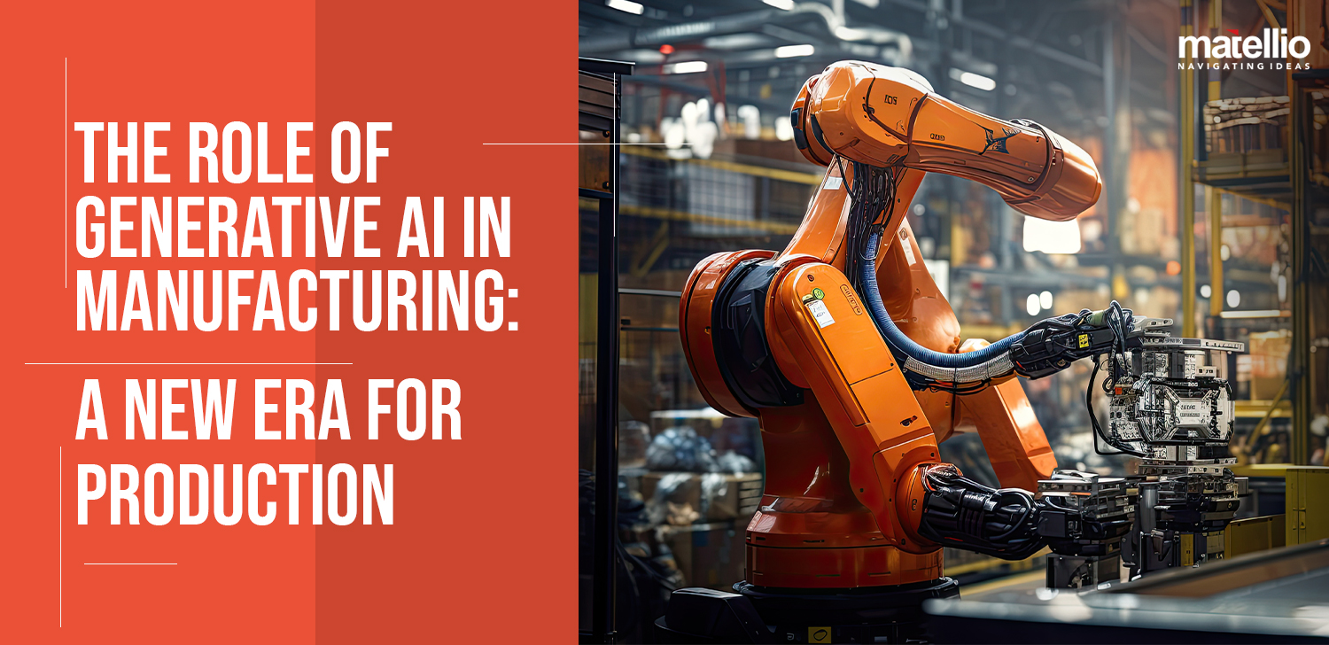
SNS COLLEGE OF TECHNOLOGY An Autonomous Institution
Coimbatore-35
Generative AI in Engineering: Manufacturing, Design & Automation
Unit I – Introduction to Generative AI

Slide 2

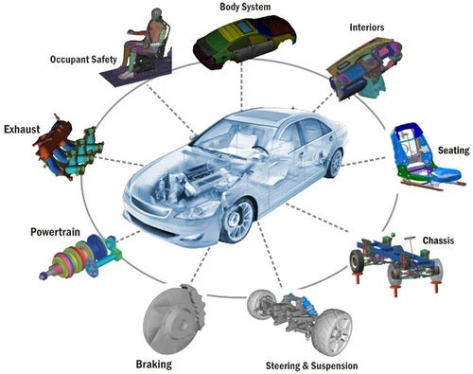


Why Generative AI in Engineering?
FUNDAMENTALS
Rising Complexity
Modern systems demand multi-variable optimization across interconnected components and subsystems

Slide 3
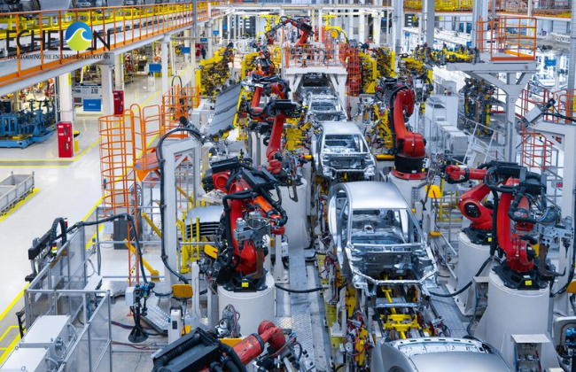
Why Generative AI in Engineering?
FUNDAMENTALS
Speed Demands
Market pressures require accelerated product development cycles without compromising quality

Slide 4

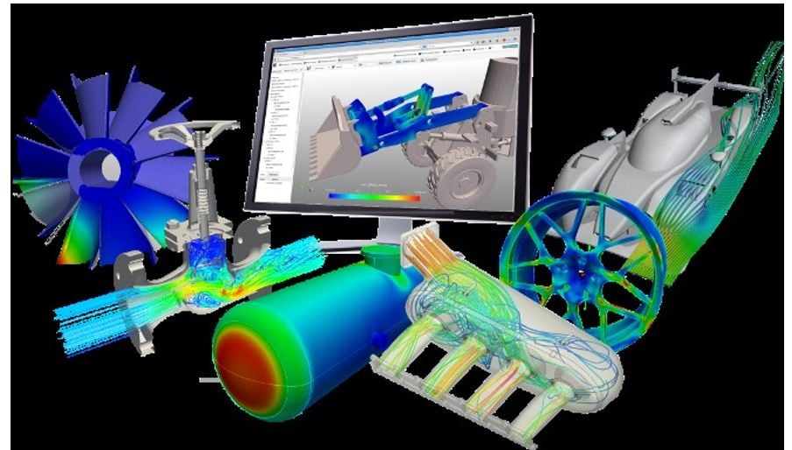
Why Generative AI in Engineering?
FUNDAMENTALS
Tool Limitations
Traditional rule-based engineering software struggles with non-linear problems and novel scenarios

Slide 5

Why Generative AI in Engineering?
FUNDAMENTALS
Intelligent Automation
AI enables adaptive systems that learn from data and improve decision-making autonomously

Slide 6
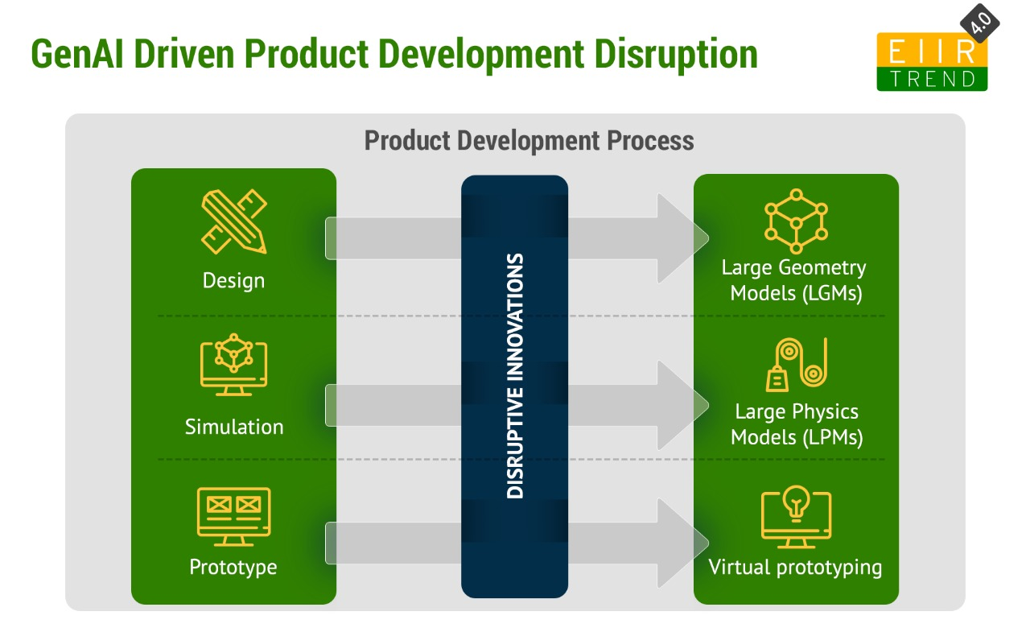
Engineering Workflow: Before vs After GenAI
TRANSFORMATION
Traditional Approach
With Generative AI
Manual design iterations taking weeks
Automated design generation in hours
Trial-and-error testing cycles
Data-driven parameter tuning
Limited design exploration
Comprehensive solution space coverage
Sequential optimization phases
Parallel multi-objective optimization
High resource consumption
Efficient resource utilization

Slide 7

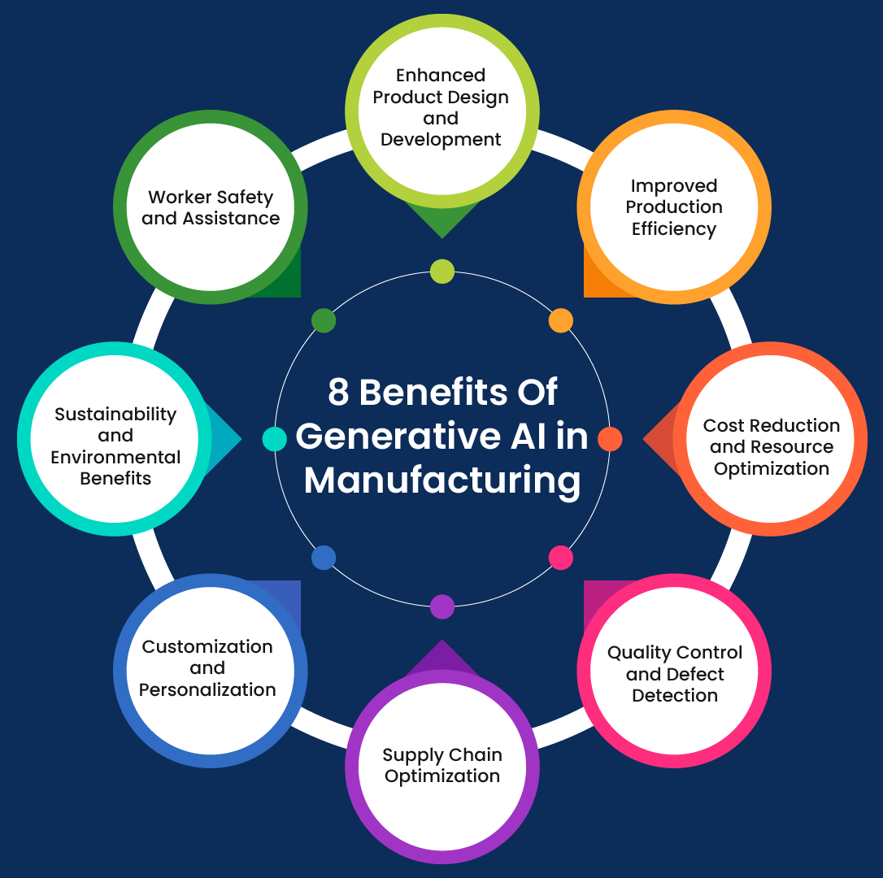
Generative AI in Manufacturing
MANUFACTURING
AI transforms production by generating optimal parameters, creating synthetic training data for rare scenarios, and predicting quality outcomes before physical production begins.
1
2
Process Optimization
Synthetic Data Creation
AI recommends machining parameters like cutting speed, feed rate, and depth of cut based on material properties and desired outcomes
Generate realistic fault patterns and defect scenarios for training predictive models without costly real-world failures
3
Quality Prediction
Forecast surface finish, dimensional accuracy, and defect probability before production run initiation

Slide 8
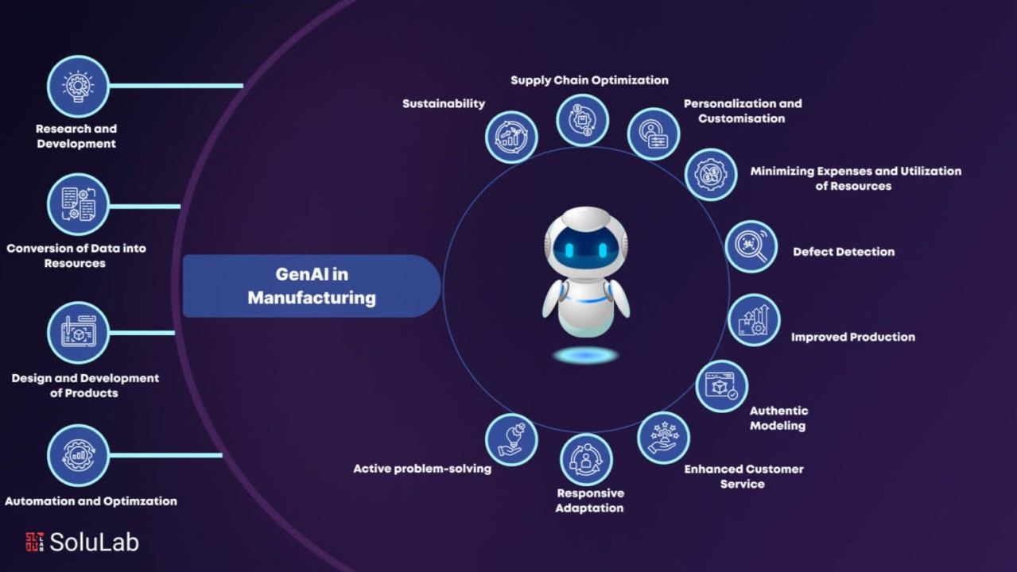



Smart Manufacturing Applications
Predictive Maintenance
Tool Wear Estimation
Surface Finish Optimization
AI analyzes vibration, temperature, and acoustic data to forecast equipment failures before breakdowns occur
Monitor cutting tool condition in real-time during turning and milling operations to optimize replacement timing
Generate parameter combinations that achieve target roughness values while minimizing cycle time and tool wear

Slide 9



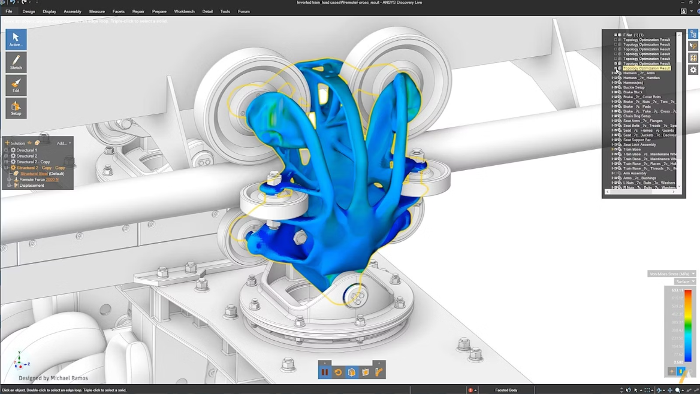

Generative AI in Engineering Design
DESIGN
AI revolutionizes the design process by automatically generating multiple concept variants, exploring vast design spaces that would take humans months to evaluate, and synthesizing solutions that meet complex engineering constraints.
Automated Concept Generation
Design Space Exploration
AI produces diverse design alternatives based on functional requirements and constraints
Systematically evaluate thousands of configurations to identify optimal solutions
Constraint-Based Synthesis
Generate designs that inherently satisfy manufacturing, material, and performance limitations

Slide 10
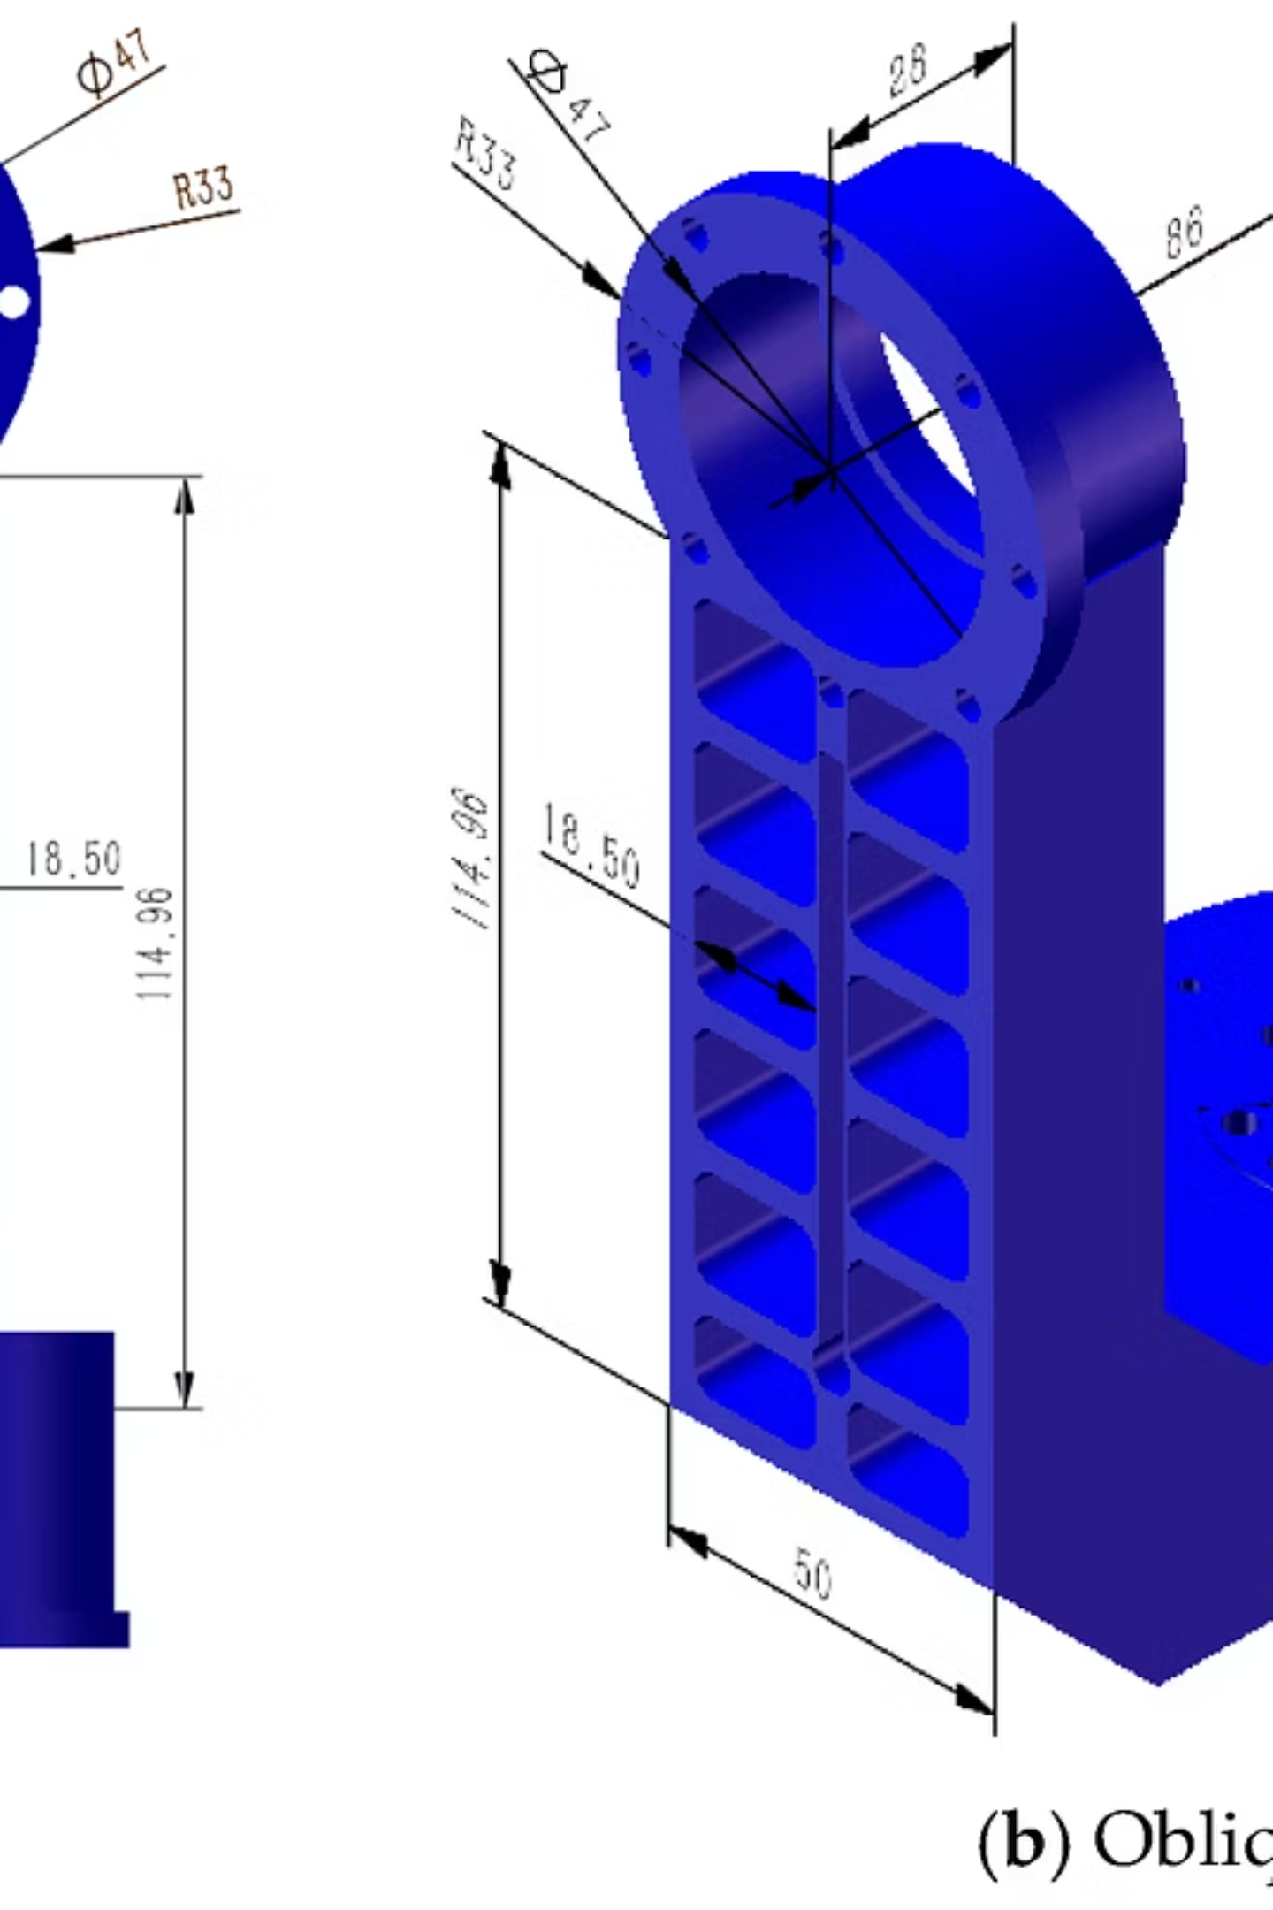




Generative Design & Topology Optimization
Generative design uses AI algorithms to create multiple optimized solutions simultaneously. The system explores geometric possibilities while respecting constraints like load paths, mounting points, and material limits.
Weight Reduction
Remove unnecessary material while maintaining structural integrity
Strength Optimization
Align material along stress paths for maximum load-bearing capacity
Material Efficiency
Minimize raw material usage and manufacturing waste
Human Selection
Engineer evaluates AI-generated options and chooses final design

Slide 11

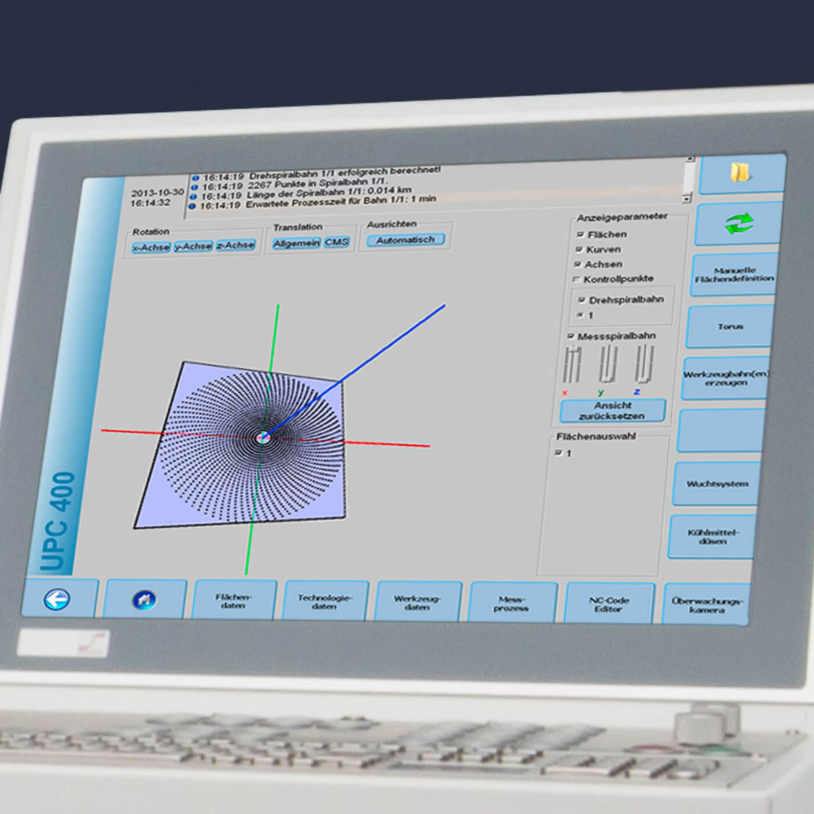
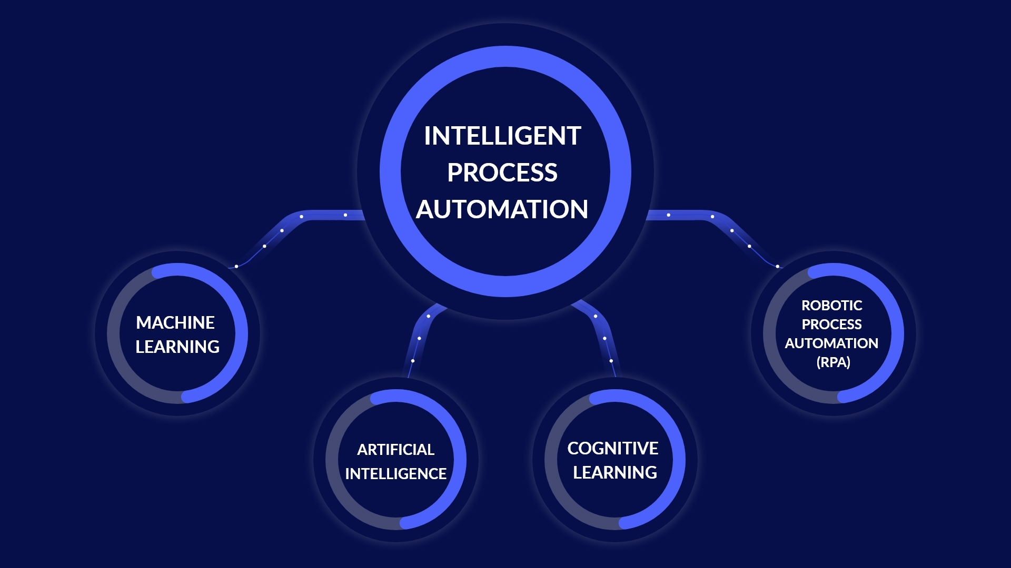
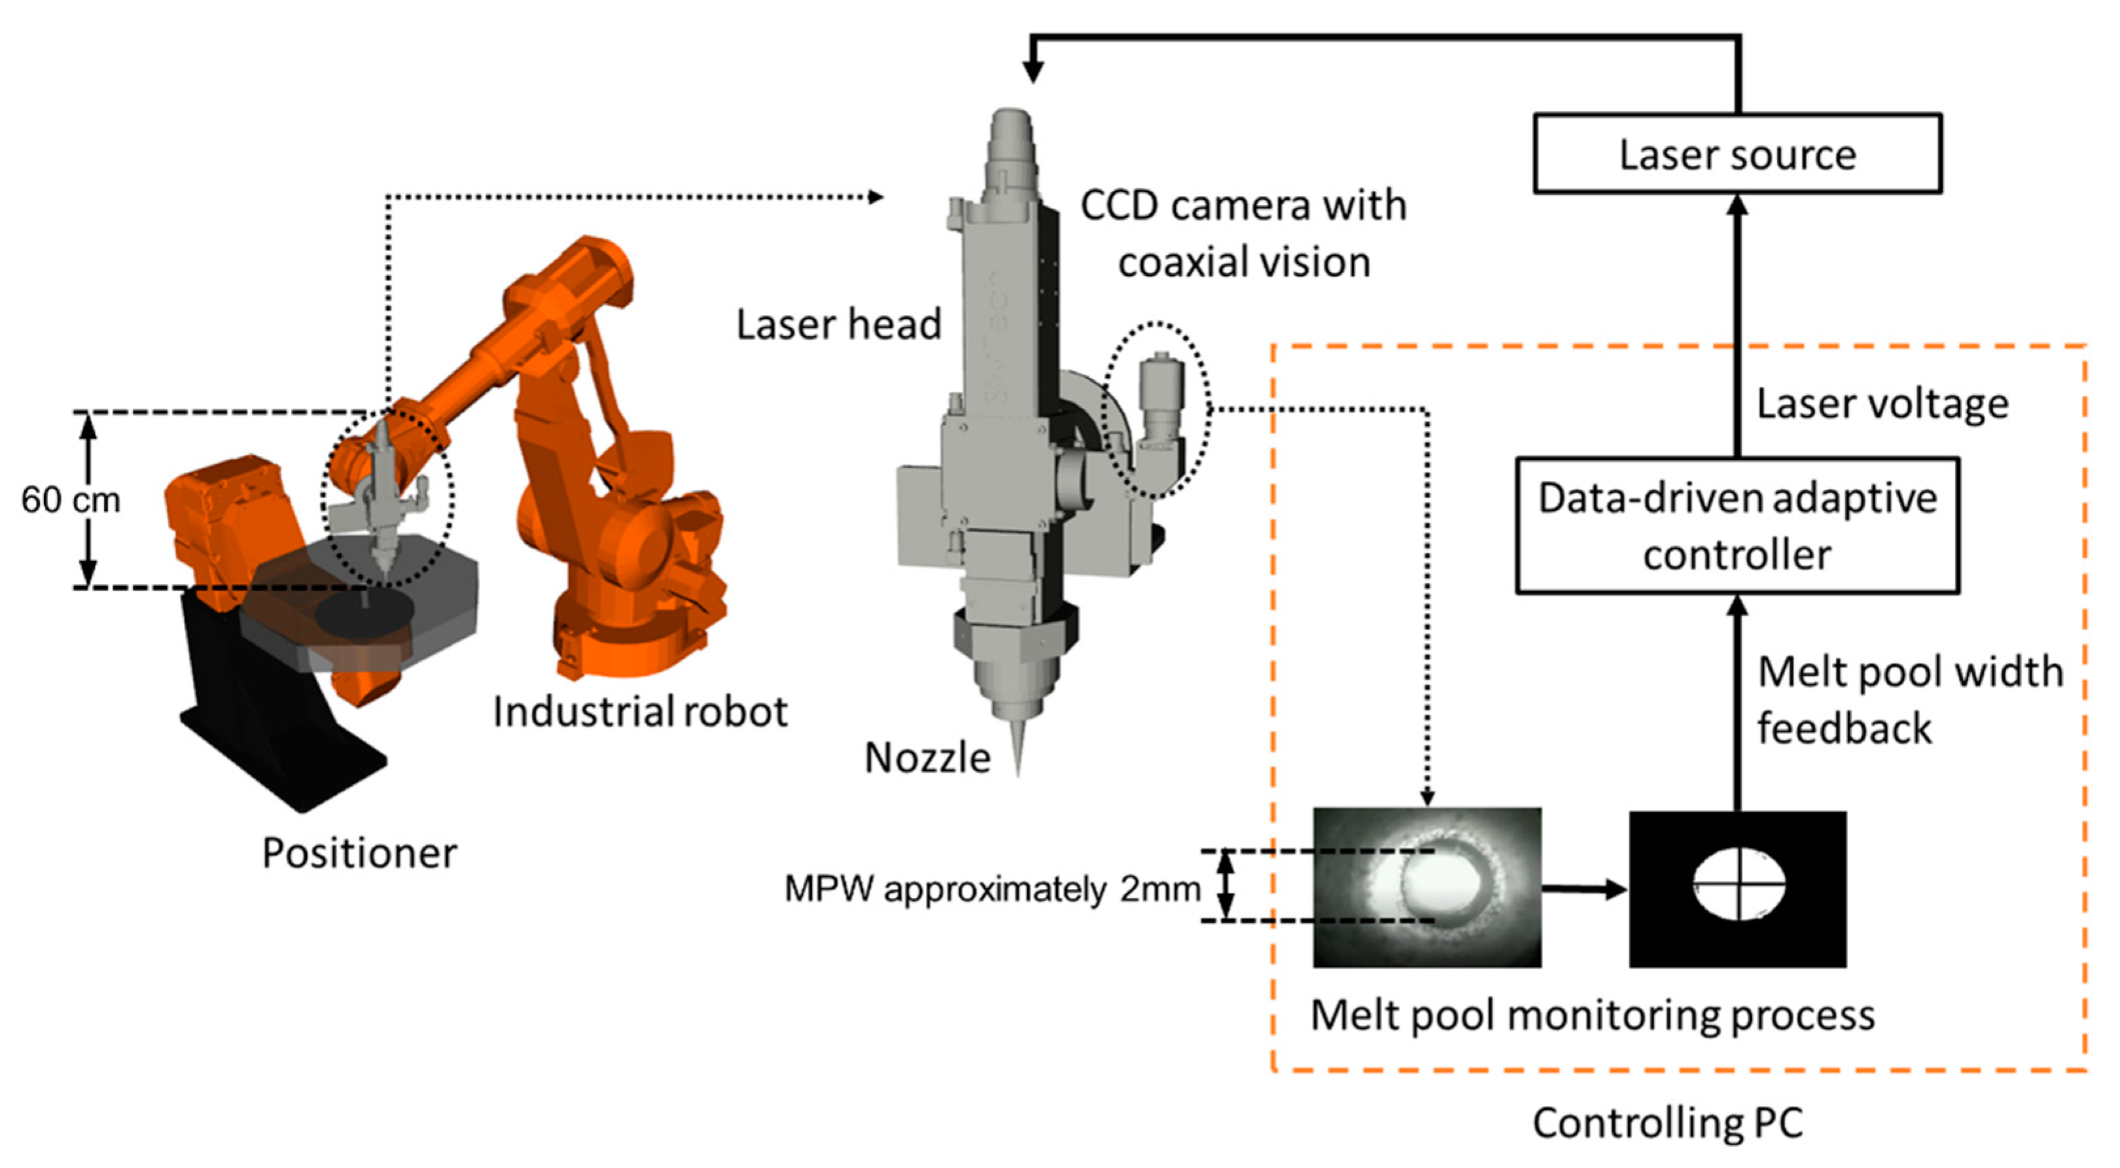
Generative AI in Automation
AUTOMATION
AI enhances automation by generating intelligent process plans, optimizing production schedules dynamically, and developing adaptive control strategies that respond to real-time conditions.
Process Planning
Intelligent Scheduling
Adaptive Control
CNC operation sequencing
Dynamic job prioritization
Real-time parameter adjustment
Tool path generation
Resource allocation
Assembly sequencing
Setup optimization
Bottleneck prediction
Quality-based feedback

Slide 12





Human–AI Collaboration in Engineering
Engineer Sets Goals
AI Generates Options
AI Refines Solutions
Engineer Reviews Feedback
Key Insight: Augmentation, Not Replacement
Generative AI amplifies human creativity and expertise by handling computational complexity, freeing engineers to focus on innovation, judgment, and strategic decision-making. The most powerful solutions emerge from combining human domain knowledge with AI's exploratory capabilities.
70%
3x
85%
Design Time Reduction
More Alternatives
Engineer Satisfaction
When engineers work with AI tools
Explored compared to manual methods
With AI-assisted design processes

Slide 13
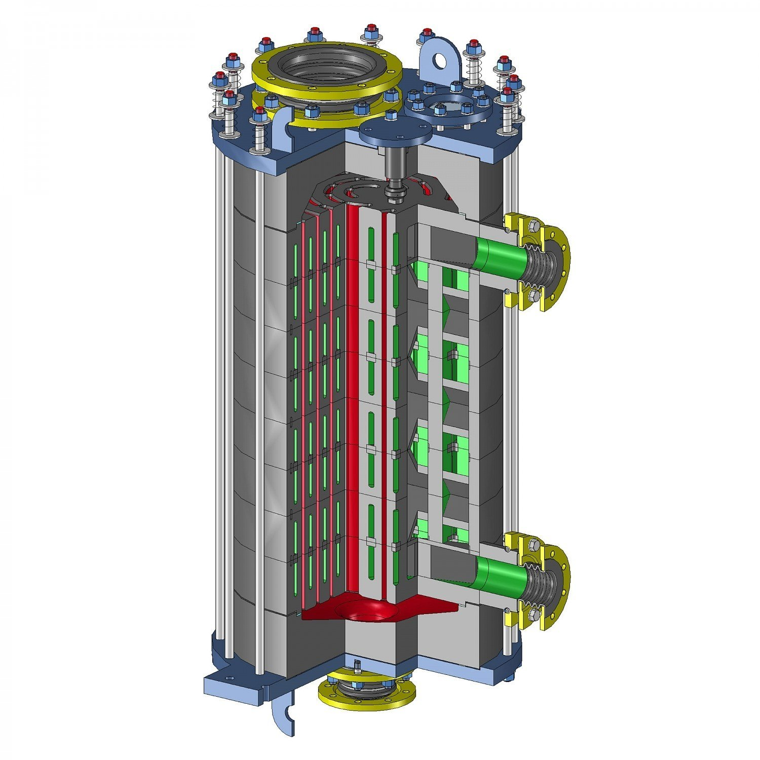

Engineering Optimization: A Practical Example
CASE STUDY
Problem Identification
Manual optimization of heat exchanger design taking 3-4 weeks per iteration with limited design variants explored
GenAI Implementation
AI generates 500+ design configurations in 8 hours, evaluating thermal performance, pressure drop, and manufacturability simultaneously
Solution Evaluation
Engineer reviews top 20 candidates using AI-provided performance data, material costs, and manufacturing complexity scores
Optimized Outcome
15% better thermal efficiency, 20% weight reduction, and 80% faster design cycle achieved through human-AI collaboration

Slide 14
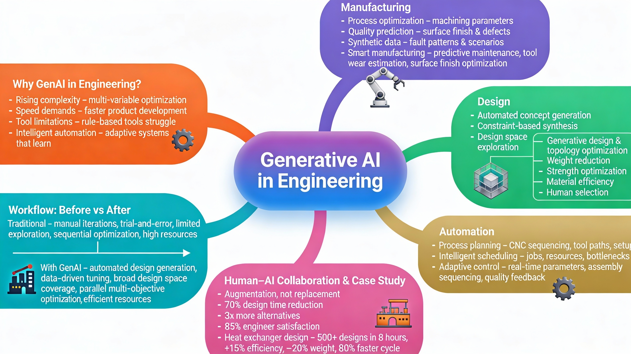
Let’s Recap!

Slide 15


