Slide 1


SNS College of Technology
(An Autonomous Institutions)
Department of Computer Science and Engineering
23CSB201-Object Oriented Programming
Topic: Inheritance
Mrs.G.Swathi
Assistant Professor

Slide 2
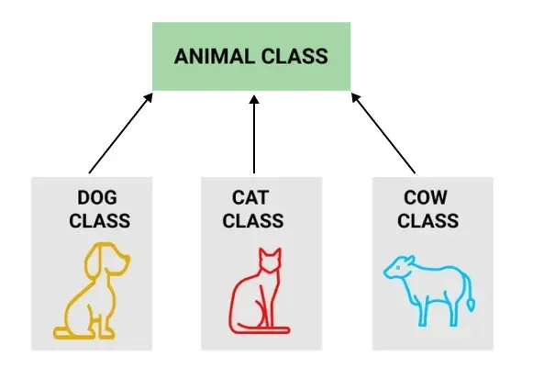
Inheritance
Inheritance means creating new classes based on existing ones.
A class that inherits from another class can reuse the methods and fields of that class.
It is the mechanism in Java by which one class is allowed to inherit the features(fields and methods) of another class.

Slide 3
Usage of Inheritance
Code Reusability: The code written in the Superclass is common to all subclasses. Child classes can directly use the parent class code.
Method Overriding: Method Overriding is achievable only through Inheritance. It is one of the ways by which Java achieves Run Time Polymorphism.
Abstraction: The concept of abstraction where we do not have to provide all details, is achieved through inheritance. Abstraction only shows the functionality to the user.

Slide 4
Key Terminologies
Class: Class is a set of objects that share common characteristics/ behavior and common properties/ attributes. Class is not a real-world entity. It is just a template or blueprint or prototype from which objects are created.
Super Class/Parent Class: The class whose features are inherited is known as a superclass(or a base class or a parent class).
Sub Class/Child Class: The class that inherits the other class is known as a subclass(or a derived class, extended class or child class). The subclass can add its own fields and methods in addition to the superclass fields and methods.
Extends Keyword: This keyword is used to inherit properties from a superclass.

Slide 5
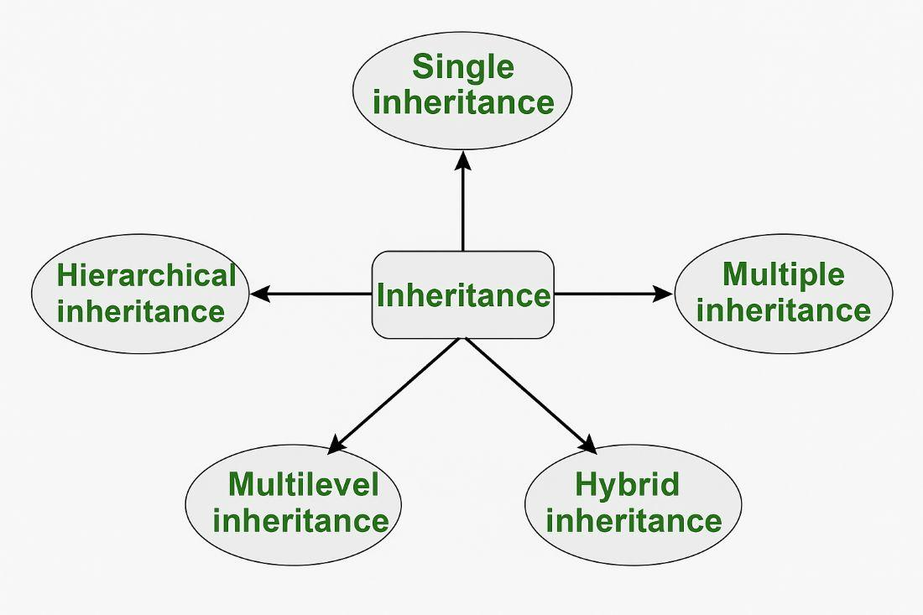
Types of Inheritance

Slide 6
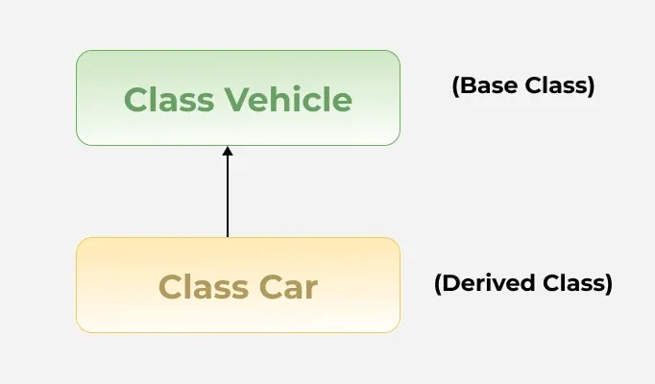
Single Inheritance
In single inheritance, a sub-class is derived from only one super class.
It inherits the properties and behavior of a single-parent class.

Slide 7

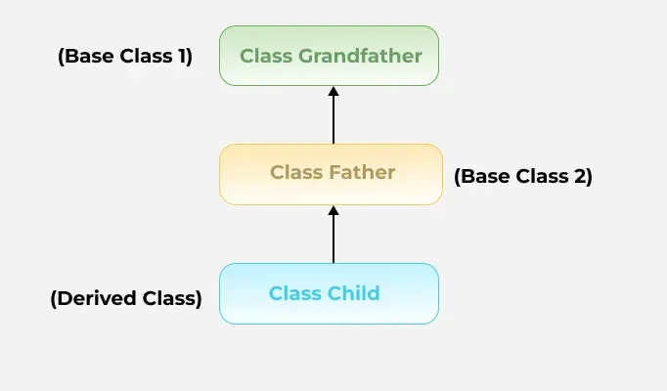
Multilevel Inheritance
In Multilevel Inheritance, a derived class will be inheriting a base class and as well as the derived class also acts as the base class for other classes.

Slide 8

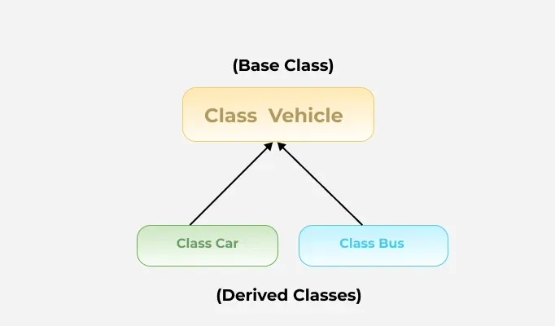
Hierarchical Inheritance
In hierarchical inheritance, more than one subclass is inherited from a single base class. i.e. more than one derived class is created from a single base class. For example, cars and buses both are vehicle

Slide 9

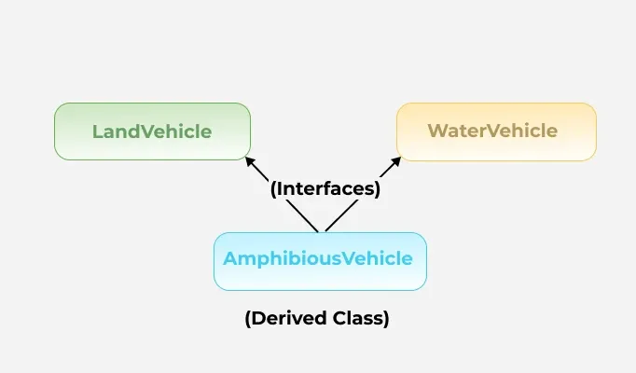
Multiple Inheritance
In Multiple inheritances, one class can have more than one superclass and inherit features from all parent classes.

Slide 10

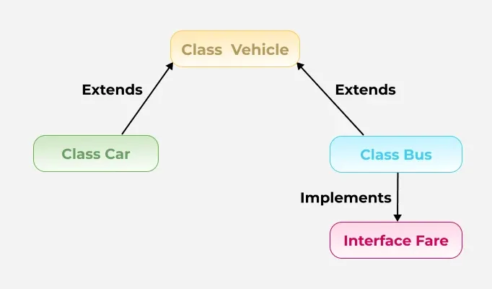
Hybrid Inheritance
It is a mix of two or more of the above types of inheritance.
In Java, we can achieve hybrid inheritance only through Interfaces if we want to involve multiple inheritance to implement Hybrid inheritance.

Slide 11
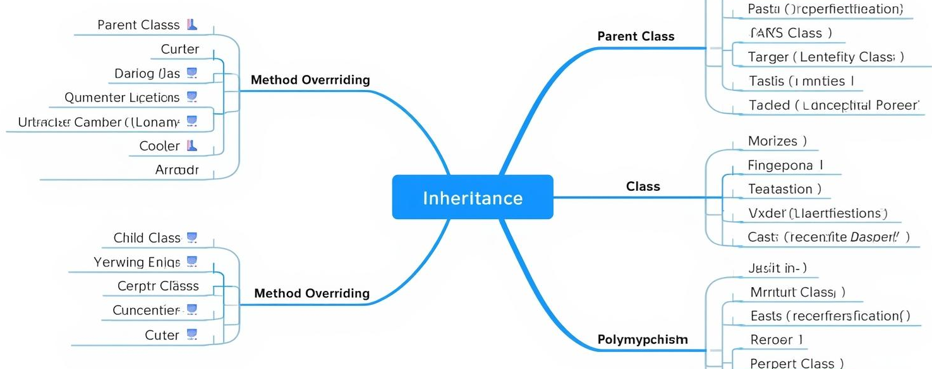
Mind Map

