Slide 1


SNS COLLEGE OF TECHNOLOGY
An Autonomous Institution Coimbatore-35
Department of Electronics and Communication Engineering
23EET103-Electrical Circuits and Electron Devices
I CSE-IOT / II SEMESTER UNIT II: AC CIRCUITS
Topic 3: Instantaneous power and power factor

Slide 2
Topicsfor discussion
Fundamentals of AC Power
Concept of Instantaneous Power
Mathematical Derivation of Instantaneous Power
Power in Resistive, Inductive, and Capacitive Loads
Average, Reactive, and Apparent Power
Power Triangle Representation
Definition and Significance of Power Factor
Types of Power Factor (Lagging, Leading, Unity)
Effects of Low Power Factor on Systems
Methods of Power Factor Improvement
Measurement of Power and Power Factor
Industrial and Real-World Applications
Summary and Future Scope
06-01-2026
2/12

Slide 3
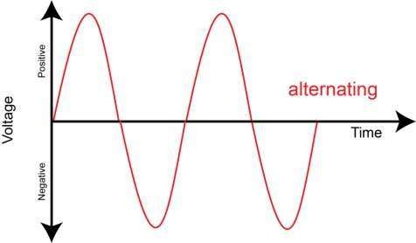
Fundamentals of AC Power
Alternating Current (AC) changes direction and magnitude with time.
AC voltage and current are sinusoidal in nature.
Power in AC circuits is not constant — it varies with time.
Three major types of power:
Real Power (P) – actual energy consumed Reactive Power (Q) – energy stored and released Apparent Power (S) – total supplied power
06-01-2026
3/12

Slide 4
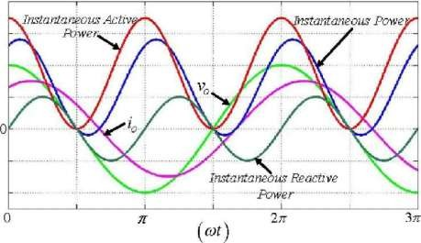
Concept of Instantaneous Power
Defined as the product of instantaneous voltage and current.
Formula: 𝑝(𝑡)=𝑣(𝑡)×𝑖(𝑡)p(t)=v(t)×i(t)
Represents the rate of energy transfer at any instant of time.
Varies continuously with the phase difference (φ)
between voltage and c
06-01-2026
4/12

Slide 5
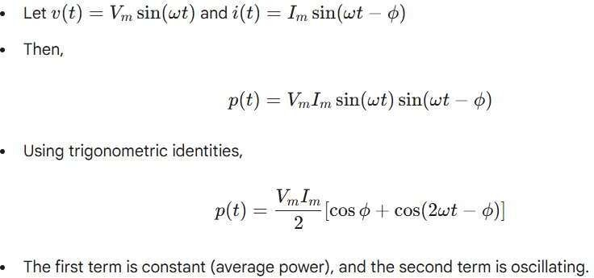
Mathematical Derivation of Instantaneous Power
06-01-2026
5/12

Slide 6
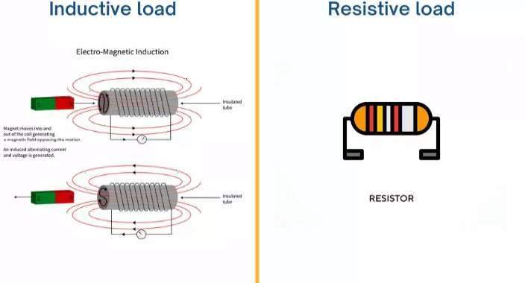
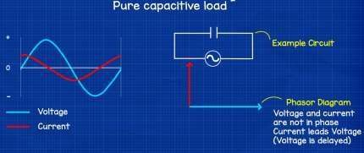
Power in Resistive, Inductive, and Capacitive Loads
Resistive Load: Voltage and current are in phase → power always positive.
Inductive Load: Current lags voltage → power alternates between positive and negative.
Capacitive Load: Current leads voltage → similar alternating pattern.
The average power for inductive/capacitive loads = 0 (no net energy consumption).
06-01-2026
6/12

Slide 7
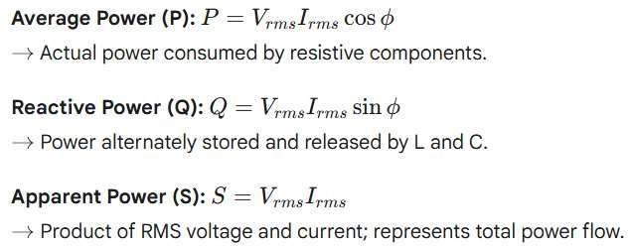
Average, Reactive, and Apparent Power
06-01-2026
7/12

Slide 8
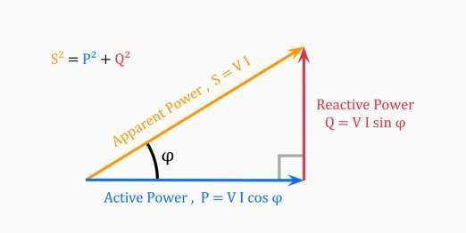

Power Triangle Representation
Right-angled triangle linking P, Q, and S.
Base = Real Power (P), Perpendicular = Reactive Power (Q), Hypotenuse = Apparent Power (S).
Relationship: 𝑆2=𝑃2+𝑄2S2=P2+
The angle (φ) between S and P denotes the phase difference.
06-01-2026
8/12

Slide 9
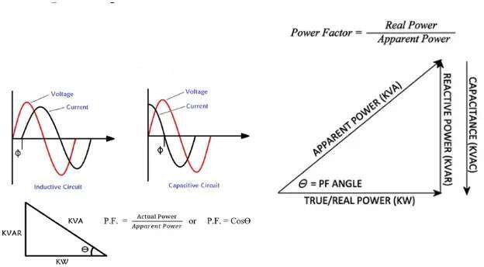
Definition and Significance of Power Factor
Power Factor (p.f.) = cos(φ) = P / S
Indicates efficiency of power utilization.
High p.f. → efficient system, low p.f. → energy losses.
Unity power factor (1.0) means all supplied power is
effectively used.
06-01-2026
9/12

Slide 10
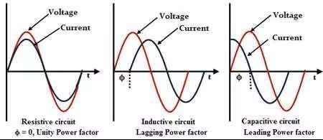
Types of Power Factor (Lagging, Leading, Unity)
Lagging Power Factor: Current lags voltage →
Inductive loads (motors, transformers).
Leading Power Factor: Current leads voltage →
Capacitive loads (capacitor banks).
Unity Power Factor: Voltage and current in phase →
purely resistive load.
06-01-2026
10/12

Slide 11
Summary and Future Scope
Looking ahead, future trends involve integrating power factor monitoring with AI- based smart systems, enabling real-time analysis, predictive maintenance, and automatic power factor correction.
Such intelligent systems can optimize energy usage dynamically, improve grid stability, and enhance overall energy efficiency in industrial and commercial setups.
06-01-2026
11/12

Slide 12
06-10-2025
12/12

