Slide 1
SNS College of Technology (An Autonomous Institutions)
Department of Computer Science and Engineering
23CSB201-Object Oriented Programming
Topic: Interface
Mrs.G.Devi
Assistant Professor

Slide 2
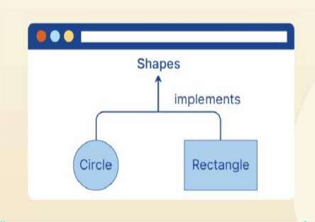
Interface
DT-Empathize
In the empathize stage, we understand that developers need a way to achieve abstraction and multiple inheritance in Java, which leads to the use of interfaces to define common behaviors that different classes can implement in their own way.

Slide 3
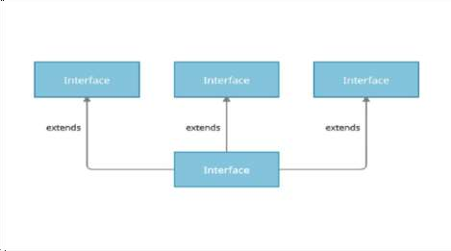
Introduction
Developers often face challenges in designing flexible and reusable
code structures.
Interfaces help address this need by allowing multiple classes to share common functionality while maintaining independent implementations.

Slide 4
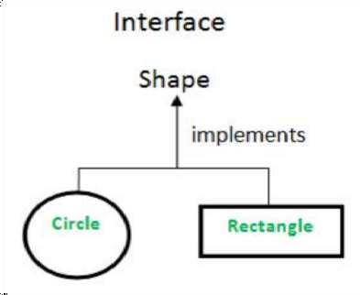
Definition
An interface in Java is a blueprint of a class that contains abstract methods and
constants.

Slide 5
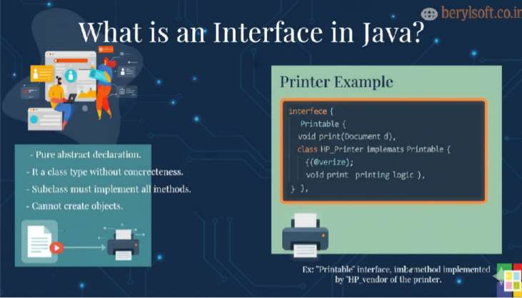
Interface

Slide 6
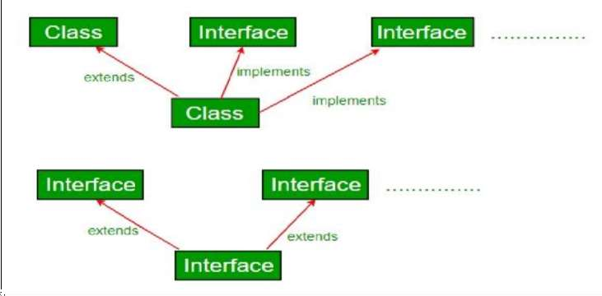
Key Concept

Slide 7
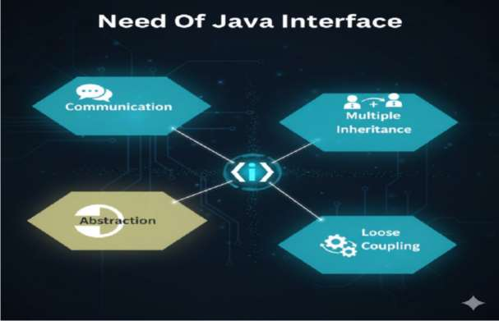
Needs

Slide 8
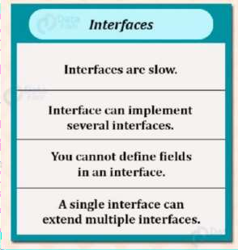
Interface
DT-Define
An interface in Java is a collection of abstract methods that define a contract for classes to implement.
Design a Java program using an interface to define a common
behavior for different types of payment methods.

Slide 9
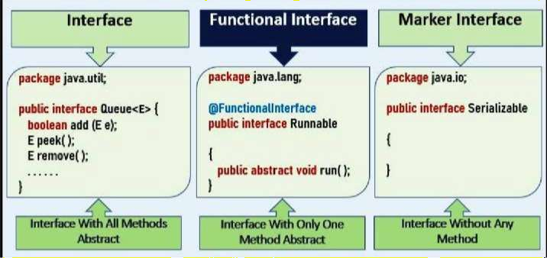
Types of Interface

Slide 10
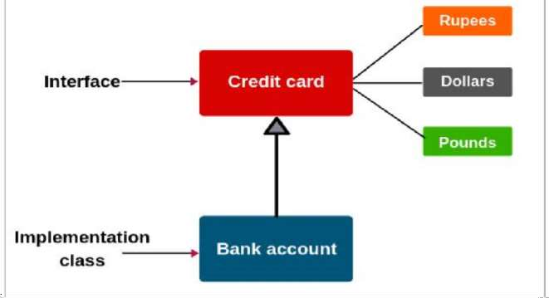
Examples

Slide 11
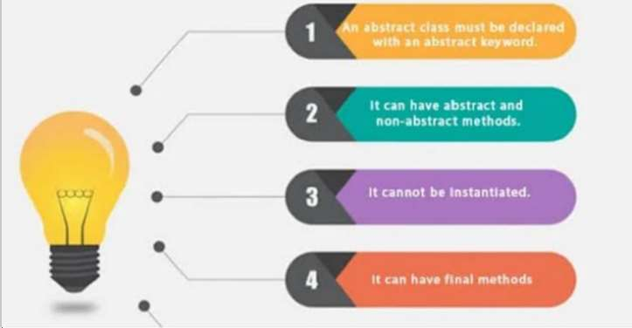
Rules

Slide 12
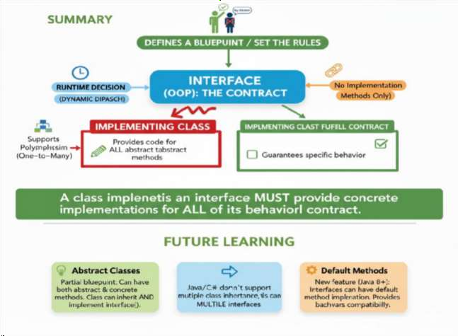
Summary

Slide 13
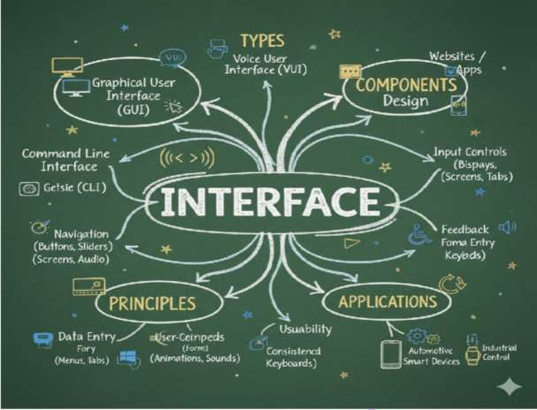
Mind Map

Slide 14
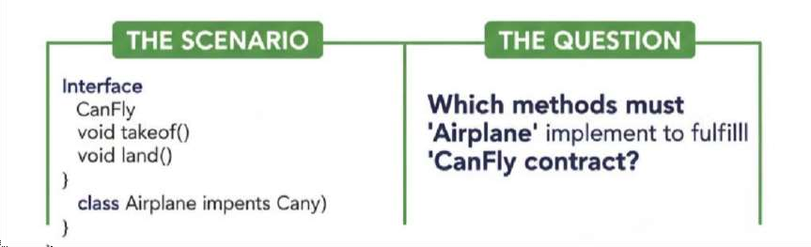
Question to solve

Slide 15
References
E. Balagurusamy, “Programming with Java – A Primer”, 6th Edition,
McGraw Hill Education, New Delhi, 2017.
Paul Deitel and Harvey Deitel, “Java: How to Program”, 11th Edition, Pearson Education, 2017.

