Slide 1
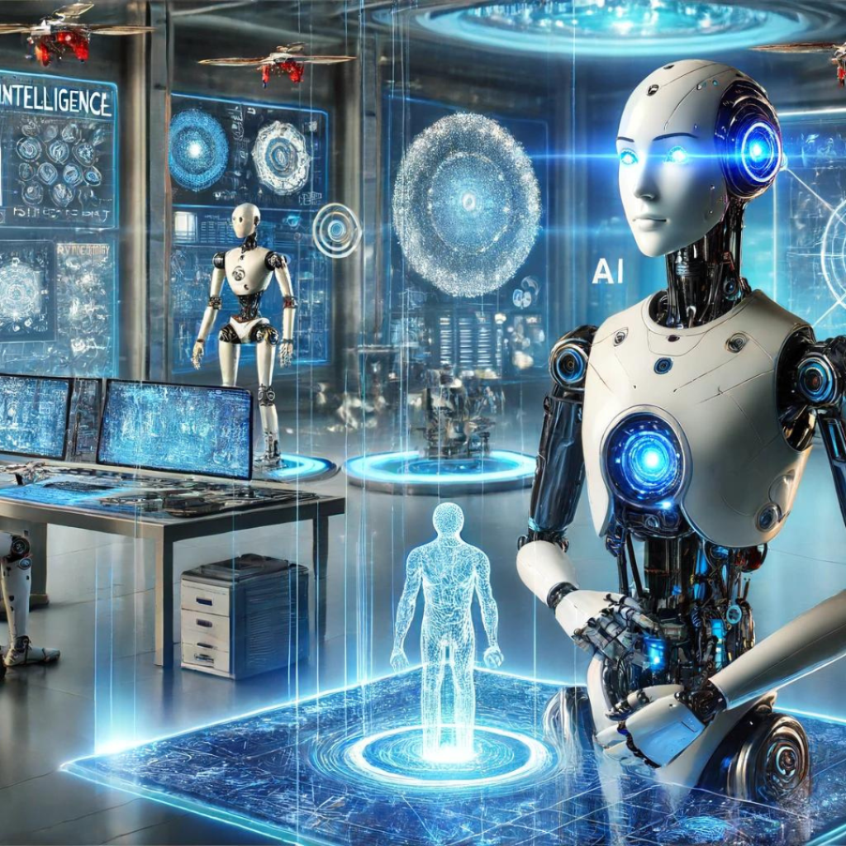
SNS COLLEGE OF TECHNOLOGY An Autonomous Institution
Coimbatore-35
Introduction to AI-Driven Robotics
UNIT I
INTRODUCTION TO GENERATIVE AI

Slide 2
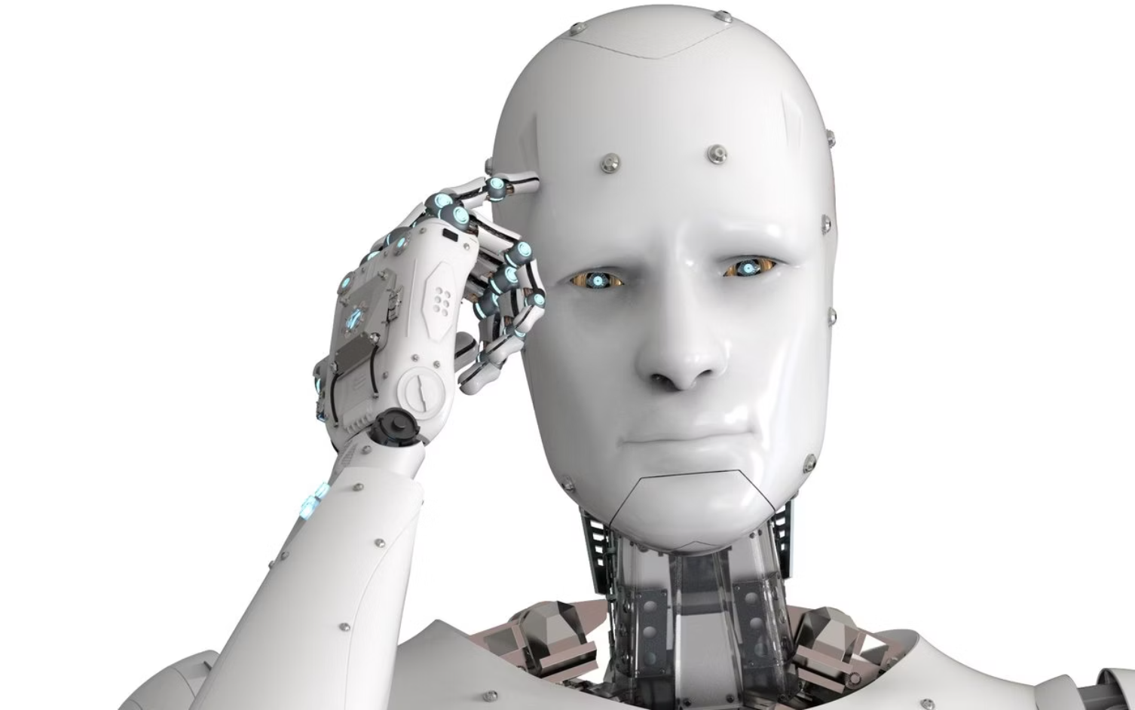
MODULE OVERVIEW
What Are AI-Driven Robots?
Beyond Fixed Programming
AI-driven robots integrate advanced perception, autonomous decision-making, and continuous learning capabilities. Unlike traditional systems, they adapt to environmental changes and task variations in real-time.
These systems move beyond executing pre-programmed motion sequences to intelligently responding to dynamic manufacturing conditions.
Enhanced Perception
Autonomous Decision-Making
Continuous Learning
Multi-sensor integration for environmental awareness
Adaptation through experience and data
Real-time processing and intelligent action selection

Slide 3



Why Robotics Needs AI
Modern manufacturing demands exceed the capabilities of traditional fixed-instruction robotics. AI bridges this gap by enabling adaptive, intelligent automation.
Sense
Think
Act
Multi-modal sensor data acquisition from environment
AI processes information and determines optimal actions
Execute precise, context-aware movements
Traditional Approach
AI-Enabled Approach
Follow predetermined instruction sets
Dynamic response to conditions
Limited to structured environments
Handle uncertainty and variability
Require manual reprogramming for changes
Self-optimize through experience

Slide 4
Core Technologies Behind AI-Driven Robotics
1
2
3
Computer Vision
Machine Learning & Deep Learning
Motion Planning
Real-time visual processing for object recognition, part orientation detection, and quality inspection using deep learning models.
AI-optimized trajectory generation accounting for obstacles, dynamics, and task constraints in real-time.
Neural networks enable pattern recognition, predictive maintenance, and adaptive control strategies from operational data.
4
5
Sensor Fusion
Generative AI Support
Integration of camera, LiDAR, force, and tactile data for comprehensive environmental understanding.
Synthetic data generation, motion synthesis, and simulation for training and planning complex manipulation tasks.

Slide 5
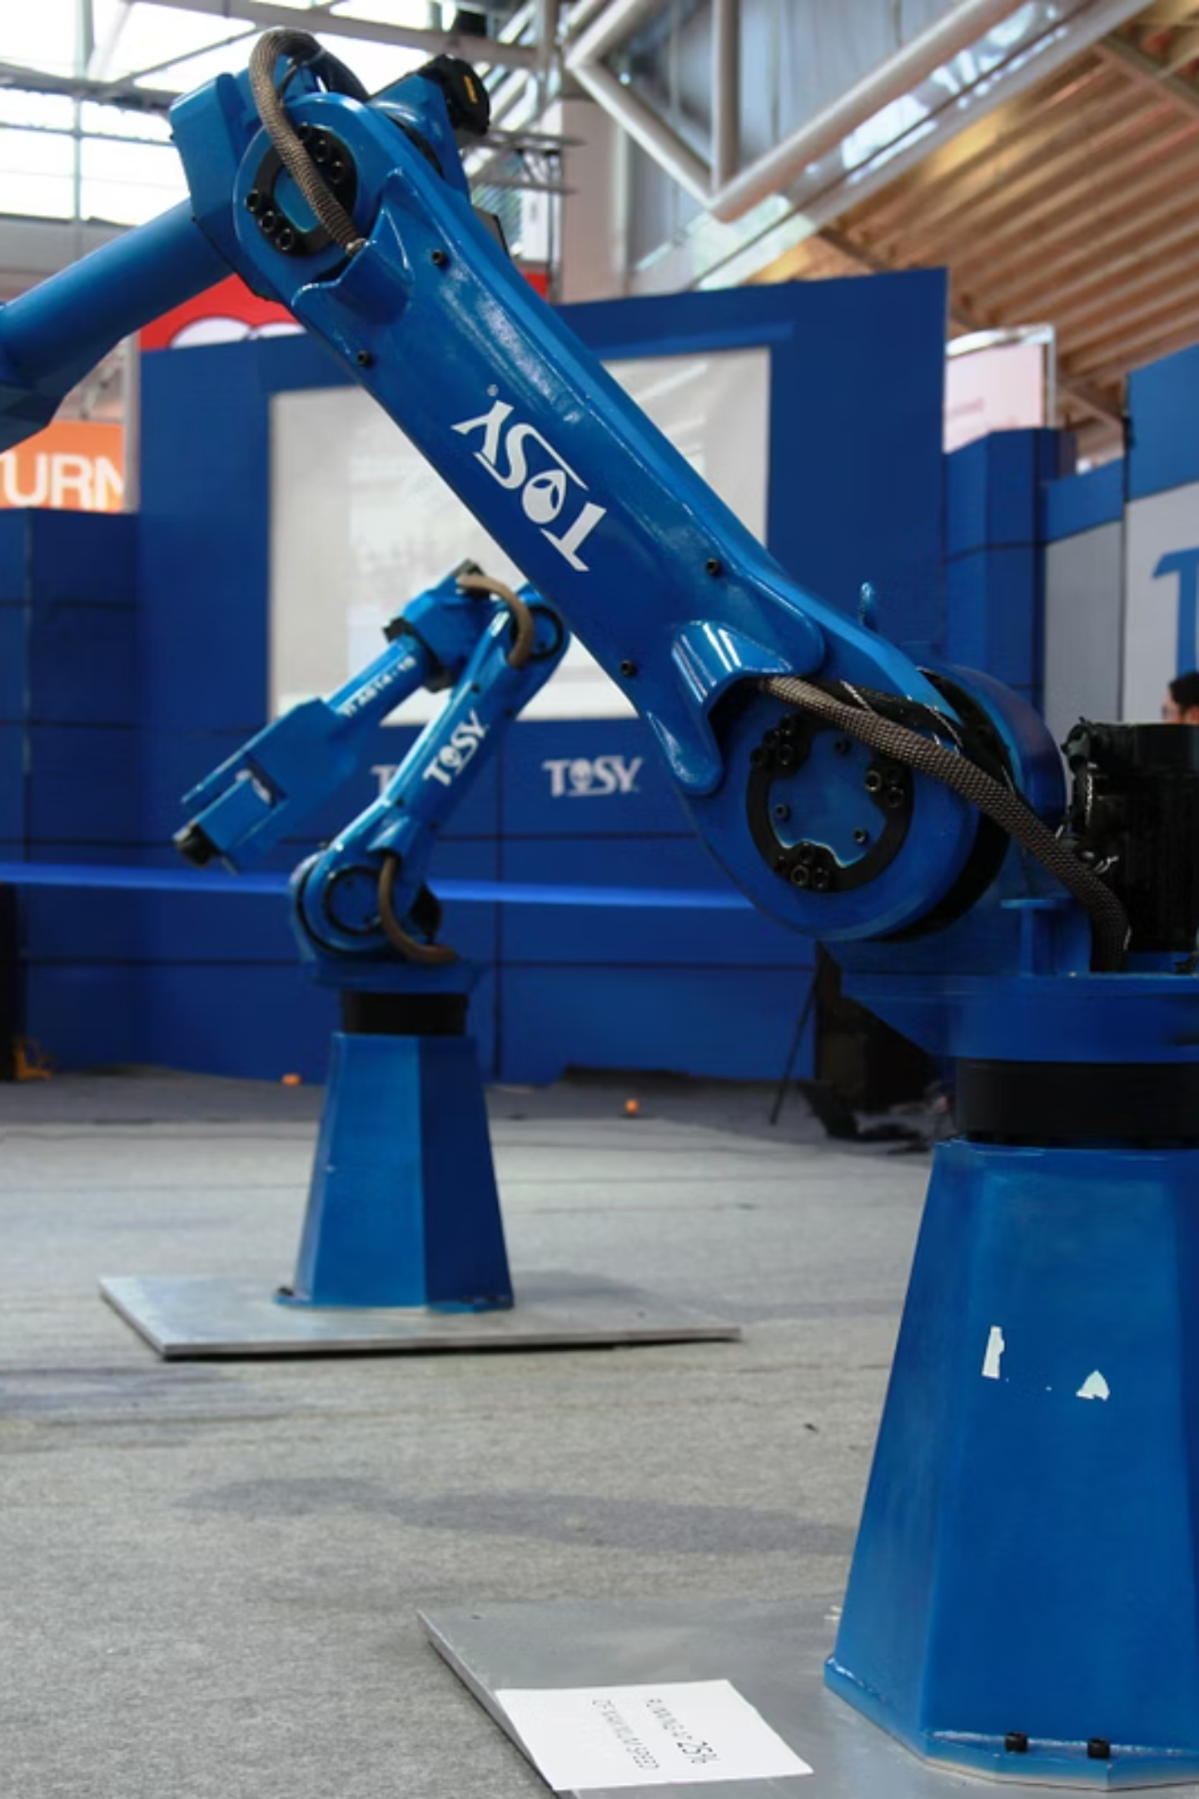
Traditional vs AI-Driven Robotics
The fundamental shift from rigid automation to intelligent, adaptive systems
Traditional Robots
Fixed programming: Hard-coded instruction sequences
Restricted tasks: Single-purpose applications
Controlled environment: Require precise part positioning
Limited sensing: Basic position feedback only
Manual adjustment: Engineering required for changes
AI-Driven Robots
Adaptive behavior: Respond to environmental variations
Multi-task capable: Flexible application range
Handle uncertainty: Function with part variation
Rich perception: Vision, force, and tactile feedback
Self-optimization: Continuous performance improvement

Slide 6

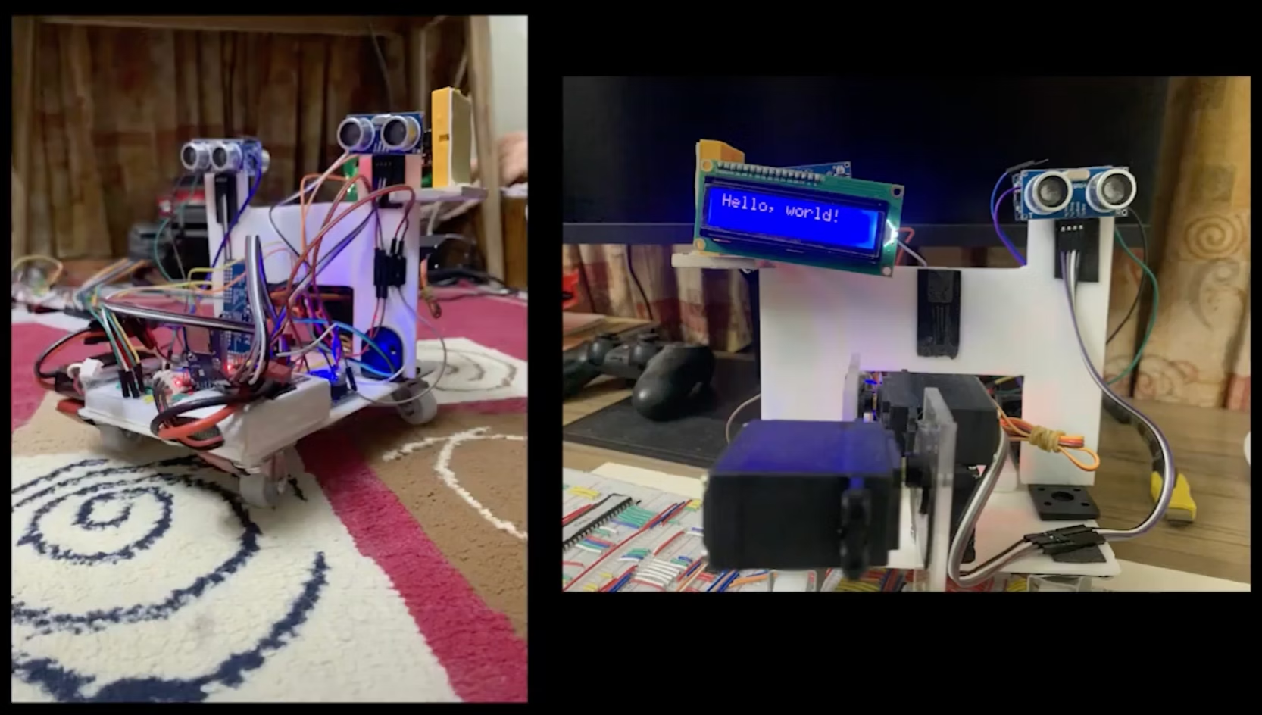
GENERATIVE AI
Role of Generative AI in Robotics
Generative AI models enhance robotic capabilities by creating synthetic training data, optimizing motion trajectories, and enabling planning for complex manipulation tasks.
These systems bridge gaps in sensor data and expand training possibilities beyond physical limitations.
01
02
Motion Trajectory Generation
Sensor Data Simulation
AI models synthesize optimal collision-free paths for complex
geometries and constrained workspaces
Generate synthetic sensor readings for training in scenarios difficult or dangerous
to capture physically
03
04
Training Sample Creation
Grasp Planning Support
Produce diverse training datasets for rare failure modes, edge cases,
and unusual part configurations
Model and predict optimal grip strategies for objects with variable geometry, weight, and surface properties

Slide 7
AI Robotics in Manufacturing
AI-driven robotics transform production environments through adaptive, intelligent automation across diverse manufacturing operations.
Machine Tending & Material Handling
Adaptive Welding & Assembly
Autonomous Inspection
Robotic Machining & Finishing
Autonomous loading/unloading of CNC machines with adaptive gripping for part variation and intelligent queue management
Vision-guided welding with real-time seam tracking, penetration control, and compensation for thermal distortion
AI-powered defect detection, dimensional verification, and surface quality assessment with sub-millimeter precision
Force-controlled deburring, polishing, and finishing operations adapting to part geometry and material properties

Slide 8

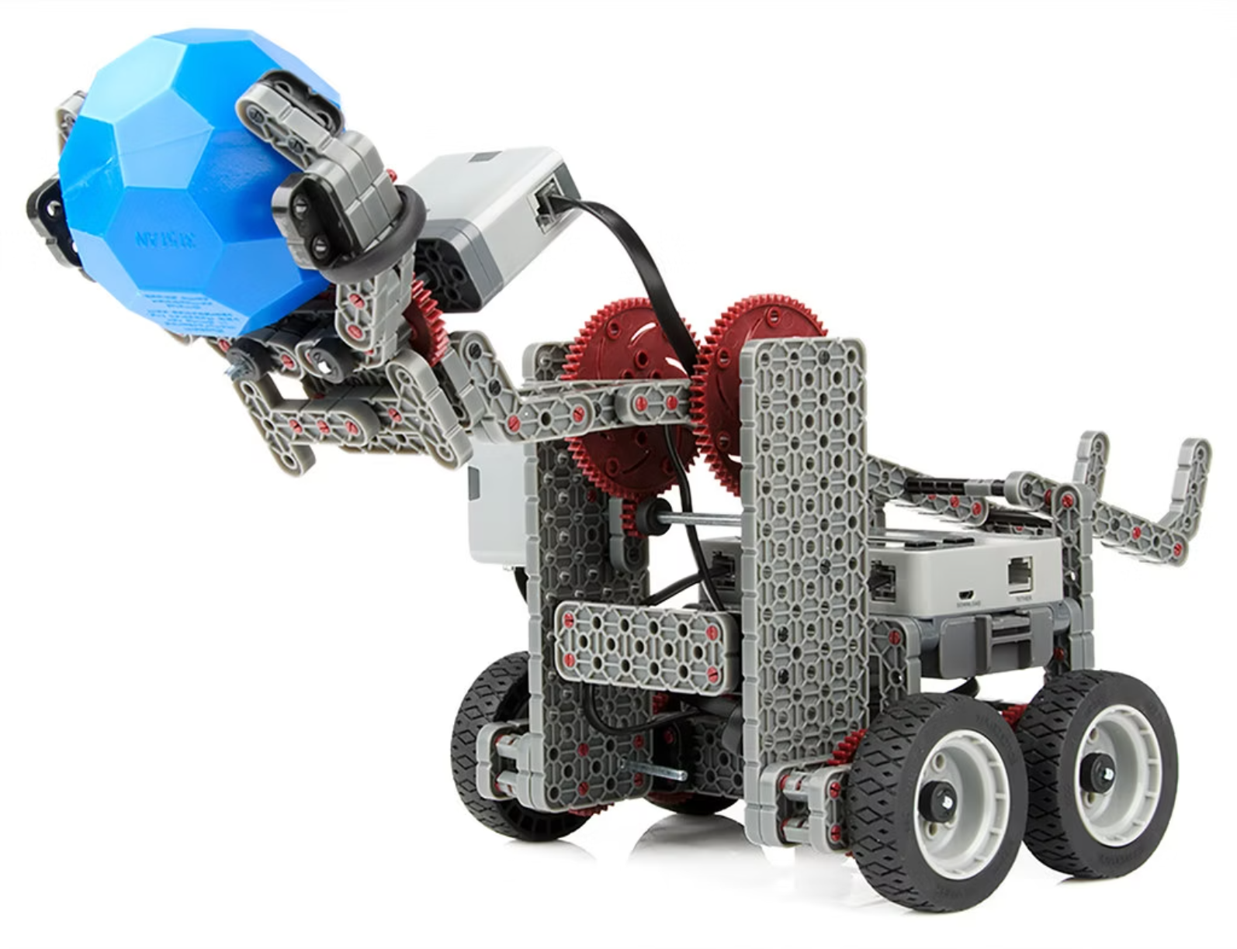
COLLABORATION
Human–Robot Collaboration (Cobots)
Working Together, Not Apart
Collaborative robots (cobots) operate safely alongside human workers in shared workspaces, augmenting human capabilities rather than replacing them. AI enables these systems to understand and respond to human presence and actions.
Collision Avoidance
Real-time motion adjustment prevents contact while maintaining productivity
Dynamic Task Sharing
Intelligent work distribution based on complexity and ergonomics
Real-Time Adjustment
Adapt speed, force, and trajectory to human proximity and intent

Slide 9












Perception and Vision in Robotics
Multi-modal sensing systems enable robots to understand and interact with complex manufacturing environments through integrated visual, spatial, and tactile feedback.
Vision Systems
LiDAR Sensing
2D/3D cameras for part identification and tracking
Precise 3D spatial mapping and distance measurement
Orientation Recognition
Tactile Feedback
Force and pressure sensing for delicate manipulation
Determine part pose for correct manipulation
Object Detection
Quality Inspection
Real-time recognition and localization of parts
Automated defect detection and surface analysis

Slide 10

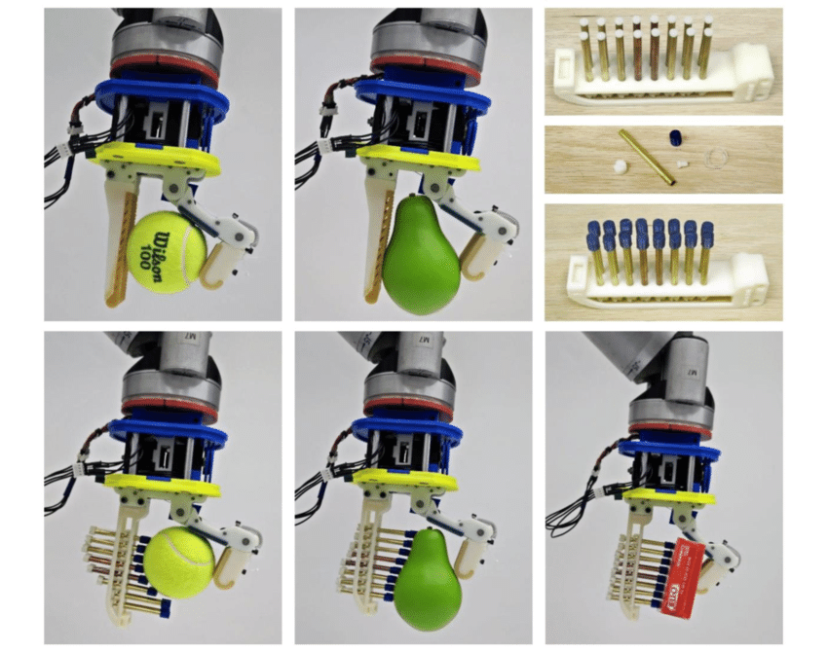
Real-World Mechanical Applications
AI-driven robotics solving practical engineering challenges across modern manufacturing operations
Adaptive Gripping of Irregular Parts
Vision-guided gripper adjustment for components with geometric variation, deformable materials, or inconsistent positioning. Force feedback ensures secure handling without damage.

Slide 11

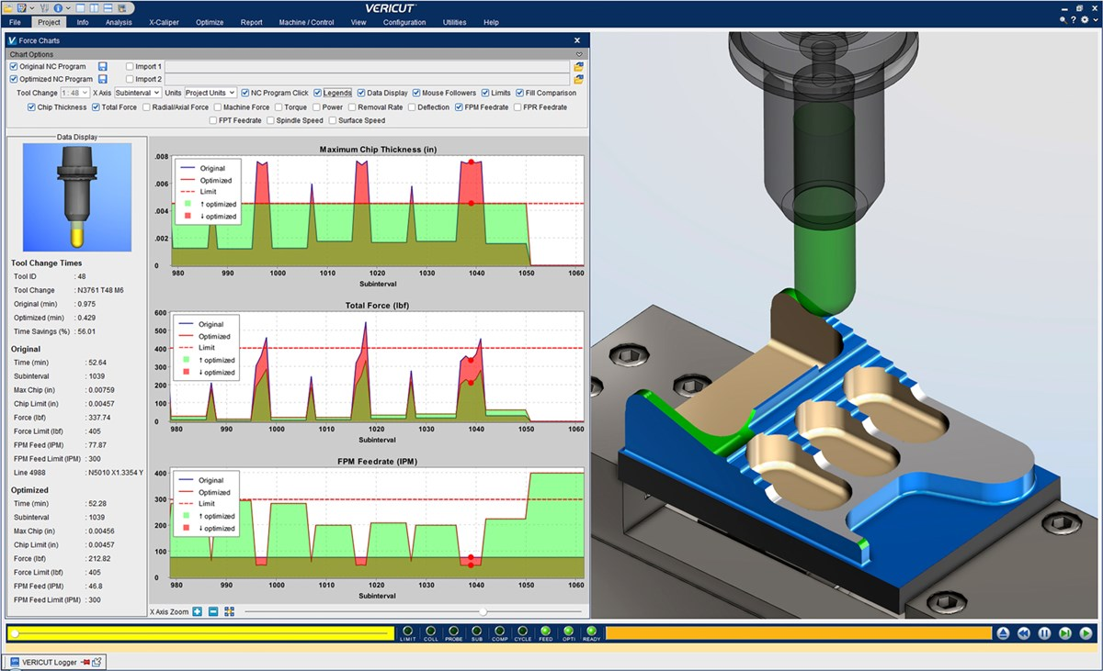
Real-World Mechanical Applications
AI-driven robotics solving practical engineering challenges across modern manufacturing operations
Real-Time Machining Optimization
Robots dynamically adjust feed rate, cutting depth, and tool path during machining operations based on measured forces, vibration, and material removal rates to optimize surface finish and tool life.

Slide 12

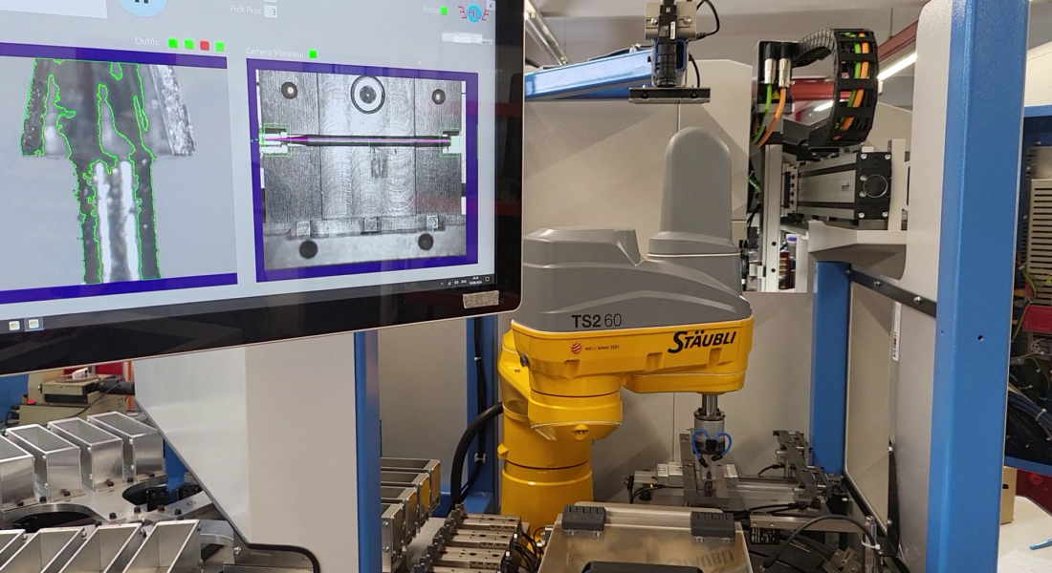
Real-World Mechanical Applications
AI-driven robotics solving practical engineering challenges across modern manufacturing operations
AI-Guided Quality Inspection
Automated visual inspection systems detect surface defects, dimensional deviations, and assembly errors with higher consistency and speed than manual inspection methods.

Slide 13

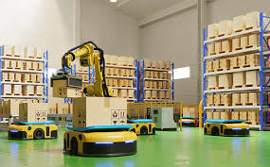
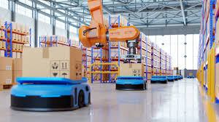
Real-World Mechanical Applications
AI-driven robotics solving practical engineering challenges across modern manufacturing operations
Autonomous Warehouse Robots
Mobile robots navigate dynamic warehouse environments, optimize pick paths, coordinate with multiple units, and adapt to changing inventory layouts without pre-mapped routes.

Slide 14
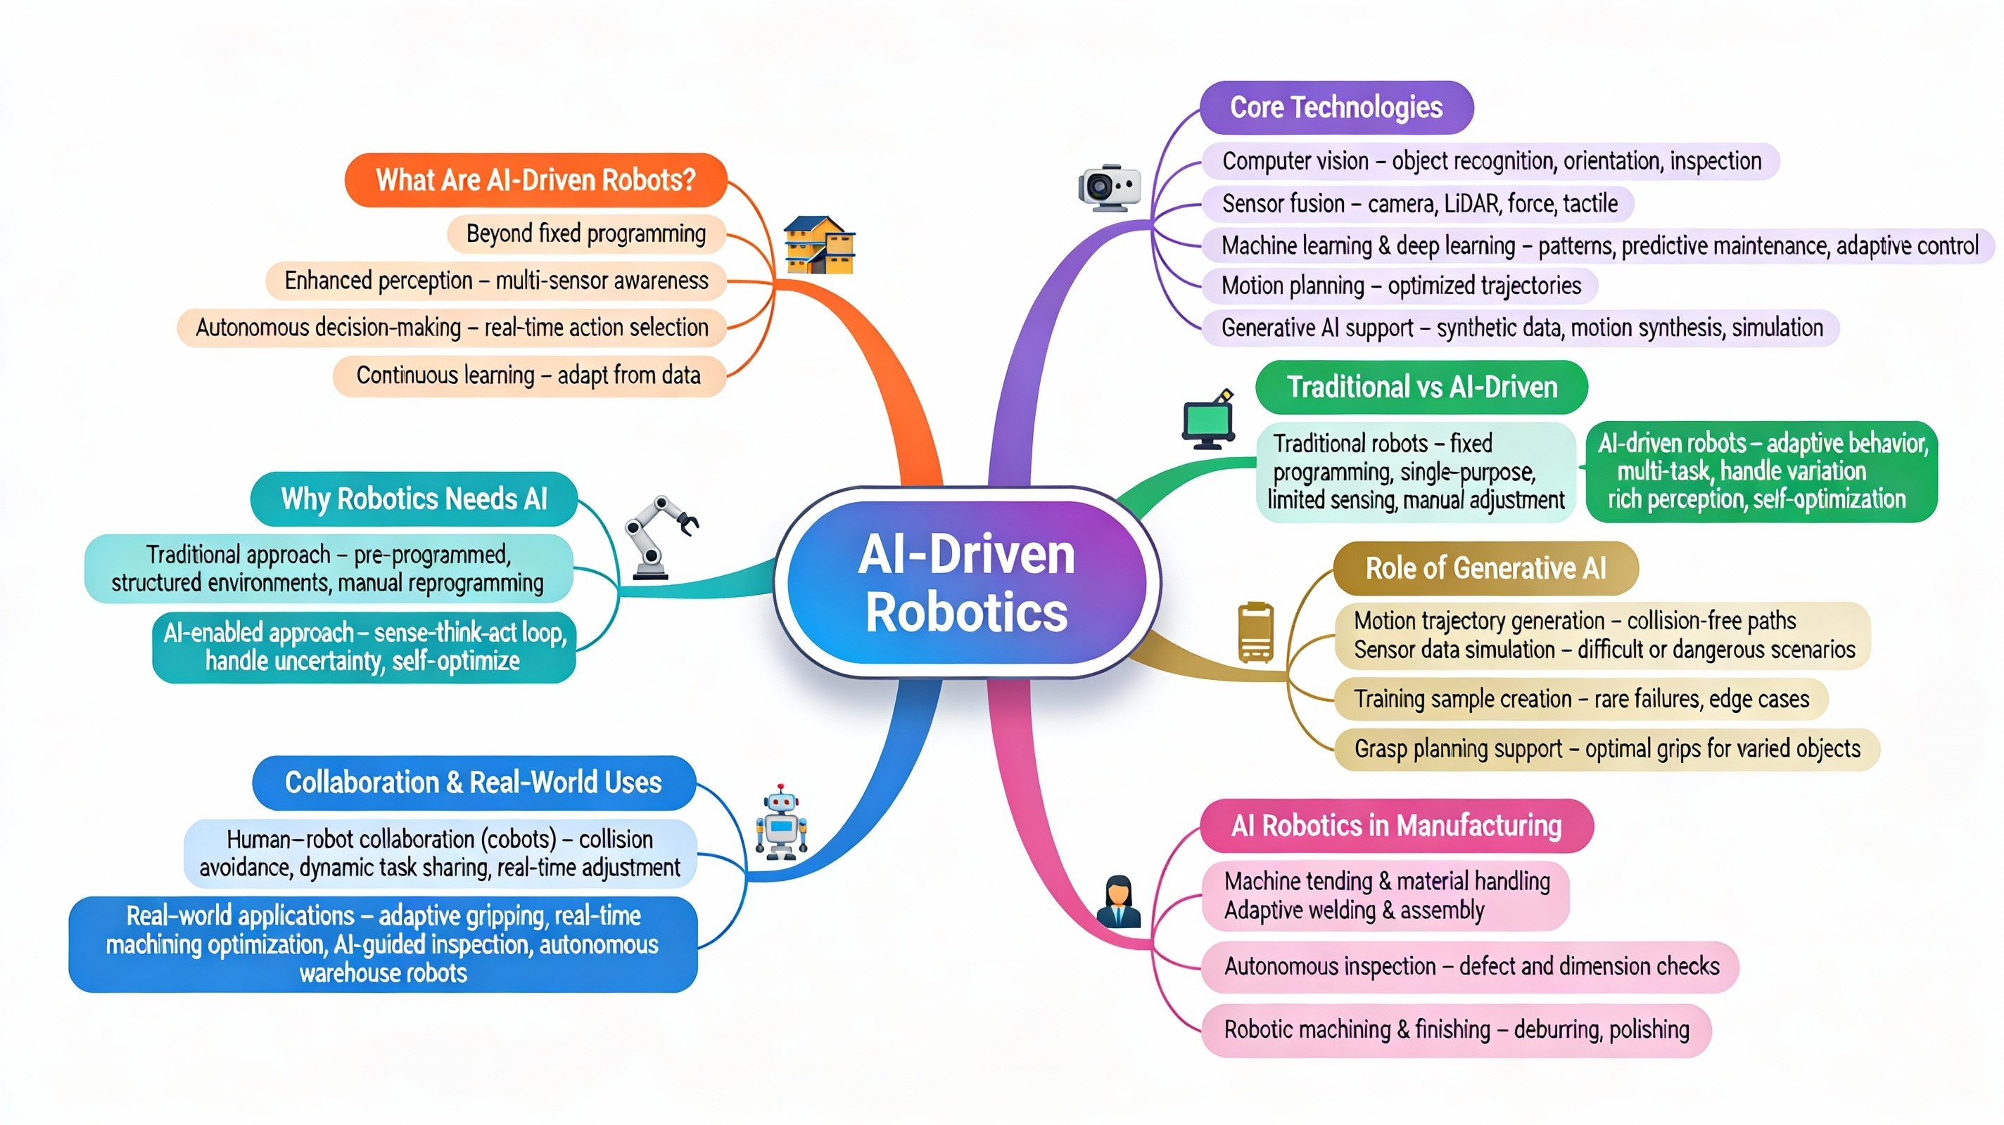
Let’s Recap!

Slide 15


