Slide 1

Dr.SNS RAJALAKSHMI COLLEGE OF ARTS AND SCIENCE (Autonomous) Accredited by NAAC – UGC with ‘A+ Grade (Cycle IV) ( Recognised by UGC, Approved by AICTE & Affiliated to Bharathiar University) Coimbatore- 49
DEPARTMENT OF COMMERCE WITH
INFORMATION TECHNOLOGY
MANAGERIAL ECONOMICS
Introduction to Managerial Economics
Dr. R.Arthi,M.Com (IB).,M.Phil., MBA.,M.Com.,Ph.D.,
Assistant Professor,
Department of Commerce with Information Technology

Slide 2

Introduction to Managerial Economics
Managerial Economics, often referred to as business economics, is a branch of economics that applies economic theories and principles to solve managerial problems. It is a field that lies at the intersection of economics and management and focuses on the practical application of economic concepts to aid decision-making within organisations.
An overarching managerial economics definition is that it uses economic analysis to optimise resource allocation and enhance the overall performance of a company.
27-11-2025 Managerial Economics Dr. R.Arthi, Assistant Professor Commerce with IT 1/11

Slide 3
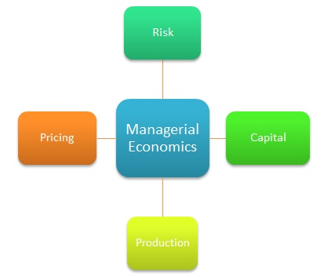
What is Managerial Economics ?
Business Economics
Managerial Economics applies economics theories to solve business problems, optimizing resource allocation and enhancing company performance through practical decision-making tools
Performance Optimization
Enhances overall business performance through economic analysis
Decision Focus
Provides actionable insights for pricing, production, and investment decisions
27-11-2025 Managerial Economics Dr. R.Arthi, Assistant Professor Commerce with IT 2/11

Slide 4

Why Managerial Economics Matters ?
1
2
3
Reduces Risk
Quantifies uncertainty in future demand and costs
Optimizes Profit
Helps in setting the ‘Right Price’ for maximum revenue
Strategic Planning
Provides the data needed for long-term expansion
27-11-2025 Managerial Economics Dr. R.Arthi, Assistant Professor Commerce with IT 3/11

Slide 5
Nature of Managerial Economics
Nature: Interdisciplinary & Micro-Focused
Interdisciplinary Approach
Microeconomic Centric
It is inherently interdisciplinary, drawing from a wide range of fields including economics, management, mathematics, statistics, and behavioral sciences. This integration provides a holistic approach, allowing managers to consider a broader spectrum of factors for robust decision-making.
While economics encompasses both macro and micro, managerial economics primarily centers on microeconomics. It analyzes individual firms, consumers, and market segments to determine optimal pricing, production strategies, and demand assessments.
27-11-2025 Managerial Economics Dr. R.Arthi, Assistant Professor Commerce with IT 4/11

Slide 6
Nature of Managerial Economics
Nature: Decision-Oriented & Real-World
Decision-Oriented
Real-World Application
Unlike traditional economics which seeks to explain phenomena, managerial economics is deeply rooted in practice. It aims to provide actionable insights for decisions regarding resource allocation, pricing strategies, production levels, and investment choices.
It is not limited to theoretical discussions. Concepts like marginal analysis, opportunity cost, elasticity, and cost-benefit analysis are employed to guide rational decisions based on quantitative and qualitative real-world data.
27-11-2025 Managerial Economics Dr. R.Arthi, Assistant Professor Commerce with IT 5/11

Slide 7
Nature of Managerial Economics
Nature: Problem-Solving & Future-Oriented
Problem-Solving Approach
Future-Oriented
Focuses on identifying and framing specific managerial challenges. Whether optimizing production levels or setting profit-maximizing prices, it helps break down complex problems into manageable components to develop effective solutions.
Takes a forward-looking perspective. It considers the long-term consequences of decisions to create sustainable outcomes in a business environment characterized by rapid changes and evolving consumer preferences
19-11-2025 Managerial Economics Dr. R.Arthi, Assistant Professor Commerce with IT 6/11

Slide 8
CASE STUDY
🔷 Case Question 1
A textile company has excess inventory because it overestimated demand. The new Managerial Economist introduces demand forecasting tools using past data.
Question: How does this reflect the nature of Managerial Economics as both a science and an art?
27-11-2025 Managerial Economics Dr. R.Arthi, Assistant Professor Commerce with IT 7/11

Slide 9
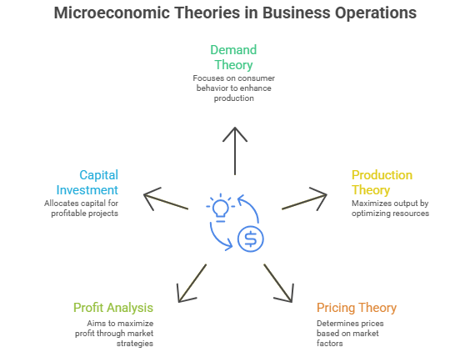
Scope of Managerial Economics
27-11-2025 Managerial Economics Dr. R.Arthi, Assistant Professor Commerce with IT 8/11

Slide 10
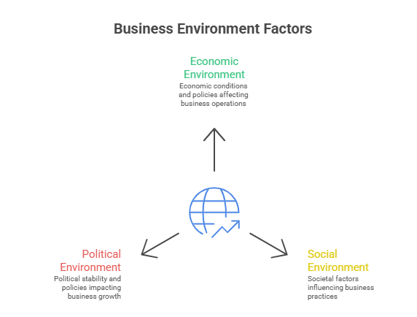
Scope of Managerial Economics
27-11-2025 Managerial Economics Dr. R.Arthi, Assistant Professor Commerce with IT 9/11

Slide 11
CASE STUDY
🔷 Case Question 2
A start-up producing electric bicycles is facing rising production costs due to increased battery prices. The management is unsure whether to increase prices or reduce costs through better planning.
Question: Which areas under the scope of Managerial Economics should the firm analyze to take an informed decision?
27-11-2025 Managerial Economics Dr. R.Arthi, Assistant Professor Commerce with IT 10/11

Slide 12
QUESTIONS
1. Managerial Economics primarily deals with:
A. Understanding historical economic events B. Applying economic concepts to business decision-making C. Studying only macroeconomic variables D. Preparing financial statements
2. Which of the following is NOT included in the scope of Managerial Economics?
A. Demand analysis and forecasting B. Production and cost analysis C. Consumer behavior laws D. Advertising and sales promotion
3. The nature of Managerial Economics can be described as:
A. Pure science with no practical applications B. Art of decision-making using economic principles C. Study of only national economic issues D. A branch of sociology
4. Managerial Economics is considered a bridge between:
A. Accounting and mathematics B. Economics and business management C. Law and finance D. Psychology and technology
5. The primary objective of Managerial Economics is to:
A. Maximize production at any cost B. Help managers make rational and profit-oriented decisions C. Forecast political trends D. Prepare tax-related documents
27-11-2025 Managerial Economics Dr. R.Arthi, Assistant Professor Commerce with IT 11/11

