Slide 1

SNS COLLEGE OF TECHNOLOGY
Kurumbapalayam (Po), Coimbatore – 641 107
An Autonomous Institution
Accredited by NBA – AICTE and Accredited by NAAC – UGC with ‘A’ Grade Approved by AICTE, New Delhi & Affiliated to Anna University, Chennai
DEPARTMENT OF COMPUTER SCIENCE AND ENGINEERING (IOT) COURSE NAME : 23CSB201 - OBJECT ORIENTED PROGRAMMING
I YEAR / II SEMESTER
Unit I - INTRODUCTION TO OOP
Topic : Evolution of Java
Dr.K.Sangeetha, – AP(SrG)/CSE-IOT

Slide 2
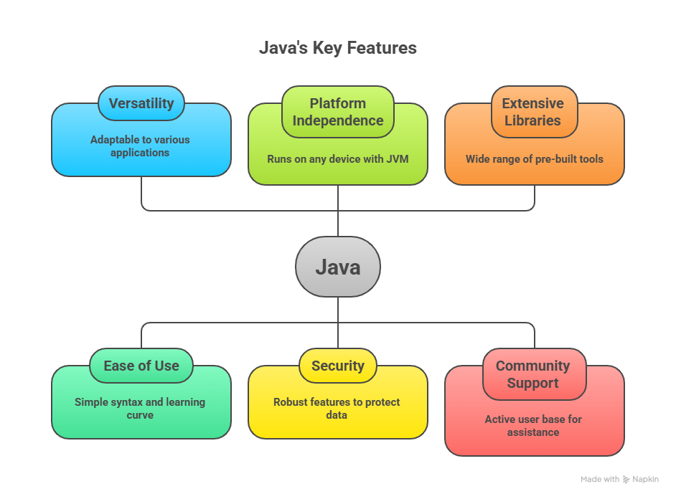
Introduction to Java
• Java is a high-level, object-oriented programming language
• Developed by Sun Microsystems
• Known for portability, security, and robustness
3.1.26 UNIT-1 /Evolution of Java / 23CSB201 OBJECT ORIENTED PROGRAMMING/Dr.K.Sangeetha/CSE -IoT/SNSCT 2/14

Slide 3
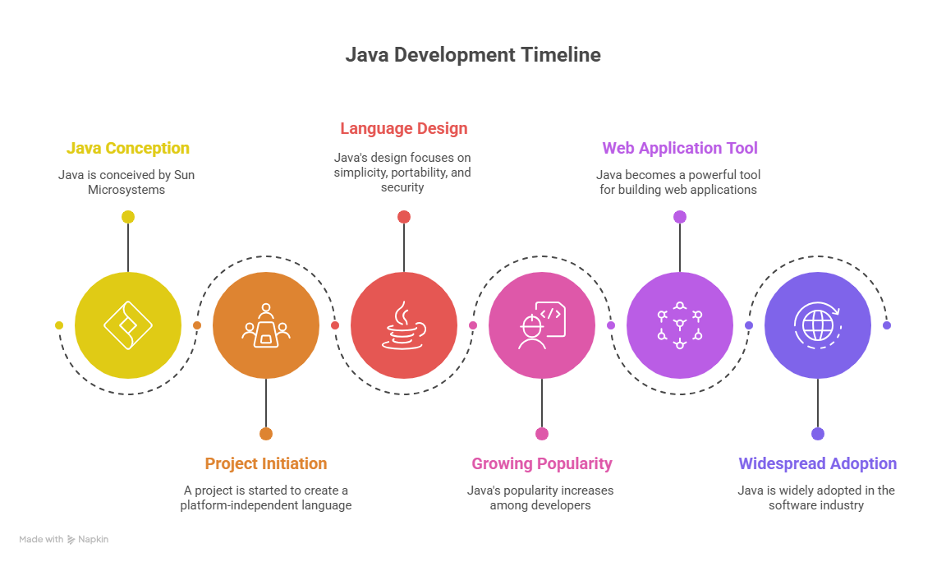
Origins of Java (1991–1995)
• Started as 'Oak' project by James Gosling
• Designed for embedded systems
• Renamed Java in 1995
• Slogan: Write Once, Run Anywhere
3.1.26 UNIT-1 /Evolution of Java / 23CSB201 OBJECT ORIENTED PROGRAMMING/Dr.K.Sangeetha/CSE -IoT/SNSCT 2/14

Slide 4
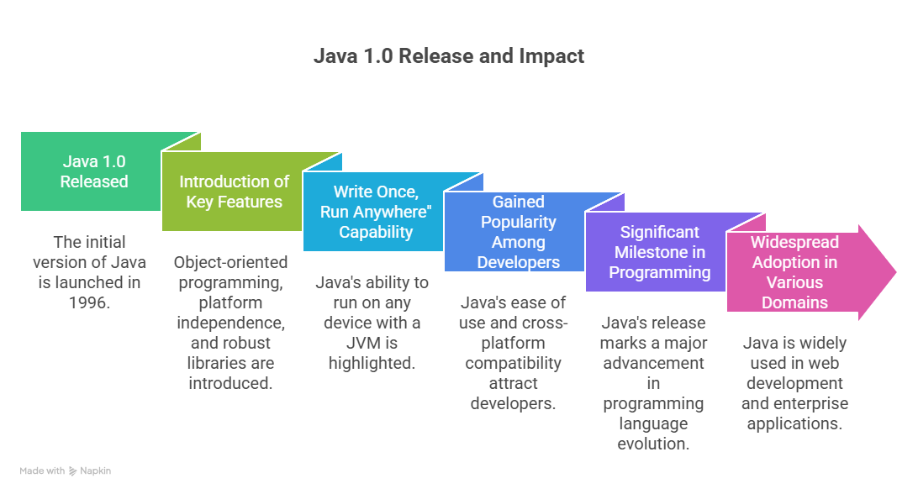
Java 1.0 (1996)
• First public release
• Applets support
• Basic OOP features
• Platform-independent execution
3.1.26 UNIT-1 /Evolution of Java / 23CSB201 OBJECT ORIENTED PROGRAMMING/Dr.K.Sangeetha/CSE -IoT/SNSCT 2/14

Slide 5
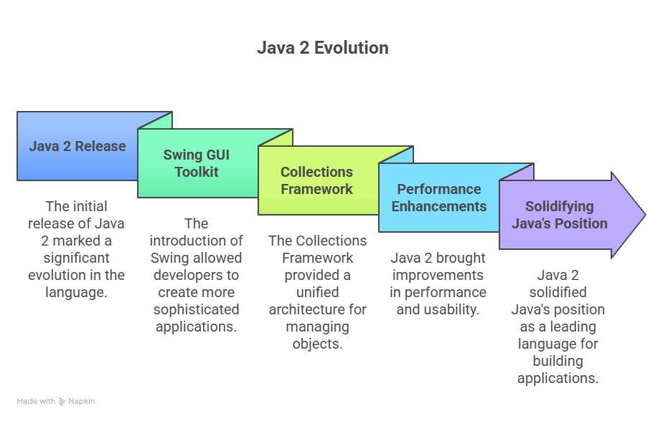
Java 2 (J2SE 1.2–1.4)
• Introduced Swing GUI
• Collections Framework
• Just-In-Time (JIT) compiler
• Improved performance
3.1.26 UNIT-1 /Evolution of Java / 23CSB201 OBJECT ORIENTED PROGRAMMING/Dr.K.Sangeetha/CSE -IoT/SNSCT 2/14

Slide 6
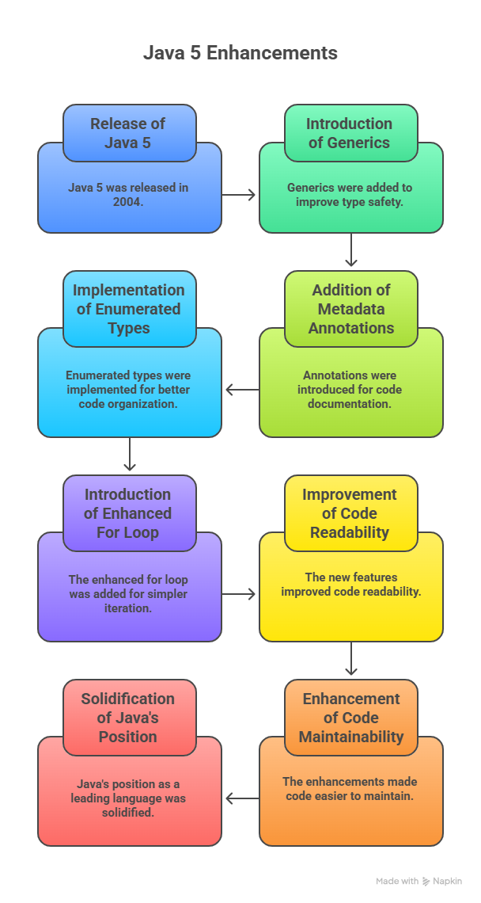
Java 5 (2004)
• Generics
• Enhanced for-each loop
• Autoboxing and unboxing
• Annotations and enums
3.1.26 UNIT-1 /Evolution of Java / 23CSB201 OBJECT ORIENTED PROGRAMMING/Dr.K.Sangeetha/CSE -IoT/SNSCT 2/14

Slide 7
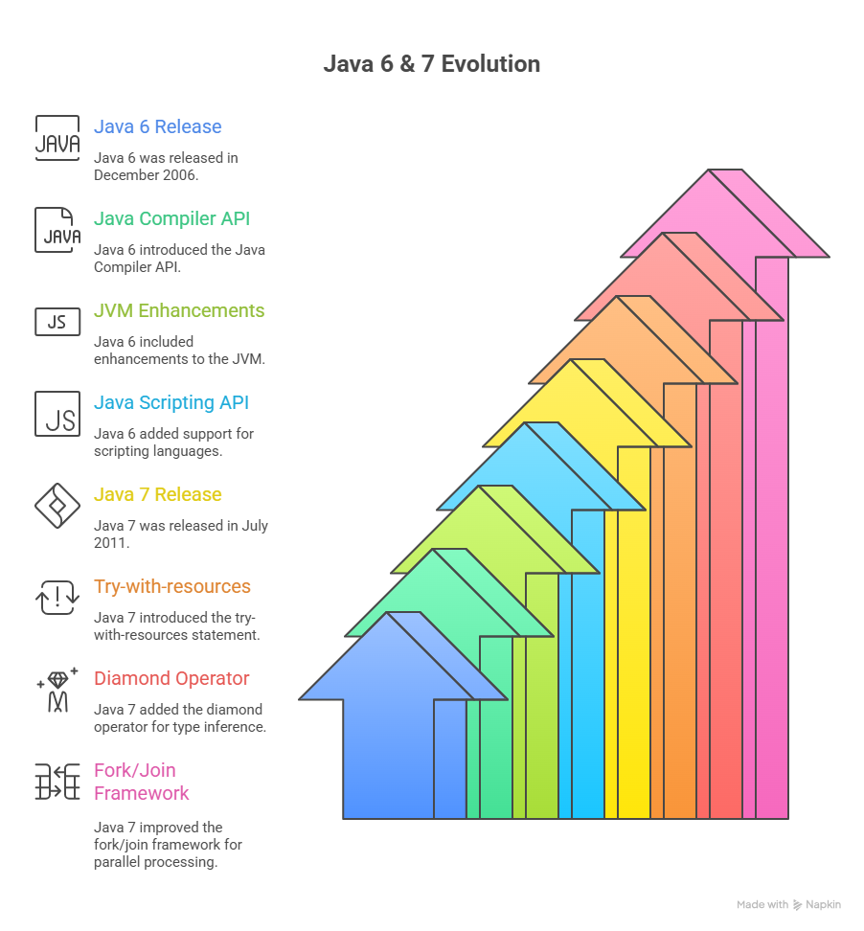
Java 6 & 7
• Improved JVM performance
• Try-with-resources
• Diamond operator
• NIO.2 file system
3.1.26 UNIT-1 /Evolution of Java / 23CSB201 OBJECT ORIENTED PROGRAMMING/Dr.K.Sangeetha/CSE -IoT/SNSCT 2/14

Slide 8
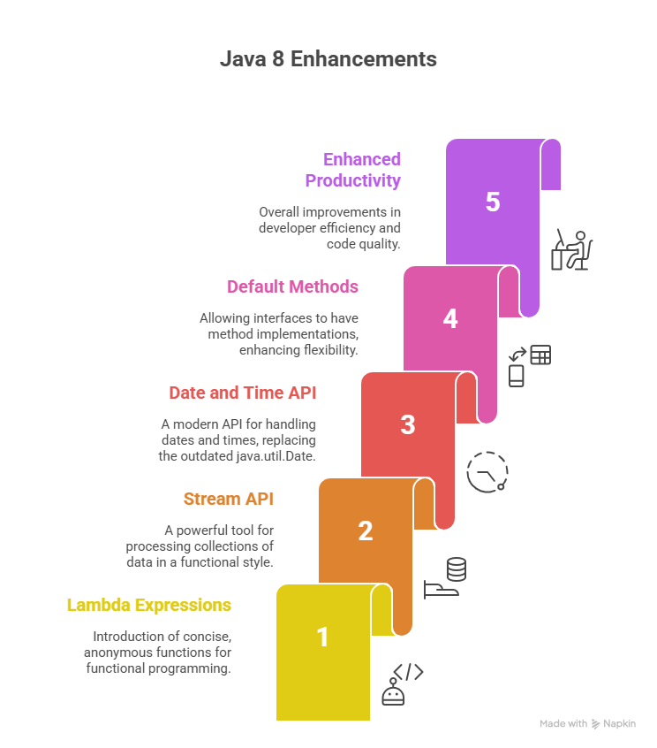
Java 8 (2014)
• Lambda expressions
• Stream API
• Default methods
• Major functional programming support
3.1.26 UNIT-1 /Evolution of Java / 23CSB201 OBJECT ORIENTED PROGRAMMING/Dr.K.Sangeetha/CSE -IoT/SNSCT 2/14

Slide 9
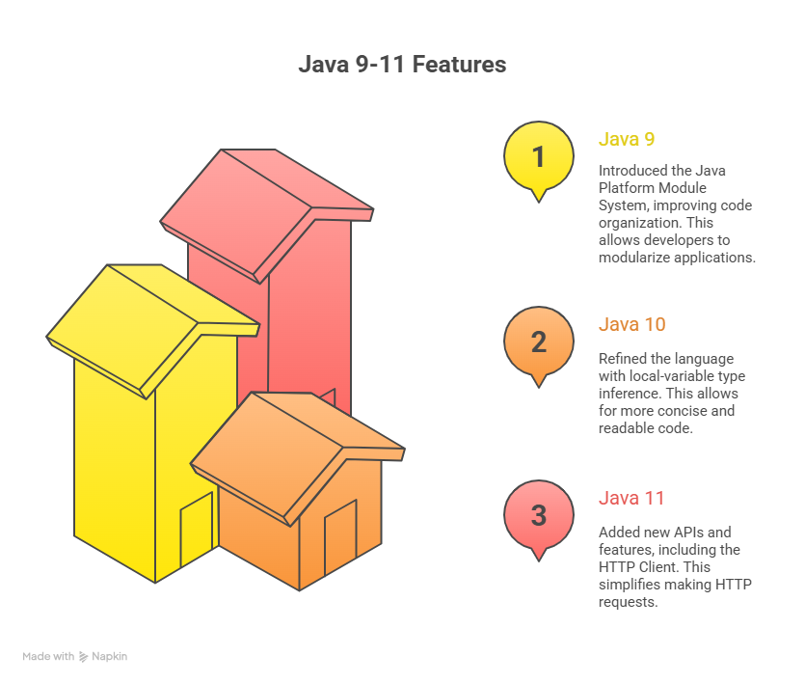
Java 9–11
• Module system (Project Jigsaw)
• JShell (interactive shell)
• Long-Term Support (LTS) versions
• Improved garbage collection
3.1.26 UNIT-1 /Evolution of Java / 23CSB201 OBJECT ORIENTED PROGRAMMING/Dr.K.Sangeetha/CSE -IoT/SNSCT 2/14

Slide 10
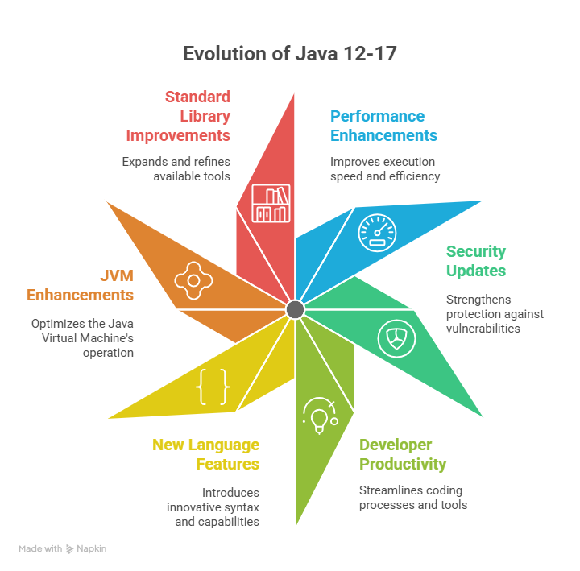
Java 12–17
• Switch expressions
• Text blocks
• Records
• Sealed classes
3.1.26 UNIT-1 /Evolution of Java / 23CSB201 OBJECT ORIENTED PROGRAMMING/Dr.K.Sangeetha/CSE -IoT/SNSCT 2/14

Slide 11
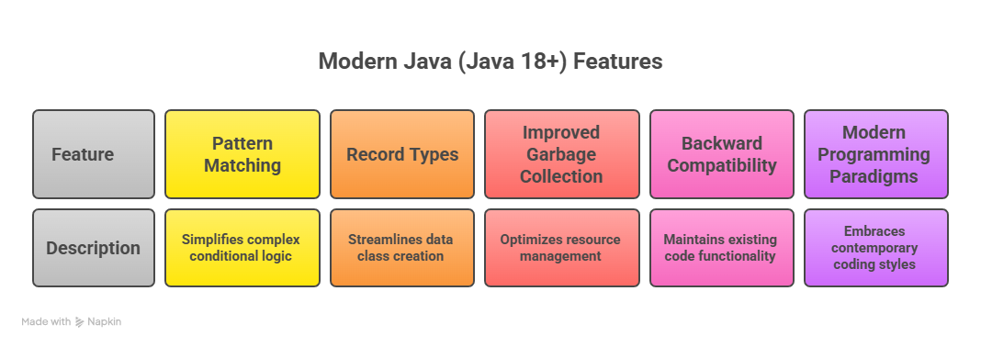
Modern Java (Java 18+)
• Pattern matching improvements
• Virtual threads (Project Loom)
• Performance and security updates
3.1.26 UNIT-1 /Evolution of Java / 23CSB201 OBJECT ORIENTED PROGRAMMING/Dr.K.Sangeetha/CSE -IoT/SNSCT 2/14

Slide 12
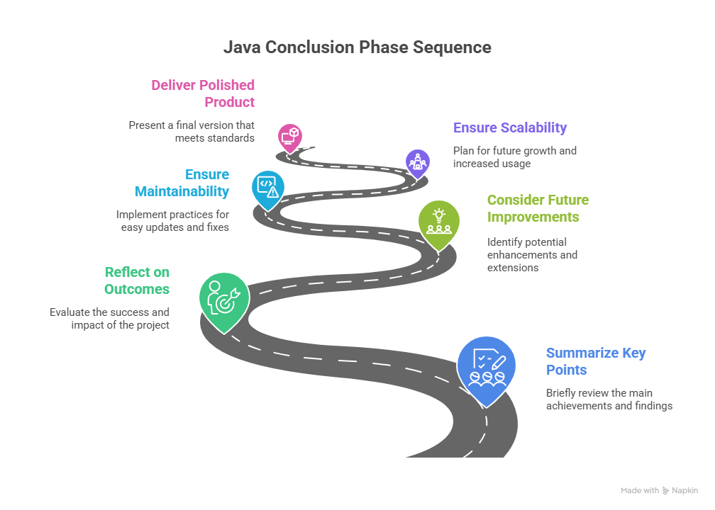
Conclusion
• Java has evolved for over 25+ years
• Widely used in enterprise, mobile, and web
• Continues to adapt to modern programming needs
3.1.26 UNIT-1 /Evolution of Java / 23CSB201 OBJECT ORIENTED PROGRAMMING/Dr.K.Sangeetha/CSE -IoT/SNSCT 2/14

Slide 13
Object Oriented Programming in Java – Questions to Solve
A software company is migrating a legacy Java 6 application. Which Java evolution features (Java 8+) would you recommend and why?
An enterprise application requires high performance and scalability. Which Java versions and features support this requirement? Justify.
A cloud-based system demands lightweight and modular applications. How does Java’s evolution support this need?
How did the evolution of Java reduce dependency on external frameworks over time?
An organization wants safe concurrent programming. How did Java evolve to handle multithreading?
3.1.26 UNIT-1 /Evolution of Java / 23CSB201 OBJECT ORIENTED PROGRAMMING/Dr.K.Sangeetha/CSE -IoT/SNSCT 2/14

Slide 14


