Slide 1

Dr.SNS RAJALAKSHMI COLLEGE OF ARTS AND SCIENCE (Autonomous) Accredited by NAAC – UGC with ‘A+ Grade (Cycle IV) ( Recognised by UGC, Approved by AICTE & Affiliated to Bharathiar University) Coimbatore- 49
DEPARTMENT OF COMMERCE WITH
INFORMATION TECHNOLOGY
MANAGERIAL ECONOMICS
Profit
Dr. R.Arthi, M.Com (IB).,M.Phil., MBA.,M.Com.,Ph.D.,
Assistant Professor,
Department of Commerce with Information Technology

Slide 2


Core Strategic Objectives
Risk Mitigation
Return Optimization
Identifying potential downsides through sensitivity analysis and volatility modeling. We focus on protecting principal capital while allowing for sustainable expansion.
Evaluating the Internal Rate of Return (IRR) and Net Present Value (NPV). Our goal is to outperform benchmark indices through disciplined security selection.
16.02.2026 Managerial Economics Dr. R.Arthi, Assistant Professor Commerce with IT 1/7

Slide 3

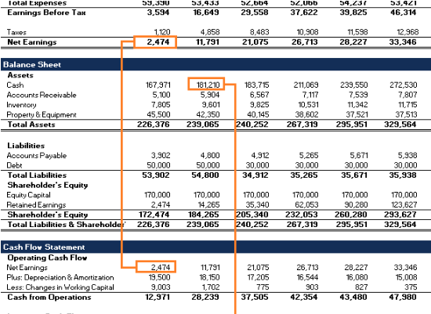
Fundamental Analysis
Fundamental analysis involves a deep dive into the intrinsic value of an asset. We analyze:
Economic Indicators: GDP growth, inflation, and interest rate trends.
•
•
Industry Dynamics: Competitive landscape and barrier to entry analysis.
Company Financials: Balance sheet strength, cash flow, and debt-to-equity ratios.
•
Goal: Determine if a security is undervalued or overvalued relative to its market price.
16.02.2026 Managerial Economics Dr. R.Arthi, Assistant Professor Commerce with IT 1/7

Slide 4
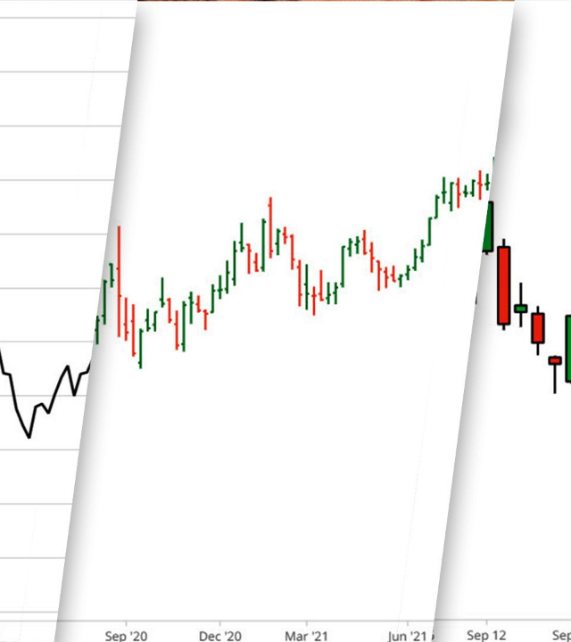
Technical Analysis
While fundamental analysis looks at "what" to buy, technical analysis focuses on "when" to buy.
Price Patterns: Identifying support and resistance levels to gauge market momentum.
Volume Analysis: Validating price trends through trading activity data.
Indicators: Utilizing Moving Averages and RSI to predict short-term psychology and market sentiment shifts.
16.02.2026 Managerial Economics Dr. R.Arthi, Assistant Professor Commerce with IT 1/7

Slide 5
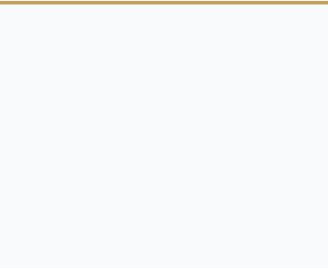

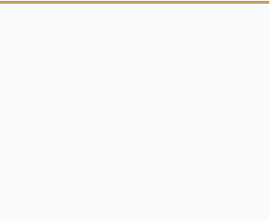



Multi-Dimensional Analysis
Quantitative
Qualitative
Macro-Economic
Hard metrics including P/E ratios, Dividend yield, and Beta. Purely data-driven decision making.
Assessing management quality, brand equity, and the strength of intellectual property.
Monitoring geopolitical climate, trade policies, and central bank fiscal interventions.
16.02.2026 Managerial Economics Dr. R.Arthi, Assistant Professor Commerce with IT 1/7

Slide 6
Investment Vehicle Matrix
Asset Class | Risk Level | Return Profile | Liquidity
Equities (Stocks) | High | Capital Appreciation | High
Fixed Income (Bonds) | Low to Medium | Regular Income | Medium
Derivatives | Very High | Speculative / Hedging | High
Real Estate | Medium | Income + Growth | Low
16.02.2026 Managerial Economics Dr. R.Arthi, Assistant Professor Commerce with IT 1/7

Slide 7




The Systematic Investment Process
Goal Setting
Allocation
Selection
Monitoring
Define time horizon and risk tolerance.
Distribute capital across asset classes.
Pick specific securities based on analysis.
Rebalance and review performance.
16.02.2026 Managerial Economics Dr. R.Arthi, Assistant Professor Commerce with IT 1/7

Slide 8
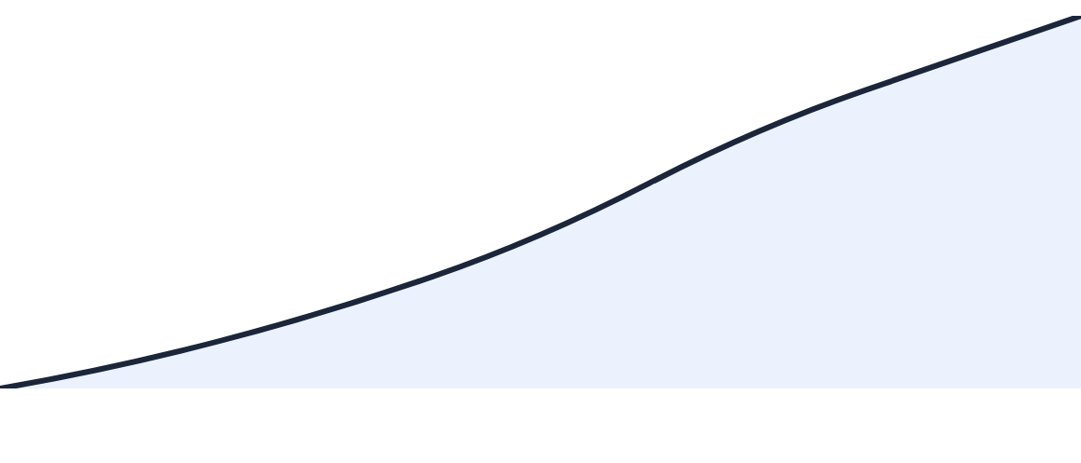
The Power of Compounding
Visualizing long-term exponential growth. Consistency over time is the investor's greatest advantage.
16.02.2026 Managerial Economics Dr. R.Arthi, Assistant Professor Commerce with IT 1/7

