Slide 1


SNS College of Technology
(An Autonomous Institutions)
Department of Computer Science and Engineering
23CSB201-Object Oriented Programming
Topic: Method Overloading & Overriding
Mrs.G.Swathi
Assistant Professor

Slide 2
Method overloading
Method overloading is a concept where multiple methods have the same name but different parameter lists (number, type, or order of parameters) within the same class.

Slide 3
Characteristic
Occurs in the same class
Method name is the same
Parameters must be different
Return type alone cannot differentiate methods
Also called Compile-time polymorphism

Slide 4
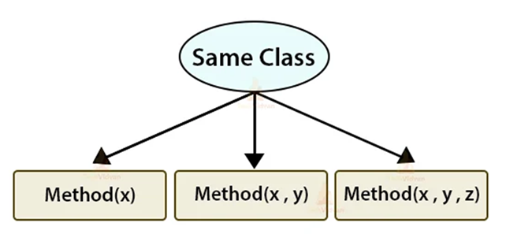
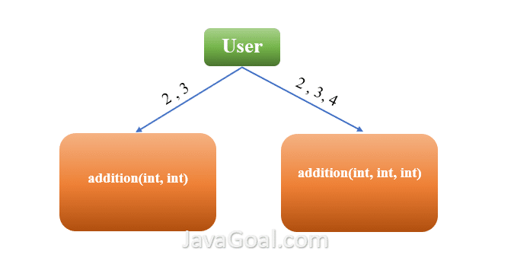
Method Overloading

Slide 5
Overloading Sample Program
class Calculator {
int add(int a, int b) {
return a + b;
}
double add(double a, double b) {
return a + b;
}
int add(int a, int b, int c) {
return a + b + c;
}
}

Slide 6
Method Overriding
Method overriding occurs when a sub class provides a specific implementation of a method that is already defined in its super class.

Slide 7

Characteristic
Occurs in different classes (inheritance required)
Method name and parameters must be same
Return type should be same or covariant
Achieved at runtime
Also called Runtime polymorphism

Slide 8

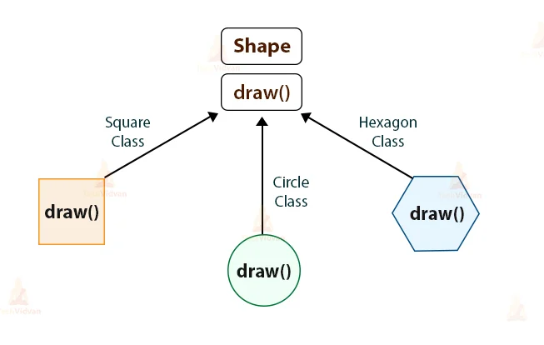
Method Overriding

Slide 9

Example Diagram
class Animal {
void sound() {
System.out.println("Animal makes a sound");
}
}
class Dog extends Animal {
@Override
void sound() {
System.out.println("Dog barks");
}
}
public class Main {
public static void main(String[] args) {
Animal a = new Dog();
a.sound(); // Dog barks
}
}

Slide 10
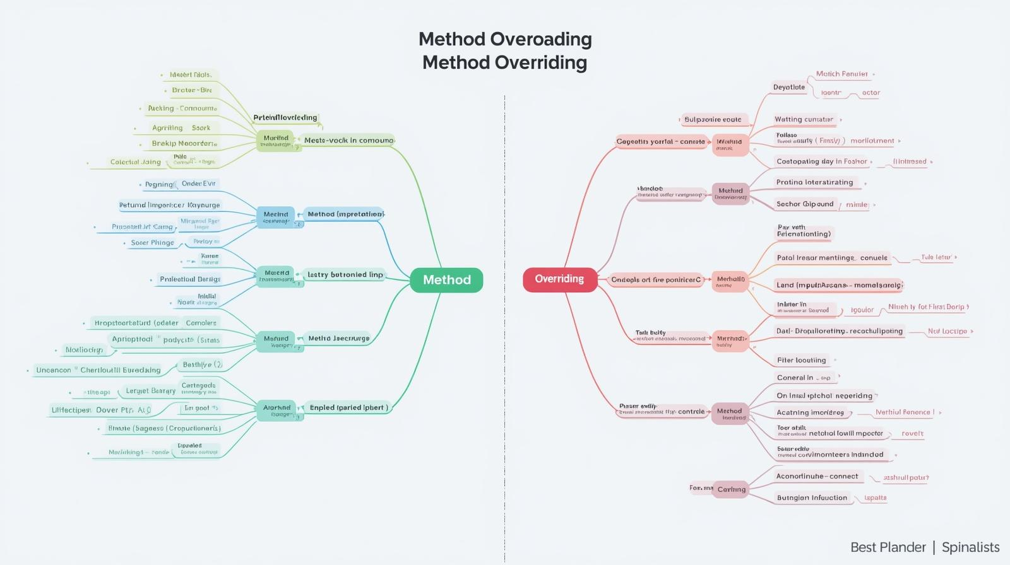
Mind Map

