Slide 1
SNS College of Technology
(An Autonomous Institutions)
Department of Computer Science and Engineering
23CSB201-Object Oriented Programming
Topic: Packages
Mrs.G.Devi
Assistant Professor

Slide 2

Packages
DT-Empathize
Developers often struggle to organize large codebases efficiently, highlighting the need for Java Packages to group related classes like folders in a file system for better maintenance and reuse.

Slide 3
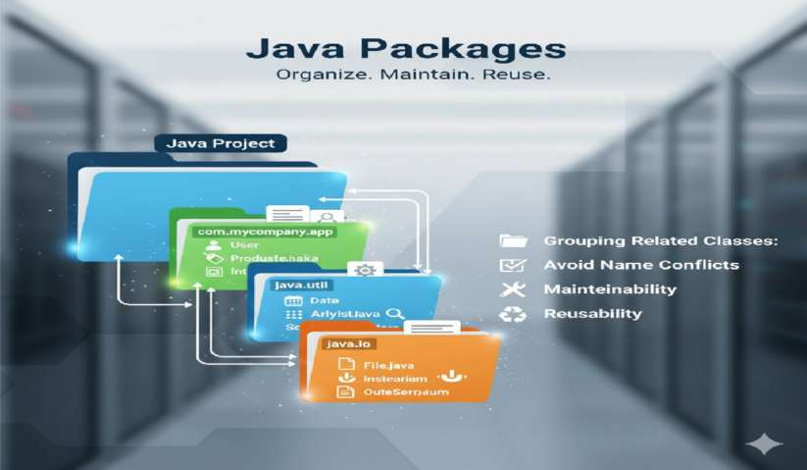
Introduction

Slide 4
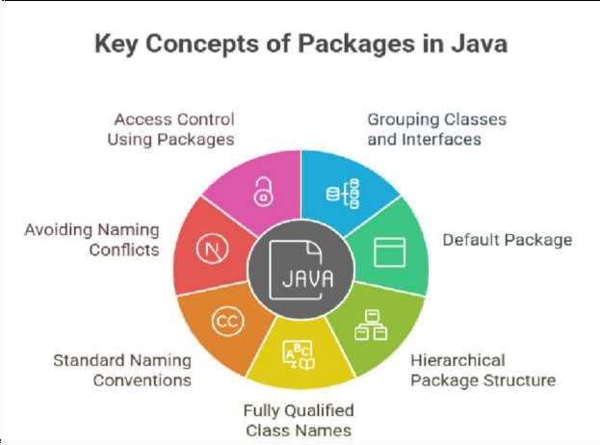
Key Concepts

Slide 5
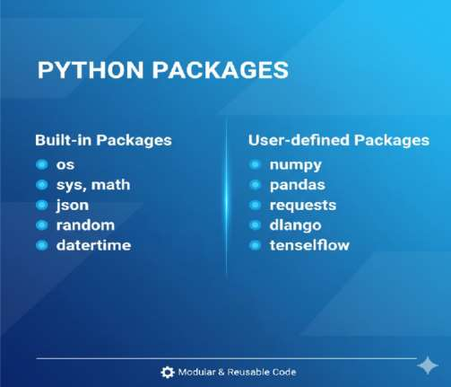
Types of Java Packages
Built-in Packages
User-defined Packages

Slide 6

Example
package mypack;
class MyPackageClass
{
public static void main(String[] args)
{
System.out.println("This is my package!");
}
}

Slide 7
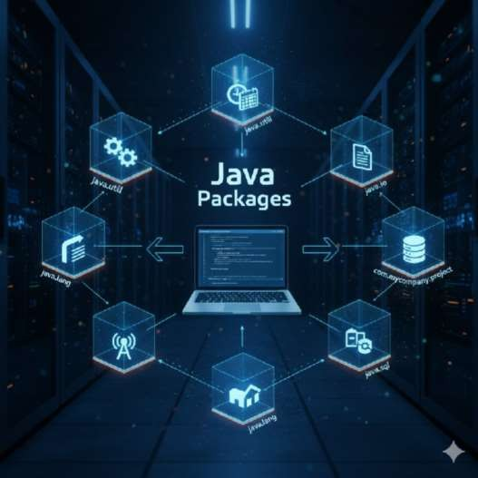
Approaches

Slide 8
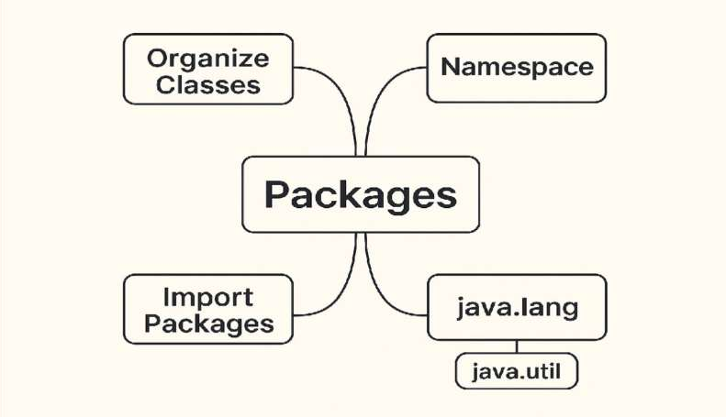
Mind Map

Slide 9
Question to solve
Which of the following is the correct way to define a package in Java?
  package mypackage;
  import mypackage;
  include mypackage;
  define package mypackage;
Answer: a) package mypackage;
Which of the following packages is automatically imported in every Java
program?
  java.util
  java.io
  java.lang
  java.net
Answer: c) java.lang

Slide 10
References
Herbert Schildt, “Java: The Complete Reference”, 11th
Edition, McGraw Hill Education, New Delhi, 2019
Cay S. Horstmann, “Core Java Fundamentals”, Volume 1, 11th Edition, Prentice Hall, 2018

