Slide 1

Dr.SNS RAJALAKSHMI COLLEGE OF ARTS AND SCIENCE (Autonomous) Accredited by NAAC – UGC with ‘A+ Grade (Cycle IV) ( Recognised by UGC, Approved by AICTE & Affiliated to Bharathiar University) Coimbatore- 49
DEPARTMENT OF COMMERCE WITH
INFORMATION TECHNOLOGY
MANAGERIAL ECONOMICS
Profit
Dr. R.Arthi, M.Com (IB).,M.Phil., MBA.,M.Com.,Ph.D.,
Assistant Professor,
Department of Commerce with Information Technology

Slide 2


Defining Profit
Fundamental Meaning
Profit is the surplus of revenue over the total cost of production. It represents the reward for the entrepreneurial factor of production.
Unlike wages or interest, profit is a residual income—it is what remains after all other contractual obligations are met.
06.02.2026 Managerial Economics Dr. R.Arthi, Assistant Professor Commerce with IT 1/9

Slide 3
Accounting vs. Economic Profit
Feature | Accounting Profit | Economic Profit
Formula | Total Revenue - Explicit Costs | Total Revenue - (Explicit + Implicit Costs)
Explicit Costs | Wages, Rent, Materials, Interest | Wages, Rent, Materials, Interest
Implicit Costs | Ignored | Opportunity cost of owner's resources
Focus | Reporting and Taxation | Resource Allocation and Survival
06.02.2026 Managerial Economics Dr. R.Arthi, Assistant Professor Commerce with IT 2/9

Slide 4
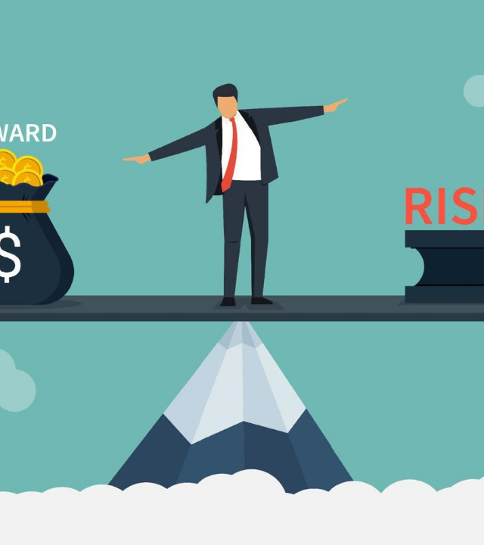
Nature of Profit
Uncertainty
Frank Knight distinguished between 'Risk' (calculable) and 'Uncertainty' (incalculable).
Profit is the reward for bearing non-insurable uncertainty. While fire or theft can be insured, changes in consumer taste or unpredictable market shifts cannot.
True entrepreneurial profit arises only because the future is unknown.
06.02.2026 Managerial Economics Dr. R.Arthi, Assistant Professor Commerce with IT 3/9

Slide 5


Risk-Bearing
F.B. Hawley argued that profit is the price paid by society to the entrepreneur for the risk he assumes.
If there were no risk, everyone would become an entrepreneur, and competition would drive profit to zero. The possibility of loss is what justifies the existence of profit.
The higher the perceived risk in an industry, the higher the required profit margin to attract capital.
06.02.2026 Managerial Economics Dr. R.Arthi, Assistant Professor Commerce with IT 4/9

Slide 6



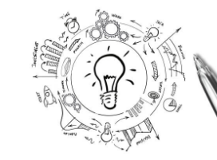
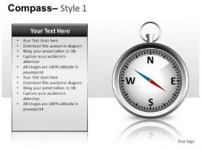

Nature: Dynamic Innovation
Schumpeter's View
Process Improvement
Transitory Status
Profit arises from "Creative Destruction." It is the reward for introducing new products or processes.
Implementing more efficient production methods that lower costs below the market price.
Innovation profits are temporary. As others imitate the successful firm, the profit eventually vanishes.
06.02.2026 Managerial Economics Dr. R.Arthi, Assistant Professor Commerce with IT 5/9

Slide 7
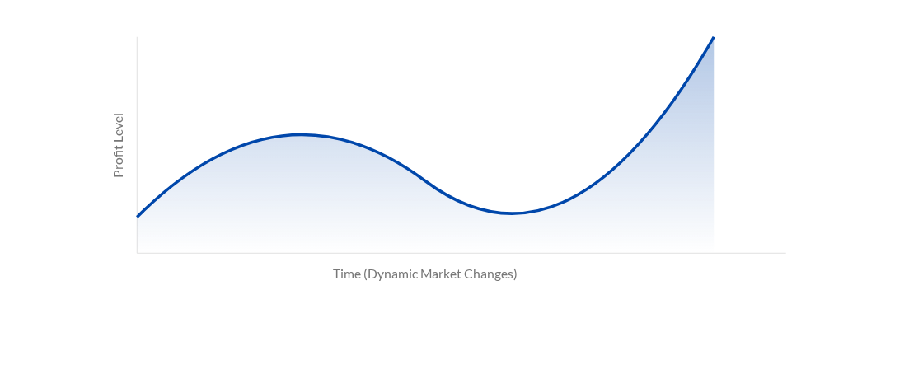
Profit in the Dynamic Economy
In a static economy, profit would tend toward zero as supply matches demand perfectly. In a dynamic world, constant shifts in population, technology, and tastes create new profit opportunities.
06.02.2026 Managerial Economics Dr. R.Arthi, Assistant Professor Commerce with IT 6/9

Slide 8






The Role of Profit
Incentive
Resource Allocation
Efficiency Indicator
The primary driver for individuals to take risks and work harder than required for a standard wage.
Profit acts as a signal. High profits in an industry attract resources (capital/labor) to that sector.
While not perfect, profit serves as a measure of how effectively a firm converts inputs into valuable outputs.
06.02.2026 Managerial Economics Dr. R.Arthi, Assistant Professor Commerce with IT 7/9

Slide 9

Structural Profit Nature
Frictional Profits
Monopoly Profits
Arise from temporary market imperfections. In the real world, markets do not reach equilibrium instantly.
Arise when a firm has some degree of market power to restrict output and raise prices above the competitive level.
A sudden increase in demand for a product creates a "frictional" profit until new supply can catch up.
This is often protected by barriers to entry such as patents, government licenses, or massive scale.
06.02.2026 Managerial Economics Dr. R.Arthi, Assistant Professor Commerce with IT 8/9

Slide 10

Social Responsibility of Profit
A profitable firm provides stable employment, pays taxes for infrastructure, and fuels further R&D.
Without profit, a business is a drain on societal resources. Sustainable profitability allows for CSR and long-term community engagement.
06.02.2026 Managerial Economics Dr. R.Arthi, Assistant Professor Commerce with IT 9/9

