Slide 1

Dr.SNS RAJALAKSHMI COLLEGE OF ARTS AND SCIENCE
(Autonomous)
Accredited by NAAC – UGC with ‘A+ Grade (Cycle IV)
( Recognised by UGC, Approved by AICTE & Affiliated to Bharathiar University) Coimbatore- 49
DEPARTMENT OF COMMERCE WITH
INFORMATION TECHNOLOGY
MANAGERIAL ECONOMICS
Profit Planning and Forecasting
Dr. R.Arthi, M.Com (IB).,M.Phil., MBA.,M.Com.,Ph.D.,
Assistant Professor,
Department of Commerce with Information Technology

Slide 2



Profit planning and forecasting
Profit planning is the deliberate process of establishing profitability goals and mapping the tactical actions required to achieve them.
Forecasting serves as the predictive engine, utilizing historical data and market indicators to estimate future financial performance under varying scenarios.
Together, they form the backbone of sound corporate governance and strategic agility.
11.02.2026 Managerial Economics Dr. R.Arthi, Assistant Professor Commerce with IT 1/9

Slide 3






Core Strategic Objectives
Target Setting
Resource Optimization
Risk Management
Establishing clear, measurable profitability benchmarks to align departmental efforts.
Ensuring capital and labor are allocated to the highest ROI initiatives.
Identifying potential financial shortfalls early through sensitivity analysis.
11.02.2026 Managerial Economics Dr. R.Arthi, Assistant Professor Commerce with IT 2/9

Slide 4
The Annual Planning Cycle
Q2: Strategy
Q4: Finalization
Define top-line targets and strategic pivot points.
Board approval and operational roll-out for year-start.
Q1: Assessment
Q3: Mapping
Analyze previous year's performance and market trends.
Detailed departmental budgeting and resource lock-in.
11.02.2026 Managerial Economics Dr. R.Arthi, Assistant Professor Commerce with IT 3/9

Slide 5

Qualitative Forecasting
Expert Opinion
Delphi Method
Leveraging the insights of seasoned executives and industry specialists to gauge market sentiment. This is vital for new product entries where data is scarce.
A structured communication technique using a panel of experts who answer questionnaires in multiple rounds until a consensus is reached.
11.02.2026 Managerial Economics Dr. R.Arthi, Assistant Professor Commerce with IT 4/9

Slide 6
Quantitative Forecasting
Time Series Analysis
Regression Analysis
Projecting future trends based on historical patterns like seasonality and cyclicality. Ideal for established businesses with stable data.
Identifying mathematical relationships between variables (e.g., ad spend vs sales) to predict how changes impact the bottom line.
11.02.2026 Managerial Economics Dr. R.Arthi, Assistant Professor Commerce with IT 5/9

Slide 7
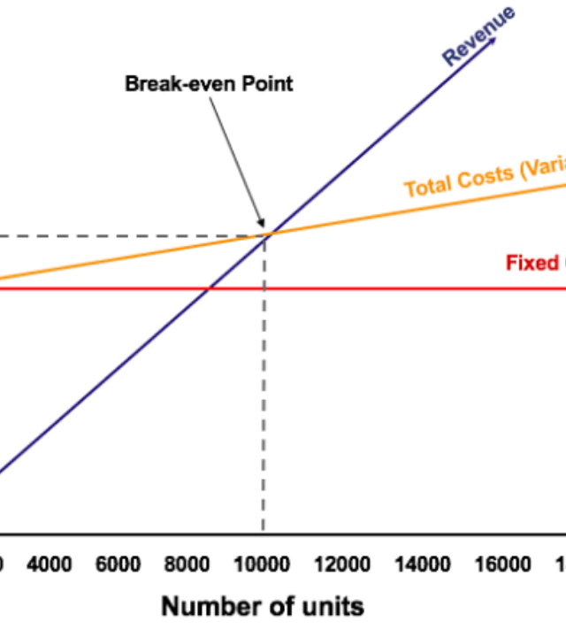

Break-Even Frontier
Understanding the point where Total Revenue equals Total Cost is the foundation of profit planning.
Sensitivity analysis on the break-even point allows managers to test "What-If" scenarios regarding pricing and cost fluctuations.
11.02.2026 Managerial Economics Dr. R.Arthi, Assistant Professor Commerce with IT 6/9

Slide 8
Budgeting vs. Forecasting
Feature | Budgeting (Planning) | Forecasting (Predicting)
Perspective | Aspiration / Commitment | Reality / Estimation
Nature | Static (Usually Annual) | Dynamic (Rolling / Quarterly)
Goal | Control of Resources | Informing Decision Making
Focus | Variance Analysis | Course Correction
11.02.2026 Managerial Economics Dr. R.Arthi, Assistant Professor Commerce with IT 7/9

Slide 9

The Digital FP&A Era
Modern profit forecasting has moved beyond spreadsheets into real-time ecosystems.
AI & Machine Learning: Detecting hidden patterns in consumer behavior to sharpen predictive accuracy.
Cloud ERP Integration: Single source of truth for unified financial reporting.
Scenario Modeling: Instant simulation of complex market shocks.
11.02.2026 Managerial Economics Dr. R.Arthi, Assistant Professor Commerce with IT 8/9

Slide 10


Challenges & Limitations
No forecast is perfect. External economic volatility (inflation, supply chain shocks) can render static plans obsolete.
Cognitive Biases: Over-optimism or anchoring on historical data can lead to flawed projections.
Data Quality: Fragmented data silos across departments often lead to inconsistent planning inputs.
11.02.2026 Managerial Economics Dr. R.Arthi, Assistant Professor Commerce with IT 9/9

