Slide 1


Dr.SNS RAJALAKSHMI COLLEGE OF ARTS AND SCIENCE
(Autonomous)
Accredited by NAAC – UGC with ‘A+ Grade (Cycle IV)
( Recognised by UGC, Approved by AICTE & Affiliated to Bharathiar University) Coimbatore- 49
DEPARTMENT OF COMMERCE WITH
INFORMATION TECHNOLOGY
MANAGERIAL ECONOMICS
Profit
Dr. R.Arthi, M.Com (IB).,M.Phil., MBA.,M.Com.,Ph.D.,
Assistant Professor,
Department of Commerce with Information Technology

Slide 2



What are Profit Policies?
Core Definition
Profit policies are administrative guidelines that dictate how a firm's net earnings should be appropriated.
Strategic Scope
Dividend Payout Ratios
Internal Financing Decisions
They establish the balance between distributing earnings to shareholders and retaining them for internal growth.
Reserve Management
Wealth Maximization Alignment
05.02.2026 Managerial Economics Dr. R.Arthi, Assistant Professor Commerce with IT 1/8

Slide 3






Key Policy Objectives
Shareholder Wealth
Funding Expansion
Financial Stability
Ensuring steady returns to maintain investor confidence and optimize market valuation.
Retaining earnings as a cost-effective source of internal capital for R&D and scaling.
Building reserves to act as a buffer against market volatility and cyclical downturns.
05.02.2026 Managerial Economics Dr. R.Arthi, Assistant Professor Commerce with IT 2/8

Slide 4
Profit vs. Wealth Focus
Criteria | Profit Maximization | Wealth Maximization
Primary Goal | Short-term net income increase | Maximizing Net Present Value (NPV)
Time Frame | Current fiscal period | Long-term sustainable growth
Risk Aspect | Often ignores uncertainty | Integrates risk and time-value
Result | Immediate dividend boost | Stock price appreciation
05.02.2026 Managerial Economics Dr. R.Arthi, Assistant Professor Commerce with IT 3/8

Slide 5






Types of Dividend Policies
Stable Dividend
Constant Payout
Residual Policy
Paying a fixed amount per share regardless of earnings volatility.
Distributing a fixed percentage of net earnings every period.
Dividends paid only after all viable projects are fully funded.
05.02.2026 Managerial Economics Dr. R.Arthi, Assistant Professor Commerce with IT 4/8

Slide 6


Internal Drivers
Liquidity & Maturity
A firm's ability to pay dividends depends heavily on its cash position rather than just book profit.
Cash Reserves: High liquidity permits higher payout.
Firm Age: Mature firms payout more; startups retain.
Earnings Stability: Steady income allows stable dividends.
05.02.2026 Managerial Economics Dr. R.Arthi, Assistant Professor Commerce with IT 5/8

Slide 7
External Influences
Legal Constraints: Corporate laws often prohibit dividends from being paid out of capital to protect creditors.
Tax Environment: Tax rates on dividends vs. capital gains significantly influence payout decisions.
Capital Access: Easy access to external debt allows firms to be more generous with their dividends.
Market Cycles: Inflationary pressures often force firms to retain more for inventory replacement costs.
05.02.2026 Managerial Economics Dr. R.Arthi, Assistant Professor Commerce with IT 6/8

Slide 8
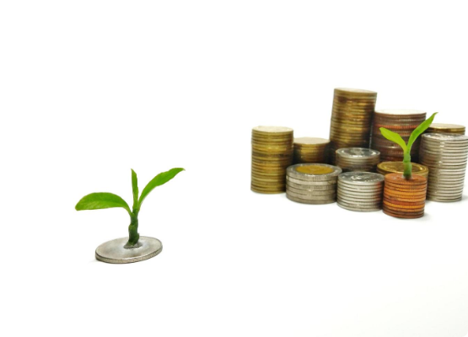
Reinvestment Strategy
"Ploughing Back" Profits
Self-financing through retained earnings is the most efficient way to fuel long-term growth without debt burden.
Benefits: No interest costs, no loss of control, and increased intrinsic value of shares.
05.02.2026 Managerial Economics Dr. R.Arthi, Assistant Professor Commerce with IT 7/8

Slide 9


Theoretical Frameworks
Walter's Valuation Model
Where r is return on investment and k is cost of equity.
These models suggest that the optimal profit policy depends on whether a firm's return exceeds its cost of capital.
05.02.2026 Managerial Economics Dr. R.Arthi, Assistant Professor Commerce with IT 8/8

