Slide 1


SNS College of Technology
(An Autonomous Institutions)
Department of Computer Science and Engineering
23CSB201-Object Oriented Programming
Topic: Super & Sub Class
Mrs.G.Swathi
Assistant Professor

Slide 2
Class
A class in Java is a blueprint or template used to create objects.
It defines the common attributes (data or fields) and behaviors (methods or functions) that all objects of that class will share.
Syntax:
class ClassName {
// fields
// methods
}
fields are used to store data
methods are used to perform some operations

Slide 3
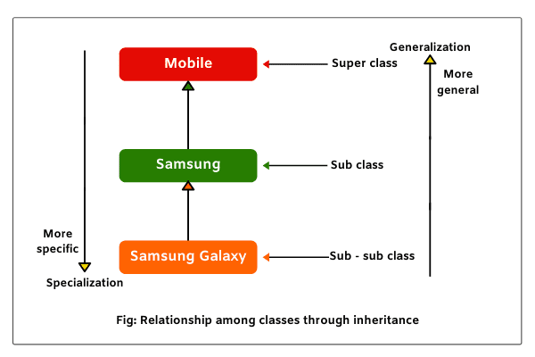
Types of Class

Slide 4
Super Class
The class whose properties are inherited is called the Super Class (Parent/Base class)
The class that is inherited by another class.
Contains common properties and methods.
Promotes code reusability.

Slide 5
Sub Class
The class whose properties are inherited is called the Super Class (Parent/Base class), and the class that inherits those properties is called the Sub Class (Child/Derived class).
The class that inherits from the super class.
Can use all public and protected members of the super class.
Can also define its own additional features.

Slide 6
Super Class Example
// Super Class
class Vehicle {
int speed;
void start() {
System.out.println("Vehicle starts");
}
}

Slide 7

Sub Class Example
// Sub Class
class Car extends Vehicle {
void drive() {
System.out.println("Car is running");
}
}
public class Main {
public static void main(String[] args) {
Car c = new Car();
c.start(); // inherited method
c.drive(); // own method
}
}

