Slide 1

SNS COLLEGE OF TECHNOLOGY
Coimbatore-35
An Autonomous Institution
Department Of Artificial Intelligence and Machine Learning
23AMO305 – Foundation of Data Science
UNIT-1 Exploratory Data Analysis (EDA)
3/1/2026
1/16
1

Slide 2
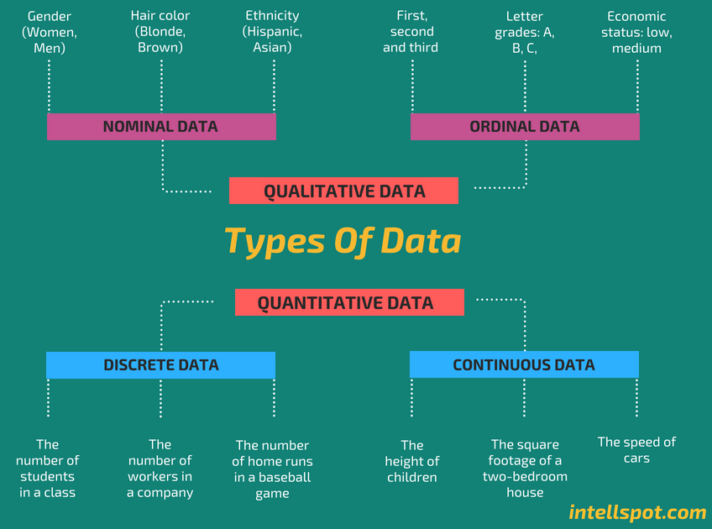
Recap
What is data?
(types of data: numerical, categorical, ordinal, nominal)
Dataset structure
(rows, columns, features, target variable)
Descriptive statistics
Mean, median, mode
Variance, standard deviation
Min, max, range, quartiles
Data distribution concepts
Normal distribution
Skewness and kurtosis

Slide 3
What We’ll Learn Today?
Why EDA?
Understanding the Dataset
Data Quality Check
Descriptive Statistics
Univariate Analysis

Slide 4
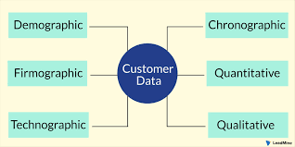
Problem Statement
A retail company wants to understand customer purchasing behavior to improve sales and customer retention. The company has collected historical data containing customer demographics, purchase details, and transaction information.
You are provided with a dataset that includes the following attributes:
Customer ID
Age
Gender
Annual Income

Slide 5
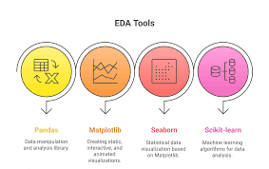
Empathize
The problem is to perform Exploratory Data Analysis (EDA) on the given dataset to uncover hidden patterns, detect data quality issues, understand variable distributions, and identify meaningful relationships among features.
Statistical summaries
Graphical visualizations
Clear interpretations and business-relevant insights

Slide 6
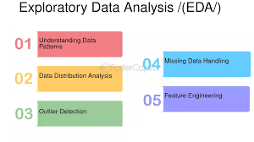
Define
To explore and analyze the given dataset by applying Exploratory Data Analysis techniques to detect missing values and outliers, summarize key characteristics of the data, and extract meaningful insights that support informed decision-making.
One-line exam answer
Lab manual definition
Soft Computing–syllabus aligned wording

Slide 7
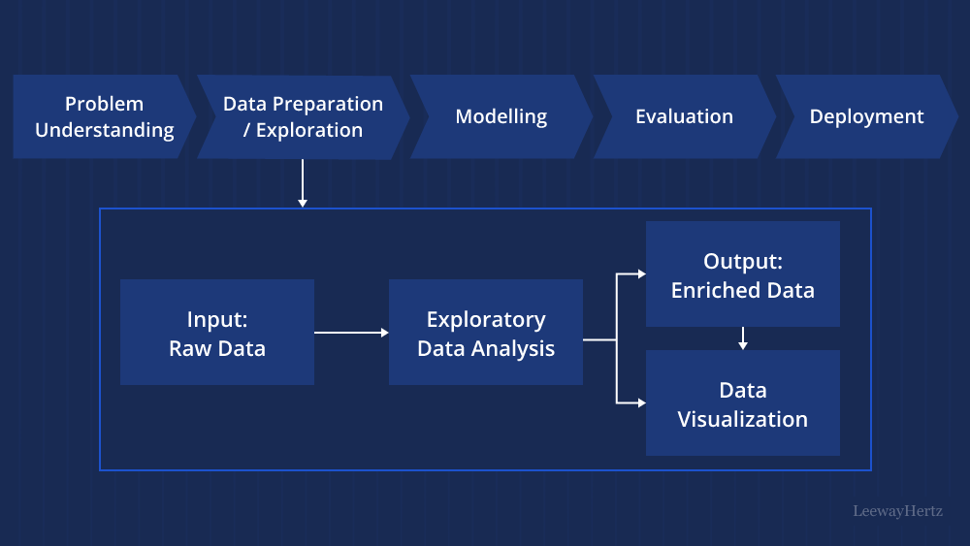
Ideate

Slide 8
Prototype
To analyze historical customer data in order to:
Understand purchasing patterns
Segment customers based on behavior
Predict future buying tendencies
Improve sales strategies and customer retention

Slide 9
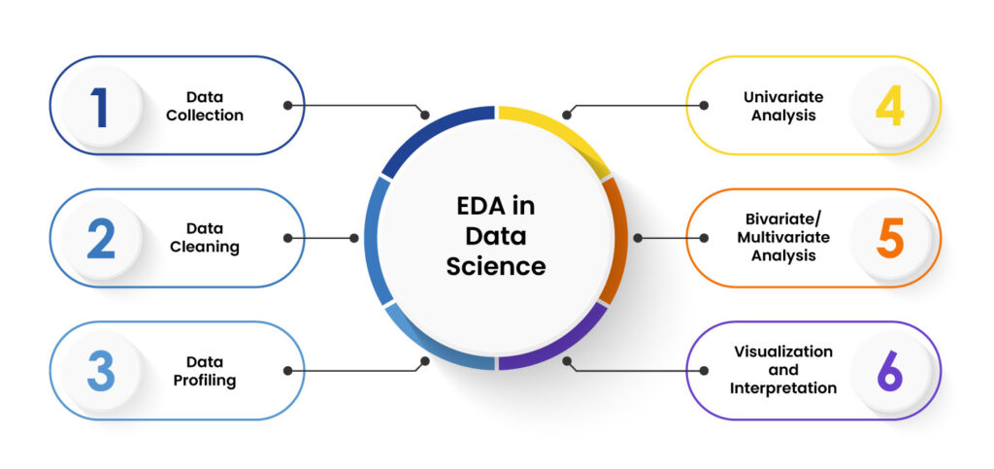
Real-World Applications

Slide 10
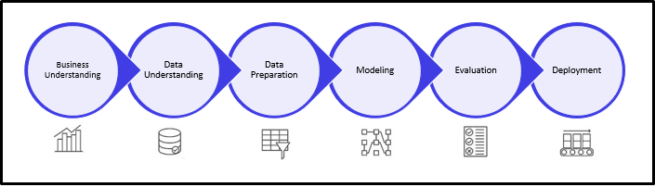
Mind Map

Slide 11
Conclusion
Exploratory Data Analysis (EDA) plays a crucial role in understanding the underlying structure and characteristics of a dataset before applying any statistical or machine learning models.
Through various techniques such as data visualization, summary statistics, and correlation analysis, EDA helps identify patterns, trends, outliers, and anomalies in the data.
t also assists in detecting missing values and inconsistencies, enabling effective data cleaning and preparation.
Overall, EDA provides valuable insights that guide feature selection, model choice, and decision-making, making it an essential step in the data analysis process.

Slide 12
Data mining Challenge!
Dirty Data Challenge (Preprocessing)
Objective: Understand real-world data issues.
Problem:
You are given customer and sales data with:
Missing values
Duplicate records
Inconsistent date formats
Task:
Identify data quality issues
Suggest preprocessing steps to clean the data
Outcome:
Data cleaning, preprocessing importance

Slide 13


