Slide 1

SNS COLLEGE OF TECHNOLOGY
Kurumbapalayam (Po), Coimbatore – 641 107
An Autonomous Institution
Accredited by NBA – AICTE and Accredited by NAAC – UGC with ‘A’ Grade Approved by AICTE, New Delhi & Affiliated to Anna University, Chennai
DEPARTMENT OF INFORMATION TECHNOLOGY
COURSE NAME : 23CSB201 - OBJECT ORIENTED PROGRAMMING
I YEAR / II SEMESTER
Unit I - INTRODUCTION TO OOP
Topic :Variables in Java
Mrs.R.Sivagami – AP/IT
03.01.2026 UNIT-1 /VARIABLES/ 23CSB201 OBJECT ORIENTED PROGRAMMING/MS.R.SIVAGAMI/IT /SNSCT 1/13

Slide 2
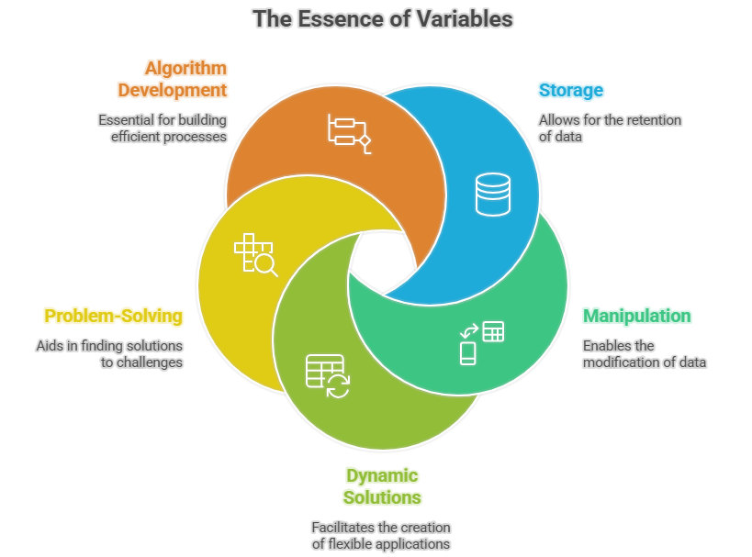
Introduction to Variables
A variable is a named memory location
Used to store data values
Value can change during program execution
Helps programs work with data
03.01.2026 UNIT-1 /VARIABLES/ 23CSB201 OBJECT ORIENTED PROGRAMMING/MS.R.SIVAGAMI/IT /SNSCT 2/13

Slide 3
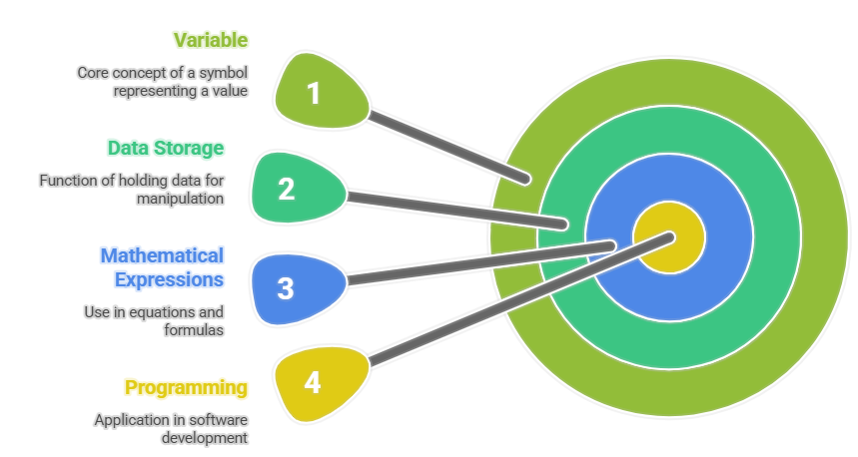
Definition of Variable
DT DEFINE
A variable is a container to store data
Each variable has a name, type, and value
Declared before use in Java
03.01.2026 UNIT-1 /VARIABLES/ 23CSB201 OBJECT ORIENTED PROGRAMMING/MS.R.SIVAGAMI/IT /SNSCT 3/13

Slide 4
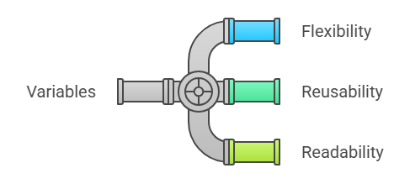
Purpose of Variables
DT IDIATE
Store information temporarily
Make programs flexible
Help reuse values
Improve program readability
03.01.2026 UNIT-1 /VARIABLES/ 23CSB201 OBJECT ORIENTED PROGRAMMING/MS.R.SIVAGAMI/IT /SNSCT 4/13

Slide 5
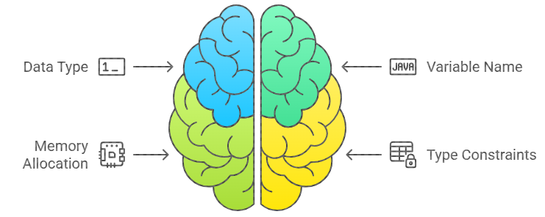
Syntax of Variable Declaration
dataType variableName;
Example:
int age;
03.01.2026 UNIT-1 /VARIABLES/ 23CSB201 OBJECT ORIENTED PROGRAMMING/MS.R.SIVAGAMI/IT /SNSCT 5/13

Slide 6
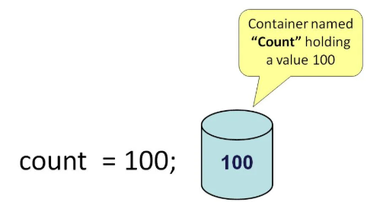
Variable Initialization
Assigning a value to a variable
Example:
int age = 20;
03.01.2026 UNIT-1 /VARIABLES/ 23CSB201 OBJECT ORIENTED PROGRAMMING/MS.R.SIVAGAMI/IT /SNSCT 6/13

Slide 7
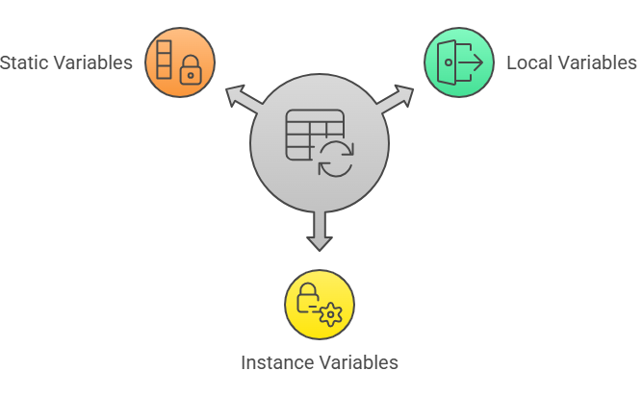
Types of Variables in Java
Local Variables
Instance Variables
Static Variables
03.01.2026 UNIT-1 /VARIABLES/ 23CSB201 OBJECT ORIENTED PROGRAMMING/MS.R.SIVAGAMI/IT /SNSCT 7/13

Slide 8

Local Variables
Declared inside methods
Used only within the method
Must be initialized before use
03.01.2026 UNIT-1 /VARIABLES/ 23CSB201 OBJECT ORIENTED PROGRAMMING/MS.R.SIVAGAMI/IT /SNSCT 8/13

Slide 9
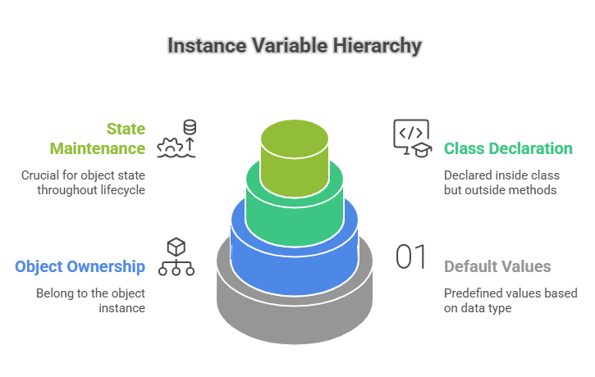
Instance Variables
Declared inside class but outside methods
Belong to object
Have default values
03.01.2026 UNIT-1 /VARIABLES/ 23CSB201 OBJECT ORIENTED PROGRAMMING/MS.R.SIVAGAMI/IT /SNSCT 9/13

Slide 10
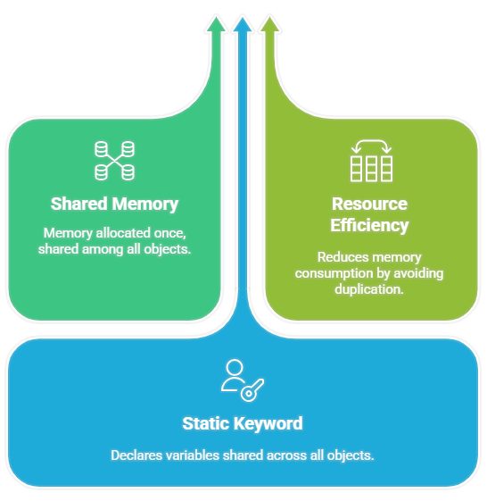
Static Variables
Declared using static k
Shared among all obje
Memory allocated onc
03.01.2026 UNIT-1 /VARIABLES/ 23CSB201 OBJECT ORIENTED PROGRAMMING/MS.R.SIVAGAMI/IT /SNSCT 10/13

Slide 11
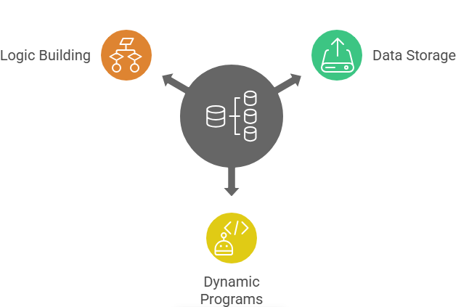
Importance of Variables
Store data for processing
Make programs dynamic
Essential for logic building
03.01.2026 UNIT-1 /VARIABLES/ 23CSB201 OBJECT ORIENTED PROGRAMMING/MS.R.SIVAGAMI/IT /SNSCT 11/13

Slide 12
Variables – Questions to Solve
Define a variable in Java
Differentiate local and instance variables
Write a Java program using variables
03.01.2026 UNIT-1 /VARIABLES/ 23CSB201 OBJECT ORIENTED PROGRAMMING/MS.R.SIVAGAMI/IT /SNSCT 12/13

Slide 13

03.01.2026 UNIT-1 /VARIABLES/ 23CSB201 OBJECT ORIENTED PROGRAMMING/MS.R.SIVAGAMI/IT /SNSCT 13/13

