Slide 1

SNS COLLEGE OF TECHNOLOGY
Kurumbapalayam (Po), Coimbatore – 641 107
An Autonomous Institution
Accredited by NBA – AICTE and Accredited by NAAC – UGC with ‘A’ Grade Approved by AICTE, New Delhi & Affiliated to Anna University, Chennai
DEPARTMENT OF INFORMATION TECHNOLOGY
COURSE NAME : 23CSB201 - OBJECT ORIENTED PROGRAMMING
I YEAR / II SEMESTER
Unit I - INTRODUCTION TO OOP
Topic : Comments
Mrs.R.Sivagami – AP/IT
03.01.2026 UNIT-1 / COMMENTS/ 23CSB201 OBJECT ORIENTED PROGRAMMING/MS.R.SIVAGAMI/IT /SNSCT 1/12

Slide 2
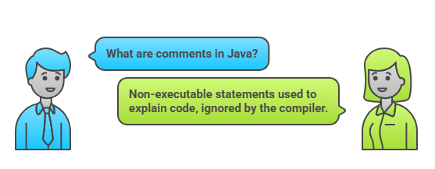
Introduction to Comments
03.01.2026 UNIT-1 / COMMENTS/ 23CSB201 OBJECT ORIENTED PROGRAMMING/MS.R.SIVAGAMI/IT /SNSCT 2/12

Slide 3
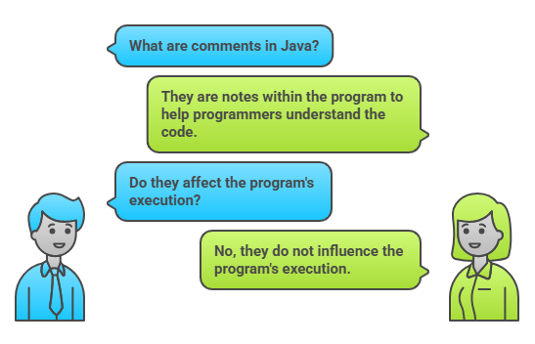
Definition
03.01.2026 UNIT-1 / COMMENTS/ 23CSB201 OBJECT ORIENTED PROGRAMMING/MS.R.SIVAGAMI/IT /SNSCT 3/12

Slide 4
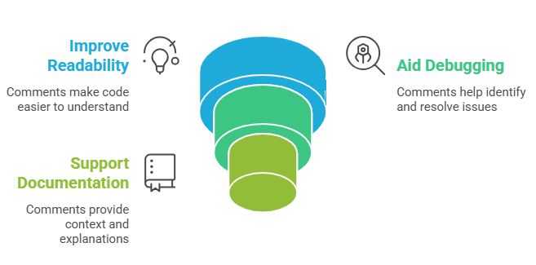
Purpose
03.01.2026 UNIT-1 / COMMENTS/ 23CSB201 OBJECT ORIENTED PROGRAMMING/MS.R.SIVAGAMI/IT /SNSCT 4/12

Slide 5
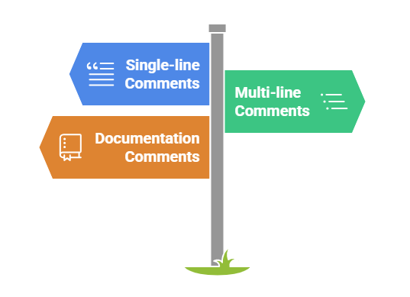
Types of Comments in Java
03.01.2026 UNIT-1 / COMMENTS/ 23CSB201 OBJECT ORIENTED PROGRAMMING/MS.R.SIVAGAMI/IT /SNSCT 5/12

Slide 6
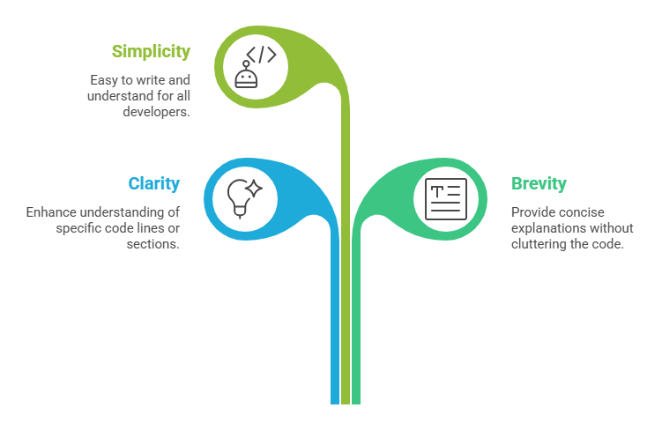
Single-line Comments
03.01.2026 UNIT-1 / COMMENTS/ 23CSB201 OBJECT ORIENTED PROGRAMMING/MS.R.SIVAGAMI/IT /SNSCT 6/12

Slide 7
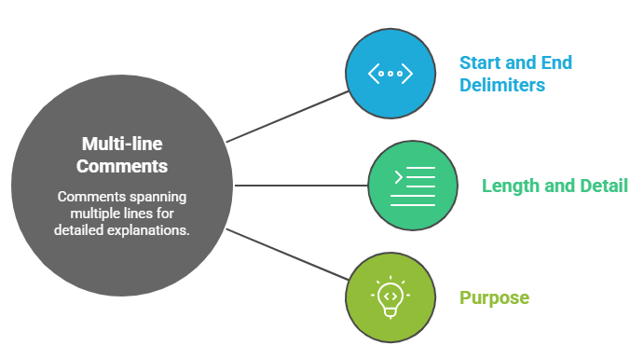
Multi-line Comments
03.01.2026 UNIT-1 / COMMENTS/ 23CSB201 OBJECT ORIENTED PROGRAMMING/MS.R.SIVAGAMI/IT /SNSCT 7/12

Slide 8
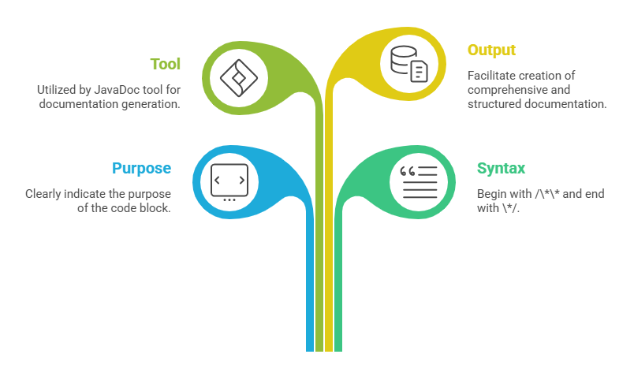
Documentation Comments
03.01.2026 UNIT-1 / COMMENTS/ 23CSB201 OBJECT ORIENTED PROGRAMMING/MS.R.SIVAGAMI/IT /SNSCT 8/12

Slide 9
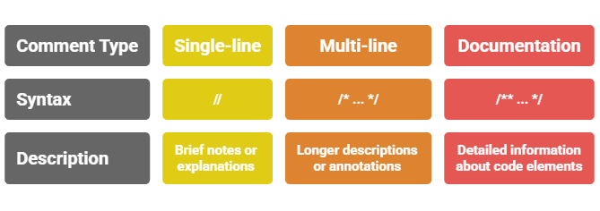
Syntax Examples
03.01.2026 UNIT-1 / COMMENTS/ 23CSB201 OBJECT ORIENTED PROGRAMMING/MS.R.SIVAGAMI/IT /SNSCT 9/12

Slide 10
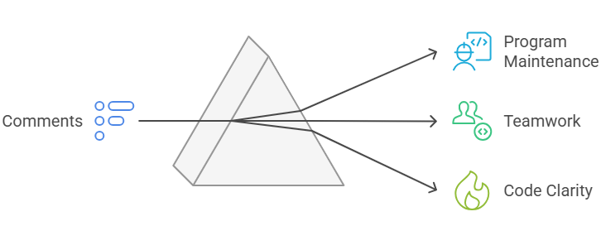
Importance of Comments
No user interaction
Faster execution
Useful in automation
03.01.2026 UNIT-1 / COMMENTS/ 23CSB201 OBJECT ORIENTED PROGRAMMING/MS.R.SIVAGAMI/IT /SNSCT 10/12

Slide 11
Comments – Questions to Solve
What are comments in Java?
List types of comments.
Write a Java program with comments.
03.01.2026 UNIT-1 / COMMENTS/ 23CSB201 OBJECT ORIENTED PROGRAMMING/MS.R.SIVAGAMI/IT /SNSCT 11/12

Slide 12

03.01.2026 UNIT-1 / COMMENTS/ 23CSB201 OBJECT ORIENTED PROGRAMMING/MS.R.SIVAGAMI/IT /SNSCT 12/12

