Slide 1

SNS COLLEGE OF TECHNOLOGY
Kurumbapalayam (Po), Coimbatore – 641 107
An Autonomous Institution
Accredited by NBA – AICTE and Accredited by NAAC – UGC with ‘A’ Grade Approved by AICTE, New Delhi & Affiliated to Anna University, Chennai
DEPARTMENT OF INFORMATION TECHNOLOGY
COURSE NAME : 23CSB201 - OBJECT ORIENTED PROGRAMMING
I YEAR / II SEMESTER
Unit I - INTRODUCTION TO OOP
Topic : Environment setup
Mrs.R.Sivagami – AP/IT
03.01.2026 UNIT-1 / ENVIRONMENT SETUP/ 23CSB201 OBJECT ORIENTED PROGRAMMING/MS.R.SIVAGAMI/IT /SNSCT 1/9

Slide 2
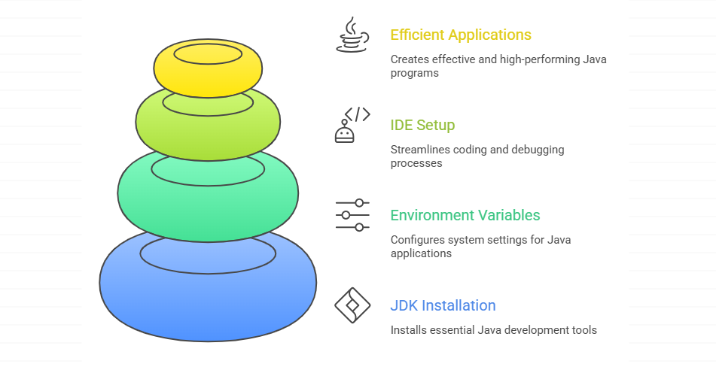
Introduction to Java Environment Setup
03.01.2026 UNIT-1 / ENVIRONMENT SETUP/ 23CSB201 OBJECT ORIENTED PROGRAMMING/MS.R.SIVAGAMI/IT /SNSCT 2/9

Slide 3
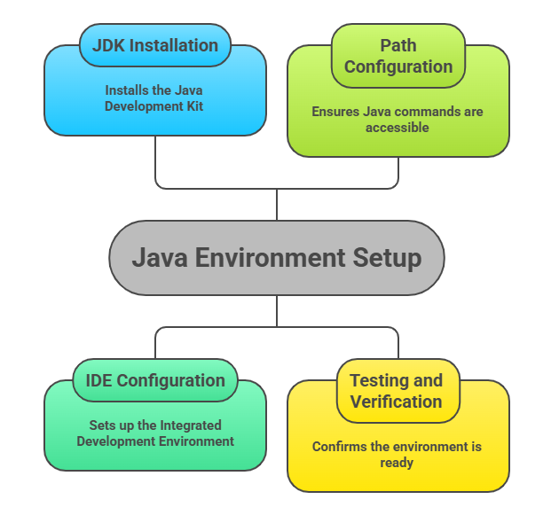
Definition
DT DEFINE
Java Environment Setup refers to the process of installing and configuring software needed to write, compile, and run Java programs.
03.01.2026 UNIT-1 / ENVIRONMENT SETUP/ 23CSB201 OBJECT ORIENTED PROGRAMMING/MS.R.SIVAGAMI/IT /SNSCT 3/9

Slide 4
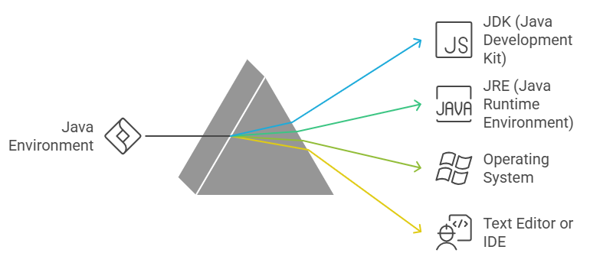
Requirements for Java Environment
DT EMPATHY
03.01.2026 UNIT-1 / ENVIRONMENT SETUP/ 23CSB201 OBJECT ORIENTED PROGRAMMING/MS.R.SIVAGAMI/IT /SNSCT 4/9

Slide 5
Step 1: Install JDK
DT IDEATE
Step 1: Install JDK
Download JDK from Oracle or OpenJDK website
Install and verify using javac command
03.01.2026 UNIT-1 / ENVIRONMENT SETUP/ 23CSB201 OBJECT ORIENTED PROGRAMMING/MS.R.SIVAGAMI/IT /SNSCT 5/9

Slide 6
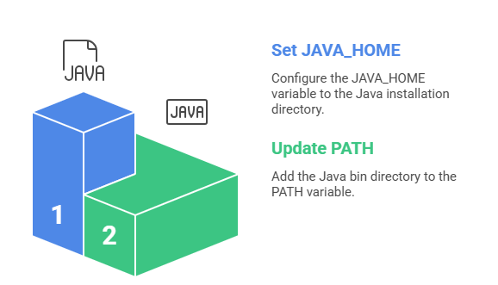
Step 2: Set Environment Variables
Step 2: Set Environment Variables
Set JAVA_HOME
Update PATH variable
03.01.2026 UNIT-1 / ENVIRONMENT SETUP/ 23CSB201 OBJECT ORIENTED PROGRAMMING/MS.R.SIVAGAMI/IT /SNSCT 6/9

Slide 7
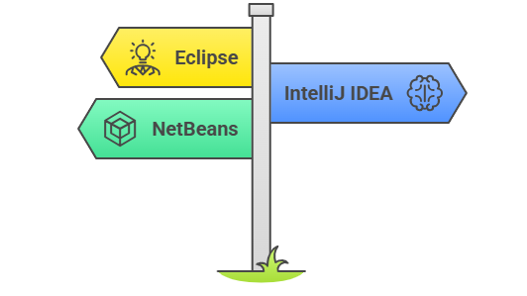
Step 3: Install IDE
Eclipse
IntelliJ IDEA
NetBeans
03.01.2026 UNIT-1 / ENVIRONMENT SETUP/ 23CSB201 OBJECT ORIENTED PROGRAMMING/MS.R.SIVAGAMI/IT /SNSCT 7/9

Slide 8
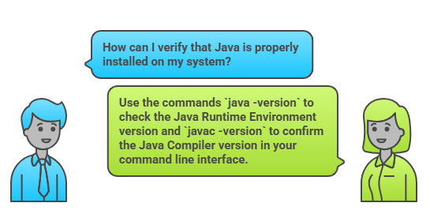
Verify Java Installation
03.01.2026 UNIT-1 / ENVIRONMENT SETUP/ 23CSB201 OBJECT ORIENTED PROGRAMMING/MS.R.SIVAGAMI/IT /SNSCT 8/9

Slide 9

03.01.2026 UNIT-1 / ENVIRONMENT SETUP/ 23CSB201 OBJECT ORIENTED PROGRAMMING/MS.R.SIVAGAMI/IT /SNSCT 9/9

