Slide 1

SNS COLLEGE OF TECHNOLOGY
Kurumbapalayam (Po), Coimbatore – 641 107
An Autonomous Institution
Accredited by NBA – AICTE and Accredited by NAAC – UGC with ‘A’ Grade Approved by AICTE, New Delhi & Affiliated to Anna University, Chennai
DEPARTMENT OF INFORMATION TECHNOLOGY
COURSE NAME : 23CSB201 - OBJECT ORIENTED PROGRAMMING
I YEAR / II SEMESTER
Unit I - INTRODUCTION TO OOP
Topic :Operations in Java
Mrs.R.Sivagami – AP/IT
03.01.2026 UNIT-1 /OPERATORS/ 23CSB201 OBJECT ORIENTED PROGRAMMING/MS.R.SIVAGAMI/IT /SNSCT 1/16

Slide 2
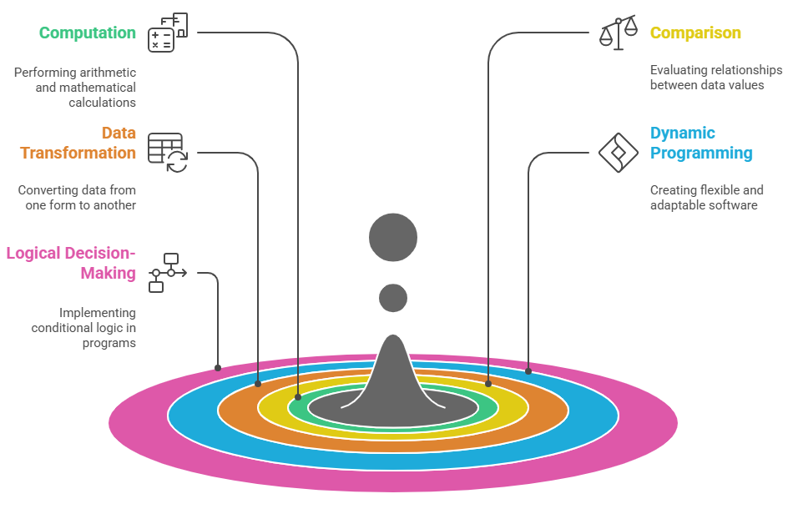
Introduction to Operations
Meaning of Operations in Java
Purpose of Operations
03.01.2026 UNIT-1 /OPERATORS/ 23CSB201 OBJECT ORIENTED PROGRAMMING/MS.R.SIVAGAMI/IT /SNSCT 2/16

Slide 3
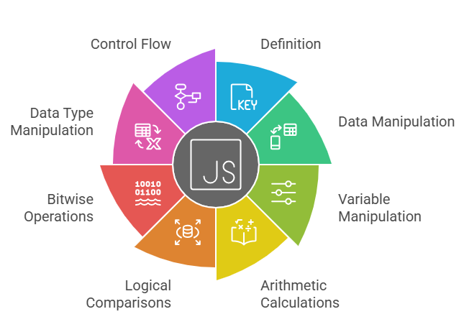
What is an Operator?
03.01.2026 UNIT-1 /OPERATORS/ 23CSB201 OBJECT ORIENTED PROGRAMMING/MS.R.SIVAGAMI/IT /SNSCT 3/16

Slide 4
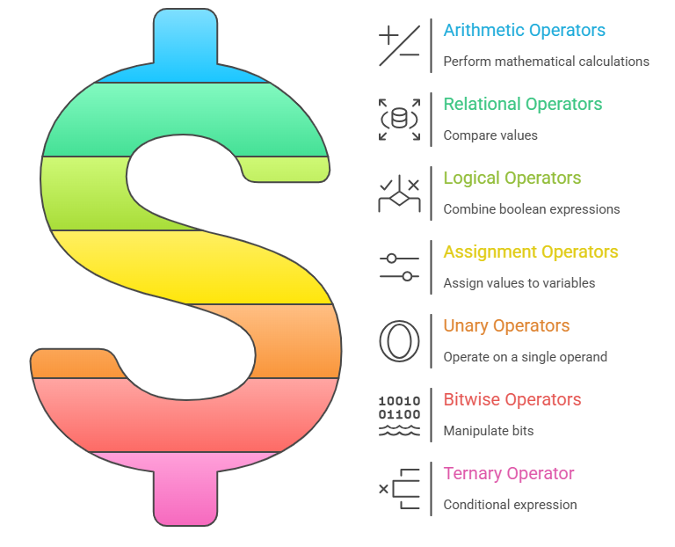
Types of Operators
03.01.2026 UNIT-1 /OPERATORS/ 23CSB201 OBJECT ORIENTED PROGRAMMING/MS.R.SIVAGAMI/IT /SNSCT 4/16

Slide 5
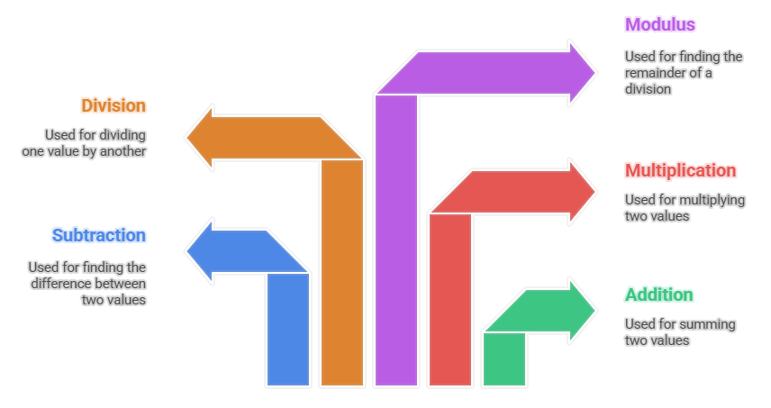
Arithmetic Operators
Subtraction (−)
Multiplication (*)
Division (/)
Modulus (%)
Addition (+)
03.01.2026 UNIT-1 /OPERATORS/ 23CSB201 OBJECT ORIENTED PROGRAMMING/MS.R.SIVAGAMI/IT /SNSCT 5/16

Slide 6
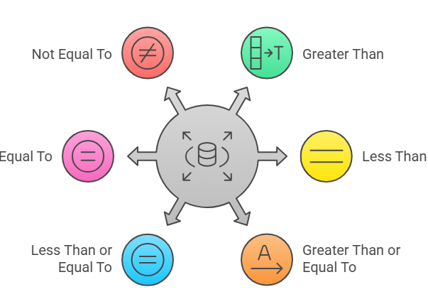
Relational operator
03.01.2026 UNIT-1 /OPERATORS/ 23CSB201 OBJECT ORIENTED PROGRAMMING/MS.R.SIVAGAMI/IT /SNSCT 6/16

Slide 7
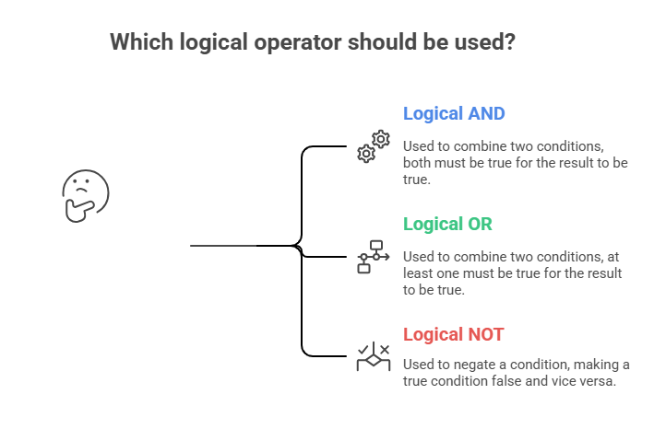
Logical Operator
Logical AND (&&)
Logical OR (||)
Logical NOT (!)
03.01.2026 UNIT-1 /OPERATORS/ 23CSB201 OBJECT ORIENTED PROGRAMMING/MS.R.SIVAGAMI/IT /SNSCT 7/16

Slide 8
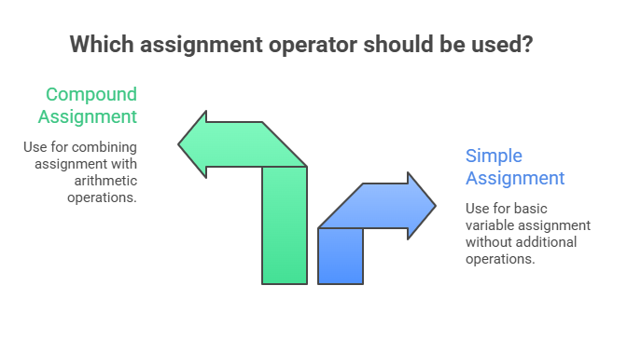
Assignment Operator
Simple assignment (=)
Compound assignment (+=, −=, *=, /=, %=)
03.01.2026 UNIT-1 /OPERATORS/ 23CSB201 OBJECT ORIENTED PROGRAMMING/MS.R.SIVAGAMI/IT /SNSCT 8/16

Slide 9
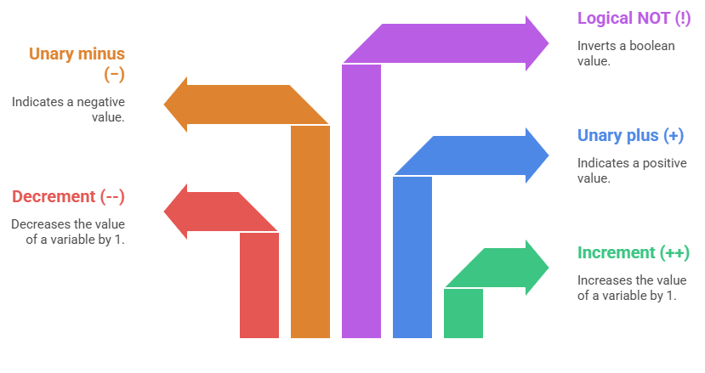
Unary Operator
03.01.2026 UNIT-1 /OPERATORS/ 23CSB201 OBJECT ORIENTED PROGRAMMING/MS.R.SIVAGAMI/IT /SNSCT 9/16

Slide 10
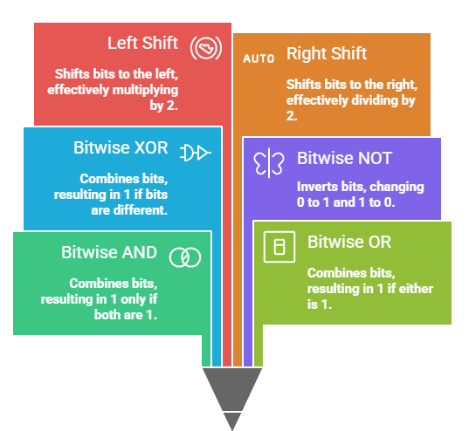
Bitwise Operator
Bitwise AND (&)
Bitwise OR (|)
Bitwise XOR (^)
Bitwise NOT (~)
Left shift (<<)
Right shift (>>)
03.01.2026 UNIT-1 /OPERATORS/ 23CSB201 OBJECT ORIENTED PROGRAMMING/MS.R.SIVAGAMI/IT /SNSCT 10/16

Slide 11
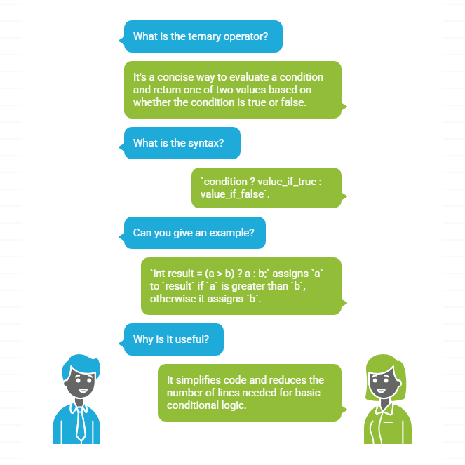
Ternary Operator
03.01.2026 UNIT-1 /OPERATORS/ 23CSB201 OBJECT ORIENTED PROGRAMMING/MS.R.SIVAGAMI/IT /SNSCT 11/16

Slide 12
Operators – Questions to Solve
Explain arithmetic operators with examples.
Explain relational operators used in Java.
What are logical operators? Explain with a truth table.
Write a short note on assignment operators.
Differentiate between i++ and ++i.
Explain the conditional (ternary) operator with an example.
Write a Java program to demonstrate arithmetic operators.
Why is the modulus operator important? Explain with an example.
03.01.2026 UNIT-1 /OPERATORS/ 23CSB201 OBJECT ORIENTED PROGRAMMING/MS.R.SIVAGAMI/IT /SNSCT 12/16

Slide 13
Activity
Activity 1: Simple Calculator using Arithmetic Operators
Problem Statement
Create a simple calculator program that accepts two numbers as input and performs the following operations:
Addition (+)
Subtraction (−)
Multiplication (*)
Division (/)
Modulus (%)
03.01.2026 UNIT-1 /OPERATORS/ 23CSB201 OBJECT ORIENTED PROGRAMMING/MS.R.SIVAGAMI/IT /SNSCT 13/16

Slide 14
Activity
import java.util.Scanner;
public class SimpleCalculator {
public static void main(String[] args) {
Scanner sc = new Scanner(System.in);
// Input two numbers
System.out.print("Enter first number: ");
int num1 = sc.nextInt();
System.out.print("Enter second number: ");
int num2 = sc.nextInt();
// Arithmetic operations
System.out.println("Addition: " + (num1 + num2));
System.out.println("Subtraction: " + (num1 - num2));
System.out.println("Multiplication: " + (num1 * num2));
System.out.println("Division: " + (num1 / num2));
System.out.println("Modulus: " + (num1 % num2));
sc.close();
}
}
03.01.2026 UNIT-1 /OPERATORS/ 23CSB201 OBJECT ORIENTED PROGRAMMING/MS.R.SIVAGAMI/IT /SNSCT 14/16

Slide 15
Activity
Sample Input
Enter first number: 20 Enter second number: 5
Sample Output
Addition: 25 Subtraction: 15 Multiplication: 100 Division: 4 Modulus: 0
03.01.2026 UNIT-1 /OPERATORS/ 23CSB201 OBJECT ORIENTED PROGRAMMING/MS.R.SIVAGAMI/IT /SNSCT 15/16

Slide 16

03.01.2026 UNIT-1 /OPERATORS/ 23CSB201 OBJECT ORIENTED PROGRAMMING/MS.R.SIVAGAMI/IT /SNSCT 16/16

