Slide 1
SNS College of Technology
(An Autonomous Institutions)
Department of Computer Science and Engineering
23CSB201-Object Oriented Programming
Topic: this keyword
Mrs.G.Devi
Assistant Professor

Slide 2
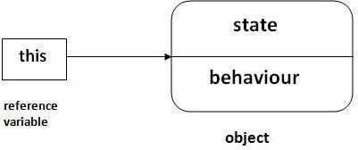
this keyword in Java
There can be a lot of usage of this keyword.
In Java, this is a reference variable that refers to the current object.

Slide 3
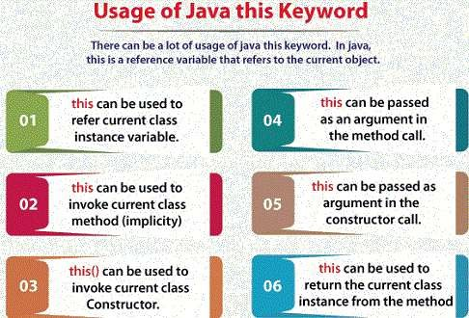
this keyword in Java

Slide 4
Example
class Demo { int x; Demo(int x) {
this.x = x; // 'this.x' refers to instance variable
}
void display() {
System.out.println("x = " + x);
}
}
Here, this.x refers to the instance variable, while x refers to the parameter

Slide 5
Invoke Current Class Method
class Demo {
void show() {
System.out.println("Show method called");
}
void call() {
this.show(); // calls show() of current object
}
}

Slide 6
Invoke Current Class Constructor
class Demo { Demo() {
this(10); // calls parameterized constructor
System.out.println("Default constructor");
}
Demo(int x) {
System.out.println("Parameterized constructor: " + x);
}
}

Slide 7
Pass Current Object
class Demo {
void display(Demo obj) {
System.out.println("Display method called");
}
void show() {
display(this); // passing current object
}
}

Slide 8
Return Current Object
class Demo {
Demo getDemo() {
return this; // returns current object
}
}

Slide 9
This
this cannot be used in static context
Always refers to the current object
Improves readability and clarity in code
Useful in constructor chaining, method calls, and object passing

Slide 10
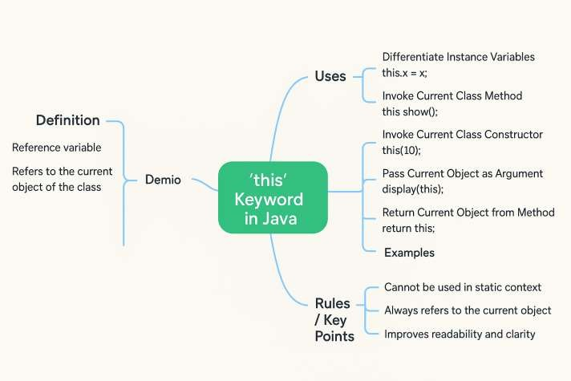
Mind Map

Slide 11
Reference
Herbert Schildt, “Java: The Complete Reference”, 11th Edition, McGraw Hill
Education, New Delhi, 2019
Cay S. Horstmann, “Core Java Fundamentals”, Volume 1, 11th Edition, Prentice Hall, 2018

