Slide 1

SNS COLLEGE OF TECHNOLOGY
Coimbatore-35
An Autonomous Institution
Department Of Artificial Intelligence and Machine Learning
23AMO305 – Foundation of Data Science
UNIT-1 INTRODUCTION TO DATA MINING AND DATA WAREHOUSING
3/1/2026
1/16
1

Slide 2
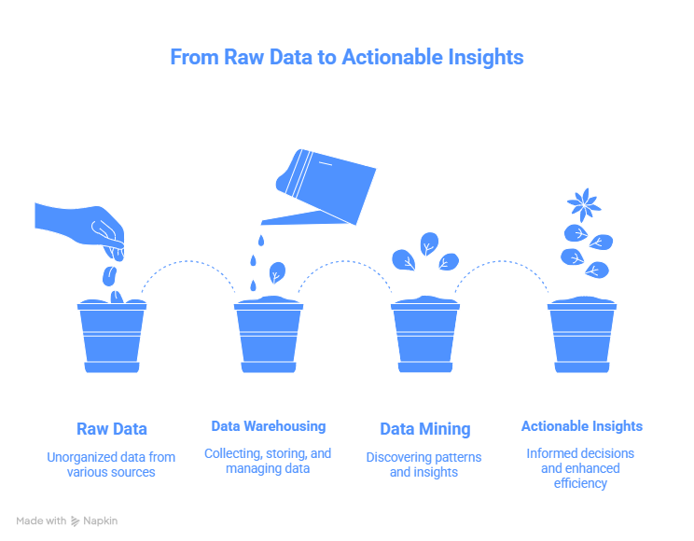
Recap
What is Data Mining and Data Ware Housing?
Data warehousing and data mining are two fundamental, interrelated processes in modern data management and business intelligence.
While data warehousing focuses on the centralized storage and organization of data, data mining involves analyzing that data to discover hidden patterns and insights.

Slide 3
What We’ll Learn Today?
Explosion of data (transactions, sensors, social media)
Raw data ≠ useful information
Difference between:
Operational systems (OLTP) → day-to-day work
Analytical systems (OLAP) → decision making

Slide 4
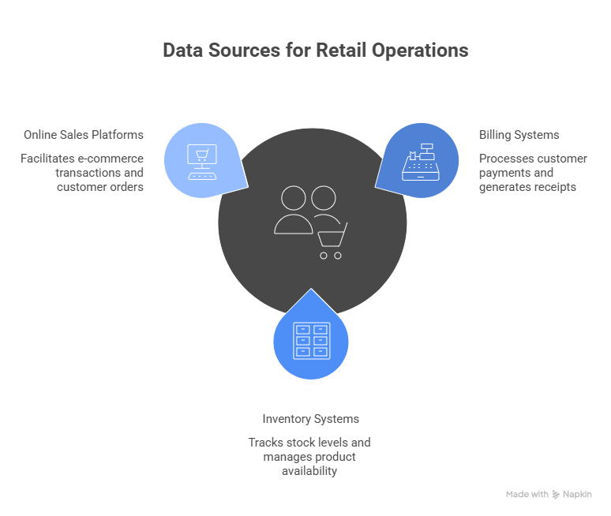
Problem Statement
A large retail chain operates hundreds of stores across different cities. Every day, millions of transactions are generated from billing systems, inventory systems, and online sales platforms.
Currently:
Data is stored in multiple operational databases.
Management struggles to analyze long-term trends.
Decision-making is slow and mostly intuition-based.

Slide 5
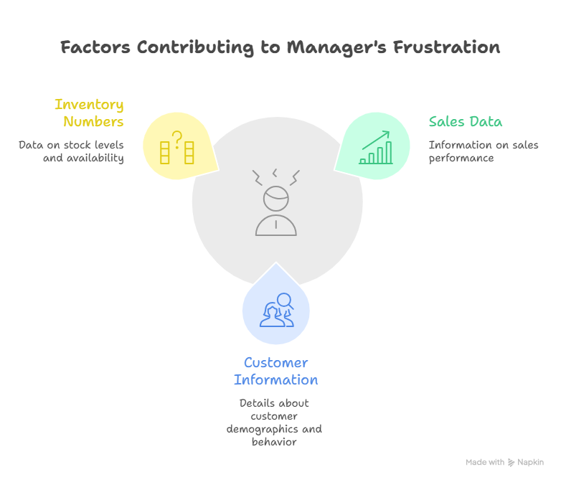
Empathize
The regional sales manager of a growing retail company starts every Monday morning the same way requesting reports from different departments.
By the time the reports arrive:
Sales data comes from one system
Customer information from another
Inventory numbers don’t match either

Slide 6
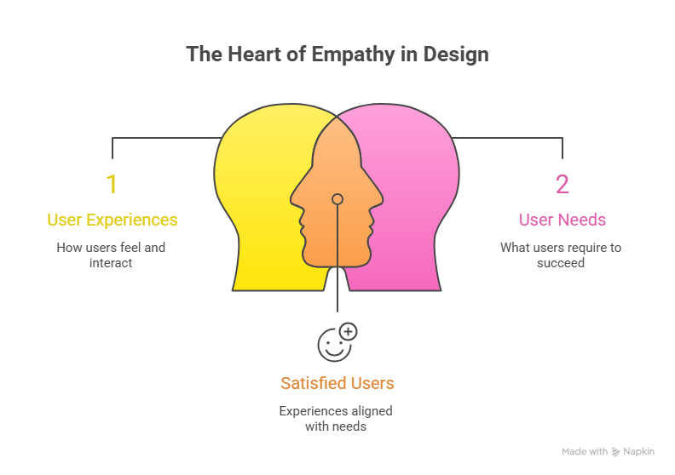
Define
The empathize problem defines the challenge by focusing on the users’ experiences, needs, and frustrations, rather than on technology or solutions.
ser: Retail manager / decision-maker
Need: Integrated, insightful, historical data analysis
Pain: Fragmented data, slow reporting, intuition-based decisions

Slide 7
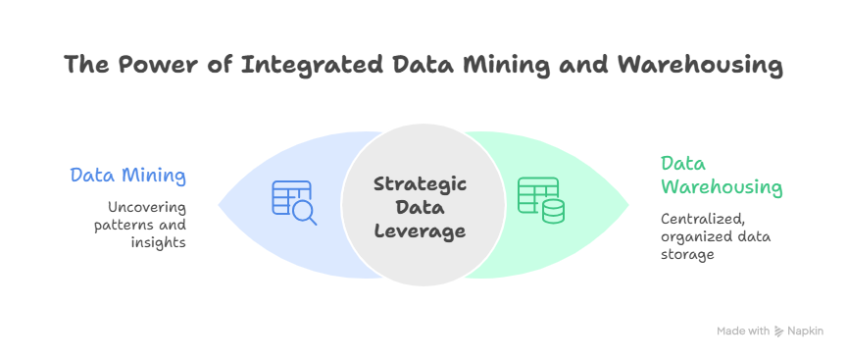
Ideate

Slide 8
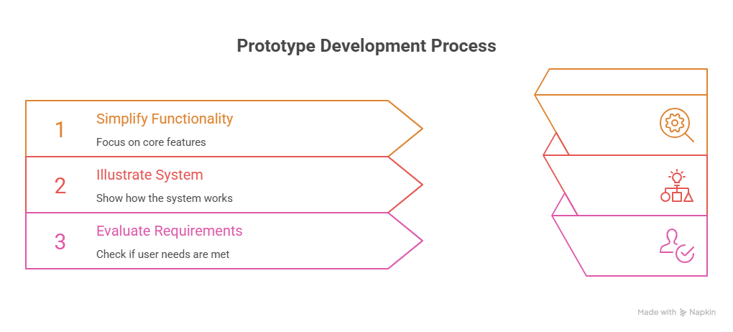
Prototype
A prototype is a simplified, early version of a solution created to visualize how the system will work and to test whether it meets user needs.
Sales database
Customer database
Inventory system

Slide 9
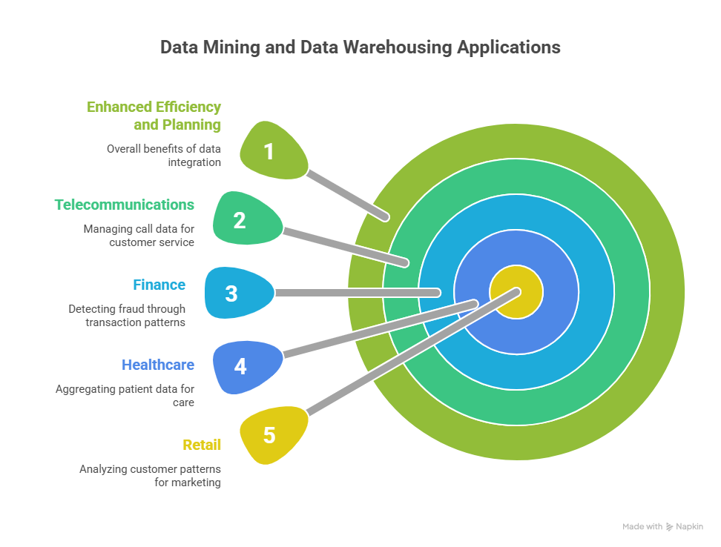
Real-World Applications

Slide 10
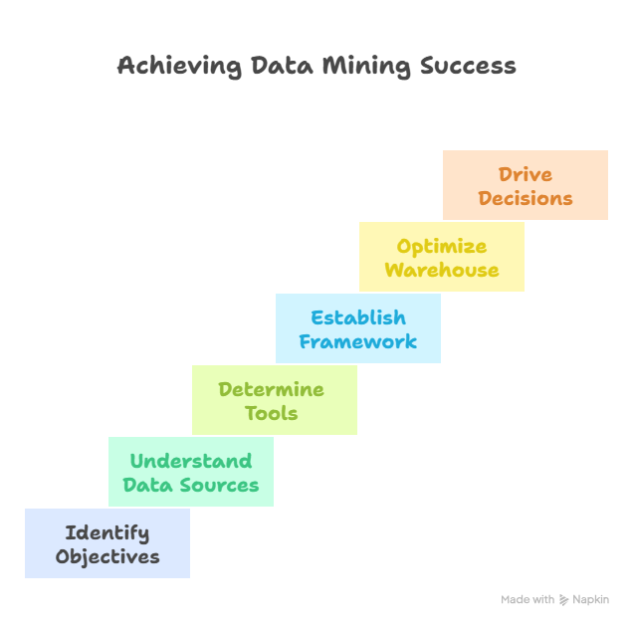
Mind Map

Slide 11
Conclusion
The proposed prototype demonstrates how integrating data through a data warehouse and applying data mining techniques can effectively address the challenges faced by decision-makers in handling large, fragmented datasets.
By centralizing historical data, enabling multidimensional analysis, and uncovering hidden patterns, the system transforms raw data into meaningful insights.
This approach reduces dependency on intuition, improves decision accuracy, and supports strategic planning.

Slide 12
Data mining Challenge!
Dirty Data Challenge (Preprocessing)
Objective: Understand real-world data issues.
Problem:
You are given customer and sales data with:
Missing values
Duplicate records
Inconsistent date formats
Task:
Identify data quality issues
Suggest preprocessing steps to clean the data
Outcome:
Data cleaning, preprocessing importance

Slide 13


