Slide 1

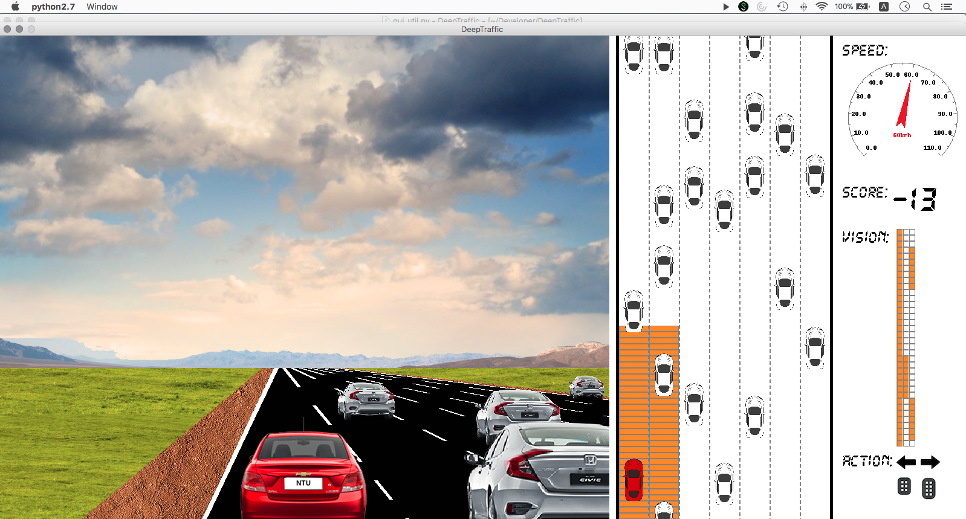
SNS COLLEGE OF TECHNOLOGY An Autonomous Institution
Coimbatore-35
Department of Automobile Engineering
23AUO303 - Road Safety and Traffic Rules
III B.E. AUTO / VI SEMESTER
UNIT II
SAFETY IN ROAD DESIGN
Topic 1 :Operating the road network for safety
M.Mohamed Ariffuddeen,AP/Auto

Slide 2
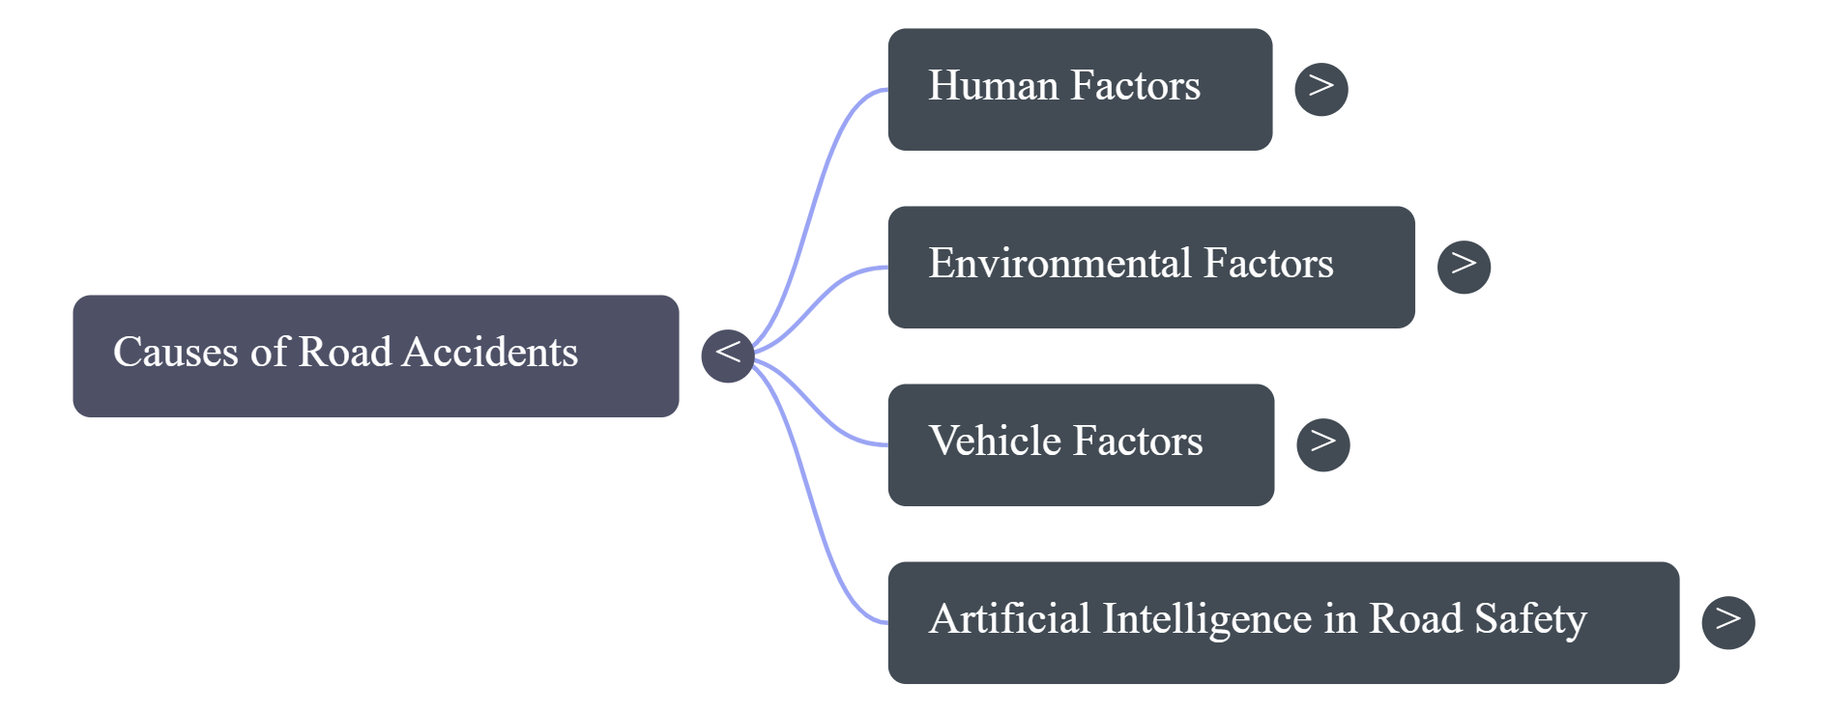
Mind Map of Operating the road network for safety

Slide 3
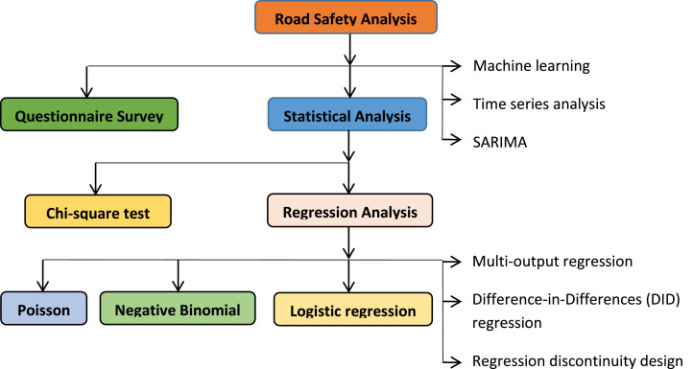
Empathy: Understanding the Real Challenge in RL

Slide 4
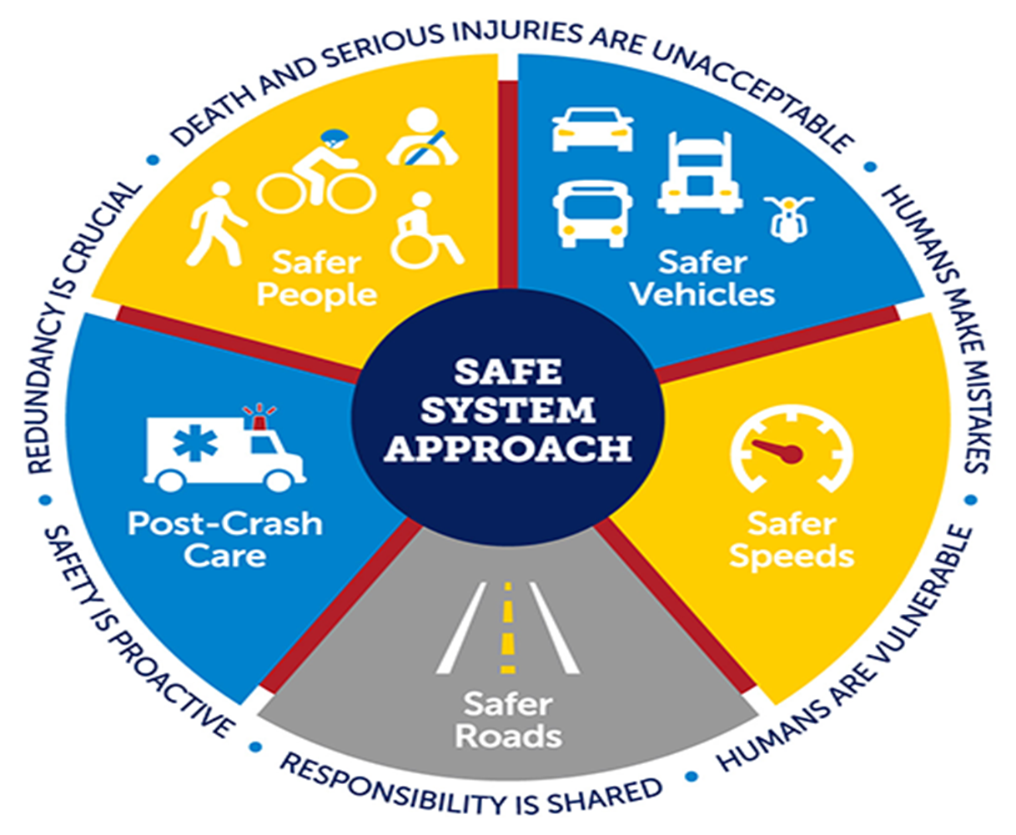

Define: Operating the road network for safety

Slide 5
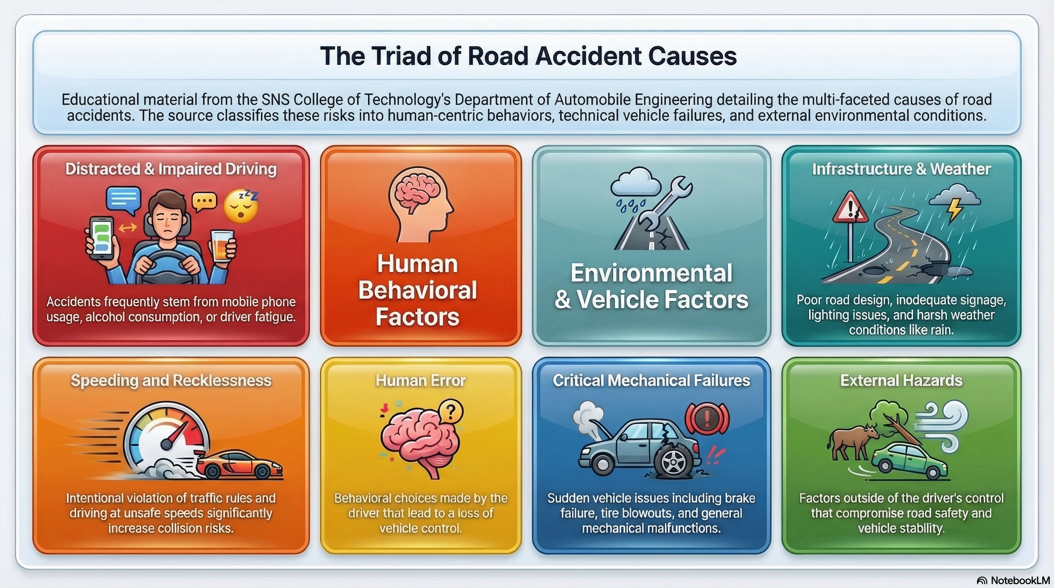
Define Operating the road network for safety

Slide 6
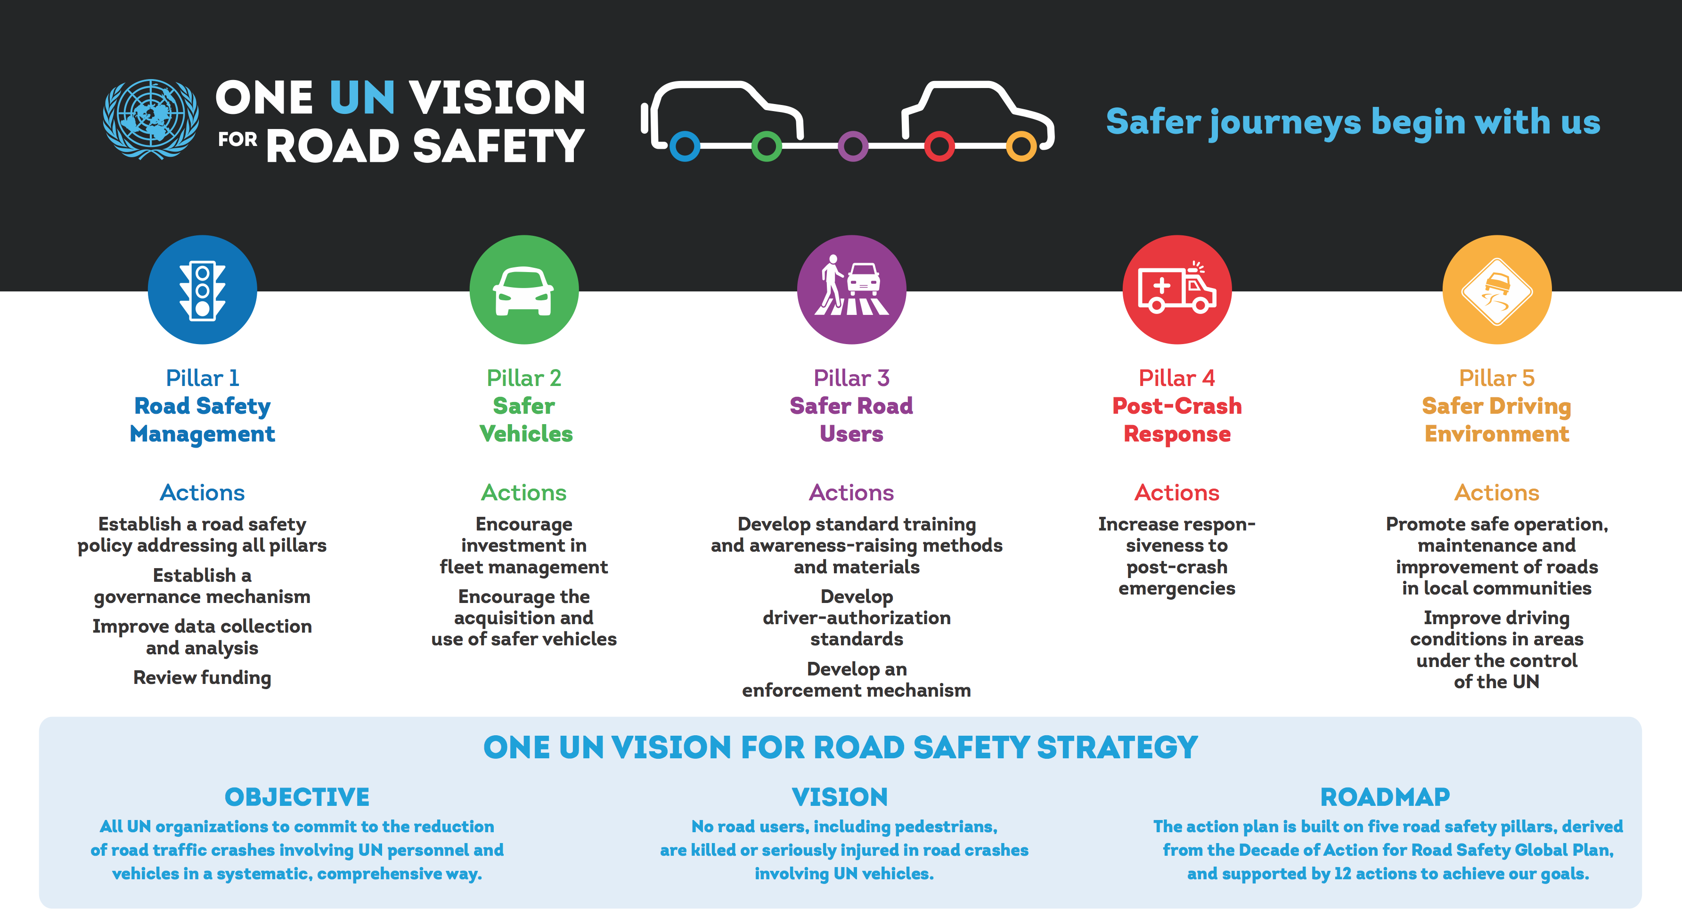
Ideate: Operating the road network for safety

Slide 7
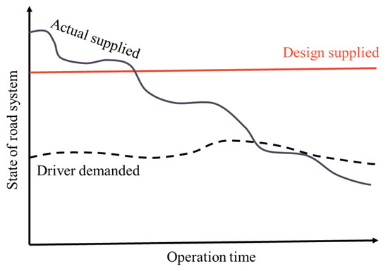

Slide 8
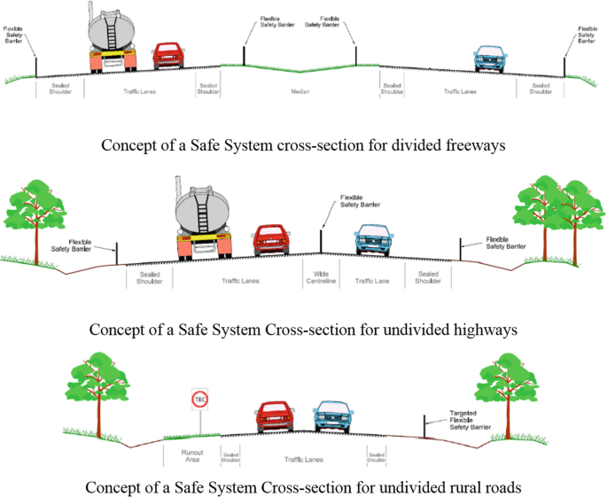

Slide 9


Slide 10
