Slide 1

SNS COLLEGE OF TECHNOLOGY
An Autonomous Institution Coimbatore-35
Department of Artificial Intelligence and Data Science
23EET103 Electric Circuits and Electron Devices
I B.TECH AIDS B/ II SEMESTER
UNIT IV : ELECTRONIC DEVICES AND APPLICATIONS
Topic : -LED, LCD,OLED & QLED

Slide 2

Let’s Recall!!
Optoelectronic devices convert electrical energy light energy.
These devices are based on PN junctions operating under forward or reverse bias depending on application.
Examples include LEDs, LCD, OLED,QLED etc.

Slide 3
Topics for discussion
How does an LED produce light?
What happens when a PN junction is exposed to light?
What is a Liquid Crystal Display (LCD) ?
How does an LCD operate?
Applications of LED, LCD, and OLED

Slide 4
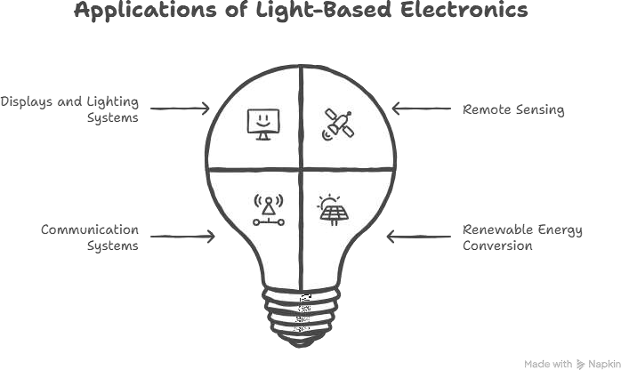
Why Study Optoelectronic Devices?
DT-Empathize
These devices are used in:
Displays and lighting systems
Remote sensing
Communication systems (fiber optics)
Renewable energy conversion
Understanding
energy-efficient
them helps design
and light-based
electronic systems.

Slide 5
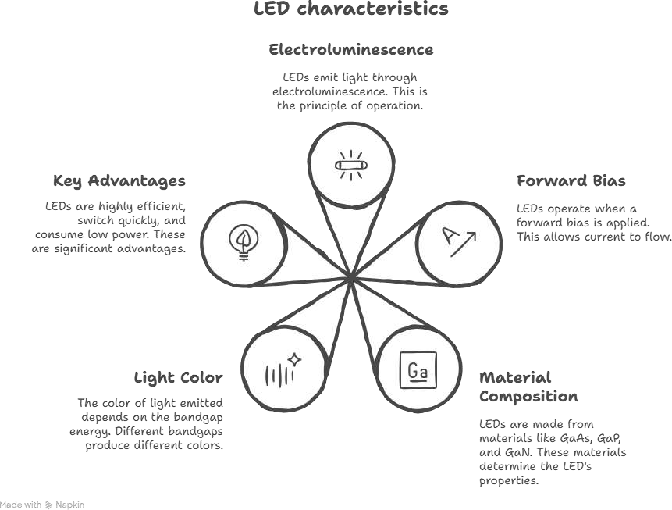
Light Emitting Diode (LED) – Principle
DT-DEFINE
LED works on the principle of
electroluminescence
Key Features
Operates under forward bias
Made from materials like GaAs, GaP, GaN
Color of light depends on bandgap energy
Highly efficient, fast switching, low power
consumption

Slide 6
LCD – Principle
DT-DEFINE
LCD is a type of flat panel display technology used in various electronic devices like televisions, computer monitors, smartphones, and calculators.

Slide 7
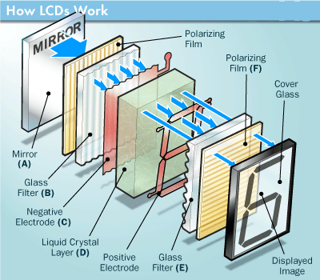

Slide 8
How does an LCD work?
An LCD consists of a layer of liquid crystals sandwiched between two transparent electrodes.
When an electric current is applied, the crystals align to control the amount of light passing through them, creating the image you see on the screen.

Slide 9
Components of an LCD
The main components of an LCD include the liquid crystals, the backlight, the color filters, and the electrodes.
The liquid crystals control the light passing through them, the backlight provides the light source, the color filters produce the different colors, and
the electrodes apply the electric current to manipulate the crystals.

Slide 10
LCD working principle:
DT-DEFINE
The fundamental principle of an LCD is that liquid crystals change their molecular alignment when an electrical voltage is applied, thereby modulating the passage of light.
Liquid crystals do not emit light themselves; they act as "light valves" that block or allow light from the backlight to pass through color filters
10/17

Slide 11
LCD Features
Low-voltage and energy efficiency: Modern LCDs utilizing LED backlights operate on significantly lower voltages (IC circuits) compared to legacy display technologies, making them ideal for battery-operated devices.
Ultra-slim profile: The physical footprint is minimal. Modern panels are often less than 10mm thick, with high-end models achieving widths under 5mm.
Non-emissive technology: Unlike OLEDs or CRTs, LCDs function by modulating light rather than emitting it directly from the liquid crystal layer. This often results in reduced eye strain during prolonged use (flicker-free backlights).

Slide 12
LCD Features-Contd
High Pixel Density: The technology allows for extremely small pixel pitch, enabling high-definition resolutions (4K and 8K) on relatively small screens.
Accurate Color Reproduction: With the integration of IPS (In-Plane Switching) and Quantum Dot technology, modern LCDs cover wide color gamuts (sRGB, DCI-P3).
Minimal Radiation: LCDs produce negligible electromagnetic radiation compared to CRT monitors, ensuring safety for users and security for information sensitive to TEMPEST attacks.
Long Lifespan: LED-backlit LCDs typically offer a lifespan of 30,000 to 60,000 hours before brightness degradation becomes noticeable.
9/17

Slide 13
LCD advantages
(1) Geometric Accuracy: Historically, CRT displays relied on electromagnetic deflection, which often caused geometric distortion (pincushion effects) at the screen edges. LCDs rely on a fixed pixel grid, ensuring zero geometric distortion and perfect linear alignment across the entire screen area.
(2) Environmental Safety: Compared to legacy CRT (which contained lead) and early CCFL-backlit LCDs (which contained mercury), modern LED-backlit LCDs are environmentally friendly. They do not emit X-rays and are generally compliant with modern RoHS (Restriction of Hazardous Substances) standards.
(3) Power Efficiency: The most significant advantage of LCD technology is power consumption. A traditional 17-inch CRT monitor could consume over 80W. In contrast, a modern 24-inch LED-backlit LCD typically consumes between 20W and 30W. This drastic reduction in wattage translates to lower thermal output and significant electricity savings in corporate environments.

Slide 14
LCD types
Based on the backlight source technology, LCDs are primarily categorized into two generations:
CCFL(Cold Cathode Fluorescent Lamp)-Legacy and
LED (Standard/Modern).
12/19

Slide 15
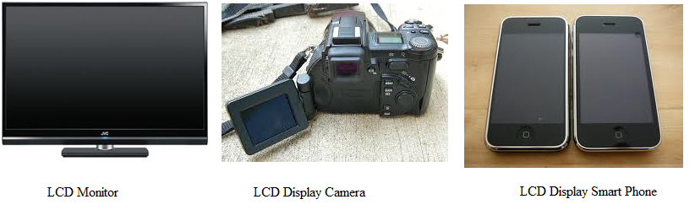
Some of the LCD Display’s:

Slide 16
OLED
OLED (Organic Light Emitting Diodes) is a flat light emitting technology, made by placing a series of organic thin films between two conductors.
When electrical current is applied, a bright light is emitted.
OLEDs are emissive displays that do not require a backlight and so are thinner and more efficient than LCD displays (which do require a white backlight).
14/19

Slide 17
OLED vs LCD
An OLED display have the following advantages over an LCD display:
Improved image quality - better contrast, higher brightness, fuller viewing angle, a wider color range and much faster refresh rates.
Lower power consumption.
Simpler design that enables ultra-thin, flexible, foldable and transparent displays
Better durability - OLEDs are very durable and can operate in a broader temperature range
OLEDs have some disadvantages, though: their lifetime is limited, and currently they are more expensive to produce than LCDs.

Slide 18
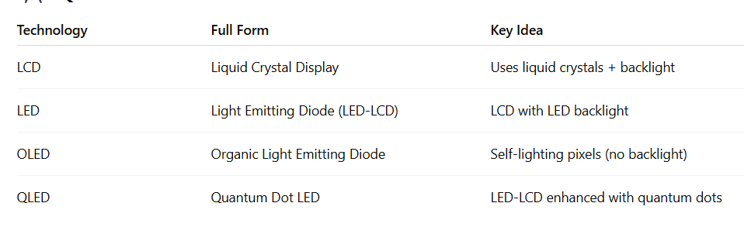
Ideate: Comparison
DT-IDEATE

Slide 19
Summary
LED
Improved LCD with LED backlight. Brighter, thinner, and more energy-efficient.
Most common today.
LCD
Uses liquid crystals with a fluorescent backlight.
Cheapest, but lower picture quality and weak contrast.
OLED
Self-lighting pixels (no backlight).
Best picture quality with perfect blacks and high contrast, but expensive.
QLED
LED TV enhanced with quantum dots.
Very bright and colorful, good for bright rooms, but blacks not as perfect as OLED

Slide 20
References
https://www.electronics-tutorials.ws/diode/diode_8.html
https://www.tutorialspoint.com/optoelectronics
https://www.allaboutcircuits.com/textbook/semiconductors/chpt- 3/light-emitting-diodes/

Slide 21
Thank You

