Slide 1

SNS COLLEGE OF TECHNOLOGY
Kurumbapalayam (Po), Coimbatore – 641 107
An Autonomous Institution
Accredited by NBA – AICTE and Accredited by NAAC – UGC with ‘A’ Grade
Approved by AICTE, New Delhi & Affiliated to Anna University, Chennai
DEPARTMENT OF ARTIFICIAL INTELLIGENCE
COURSE NAME : 23EET103- ELECTRIC CIRCUITS AND ELECTRON DEVICES
I YEAR /II SEMESTER
Unit-5 - RECTIFIERS AND POWER SUPPLIES
Topic : Rectifiers: Half wave

Slide 2

Story Telling

Slide 3
Topics for discussion
Half Wave Rectifier Circuit
Working of Half Wave Rectifier
Half Wave Rectifier Waveform
Half Wave Rectifier Capacitor Filter
Half Wave Rectifier Formula
  Ripple Factor of Half Wave Rectifier
  Efficiency of Halfwave Rectifier
  RMS value of Half Wave Rectifier
  Form factor of a Halfwave Rectifier
Applications of Half Wave Rectifier
Disadvantages of Half Wave Rectifier
What is Half-wave rectifiers
Half-wave rectifiers transform AC voltage to DC voltage. A halfwave rectifier circuit uses only one diode for the transformation.
A halfwave rectifier is defined as a type of rectifier that allows only one-half cycle of an AC voltage waveform to pass while blocking the other half cycle. In this session, let us know in detail about the half-wave rectifier.

Slide 4
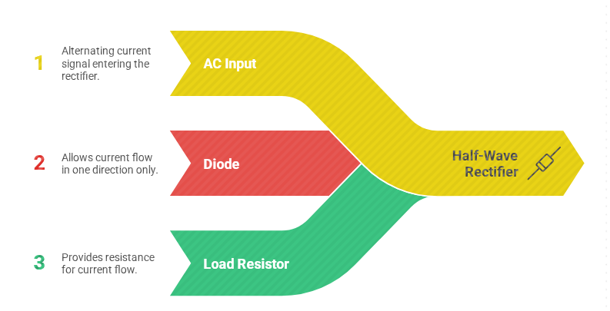
DT-Empathize

Slide 5
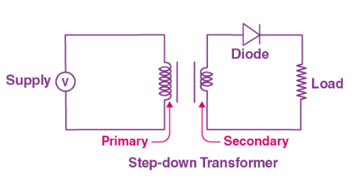
DT-Empathize
Half Wave Rectifier Circuit
A half-wave rectifier is the simplest form of the rectifier and requires only one diode for the construction of a halfwave rectifier circuit.
A halfwave rectifier circuit consists of three main components as follows:
A diode
A transformer
A resistive load
Given below is the half-wave rectifier diagram:

Slide 6
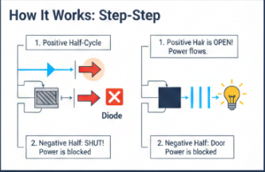
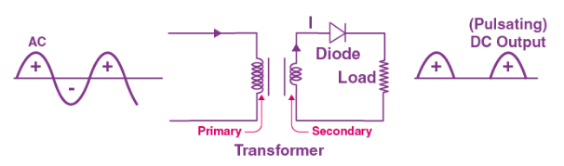
Working of Half Wave Rectifier
In this section, let us understand how a half-wave rectifier transforms AC into DC.
A high AC voltage is applied to the primary side of the step-down transformer. The obtained secondary low voltage is applied to the diode.
The diode is forward biased during the positive half cycle of the AC voltage and reverse biased during the negative half cycle.
The final output voltage waveform is as shown in the figure below:
DT-DEFINE

Slide 7
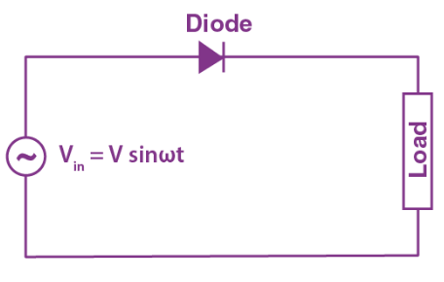
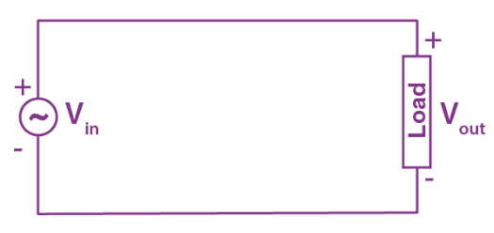
DT-DEFINE
For better understanding, let us simplify the half-wave circuit by replacing the secondary transformer coils with a voltage source as shown below:
For the positive half cycle of the AC source voltage, the circuit effectively becomes as shown below in the diagram:

Slide 8
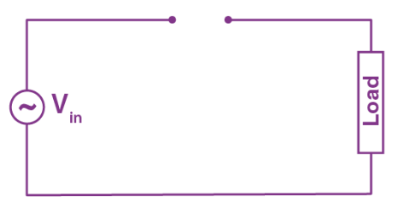
DT-DEFINE
When the diode is forward biased, it acts as a closed switch. But, during the negative half cycle of the AC source voltage, the equivalent circuit becomes as shown in the figure below
When a diode is reverse biased, it acts as an open switch. Since no current can flow to the load, the output voltage is equal to zero.

Slide 9
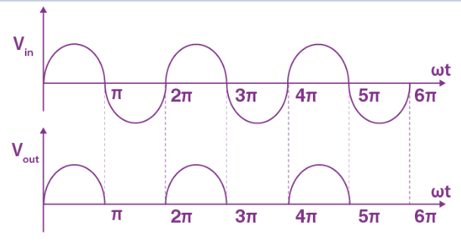
DT-DEFINE
Half Wave Rectifier Waveform
The halfwave rectifier waveform before and after rectification is shown below in the figure.

Slide 10
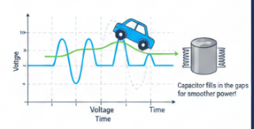
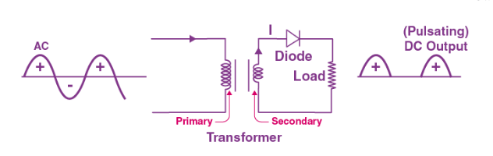
DT-IDEATE
Half Wave Rectifier Capacitor Filter
The output waveform of a halfwave rectifier is a pulsating DC waveform. Filters in halfwave rectifiers are used to transform the pulsating waveform into constant DC waveforms. A capacitor or an inductor can be used as a filter.
The circuit diagram below shows how a capacitive filter is used with halfwave rectifier to smoothen out a pulsating DC waveform into a constant DC waveform.

Slide 11
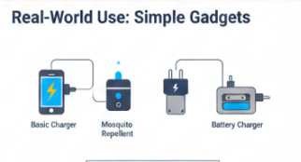
DT - Prototype
Applications of Half Wave Rectifier
Here are a few common applications of half wave rectifiers:
They are used for signal demodulation purpose
They are used for rectification applications
They are used for signal peak applications
Disadvantages of Half Wave Rectifier
Power loss
Low output voltage
The output contains a lot of ripples

Slide 12


DT –Test
RMS value of Half Wave Rectifier
The RMS value of the load current for a half-wave rectifier is given by the formula:
Form factor of a Halfwave Rectifier
The form factor is the ratio between RMS value and average value and is given by the formula:

Slide 13


DT –Test
Half Wave Rectifier Formula
Ripple Factor of Half Wave Rectifier
Ripple factor determines how well a halfwave rectifier can convert AC voltage to DC voltage.
Ripple factor can be quantified using the following formula:
The ripple factor of a halfwave rectifier
Efficiency of Halfwave Rectifier
The efficiency of a halfwave rectifier is the ratio of output DC power to the input AC power.
The efficiency formula for halfwave rectifier is given as follows;

Slide 14
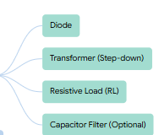
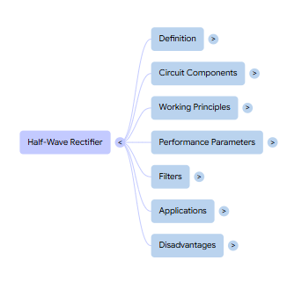
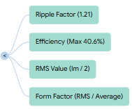

Summary

Slide 15
Quiz / Gamified Questions:
A diode in a half wave rectifier conducts during:
A) Positive half cycle
B) Negative half cycle
C) Both half cycles
D) None
(Correct: A)
Scenario: You have a small sensor circuit that requires 5V DC but your supply is 9V AC. You want a simple rectification solution. Would a half wave rectifier be ideal? Why or why not?
Real-time: If the AC input is 10V RMS and the diode is ideal, calculate the average DC output voltage.

Slide 16
Assessment Q&A
Question
1. Why is ripple factor of half wave rectifier 1.21 and not zero?
Answer
Answer: Only positive half-cycle is passed → output is pulsing, not constant DC Ripple factor = √(Vrms² – Vdc²)/Vdc = 1.21
Answer: NO → Not practical Reasons (with icons): •
Efficiency only 40.6% → 60 W wasted as heat → diode will burn • High ripple damages laptop battery & components • Transformer core saturation due to DC component • Needs at least full-wave + big filter capacitor
Answer Revealed: Add one Electrolytic Capacitor across load RL Diagram (before → after): • Left: Pulsating half-wave output (jagged) • Right: Smooth DC after adding 1000 µF capacitor (almost flat line)
2. Can we use half wave rectifier for 100 W laptop charger? Why/Why not?
3. Curiosity Challenge: Design a circuit to get smooth DC from half wave rectifier (Hint: Add one component)

Slide 17

References
Muthusubramanian R, Salivahanan S, “Basic Electrical and Electronics Engineering”, TataMcGrawHillPublishers,2014.
Kothari DP and I.J Nagrath, “Basic Electrical and Electronics Engineering”, Second Edition, McGraw Hill Education, 2020.
Thank you

