Slide 1

SNS COLLEGE OF TECHNOLOGY
Kurumbapalayam (Po), Coimbatore – 641 107
An Autonomous Institution
Accredited by NBA – AICTE and Accredited by NAAC – UGC with ‘A’ Grade
Approved by AICTE, New Delhi & Affiliated to Anna University, Chennai
DEPARTMENT OF ARTIFICIAL INTELLENGE AND DATA SCIENCE
COURSE NAME : 23EET103- ELECTRIC CIRCUITS AND ELECTRON DEVICES
I YEAR /II SEMESTER
Unit-5 - RECTIFIERS AND POWER SUPPLIES
Topic : Rectifiers: Full wave

Slide 2
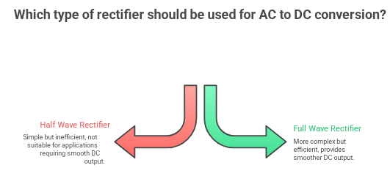
DT-Empathize

Slide 3
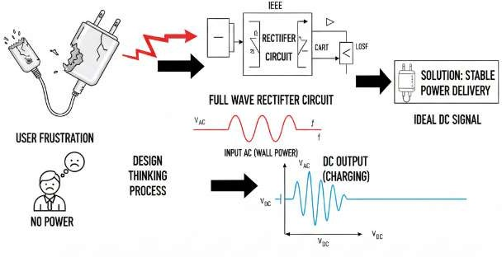
Electric circuits that convert AC to DC are known as rectifiers. Rectifiers are classified into two types as Half Wave Rectifiers and Full Wave Rectifiers.
Significant power is lost while using a half-wave rectifier and is not feasible for applications that need a smooth and steady supply.
DT-Empathize
Topics for discussion
Defining Full Wave Rectifiers
Full Wave Rectifier Circuit
Working of Full Wave Rectifier
Full Wave Rectifier Formula
  Peak Inverse Voltage
  DC Output Voltage
  RMS Value of Current
  Form Factor
  Peak Factor
  Rectification Efficiency
Advantages of Full Wave Rectifier
Frequently Asked Questions – FAQs

Slide 4
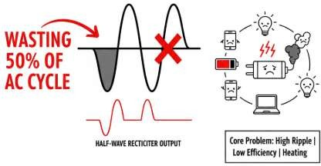
Defining Full Wave Rectifiers
A full wave rectifier is defined as a rectifier that converts the complete cycle of alternating current into pulsating DC.
Unlike halfwave rectifiers that utilize only the halfwave of the input AC cycle, full wave rectifiers utilize the full cycle.
The lower efficiency of the half wave rectifier can be overcome by the full wave rectifier.
DT-DEFINE
Full Wave Rectifier Circuit
The circuit of the full wave rectifier can be constructed in two ways. The first method uses a centre tapped transformer and two diodes.
This arrangement is known as a centre tapped full wave rectifier. The second method uses a standard transformer with four diodes arranged as a bridge.This is known as a bridge rectifier.

Slide 5
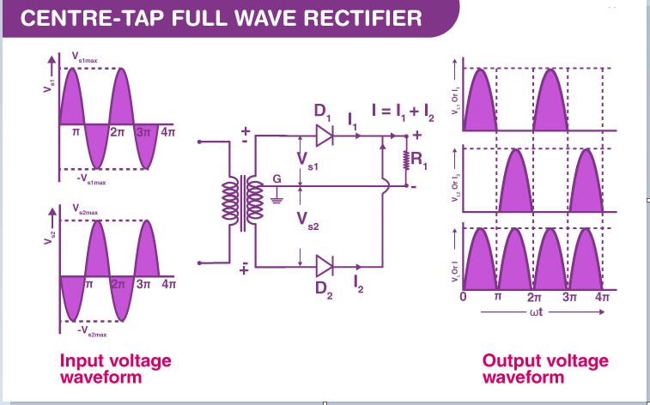
DT-IDEATE
The circuit of the full wave rectifier consists of a step-down transformer and two diodes that are connected and centre tapped. The output voltage is obtained across the connected load resistor.

Slide 6
Working of Full Wave Rectifier
During the positive half cycle of the alternating current, the top half of the secondary winding becomes positive while the second half of the secondary winding becomes negative.
During the positive half cycle, diode D₁ is forward biased as it is connected to the top of the secondary winding while diode D₂ is reverse biased as it is connected to the bottom of the secondary winding.
Due to this, diode D₁ will conduct acting as a short circuit and D₂ will not conduct acting as an open circuit
During the negative half cycle, the diode D₁ is reverse biased and the diode D₂ is forward biased because the top half of the secondary circuit becomes negative and the bottom half of the circuit becomes positive.

Slide 7
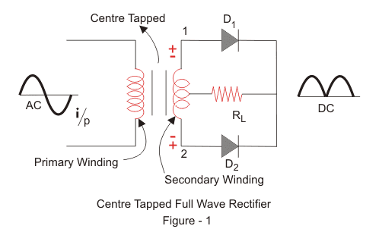
DT-IDEATE
Full wave rectifiers are further classified into:
Centre-tapped Full Wave Rectifier
Full Wave Bridge Rectifier

Slide 8
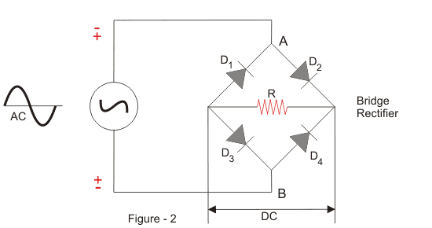
DT-IDEATE

Slide 9
Centre-tapped Full Wave Rectifier
Construction of Centre-tapped Full Wave Rectifier
A centre-tapped full-wave rectifier system consists of:
Centre-tapped Transformer
Two Diodes
Resistive Load
Centre-tapped Transformer: – It is a normal transformer with one slight modification. It has an additional wire connected to the exact centre of the secondary winding.
This type of construction divides the AC voltage into two equal and opposite voltages, namely +Ve voltage (V_{a}) and -Ve voltage (V_{b}). The total output voltage is

Slide 10
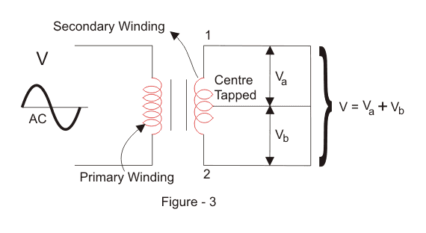
DT-IDEATE

Slide 11
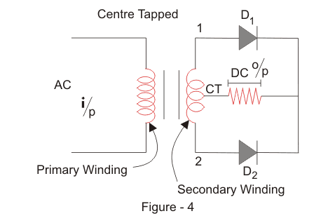
DT-IDEATE

Slide 12
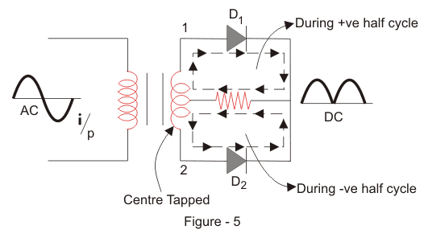
Working of Centre-tapped Full Wave Rectifier
We apply an AC voltage to the input transformer. During the positive half-cycle of the AC voltage, terminal 1 will be positive, centre-tap will be at zero potential, and terminal 2 will be negative potential.

Slide 13
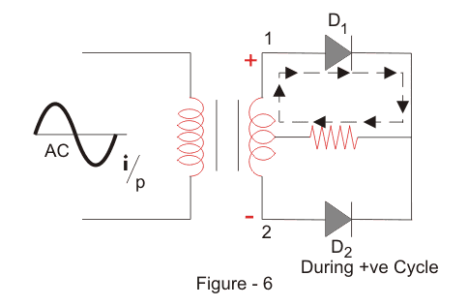
This will lead to forwarding bias in diode D₁ and cause current to flow through it. During this time, diode D₂ is in reverse bias and will block current through it.

Slide 14
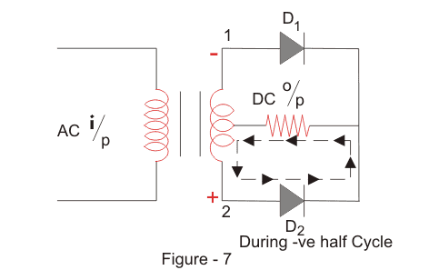
During the negative half-cycle of the input AC voltage, terminal 2 will become positive relative to terminal 2 and centre-tap. This will lead to forwarding bias in diode D₂ and cause current to flow through it. During this time, diode D₁ is in reverse bias and will block current through it.

Slide 15
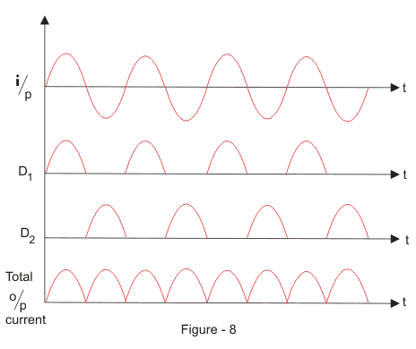
During the positive cycle, diode D₁ conducts, and during the negative cycle, diode D₂ conducts and during the positive cycle.
As a result, both half-cycles are allowed to pass through. The average output DC voltage here is almost twice the DC output voltage of a half-wave rectifier.

Slide 16
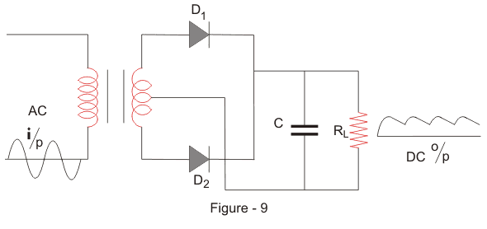
Filter Circuit
We get a pulsating DC voltage with many ripples as the output of the centre-tapped full wave rectifier. We cannot use this pulsating for practical applications.
So, to convert the pulsating DC voltage to pure DC voltage, we use a filter circuit as shown above. Here we place a capacitor across the load.
DT-Prototype

Slide 17
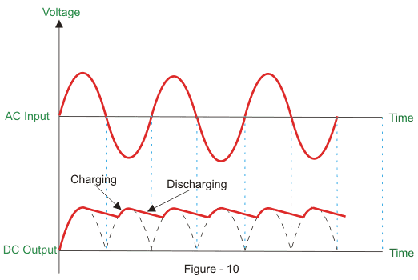
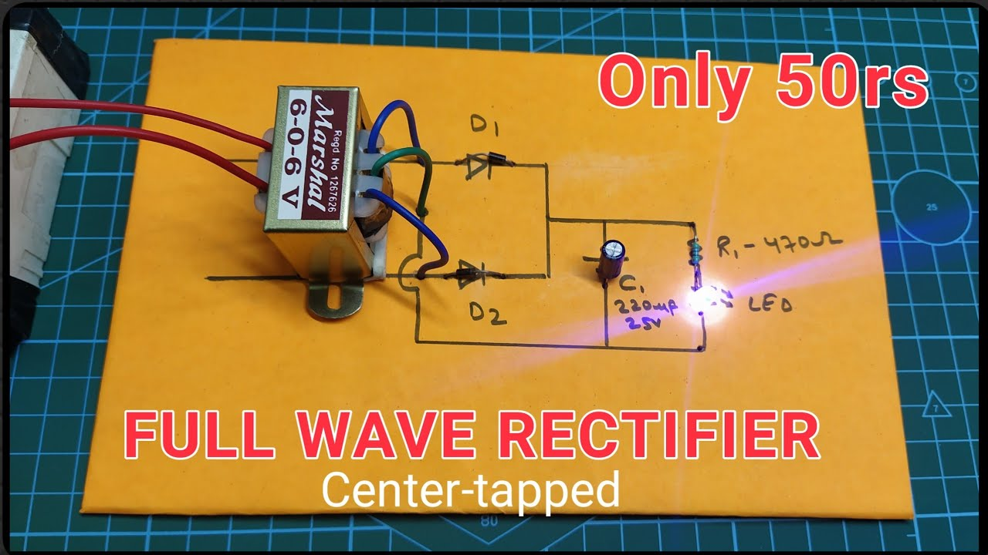
DT-Prototype

Slide 18


DT-Test
Full Wave Rectifier Formula
Peak Inverse Voltage
Peak inverse voltage is the maximum voltage a diode can withstand in the reverse-biased direction before breakdown. The peak inverse voltage of the full-wave rectifier is double that of a half-wave rectifier. The PIV across D₁ and D₂ is 2V_{max}.
DC Output Voltage
The following formula gives the average value of the DC output voltage:
RMS Value of Current
The RMS value of the current can be calculated using the following formula:

Slide 19

DT-Test
Form Factor
The form factor of the full wave rectifier is calculated using the formula:
Peak Factor
The following formula gives the peak factor of the full wave rectifier:

Slide 20

DT-Test
Rectification Efficiency
The rectification efficiency of the full-wave rectifier can be obtained using the following formula:
The efficiency of the full wave rectifiers is 81.2%.
Advantages of Full Wave Rectifier
The rectification efficiency of full wave rectifiers is double that of half wave rectifiers. The efficiency of half wave rectifiers is 40.6% while the rectification efficiency of full wave rectifiers is 81.2%.
The ripple factor in full wave rectifiers is low hence a simple filter is required. The value of ripple factor in full wave rectifier is 0.482 while in half wave rectifier it is about 1.21.
The output voltage and the output power obtained in full wave rectifiers are higher than that obtained using half wave rectifiers.
The only disadvantage of the full wave rectifier is that they need more circuit elements than the half wave rectifier which makes, making it costlier.

Slide 21
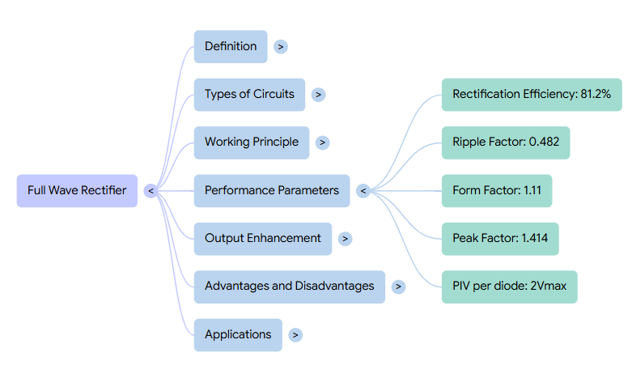
Summary

Slide 22
Multiple Choice: A centre-tapped full wave rectifier requires:
A) One diode
B) Two diodes
C) Four diodes
D) Six diodes
(Correct: B)
Scenario: You are designing a power supply for a 12V DC LED system. Which rectifier will reduce ripple better, half wave or full wave? Explain with reasoning.
Real-time: If peak AC voltage is 20V, find the average output voltage of the full wave rectifier.

Slide 23

References
Muthusubramanian R, Salivahanan S, “Basic Electrical and Electronics Engineering”, TataMcGrawHillPublishers,2014.
Kothari DP and I.J Nagrath, “Basic Electrical and Electronics Engineering”, Second Edition, McGraw Hill Education, 2020.
Thank you

