Slide 1

SNS COLLEGE OF TECHNOLOGY
Kurumbapalayam (Po), Coimbatore – 641 107
An Autonomous Institution
Accredited by NBA – AICTE and Accredited by NAAC – UGC with ‘A’ Grade
Approved by AICTE, New Delhi & Affiliated to Anna University, Chennai
DEPARTMENT OF ARTIFICIAL INTELLIGENCE AND DATA SCIENCE
COURSE NAME : 23EET103- ELECTRIC CIRCUITS AND ELECTRON DEVICES
I YEAR /II SEMESTER
Unit-5 - RECTIFIERS AND POWER SUPPLIES
Topic : Bridge Rectifiers

Slide 2
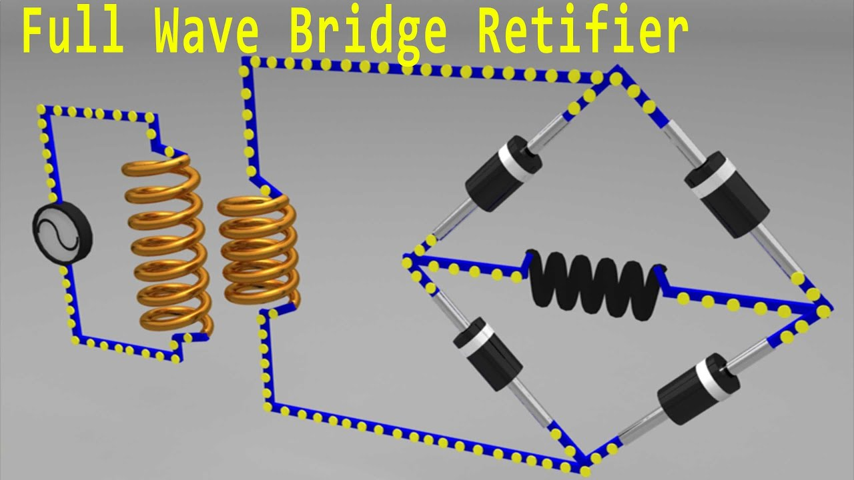
DT-Empathize
Here is an in-depth empathy for why bridge rectifiers are used
Maximum Efficiency: Utilizing the Full Wave
Eliminates Costly & Heavy Components
Lower Ripple Factor & Better Performance
Better Transformer Utilization (TUF)
Increased Reliability and Safety

Slide 3
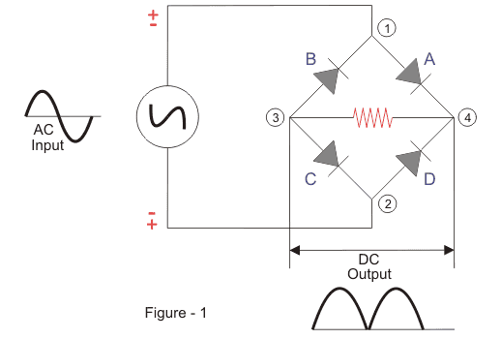
DT-DEFINE
Full Wave Bridge Rectifier
Construction of Full Wave Bridge Rectifier
A full wave bridge rectifier is a rectifier that will use four diodes or more than that in a bridge formation.
A full wave bridge rectifier system consists of
Four Diodes
Resistive Load
We use the diodes, namely A, B, C and D, which form a bridge circuit. The circuit diagram is as follows.

Slide 4
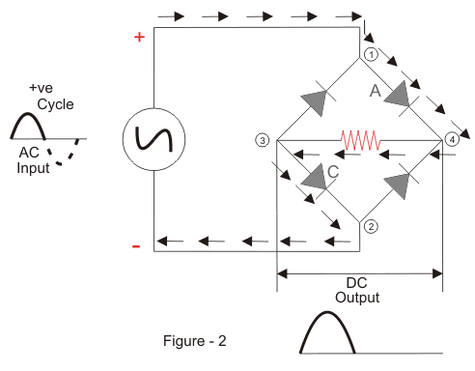
Principle of Full Wave Bridge Rectifier
We apply an AC across the bridge. During the positive half-cycle, terminal 1 becomes positive, and terminal 2 becomes negative.
DT-DEFINE

Slide 5
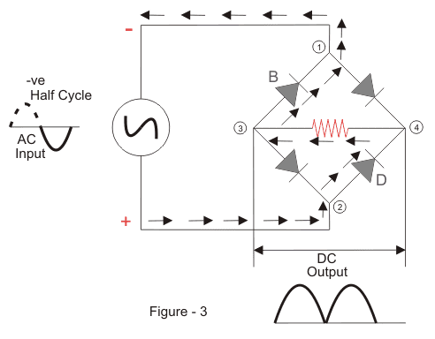
This will cause the diodes A and C to become forward-biased, and the current will flow through it. Meanwhile, diodes B and D will become reverse-biased and block current through them. The current will flow from 1 to 4 to 3 to 2.
During the negative half-cycle, terminal 1 will become negative, and terminal 2 will become positive.

Slide 6
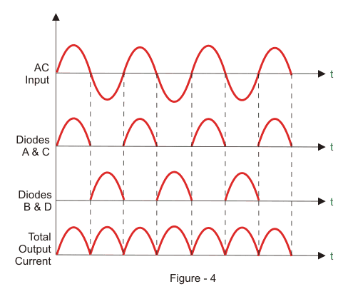
This will cause the diodes B and D to become forward-biased and will allow current through them. At the same time, diodes A and C will be reverse-biased and will block the current through them. The current will flow from 2 to 4 to 3 to 1.

Slide 7
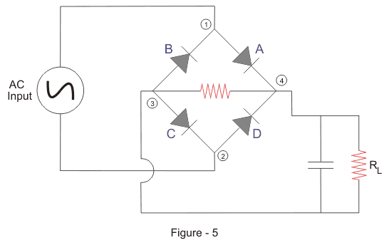
Filter Circuit
The output from a full wave bridge rectifier is a pulsating DC voltage with noticeable ripples, which is unsuitable for practical applications without further modification.
DT-IDEATE

Slide 8
So, to convert the pulsating DC voltage to pure DC voltage, we use a filter circuit as shown above. Here we place a capacitor across the load. The working of the capacitive filter circuit is to short the ripples and block the DC component so that it flows through another path, and that is through the load.
During the half-wave, the diodes A and C conduct. It charges the capacitor immediately to the maximum value of the input voltage. When the rectified pulsating voltage starts decreasing and less than the capacitor voltage, the capacitor starts discharging and supplies current to the load.
This discharging is slower when compared to the charging of the capacitor, and it does not get enough time to discharge entirely, and the charging starts again in the next pulse of the rectified voltage waveform.
So around half of the charge present in the capacitor gets discharged. During the negative cycle, the diodes B and D start conducting, and the above process happens again. This causes the current to continue to flow through the same direction across the load.

Slide 9
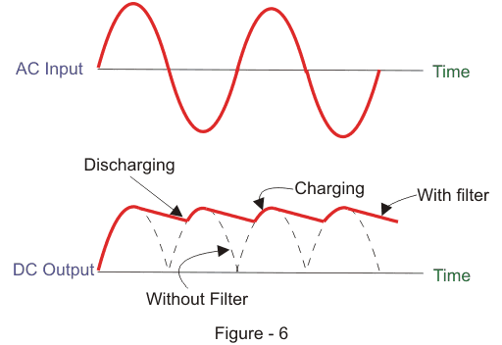

Slide 10
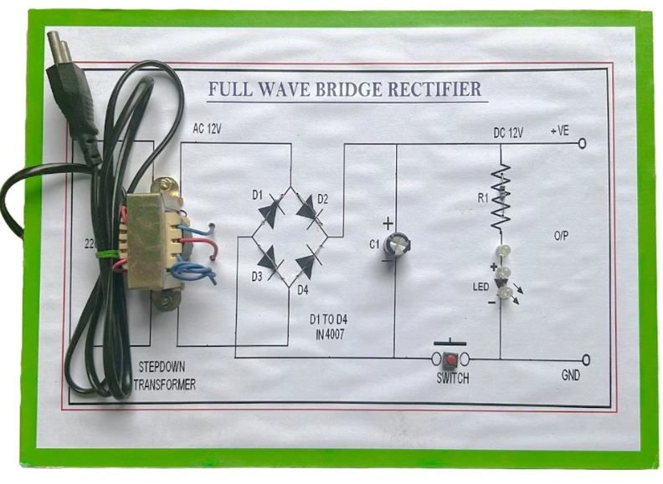
DT- Prototype

Slide 11

DT-Test
Full Wave Rectifier Formula
We will now derive the various formulas for a full wave rectifier based on the preceding theory and graphs above.
Ripple Factor of a Full Wave Rectifier (γ)
‘Ripple’ is the unwanted AC component remaining when converting the AC voltage waveform into a DC waveform.
Even though we try out best to remove all AC components, there is still some small amount left on the output side which pulsates the DC waveform. This undesirable AC component is called ‘ripple’.
To quantify how well the half-wave rectifier can convert the AC voltage into DC voltage, we use what is known as the ripple factor (represented by γ or r).
The ripple factor is the ratio between the RMS value of the AC voltage (on the input side) and the DC voltage (on the output side) of the rectifier.
The formula for ripple factor is:

Slide 12

DT-Test
Where V_{rms} is the RMS value of the AC component, and V_{dc} is the DC component in the rectifier.
The ripple factor of a centre-tapped full-wave rectifier is equal to 0.48 (i.e. γ = 0.48).
Note: To construct a good rectifier, we need to keep the ripple factor as minimum as possible. We can use capacitors or inductors to reduce the ripples in the circuit.
Efficiency of a Full Wave Rectifier (η)
Rectifier efficiency (η) is the ratio between the output DC power and the input AC power. The formula for the efficiency is equal to:
The efficiency of a centre-tapped full-wave rectifier is equal to 81.2% (i.e. η_{max} = 81.2%)
.

Slide 13

Form Factor of a Full Wave Rectifier (F.F)
The form factor is the ratio between RMS value and average value.
DT-Test
The formula for form factor is given below:
The form factor of a centre-tapped full wave rectifier is equal to 1.11 (i.e. FF = 1.11).

Slide 14
Advantages of Full Wave Rectifiers
The advantages of full wave rectifiers include:
Full wave rectifiers have higher rectifying efficiency than half-wave rectifiers. This means that they convert AC to DC more efficiently.
They have low power loss because no voltage signal is wasted in the rectification process.
The output voltage of a centre-tapped full wave rectifier has lower ripples than a halfwave rectifiers.
Disadvantages of Full Wave Rectifiers
The disadvantages of full wave rectifiers include:
The centre-tapped rectifier is more expensive than a half-wave rectifier and tends to occupy a lot of space.

Slide 15
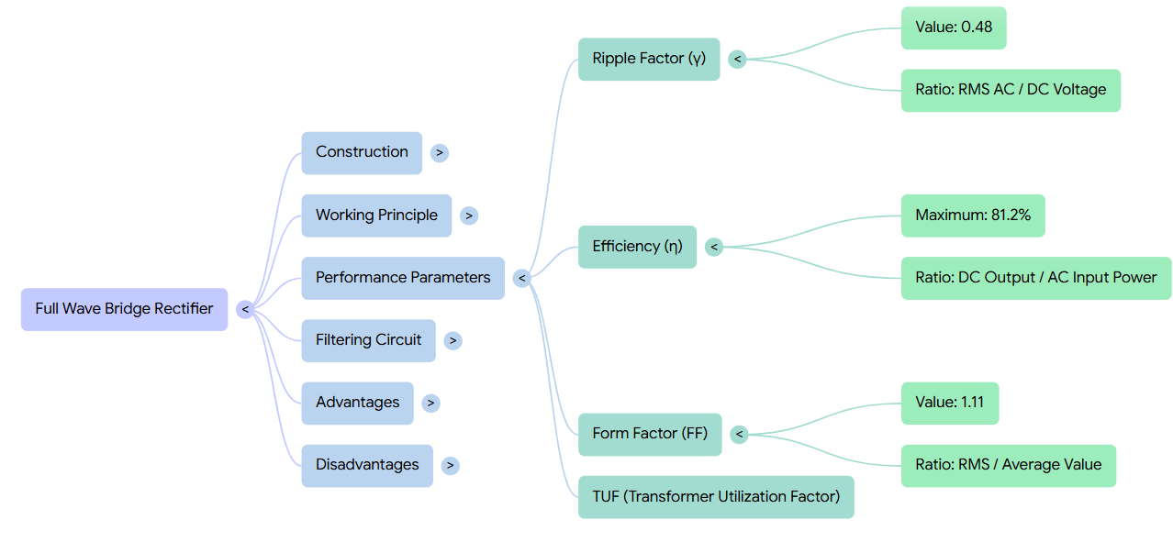
Summary
23-01-2026

Slide 16
Quiz: How many diodes are required for a bridge rectifier?
A) 1
B) 2
C) 4
D) 3
(Correct: C)
Scenario: Your circuit doesn’t have a centre-tapped transformer. Which rectifier would you choose and why?
Real-time: The bridge rectifier output shows ripple voltage. Suggest a simple filtering method to reduce it.

Slide 17

References
Muthusubramanian R, Salivahanan S, “Basic Electrical and Electronics Engineering”, TataMcGrawHillPublishers,2014.
Kothari DP and I.J Nagrath, “Basic Electrical and Electronics Engineering”, Second Edition, McGraw Hill Education, 2020.
Thank you

