Slide 1

SNS COLLEGE OF TECHNOLOGY
Kurumbapalayam (Po), Coimbatore – 641 107
An Autonomous Institution
Accredited by NBA – AICTE and Accredited by NAAC – UGC with ‘A’ Grade
Approved by AICTE, New Delhi & Affiliated to Anna University, Chennai
DEPARTMENT OF ARTIFICIAL INTELLIGENCE AND DATA SCIENCE
COURSE NAME : 23EET103- ELECTRIC CIRCUITS AND ELECTRON DEVICES
I YEAR /II SEMESTER
Unit-5 - RECTIFIERS AND POWER SUPPLIES
Topic : Filters

Slide 2
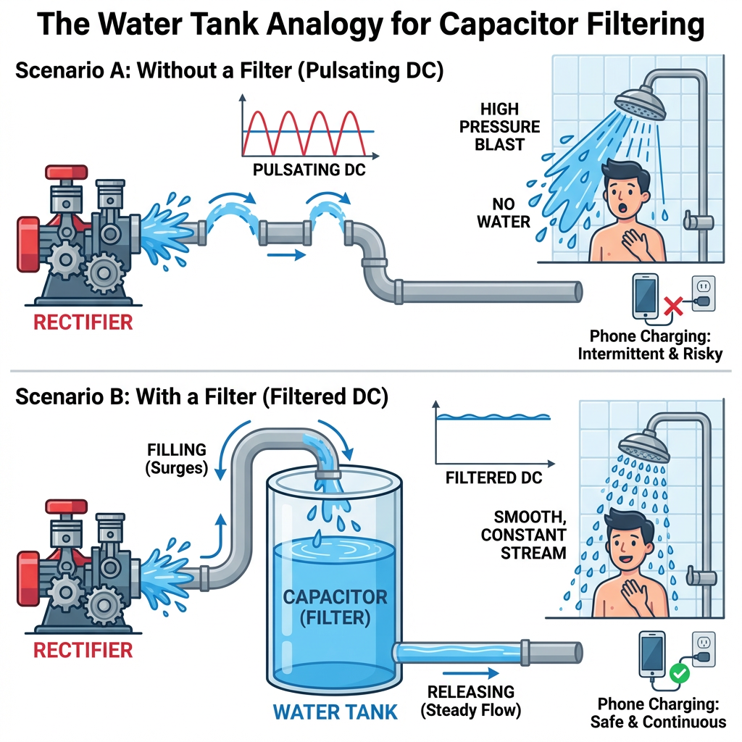
Story telling

Slide 3
DT-Empathize
An electronic circuit called a filter circuit is made to either pass or block specific frequencies from an electrical signal. It is an essential part of many electrical systems and applications because it shapes a circuit's frequency response by blocking out undesired frequencies and letting in desired ones. Many electrical devices, including power supply, signal processing applications, audio systems, and communication systems, use filters.
Content
What is a Filter Circuit?
Why Do We Need Filters?
Components of a Filter Circuit
Filter design techniques
Types of Filter Circuits
Digital Signal Processing Filter
Characteristics of Filter Circuit
Advantages of Filter Circuit
Disadvantages of Filter Circuit
Applications of Filter Circuits
Difference Between Active Filter and Passive Filter

Slide 4
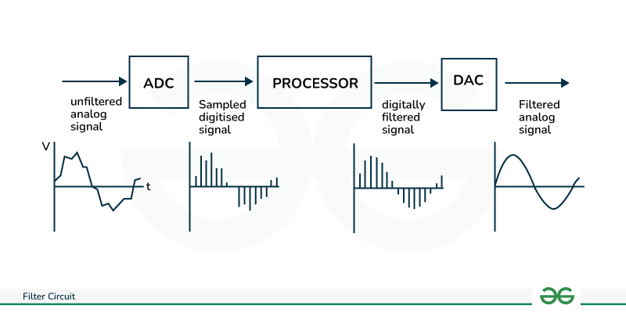
Need for Filtering
The output of a rectifier is pulsating DC.
It contains AC ripples, which are undesirable.
Electronic circuits require smooth and steady DC.
👉 Filter is a circuit used to remove AC ripples from rectifier output and produce pure DC.
DT-DEFINE

Slide 5
DT-DEFINE
Why Do We Need Filters?
In high-performance stereo systems, filter circuits are frequently required because, in order to achieve the highest possible sound quality and power efficiency, specific audio frequency ranges must be increased or suppressed.
Noise Reduction: To remove undesired noise or interference from a signal, filters are frequently utilized. This is essential for applications requiring a clean signal, such as audio processing and communication systems.
Signal smoothing: Filters are employed in many electrical systems, particularly power supply, to reduce fluctuations in the signal and produce an output that is more steady and continuous.

Slide 6
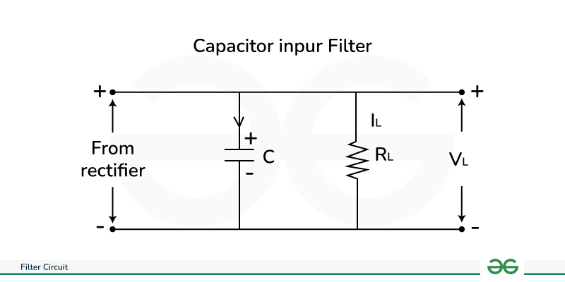
DT-IDEATE
The components of the rectified output to reach the load while removing the A.C. components from it. An LC filter circuit is a type of filter circuit that typically consists of an inductor (L) and a capacitor (C).
An inductor only permits D.C. to flow, while a capacitor only permits A.C. to do so. Thus, the A.C. component of the rectified wave can be efficiently filtered out using an appropriate L and C network.

Slide 7
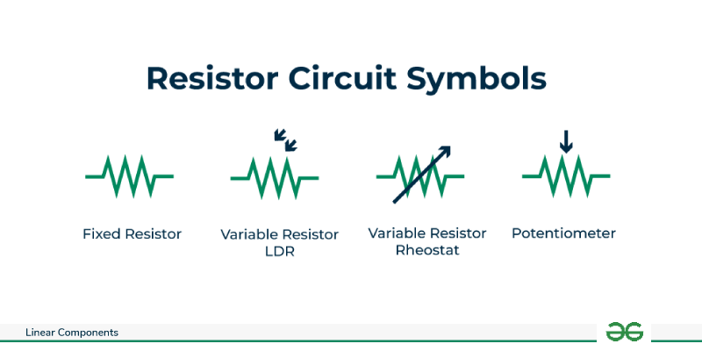
Components of a Filter Circuit
The components of a filter circuit are as follows:
Resistor
Capacitor
Inductor
Resistor (R)
Function: The circuit's current flow is managed by a resistor. It is frequently used in filter circuits to set the time constants in conjunction with capacitors.
Symbol: The symbol of resistor is given below with its representations.
DT-IDEATE

Slide 8
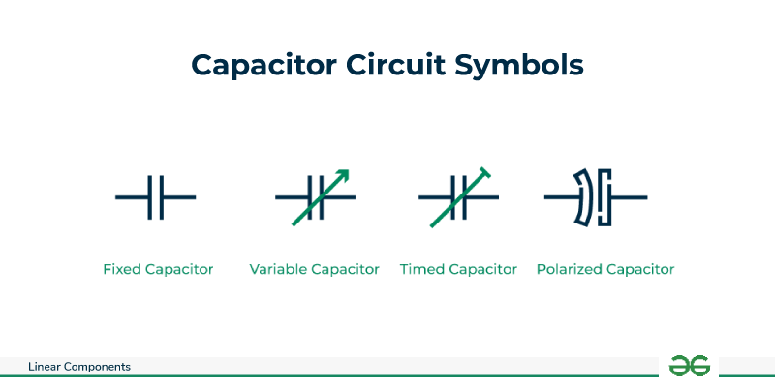
Capacitor (C)
Symbol: The symbol of Capacitor is given below with its representations.
Function: Electrical energy is stored and released by capacitors. Capacitors are frequently employed in filter circuits to pass AC signals while blocking DC signals.
DT-IDEATE

Slide 9
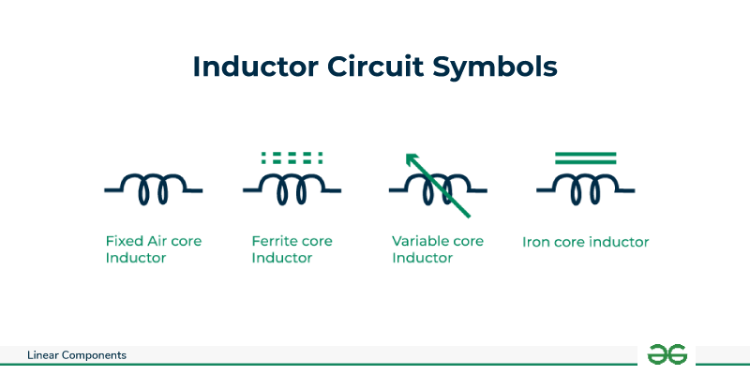
Inductor (L)
Symbol: The symbol of Inductor is given below with its representations.
Function: Inductors store energy in their magnetic fields and resist changes in current. They are frequently employed in filter circuits to allow high-frequency signals to be blocked and low-frequency signals to be passed.

Slide 10
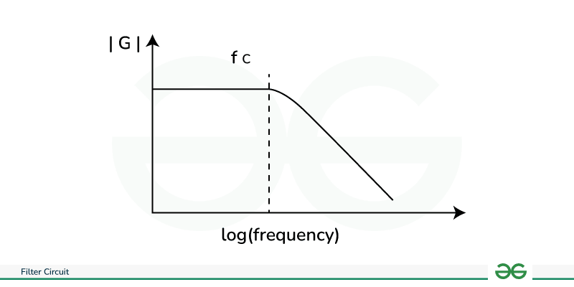
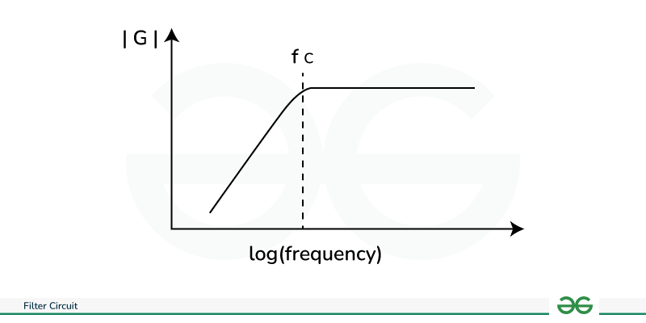
Types of Filter Circuits
Low-Pass Filter (LPF)
High- Pass Filter (HPF)
Band-Pass Filter (BPF)
Band -Stop Filter (BSF) or Notch filter

Slide 11
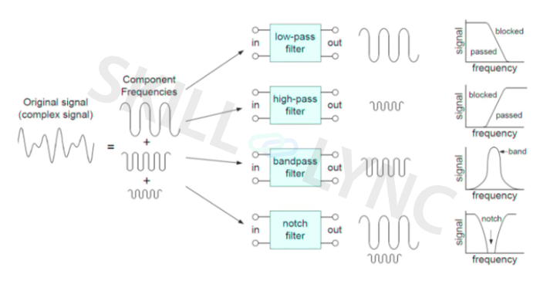

Slide 12
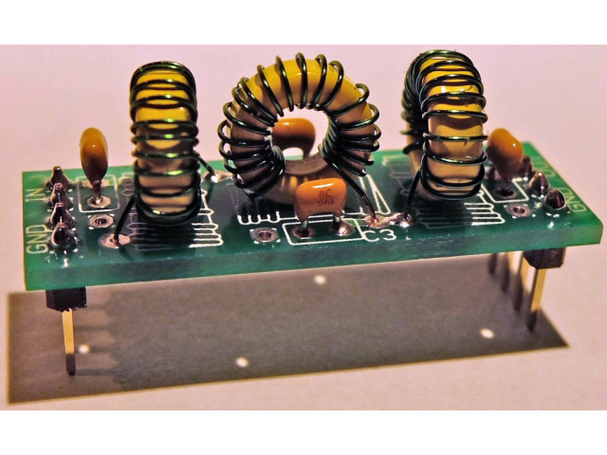
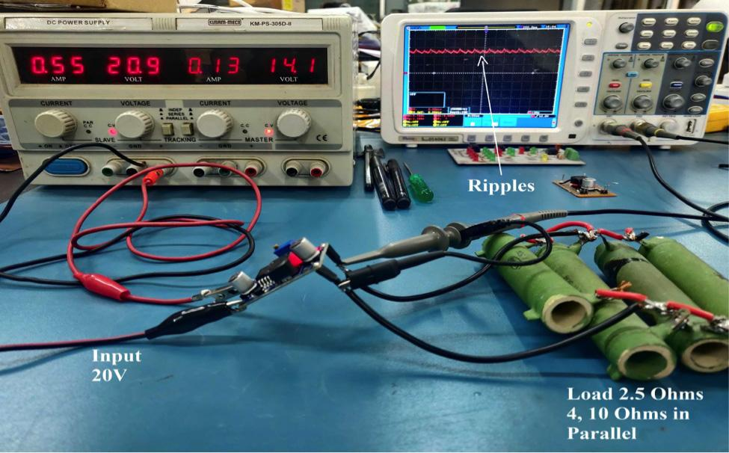
DT-Prototype
Low Pass Filter kit
Practical application of hardware filters

Slide 13

DT-Test
Ripple Reduction Concept
Ripple = unwanted AC component in DC output.
Filters work by:
  Allowing DC to pass
  Blocking or reducing AC components
Ripple Factor (r):
Lower ripple factor = better DC output

Slide 14
Applications of Filter Circuits
Anti-Alias Filtering : Because digital systems may only represent a signal at specific points in time, aliasing is a phenomenon that occurs.
Noise Rejection : All of the frequencies present in a circuit's components contribute to noise generation. This implies that the output of a circuit that responds to a smaller frequency range will be less noisy. Thus, filters that restrict the frequency range in their output can be helpful in reducing the quantity of noise.
Interference Rejection : It is feasible to minimize interference by a factor of 400 without weakening the signal at 500 Hz by using a band-pass filter with a characteristic frequency of 500 Hz.

Slide 15
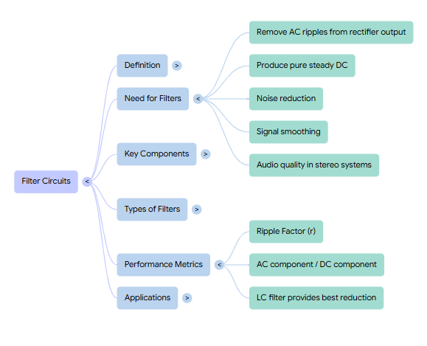
Summary

Slide 16
Quiz: Which filter provides the best ripple reduction for DC output?
A) Capacitor filter
B) Inductor filter
C) LC filter
D) No filter
(Correct: C)
Scenario: You are powering a microcontroller that cannot tolerate voltage fluctuations. Which filter type would you use and why?
Real-time: A capacitor filter has 1000μF across a 1kΩ load with 10V peak voltage. Calculate the ripple voltage approximately.

Slide 17

References
Muthusubramanian R, Salivahanan S, “Basic Electrical and Electronics Engineering”, TataMcGrawHillPublishers,2014.
Kothari DP and I.J Nagrath, “Basic Electrical and Electronics Engineering”, Second Edition, McGraw Hill Education, 2020.
Thank you

