Slide 1

SNS COLLEGE OF TECHNOLOGY
Kurumbapalayam (Po), Coimbatore – 641 107
An Autonomous Institution
Accredited by NBA – AICTE and Accredited by NAAC – UGC with ‘A’ Grade
Approved by AICTE, New Delhi & Affiliated to Anna University, Chennai
DEPARTMENT OF ARTIFICIAL INTELLIGENCE AND DATA SCIENCE
COURSE NAME : 23EET103- ELECTRIC CIRCUITS AND ELECTRON DEVICES
I YEAR /II SEMESTER
Unit-5 - RECTIFIERS AND POWER SUPPLIES
Topic : Voltage Regulators

Slide 2
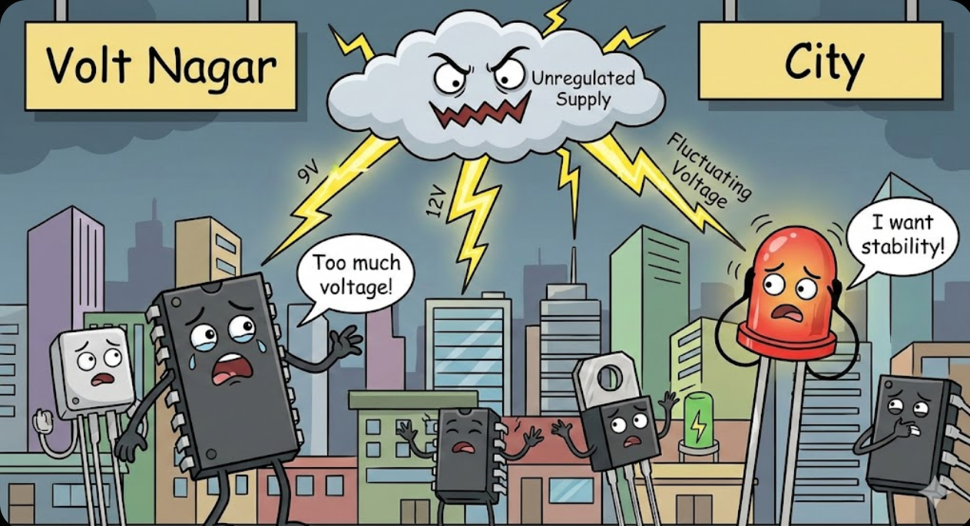
Story Telling

Slide 3
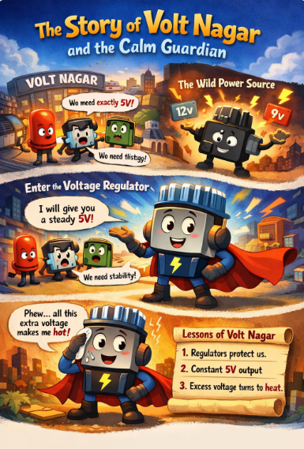

Slide 4
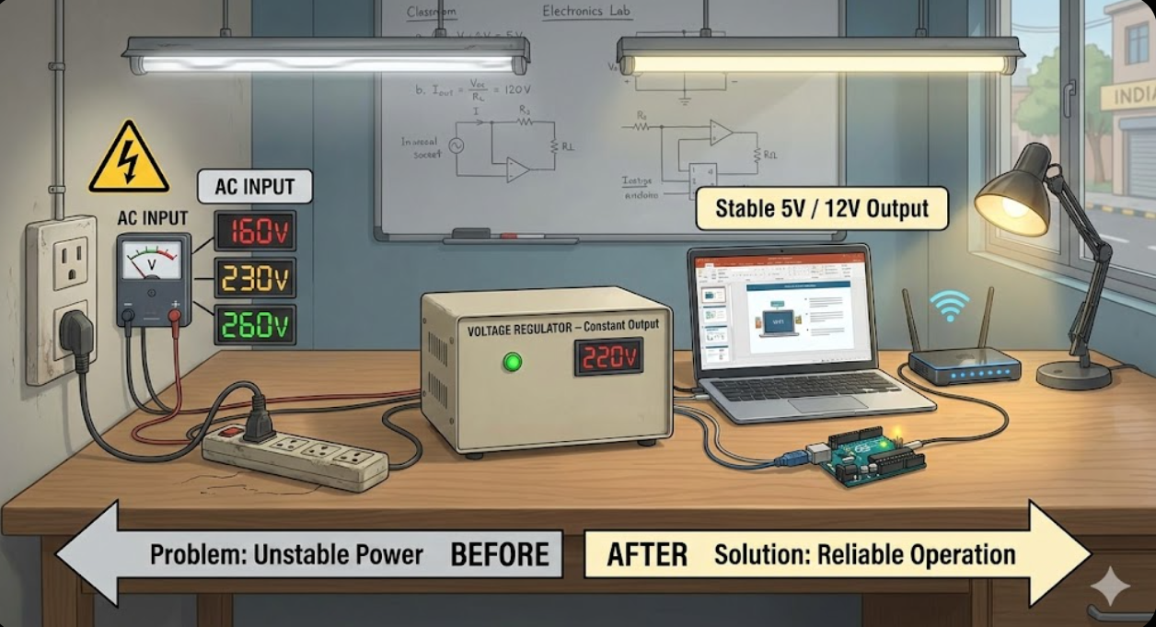
DT-Empathize

Slide 5
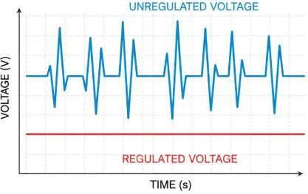
DT-DEFINE
Voltage regulation refers to the ability of the power supply typically a voltage regulator or transformer to maintain a steady and stable output voltage despite variations in input voltage or other factors. It ensures that the output voltage remains within the specified limits to power electronic devices reliably. In this article, we are going to discuss the definition of Voltage regulation, its formulas, effects, different types with variety, working, applications, properties and characteristics.
Content
What is Voltage Regulation?
Formula
Effects
Types
Working
Properties and Characteristics
Applications
Series and Shunt Regulation

Slide 6
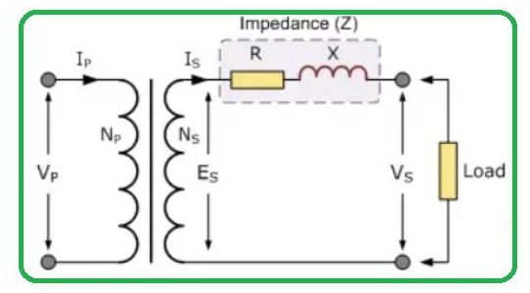
What is Voltage Regulation?
Voltage regulation is a process of controlling and adjusting the output voltage of a power supply or electrical system to maintain it within the specified range typically a narrow tolerance band. This ensures that connected devices receive a stable and consistent voltage or malfunction due to voltage fluctuations.
When an electrical power transformer is open-circuit state, there's no load connected to its secondary terminals. the secondary terminal voltage will be equal to the secondary induced electromotive force.
However, when a full load is connected to the secondary terminals of the transformer rated current I2 flows through the secondary circuit, and voltage drop becomes a factor. In this scenario, the primary winding also draws an equivalent full load current from a power source. The voltage drop in the secondary circuit can be attributed to the impedance of the secondary winding. This voltage drop is calculated as I2 multiplied by Z2. where I2 represents the secondary current and Z2 represents the secondary impedance of the transformer.

Slide 7
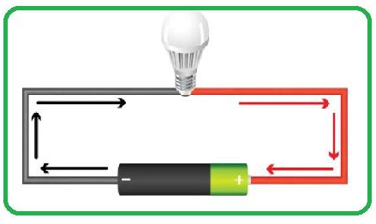
What is Voltage?
Voltage denoted as V is a fundamental electrical quantity measured in volts (V). It represents the electric potential difference between the two points in an electrical circuit. The Voltage is responsible for pushing electric charges through conductors such as wires and components and it determines the energy available to do electrical work.

Slide 8
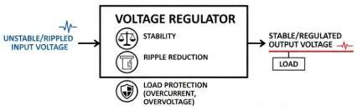
Effects of Voltage Regulation
Solidness: The Voltage guideline guarantees a steady power supply and forestalling voltage spikes or drops that can hurt electronic gear.
Dependability: It improves the unwavering quality of electronic gadgets by the giving a predictable voltage level.
Security: The Shields delicate gadgets from the harm because of the voltage varieties.
Effectiveness: The Improves the proficiency of the electronic frameworks by conveying the necessary voltage without the extreme waste.

Slide 9
Types of Voltage Regulation
There are list of types of voltage regulation :
Line Regulation
Load Regulation
Series Voltage Regulation
Shunt Voltage Regulation
Line Regulation: This type of regulation focuses on maintaining the output voltage when the input voltage fluctuates. It is typically expressed as a percentage change in output voltage for the given percentage change in input voltage.
Load Regulation: The Load regulation ensures that the output voltage remains constant as the load connected to power supply changes. It is expressed as a percentage change in output voltage for given change in load current.
Series Voltage Regulation: In series voltage regulation, series element is used to adjust the output voltage. The output voltage is taken from the across the series element.
Shunt Voltage Regulation: The Shunt voltage regulation employs a shunt element connected parallel to load. It diverts excess current to maintain the desired voltage.

Slide 10
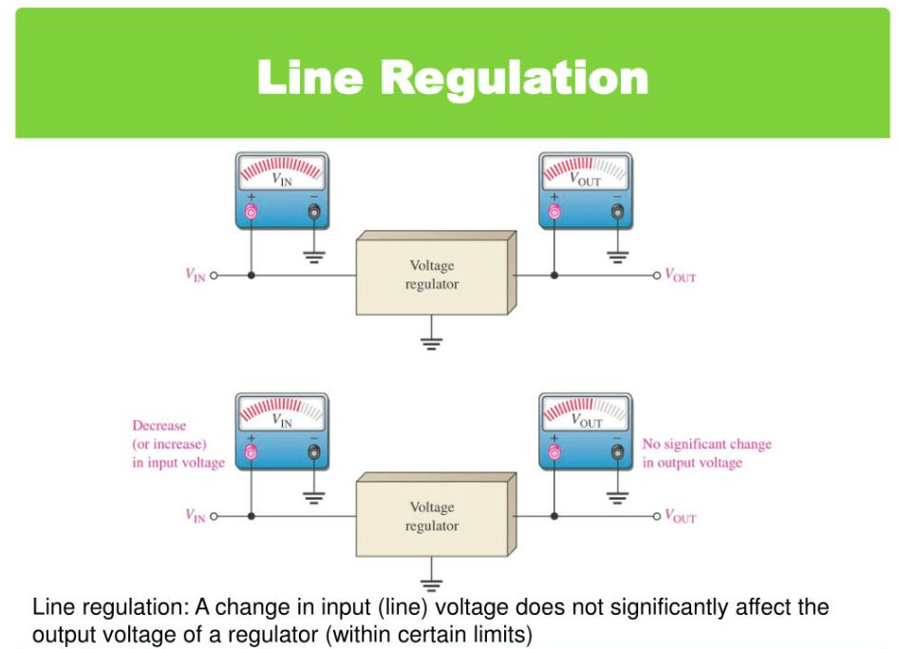
DT-IDEATE

Slide 11
Working of Voltage Regulation
The Voltage regulation can be achieved through various techniques including the use of voltage regulators and electronic control circuits.
Here's a simplified overview of working principle of a voltage regulator:
Sensing: The regulator continuously monitors the output voltage and compares it to reference voltage.
Error Amplification: Any deviation between the reference voltage and actual output voltage is amplified to generate an error signal.
Control Element: The error signal is used to control a variable element within regulator such as a transistor or a switch.
Adjustment: The control element adjusts the output voltage by the varying its resistance or switching state bringing the output voltage back to desired level.

Slide 12
Properties and Characteristics of Voltage Regulation
Voltage Tolerance: The range within which the output voltage can vary while still the meeting specifications.
Load Regulation: How well the regulator maintains the voltage when the load changes.
Line Regulation: The ability to maintain voltage despite variations in the input voltage.
Ripple Rejection: The ability to filter out AC ripple or noise from output.
Transient Response: How quickly the regulator responds to sudden changes in the load or input.
Efficiency: The percentage of the input power converted to usable output power.

Slide 13
Applications of Voltage Regulation
Power Supplies: The Voltage regulators are widely used in the power supplies for computers, electronics and appliances.
Automotive Electronics: To Ensures stable voltage for the automotive systems including engine control units and infotainment systems.
Telecommunications: The Maintains consistent voltage for the communication equipment.
Medical Devices: The Critical for the medical instruments to prevent malfunctions due to voltage fluctuations.
Industrial Automation: The Voltage regulation is essential for PLCs and control systems.
Aerospace: To Used in avionics and spacecraft to ensure reliable operation.

Slide 14
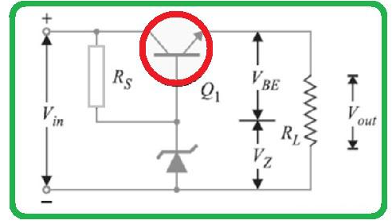
Series and Shunt Regulation in Voltage Regulation
The following terms : Series and Shunt Regulation are discussed below:
Series Voltage Regulation
In series voltage regulation a regulating element is connected in series with load. The regulating element adjusts its resistance to maintain a steady output voltage despite variations in the load or input voltage.

Slide 15
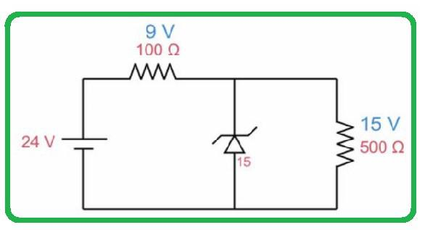
Shunt Voltage Regulation
In shunt voltage regulation a regulating element is connected in parallel with load. The regulating element diverts excess current to maintain a constant voltage across the load.

Slide 16
Advantages and Disadvantages of Voltage Regulation
There are some list of Advantages and Disadvantages of Voltage Regulation given below :
Advantages of Voltage Regulation
The Protects sensitive electronic devices.
Increases the lifespan of the electronic components.
To Ensures consistent performance of equipment.
Reduces the risk of the data loss or corruption.
Disadvantages of Voltage Regulation
The Costly to implement in some applications.
May introduce heat dissipation.
The Some regulators require a minimum input voltage to operate efficiently.

Slide 17
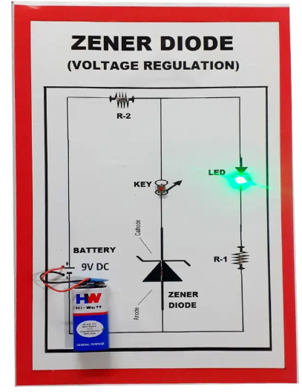
DT - Prototype

Slide 18
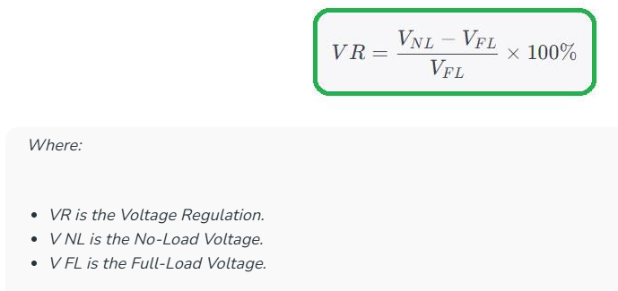
DT –Test
Formula of Voltage Regulation
The Voltage Regulation often denoted as VR is a measure of how well a voltage source maintains a consistent output voltage despite changes in the load conditions. It is typically expressed as a percentage and calculated using following formula:

Slide 19
Multiple Choice: 7805 regulator provides:
A) 5V positive output
B) 12V negative output
C) 3.3V positive output
D) Variable output
(Correct: A)
Scenario: Your sensor output fluctuates due to input variations. Which voltage regulation method is suitable: Zener diode or IC regulator? Explain.
Real-time: You need 9V DC for a device. Suggest a regulator and show the approximate circuit.

Slide 20
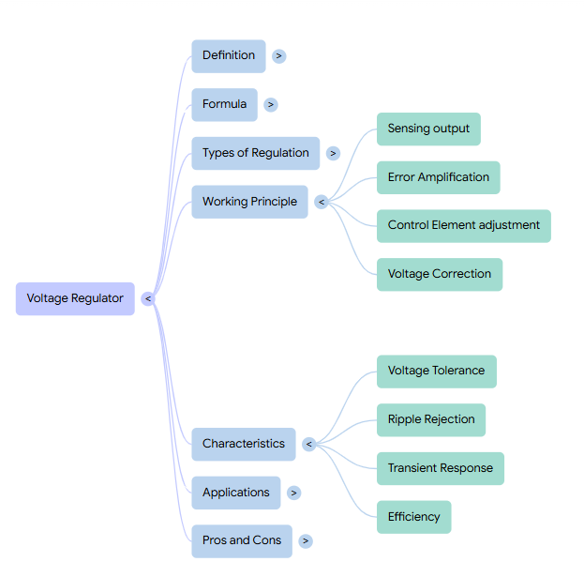
Summary

Slide 21

References
Muthusubramanian R, Salivahanan S, “Basic Electrical and Electronics Engineering”, TataMcGrawHillPublishers,2014.
Kothari DP and I.J Nagrath, “Basic Electrical and Electronics Engineering”, Second Edition, McGraw Hill Education, 2020.
Thank you

