Slide 1

SNS COLLEGE OF TECHNOLOGY
Kurumbapalayam (Po), Coimbatore – 641 107
An Autonomous Institution
Accredited by NBA – AICTE and Accredited by NAAC – UGC with ‘A’ Grade
Approved by AICTE, New Delhi & Affiliated to Anna University, Chennai
DEPARTMENT OF ARTIFICIAL INTELLIGENCE AND DATA SCIENCE
COURSE NAME : 23EET103- ELECTRIC CIRCUITS AND ELECTRON DEVICES
I YEAR /II SEMESTER
Unit-5 - RECTIFIERS AND POWER SUPPLIES
Topic : Linear Mode Power Supply

Slide 2
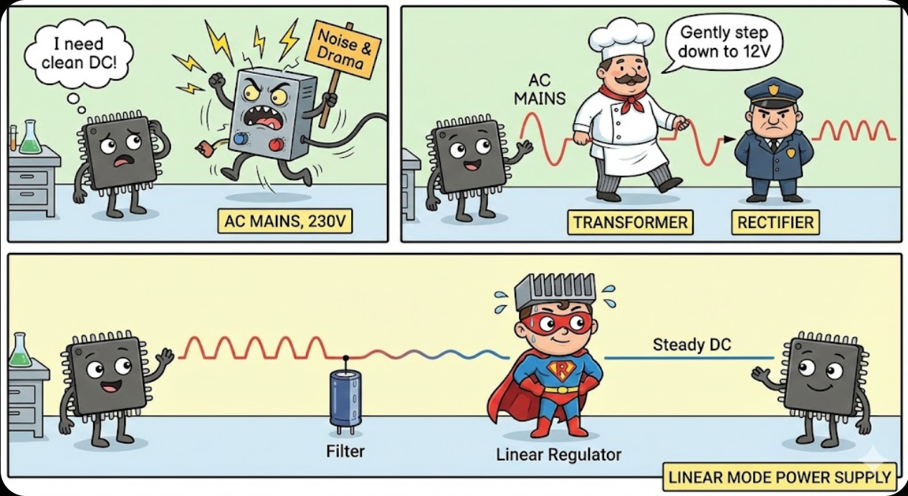
Story Telling

Slide 3
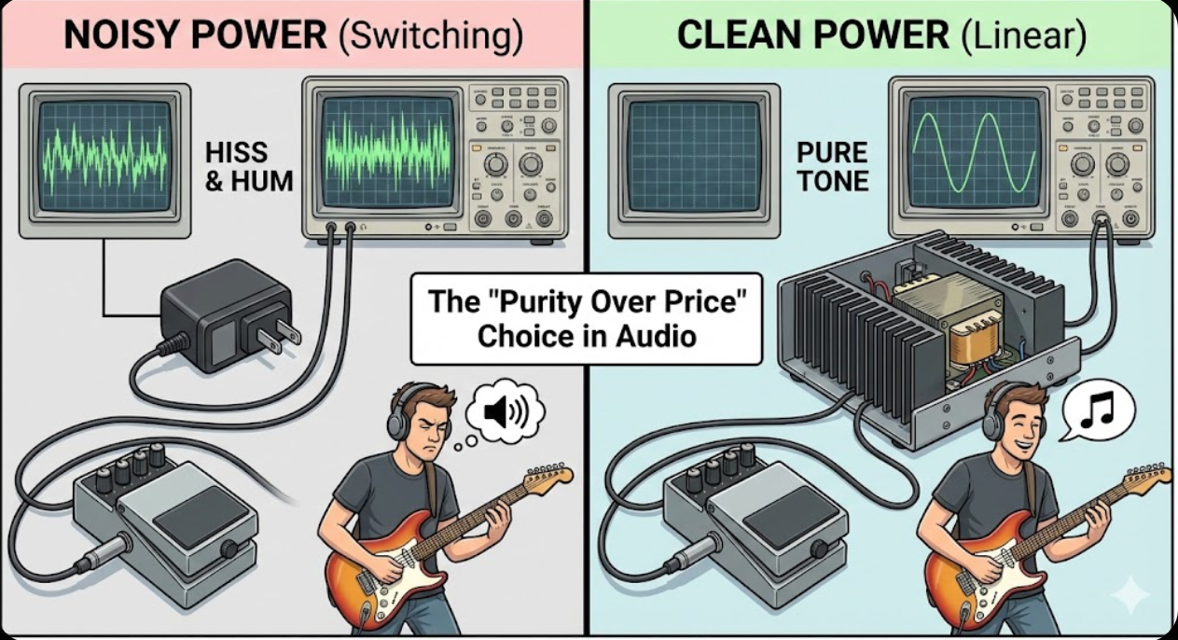
DT-Empathize

Slide 4
Linear Mode Power Supply
DT-Empathize
A linear power supply converts AC mains to stable DC by progressively reducing, rectifying, filtering, and regulating voltage.
Using components like transformers, diodes, capacitors, and transistors that operate linearly.
Dissipating excess energy as heat, making them bulky but providing clean, low-noise power ideal for sensitive devices like audio amps and lab instruments, unlike less efficient, bulky switched-mode supplies (SMPS)

Slide 5
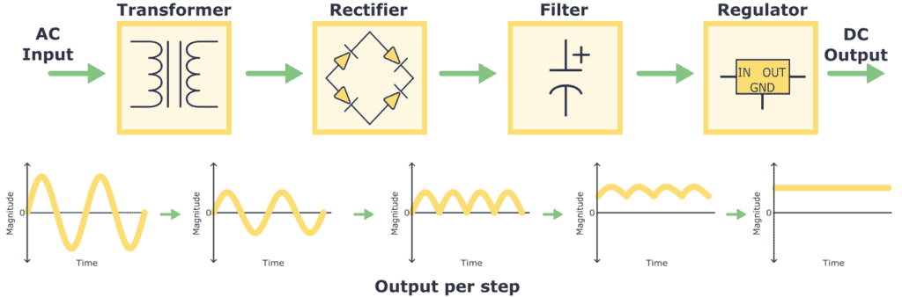
DT-DEFINE

Slide 6
DT-DEFINE
How it Works (Block Diagram)
Transformer: Steps down high-voltage AC (from wall outlet) to a lower AC voltage.
Rectifier: Uses diodes (often a bridge rectifier) to convert the AC to pulsating DC (always positive, but with dips).
Filter: A large capacitor smooths the pulsating DC into a relatively stable, but still rippling, DC voltage.
Regulator: A series-pass transistor and error amplifier maintain a constant output voltage by adjusting its resistance, essentially burning off excess voltage as heat.

Slide 7
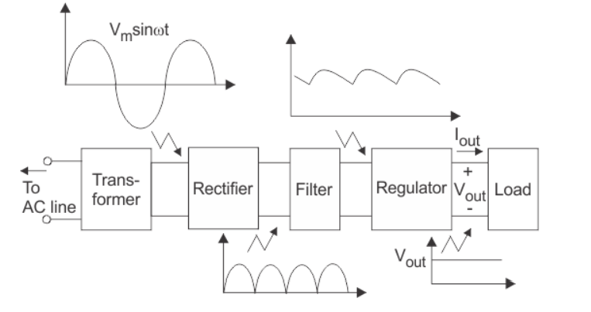
DT-DEFINE
Figure A Linear mode power Supply Components

Slide 8
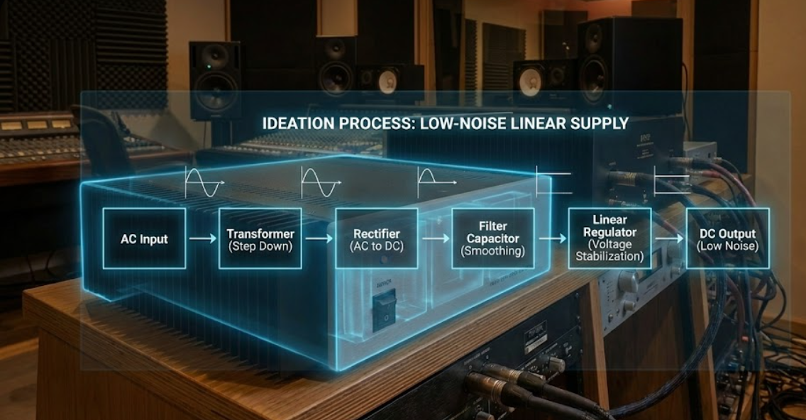
DT-IDEATE

Slide 9
DT-IDEATE
Linear mode power supply
A regulated power supply converts unregulated AC (Alternating Current) to a constant DC (Direct Current).
A regulated power supply is used to ensure that the output remains constant even if the input changes.
A regulated DC power supply is also known as a linear power supply, it is an embedded circuit and consists of various blocks.
The regulated power supply will accept an AC input and give a constant DC output.
The figure below shows the block diagram of a typical regulated DC power supply.

Slide 10
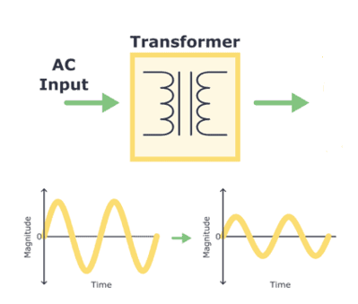
The basic building blocks of a regulated DC power supply are as follows:
1. A step-down transformer
2. A rectifier
3. A DC filter
4. A regulator
Operation of Regulated Power Supply Step Down Transformer
A step down transformer will step down the voltage from the ac mains to the required voltage level.
The turn’s ratio of the transformer is so adjusted such as to obtain the required voltage value.
The output of the transformer is given as an input to the rectifier circuit.

Slide 11
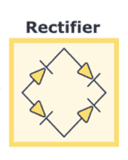
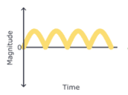
Rectification
Rectifier is an electronic circuit consisting of diodes which carries out the rectification process. Rectification is the process of converting an alternating voltage or current into corresponding direct (DC) quantity.
The input to a rectifier is AC whereas its output is unidirectional pulsating DC. Although a half wave rectifier could technically be used, its power losses are significant compared to a full wave rectifier.
As such, a full wave rectifier or a bridge rectifier is used to rectify both the half cycles of the ac supply (full wave rectification). The figure below shows a full wave bridge rectifier.

Slide 12
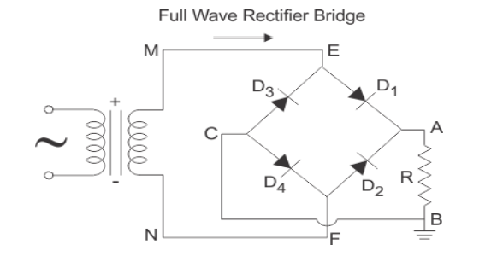
A bridge rectifier consists of four p-n junction diodes connected in the manner shown above figure .
In the positive half cycle of the supply, the voltage induced across the secondary of the electrical transformer i.e. VMN is positive.
Therefore point E is positive with respect to F. Hence, diodes D3 and D2 are reversed biased and diodes D1 and D4 are forward biased.
The diode D3 and D2 will act as open switches (practically there is some voltage drop) and diodes D1 andD4 will act as closed switches and will start conducting.
Hence a rectified waveform appears at the output of the rectifier as shown in the first figure. When voltage induced in secondary i.e. VMN is negative than D3 and D2 are forward biased with the other two reversed biased and a positive voltage appears at the input of the filter.
Figure A Full Wave Rectifier Power Supply

Slide 13
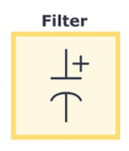
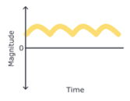
DC Filtration
The rectified voltage from the rectifier is a pulsating DC voltage having very high ripple content. But this is not we want, we want a pure ripple free DC waveform.
Hence a filter is used. Different types of filters are used such as capacitor filter, LC filter, Choke input filter, π type filter. The figure below shows a capacitor filter connected along the output of the rectifier and the resultant output waveform in figure
As the instantaneous voltage starts increasing the capacitor charges, it charges until the waveform reaches its peak value.
When the instantaneous value starts reducing the capacitor starts discharging exponentially and slowly through the load (input of the regulator in this case).
Hence, an almost constant DC value having very less ripple content is obtained.

Slide 14
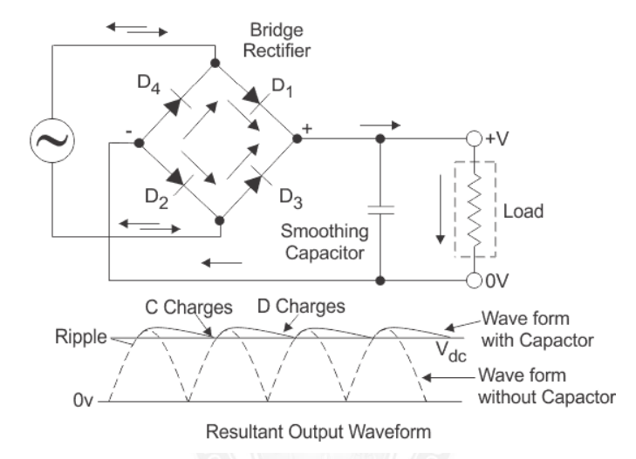
Figure A Bridge Rectifier Power Supply and its resultant Waveform

Slide 15
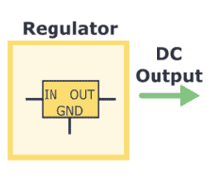
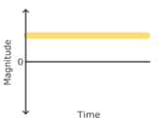
Regulation
This is the last block in a regulated DC power supply.
The output voltage or current will change or fluctuate when there is a change in the input from ac mains or due to change in load current at the output of the regulated power supply or due to other factors like temperature changes.
This problem can be eliminated by using a regulator. A regulator will maintain the output constant even when changes at the input or any other changes occur.
Transistor series regulator, Fixed and variable IC regulators or a zener diode operated in the zener region can be used depending on their applications. IC’s like 78XX and 79XX (such as the IC 7805) are used to obtained fixed values of voltages at the output.

Slide 16
Key Characteristics
Pros:
Provides very clean, low-ripple DC with minimal noise.
Simple design, reliable.
Excellent for sensitive audio, RF, and lab equipment.
Cons:
Inefficient: Wastes significant power as heat (requires heat sinks).
Bulky & Heavy: Due to large transformers and heat sinks.
Limited to Lower Power: Better for low-power needs.
Comparison to Switch-Mode Power Supplies (SMPS)
Linear: Transformer -> Rectify -> Filter -> Regulate (Heat).
SMPS: Rectify -> Switch (High Frequency) -> Transform -> Filter (More efficient, smaller, but can introduce switching noise).

Slide 17
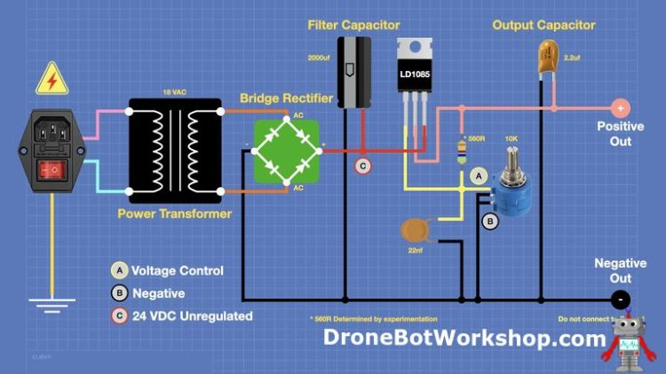
DT - Prototype

Slide 18
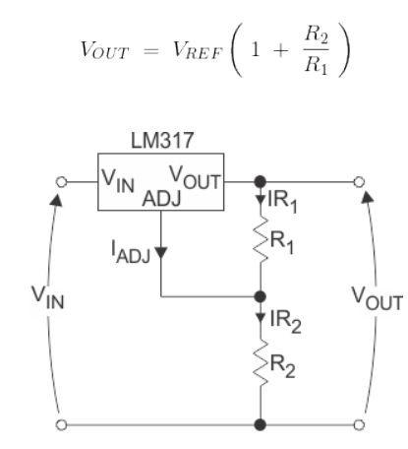
DT –Test
With IC’s like LM 317 and 723, we can adjust the output voltage to a required constant value. The figure below shows the LM317 voltage regulator.
The output voltage can be adjusted by adjusting the values of resistances R1 and R2.
Usually, coupling capacitors of values about 0.01µF to 10µF need to be connected at the output and input to address input noise and output transients. Ideally, the output voltage is given by
The figure above shows the complete circuit of a regulated +5V DC power supply

Slide 19
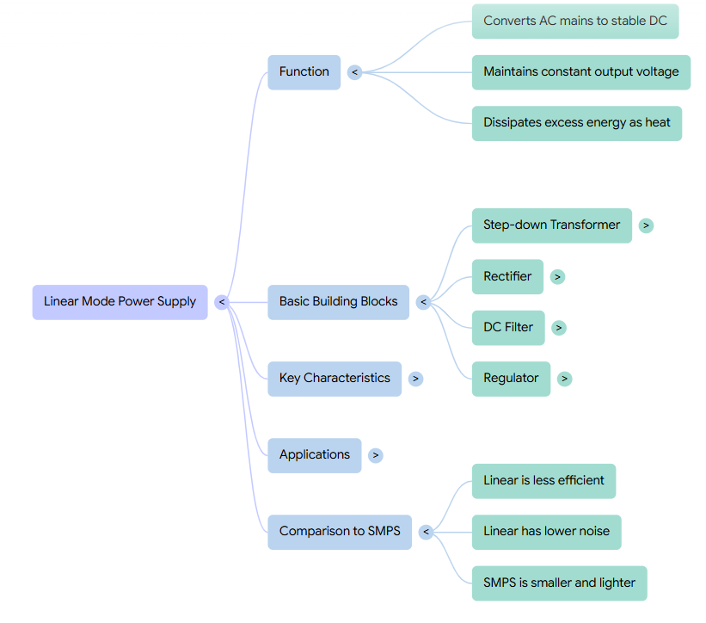
Summary

Slide 20
Quiz: Efficiency of a linear power supply is typically: A) 95–98% B) 40–60% C) 80–90% D) 100% (Correct: B)
Scenario: You are designing a lab power supply for sensitive instruments. Would you choose a linear or switched-mode supply? Justify.
Real-time: If Vin = 12V AC RMS, and you need 5V DC output, outline the stages of a linear power supply.

Slide 21

References
Muthusubramanian R, Salivahanan S, “Basic Electrical and Electronics Engineering”, TataMcGrawHillPublishers,2014.
Kothari DP and I.J Nagrath, “Basic Electrical and Electronics Engineering”, Second Edition, McGraw Hill Education, 2020.
Thank you

