Slide 1

SNS COLLEGE OF TECHNOLOGY
Kurumbapalayam (Po), Coimbatore – 641 107
An Autonomous Institution
Accredited by NBA – AICTE and Accredited by NAAC – UGC with ‘A’ Grade
Approved by AICTE, New Delhi & Affiliated to Anna University, Chennai
DEPARTMENT OF ARTIFICIAL INTELLIGENCE AND DATA SCIENCE
COURSE NAME : 23EET103- ELECTRIC CIRCUITS AND ELECTRON DEVICES
I YEAR /II SEMESTER
Unit-5 - RECTIFIERS AND POWER SUPPLIES
Topic : Switched Mode Power Supply (SMPS)

Slide 2
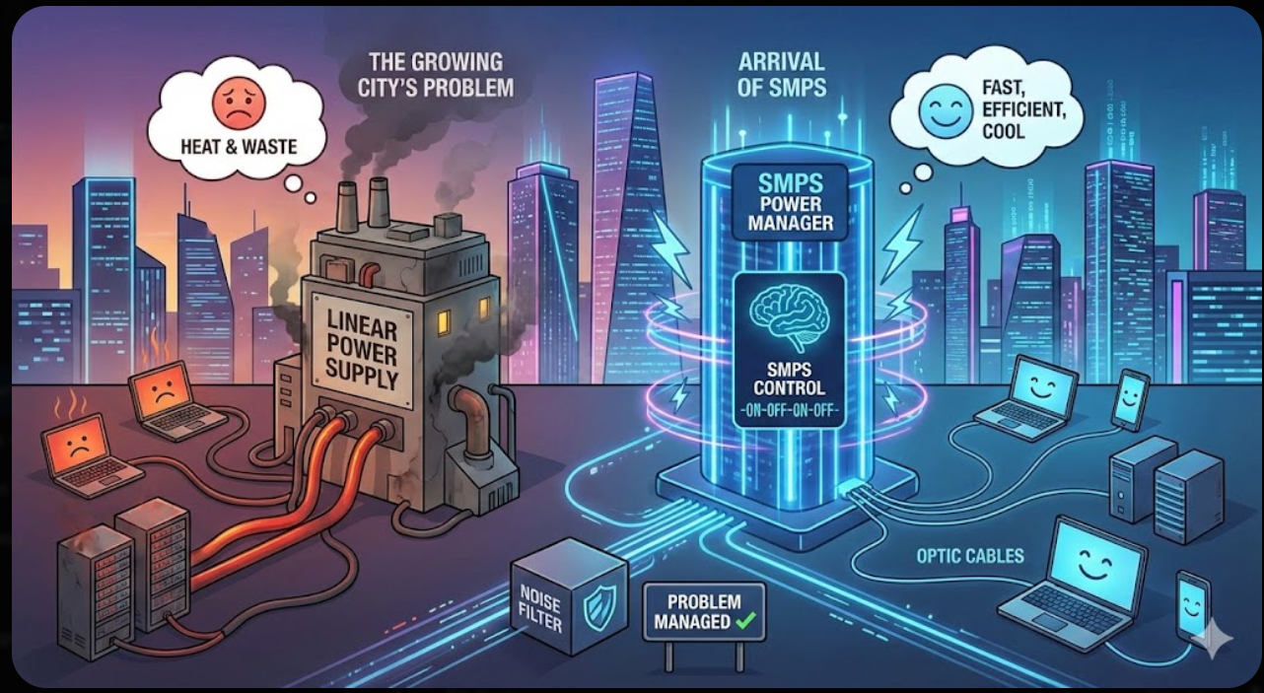
Story Telling

Slide 3

Disadvantages of LPS
The transformers used are heavier and large. The heat dissipation is more. The efficiency of linear power supply is 40 to 50%Power is wasted in the form of heat in LPS circuits.
Single output voltage is obtained. The block diagram of a Linear Power Supply is as shown in the following figure 5.4.1. In spite of the above disadvantages, Linear Power Supplies are widely used in low-noise amplifiers, test equipment, control circuits. In addition, they are also used in data acquisition and signal processing.
Figure 5.4.1 A Linear mode power Supply Components

Slide 4
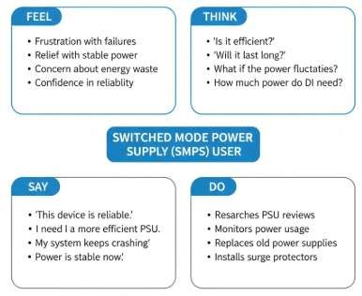
DT-Empathize

Slide 5
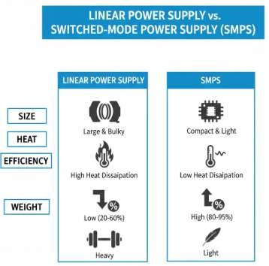
DT-DEFINE

Slide 6
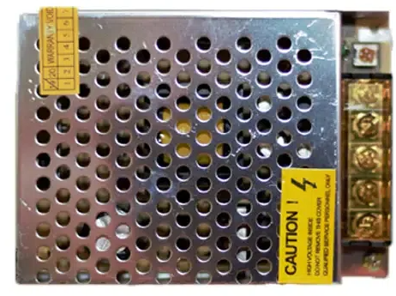
Content
What is SMPS?
Working Principle of SMPS
Types of SMPS
Advantages and Disadvantages
Applications of SMPS
FAQs on SMPS

Slide 7
What is Switch Mode Power Supply?
A switching regulator is included in an electronic power supply called a switched-mode power supply (SMPS) to facilitate effective electrical power conversion. An SMPS converts voltage and current while transferring power to DC loads via a DC or AC source, just like other suppliers.
Working Principle of SMPS
Switching regulators are employed in SMPS devices to maintain & regulate the output voltage by turning on or off the load current.
The mean value between on and off is the appropriate power output for a system.
The SMPS reduces depletion strength because, in contrast to the linear power supply, it carries transistor switches between low dissipation, full-on as well as full-off phases and spends significantly fewer seconds in high dissipation cycles.

Slide 8
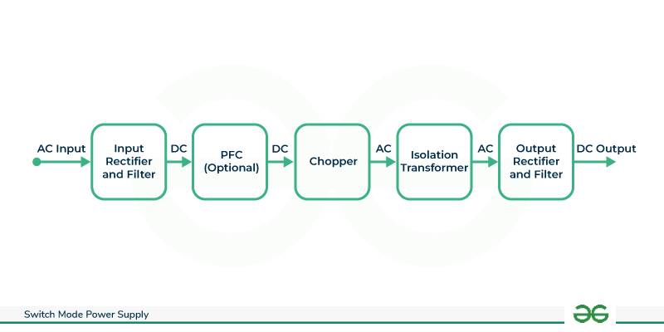
DT-IDEATE
In the initial stage, a rectifier and filter are used to process the AC power that comes in into DC.
Because the SMPS operates at high frequencies, the DC signal is processed by a high-frequency switch to produce a medium-frequency pulsating DC signal.
A power transformer reduces the high-voltage DC output to the proper level of DC signal.
Reversing and filtering the stepped-down DC signal results in a constant steady DV output.
To guarantee a constant output stream of the intended voltage, the control circuitry continuously monitors the generated voltage and modifies the high-frequency switch.

Slide 9
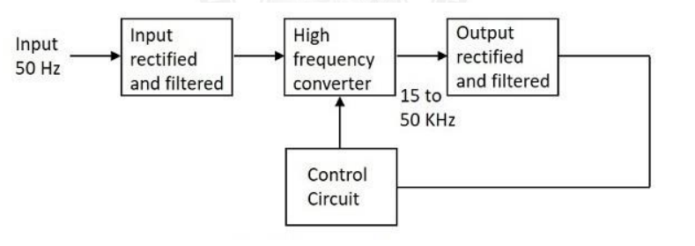
DT-IDEATE
Working The working of SMPS Working The working of SMPS can be understood by the following figure

Slide 10
DT-IDEATE
Input Stage
The AC input supply signal 50 Hz is given directly to the rectifier and filter circuit combination without using any transformer. This output will have many variations and the capacitance value of the capacitor should be higher to handle the input fluctuations. This unregulated dc is given to the central switching section of SMPS.
Switching Section
A fast switching device such as a Power transistor or a MOSFET is employed in this section, which switches ON and OFF according to the variations and this output is given to the primary of the transformer present in this section. The transformer used here are much smaller and lighter ones unlike the ones used for 60 Hz supply. These are much efficient and hence the power conversion ratio is higher.
Output Stage
The output signal from the switching section is again rectified and filtered, to get the required DC voltage. This is a regulated output voltage which is then given to the control circuit, which is a feedback circuit. The final output is obtained after considering the feedback signal

Slide 11
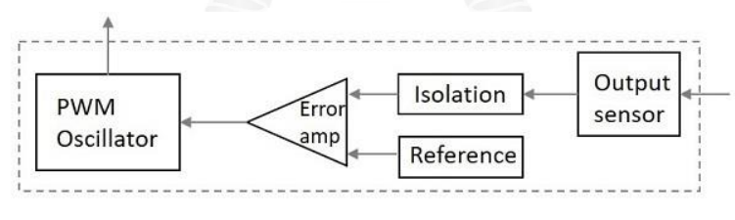
DT-IDEATE
Control Unit
This unit is the feedback circuit which has many sections. Let us have a clear understanding about this from The following figure
Figure Inner parts of a control unit.
The above figure explains the inner parts of a control unit. The output sensor senses the signal and joins it to the control unit. The signal is isolated from the other section so that any sudden spikes should not affect the circuitry. A reference voltage is given as one input along with the signal to the error amplifier which is a comparator that compares the signal with the required signal level.

Slide 12
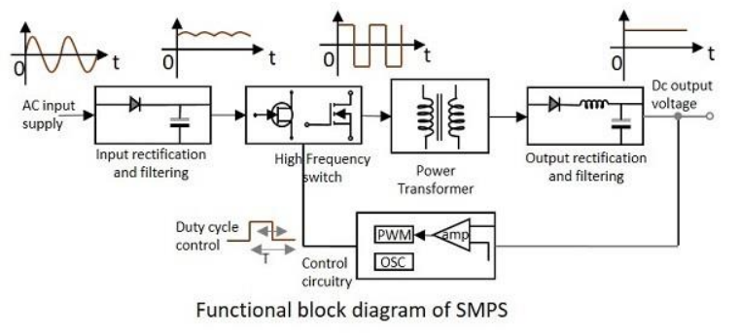
DT-IDEATE
By controlling the chopping frequency the final voltage level is maintained. This is controlled by comparing the inputs given to the error amplifier, whose output helps to decide whether to increase or decrease the chopping frequency. The PWM oscillator produces a standard PWM wave fixed frequency. We can get a better idea on the complete functioning of SMPS by having a look at the following figure

Slide 13
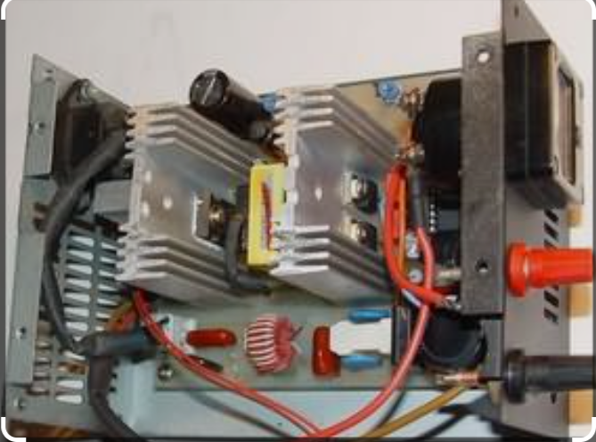
DT- Prototype

Slide 14
Disadvantages
There are few disadvantages in SMPS, such as The noise is present due to high frequency switching.The circuit is complex. It produces electromagnetic interference.
Advantages
The advantages of SMPS include, The efficiency is as high as 80 to 90% ,Less heat generation; less power wastage. Reduced harmonic feedback into the supply mains. The device is compact and small in size. The manufacturing cost is reduced.Provision for providing the required number of voltages.
Applications
There are many applications of SMPS. They are used in the motherboard of computers, mobile phone chargers, HVDC measurements, battery chargers, central power distribution, motor vehicles, consumer electronics, laptops, security systems, space stations, etc.

Slide 15
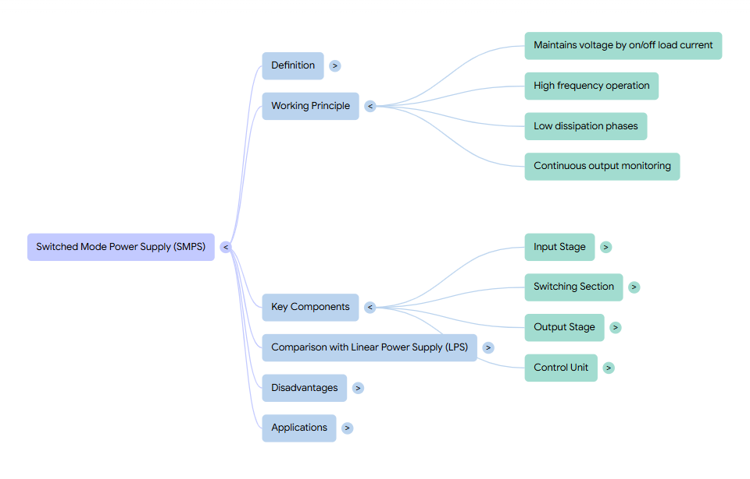
Summary

Slide 16
Quiz: Main advantage of SMPS over linear supply: A) Simpler design B) Higher efficiency C) Low switching noise D) Bigger size (Correct: B)
Scenario: You are building a compact phone charger. Why SMPS is preferred over linear supply?
Real-time: An SMPS converts 230V AC mains to 12V DC. Describe the main blocks that achieve this conversion.

Slide 17

References
Muthusubramanian R, Salivahanan S, “Basic Electrical and Electronics Engineering”, TataMcGrawHillPublishers,2014.
Kothari DP and I.J Nagrath, “Basic Electrical and Electronics Engineering”, Second Edition, McGraw Hill Education, 2020.
Thank you

